Slide 1
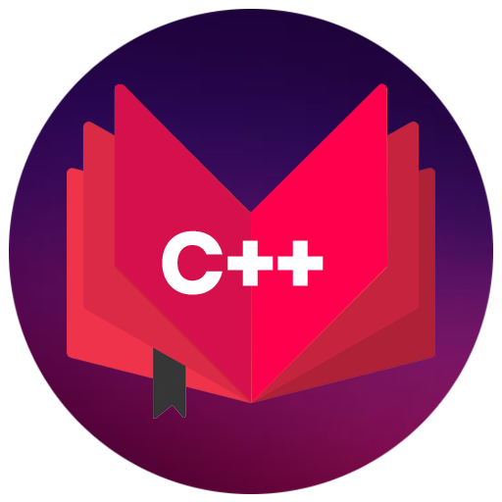
CAP444 OBJECT ORIENTED PROGRAMMING USING C++
Session #1

Slide 2
Basic Concepts in C ++

Slide 3
Variable and its types
A name of storage location which holds some value
1001
Syntax:
Var_type var_name;// declaration
Var_type var_name=value;//initialization
A

Slide 4
Data types
User-define type
Built-in-type
Derived type
Integer
Character
Boolean
Floating Point
Double
Void
Wide Character
Class
Structure
Union
Enumeration
Function
Array
Pointer
Reference

Slide 5
Data type modifiers are:
Signed
Unsigned
Short
Long

Slide 6
Data type | Size(in byte) | Range
char | 1 =8 bits ( 2⁸ ) | -127 to 127 or 0 to 255
unsigned char | 1 | 0 to 255
signed char | 1 | -127 to 127
int | 4=32 bits ( 2³² ) | -2,147,483,648 to 2,147,483,647
short int | 2 | -32,768 to 32,767
unsigned short int | 2 | 0 to 65,535
unsigned int | 4 | 0 to 4,294,967,295
float | 4
double | 8
long double | 12

Slide 7
Memory representation
1 Byte= 8 Bits
128 0 | 64 1 | 32 0 | 16 0 | 8 0 | 4 0 | 2 0 | 1 1
A(65)=01000001
char ch=65;
Or
char ch=‘A’
Char is occupying 1 Byte memory

Slide 8
Operators
Arithmetic operators
Assignment operators
Comparison operators
Logical operators
Bitwise operators

Slide 9
Arithmetic operators
Operator | Name | Example
+ | Addition | x + y
- | Subtraction | x - y
* | Multiplication | x * y
/ | Division | x / y
% | Modulus | x % y
++ | Increment | ++x
-- | Decrement | --x

Slide 10
Assignment Operators
Operator | Example | Same As
= | x = 5 | x = 5
+= | x += 3 | x = x + 3
-= | x -= 3 | x = x - 3
*= | x *= 3 | x = x * 3
/= | x /= 3 | x = x / 3
%= | x %= 3 | x = x % 3
&= | x &= 3 | x = x & 3
|= | x |= 3 | x = x | 3
^= | x ^= 3 | x = x ^ 3
>>= | x >>= 3 | x = x >> 3
<<= | x <<= 3 | x = x << 3

Slide 11
Comparison operators
Operator | Name | Example
== | Equal to | x == y
!= | Not equal | x != y
> | Greater than | x > y
< | Less than | x < y
>= | Greater than or equal to | x >= y
<= | Less than or equal to | x <= y

Slide 12
Logical operators
Operator | Name | Description | Example
&& | Logical and | Returns true if both statements are true | x < 5 && x < 10
|| | Logical or | Returns true if one of the statements is true | x < 5 || x < 4
! | Logical not | Reverse the result, returns false if the result is true | !(x < 5 && x < 10)

Slide 13
Bitwise operators
Operator | Description | Example
& | AND Operator | (A & B) will give 12 which is 0000 1100
| | OR Operator | (A | B) will give 61 which is 0011 1101
^ | XOR Operator | (A ^ B) will give 49 which is 0011 0001
~ | Ones Complement Operator | (~A ) will give -61 which is 1100 0011 in 2's complement form due to a signed binary number.
<< | Left Shift Operator | A << 2 will give 240 which is 1111 0000
>> | Right Shift Operator | A >> 2 will give 15 which is 0000 1111

Slide 14
Bitwise Operators
AND Operator
OR Operator
XOR Operator
Ones Complement Operator
Left Shift Operator
Right Shift Operator

Slide 15
Bitwise operators
Operator | Description | Example
& | AND Operator | (A & B) will give 12 which is 0000 1100
| | OR Operator | (A | B) will give 61 which is 0011 1101
^ | XOR Operator | (A ^ B) will give 49 which is 0011 0001
~ | Ones Complement Operator | (~A ) will give -61 which is 1100 0011 in 2's complement form due to a signed binary number.
<< | Left Shift Operator | A << 2 will give 240 which is 1111 0000
>> | Right Shift Operator | A >> 2 will give 15 which is 0000 1111

Slide 16
insertion operator(<<):
The cout is used in conjunction with stream insertion operator (<<) to display the output on a console
extraction operator (>>):
The cin is used in conjunction with stream extraction operator (>>) to read the input from a console.

Slide 17
Control structure
Conditional structure: if and else
Selective structure: switch case
Iteration structures (loops): while, do while, for
Jump statements: break, continue, goto

Slide 18
Conditional structure
if(condition)
{
//statement
}
else
{
//statement
}

Slide 19
Any Query?

