Slide 1

CAP444 OBJECT ORIENTED PROGRAMMING USING C++

Slide 2
classes and objects
Class : collection of data members and member functions
Object: instance of class

Slide 3
access specifier
private
public
protected
By default, all members of a class are private if you don't specify an access specifier.

Slide 4
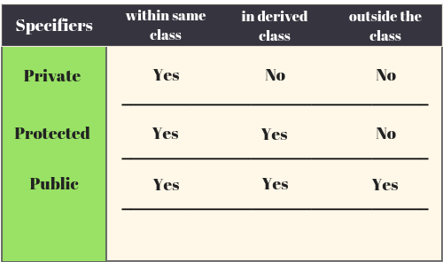

Slide 5
How to achieve encapsulation features in C++?
Define private data members in a class and
Define public set and get accessors functions which can be used to access these private data members.
Why Encapsulation?
Increased security of data

Slide 6
Any Query?

