Slide 1

CAP444 OBJECT ORIENTED PROGRAMMING USING C++

Slide 2



Slide 3





Slide 4


Slide 5




Slide 6
Why File is required?
To store data or information
In Programming how we are doing?
Using variable→ through RAM
Using File→ through hard disk

Slide 7
Why File is required?
A. To store data or information
B. To use data in our program
C. Both above
D. None

Slide 8
#include <iostream>
using namespace std;
int main()
{
int num;
cout<<"Enter number"<<endl;
cin>>num;
return 0;
}
Temporary Storage
RAM
aaa
5

Slide 9
Managing Output Stream/Input Stream
Hard disk
File
RAM
5
File
We have predefine classes

Slide 10
ios
istream
ostream
>>
<<
cin
iostream
ifstream
fstream
ofstream
istream_withassign
ostream_withassign
cin
cout

Slide 11
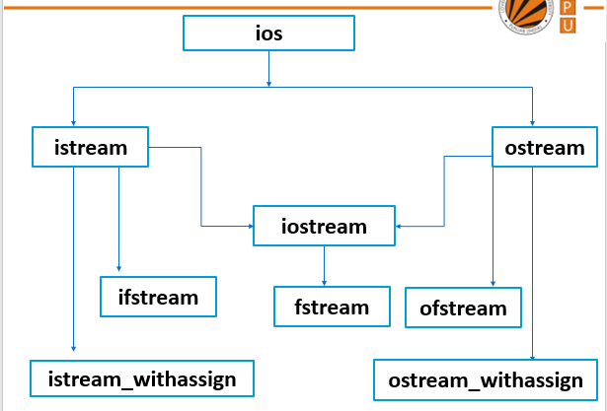
extraction
insertion

Slide 12
In C++, files are mainly deal with three classes fstream, ifstream, ofstream.
ofstream: This Stream class indicates the output file stream and is applied to create files for writing information to files
ifstream: This Stream class indicates the input file stream and is applied for reading information from files
fstream: This Stream class can be used for both read and write from/to files.

Slide 13
C++ provides us with the following operations in File Handling:
Creating a file: open()
Reading data: read()
Writing new data: write()
Closing a file: close()

Slide 14
Which of the following is used to create a stream that performs both input and output operations? a) ofstream b) ifstream c) iostream d) fstream

Slide 15
Any Query?

