Slide 1

CAP444 OBJECT ORIENTED PROGRAMMING USING C++

Slide 2
Friend function
It can access all private and protected member of a class
It can be access without object of the class
It can define out side of the class scope
Rule:
Prototypes of friend function must be declare inside the class
It can be declared either in the private or the public part.

Slide 3
Simple example : friend function
#include <iostream>
using namespace std;
class A
{
private:
int x;
public:
A()
{
x=10;
}
private:
friend void newfriend(A &a);
};
void newfriend(A &a)
{
a.x=20;
cout<<a.x;
}
int main()
{
A a1;
newfriend(a1);
return 0;
}

Slide 4
How many member functions are there in this class except constructors and destructors?
class Box
{
int capacity;
public:
void print();
friend void show();
bool compare();
friend bool lost();
};
a) 1
b) 2
c) 3
d) 4

Slide 5
Operator overloading
To specify more then one definition for an operator within the same scope.
You can redefine built in operators except few:
Scope operator (::)
Sizeof
member selector(.)
member pointer selector(.*)
ternary operator(?:)

Slide 6
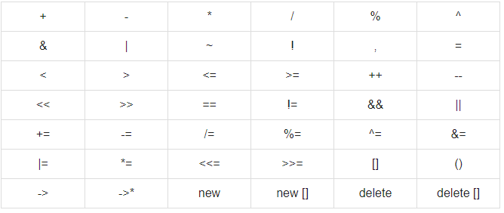
Operators which can overload

Slide 7
Unary operators operate on only one operand
Ex:
i++
Binary operators work on two operands
Ex:
+

Slide 8
Syntax:
Return_type operator operator_Symbol(parameters)
{
}
Why operator overloading:
class obj1,obj2,obj3 Replace to
obj3=obj1.add(obj2)
obj3=obj1+obj2//

Slide 9
Which of the following operator cannot be overloaded? a) + b) ?: c) – d) %

Slide 10
What is a binary operator? a) Operator that performs its action on a single operand b) Operator that performs its action on two operand c) Operator that performs its action on three operand d) Operator that performs its action on any number of operands

Slide 11
Operator overloading for Unary operators:
The unary operators operate on a single operand :
The increment (++) and decrement (--) operators.
The unary minus (-) operator.
The logical not (!) operator.

Slide 12
Overloading binary operators using friend function
friend function takes two parameters in case when we want to overload binary operators using friend function
Ex:
friend A operator +(A &x, A &y);

Slide 13
Any Query?

