Slide 1

CAP444 OBJECT ORIENTED PROGRAMMING USING C++

Slide 2
Functions overloading
same function name but different parameters.
same function name with different signature
example of polymorphism(compile time)
overloaded functions should be there in same scope.

Slide 3
What will be output?
#include <iostream>
using namespace std;
void print(int i)
{
cout << i;
}
void print(double f)
{
cout << f;
}
int main(void)
{
print(5);
print(500.263);
return 0;
}
A) 5500.263
B) 500.2635
C) 500.263

Slide 4
Inheritance: types of inheritance
One class can hire properties from other class
Advantages: Reusability
A
A
A
B
B
B
C
C
Single
Multilevel
Multiple

Slide 5
A
A
B
C
B
C
Hierarchical Inheritance
D
Hybrid Inheritance

Slide 6
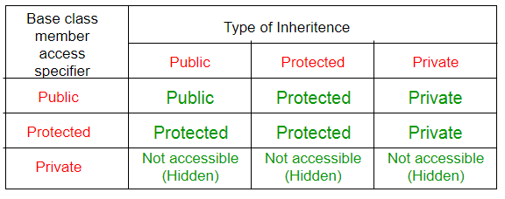
class base_class
{
//base class members (x, y)
};
class derive_class : access_Specifier base_class
{
//base class members (x, y)
//derive class members (a,b)
};

Slide 7
Which among the following best defines single level inheritance?
A) A class inheriting a derived class
B) A class inheriting a base class
C) A class inheriting a nested class
D) A class which gets inherited by 2 classes

Slide 8
Any Query?

