Slide 1

CAP444 OBJECT ORIENTED PROGRAMMING USING C++

Slide 2
Inheritance: types of inheritance
One class can hire properties from other class
Advantages: Reusability
A
A
A
B
B
B
C
C
Single
Multilevel
Multiple

Slide 3
A
A
B
C
B
C
Hierarchical Inheritance
D
Hybrid Inheritance

Slide 4
Single inheritance:
Syntax:
class derive_class_name : access_mode base_class_name
{
//body of derive_class
};

Slide 5
Multiple Inheritance:
class derive_class_name : access_mode base_class1, access_mode base_class2, ....
{
//body of derive_class
};

Slide 6
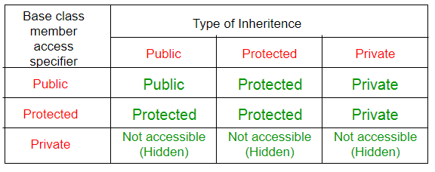
class base_class
{
//base class members (x, y)
};
class derive_class : access_Specifier base_class
{
//base class members (x, y)
//derive class members (a,b)
};

Slide 7
Which among the following is correct for a hierarchical inheritance?
a) Two base classes can be used to be derived into one single class
b) Two or more classes can be derived into one class
c) One base class can be derived into other two derived classes or more
d) One base class can be derived into only 2 classes

Slide 8
class base
{
public:
int x;
protected:
int y;
private:
int z;
};
class derive: public base
{
//x is public
//y is protected
//z is private
};
class derive: protected base
{
//x is protected
//y is protected
//z is private
};
class derive: private base
{
//x is private
//y is private
//z is private
};
Accessibility in public inheritance
accessibility | public | protected | private
From base | Yes | Yes | Yes
From derive1 | yes | yes | no
From derive2 | yes | yes | no

Slide 9
Which among the following is correct for multiple inheritance?
a) class student{public: int marks;}s; class stream{int total;}; class topper:public student, public stream{ };
b) class student{int marks;}; class stream{ }; class topper: public student{ };
c) class student{int marks;}; class stream:public student{ };
d) class student{ }; class stream{ }; class topper{ };

Slide 10
Any Query?

