Slide 1

CAP444 OBJECT ORIENTED PROGRAMMING USING C++

Slide 2




Student
Exam
Project
Result

Slide 3
virtual base class introduce

Slide 4
virtual base classes
Student
Virtual
Exam
name
Project
regno
Result

Slide 5

virtual base classes
It means we are making base class as virtual
But why ???
In situation???
int b int c
Let’s assume ( int a)
A
int a
(int a)
B
C
int a
D
int d

Slide 6
Which of the following can derived class inherit? a) members b) functions c) both members & functions d) classes

Slide 7
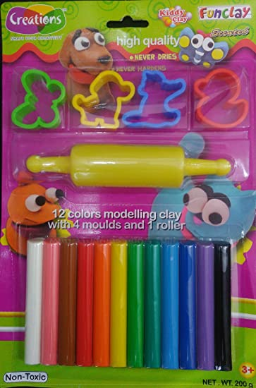



Slide 8
Concept of Function overriding Introduce

Slide 9
Function overloading (with in same class)
Function overriding (with in different classes of inheritance)
Function hiding (with in different classes of inheritance)

Slide 10
Function overriding is the example of ?
a) Encapsulation b) Polymorphism c) Abstraction

Slide 11




What do we need to know?
Run-time Polymorphism and Virtual Functions
Preparing food
according to hotel menu
During competition preparing food
(Run-time)
Compile time)

Slide 12
Any Query?

