Slide 1
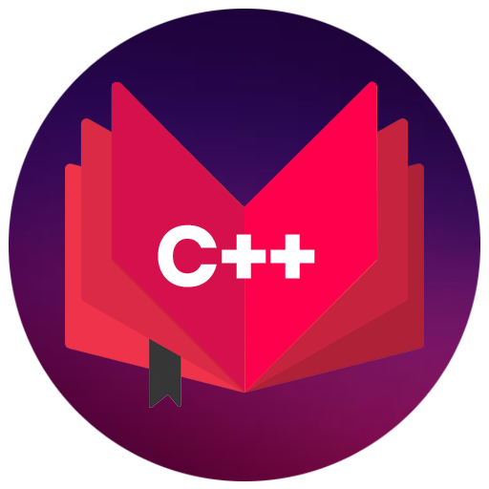
CAP444 OBJECT ORIENTED PROGRAMMING USING C++
Session #1

Slide 2
Basic Concepts of Object Oriented Programming
Procedural Programming and Object Oriented Programming:
Languages used in Procedural Programming:
FORTRAN, ALGOL, COBOL,
BASIC, Pascal and C.
Languages used in Object Oriented Programming:
Java, C++, C#, Python,
PHP, JavaScript, Ruby, Perl,
Objective-C, Dart, Swift, Scala.

Slide 3
OOPs Features
Class
Objects
Encapsulation
Abstraction
Polymorphism
Inheritance
Dynamic Binding
Message Passing

Slide 4

Class
Class is a collection of similar types of objects.
For example: Fruits is class of mango, apple , orange etc.
Fruits

Slide 5
Class
Class is a collection of data members and member functions.
Example:
class Employee{
//data members
// member functions
}
Employee
employeeId employeeName
getDetails() setDetails()

Slide 6
class student
{
public:
int regno;
void getStudentDetails();
}
In this code which option is correct?
A: regno is data member
B. getStudentDetails() is member function
C. above both options are correct

Slide 7
Object
Object is an instance of a Class.
class Employee
{
int employeeId;
char employeeName[20];
public:
void getDetails(){}
void setDetails(){}
};
int main()
{
Employee e1; // e1 is a object
return 0;
}

Slide 8
Encapsulation
Wrapping up of data and information under a single unit.
Binding together the data and the functions in a single unit
Encapsulation also hides the data
We can achieve encapsulation features by making data member as a private and use get and set accessor methods to access data members.

Slide 9


Abstraction
Hiding background details and showing features or functionality only

Slide 10
You know how to drive the car but you don’t know about the internal details this is the example of ….?
Encapsulation
Abstraction
None

Slide 11
How to achieve abstraction in C++ ?

Slide 12
An abstraction can be achieved using classes.
A class has the responsibility to determine which data member is to be visible outside and which is not.
Access specifiers is used to follow this access mechanism within class

Slide 13


Polymorphism
The ability to perform a task in more than one form.
We use Function overloading and Function overriding to achieve polymorphism.
Good Student
Good Singer
Rahul

Slide 14
Inheritance
Reusability

Slide 15



Inheritance
father
mother
child

Slide 16
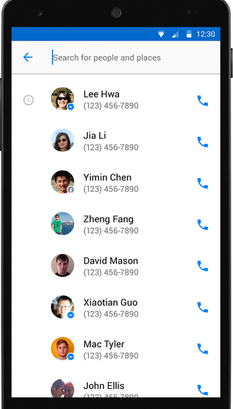
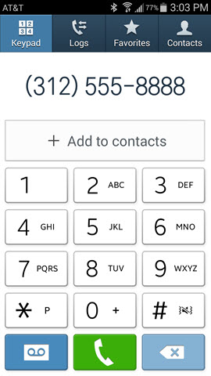
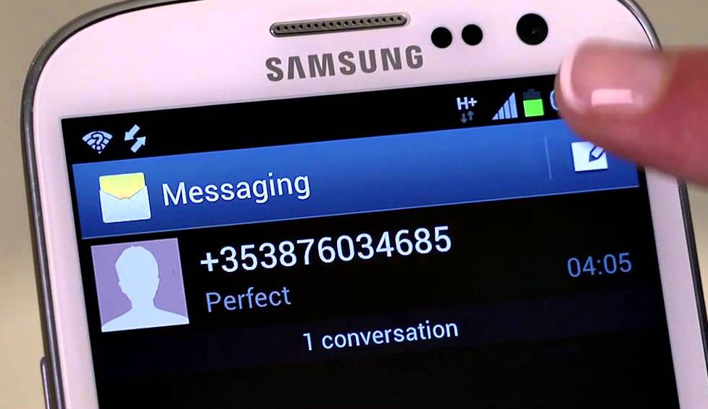
More examples of inheritance:
Contact List

Slide 17
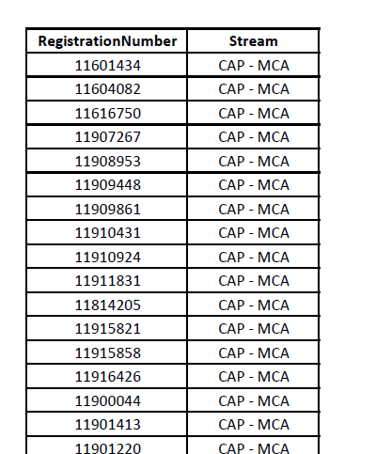
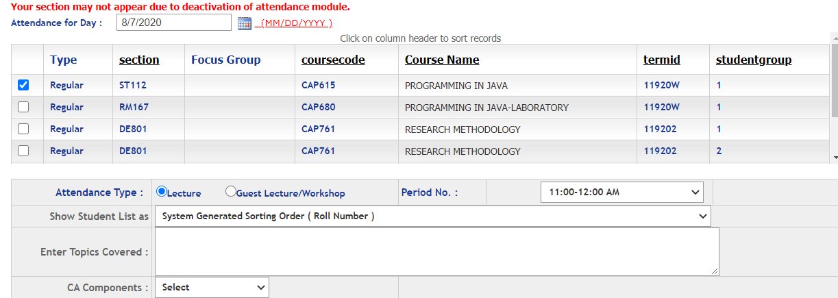
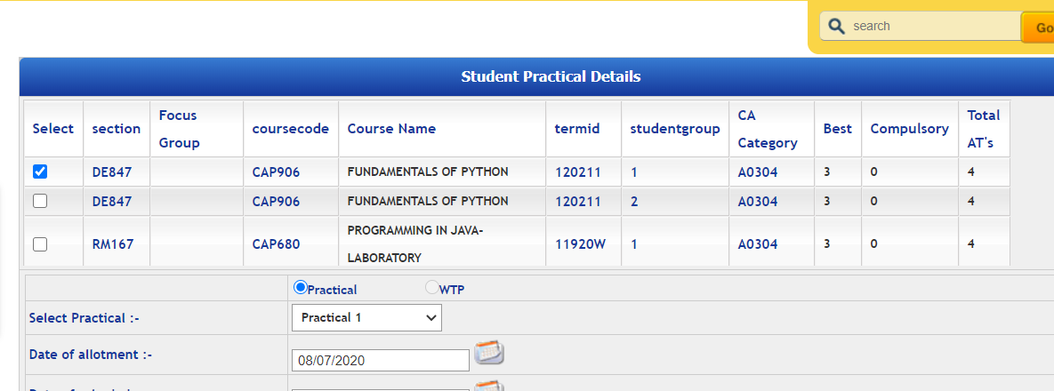
Students
More examples of inheritance:
Students in Attendance Module
Same Students in CA Module

Slide 18
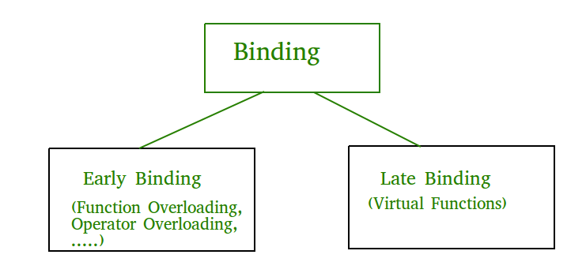
Function calling mechanism determined at compile time and run time
Dynamic Binding

Slide 19
Dynamic Binding
Early Binding (compile-time time polymorphism)
Late Binding : (Run time polymorphism)

Slide 20

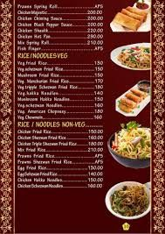


Preparing food
according to hotel menu
During competition preparing food
(Run-time)
Compile time)

Slide 21

Message Passing
One object is communicating with another object.

Slide 22
Any Query?

