Slide 1

CAP444 OBJECT ORIENTED PROGRAMMING USING C++

Slide 2
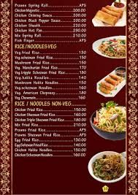




Slide 3
Preparing food
according to hotel menu
During competition preparing food
(Run-time)
Compile time)

Slide 4
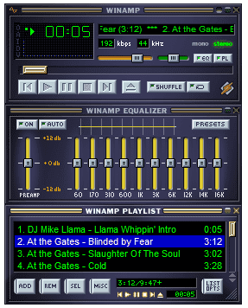

Slide 5
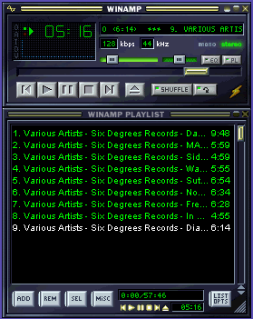
Shuffle
is On

Slide 6
……………. binding means that an object is bound to its function call at compile time.
A) late
B) static
C) dynamic
D) fixed

Slide 7
Polymorphism
Compile Time Polymorphism
Run Time Polymorphism
Function overloading
Operator overloading
Virtual function

Slide 8
Problems in function overriding
Overriding using base class pointer compiler don’t know about pointer which address is pointing because address will be decided at run time when memory will be allocated.
To over come this problem we use virtual function
With the help of virtual function, we can override function at run time

Slide 9
Run time polymorphism is achieved only when a ……………….. is accessed through a pointer to the base class. A) member function B) virtual function C) static function D) real function

Slide 10
Any Query?

