Slide 1

"Behind Closed Doors: Decoding Airbnb's Presence in NYC"
Nitish kumar

Slide 2
AGENDA
Objective
Background Key findings
Recommendations Appendix:
Data sources
Data methodology
Data model assumptions

Slide 3
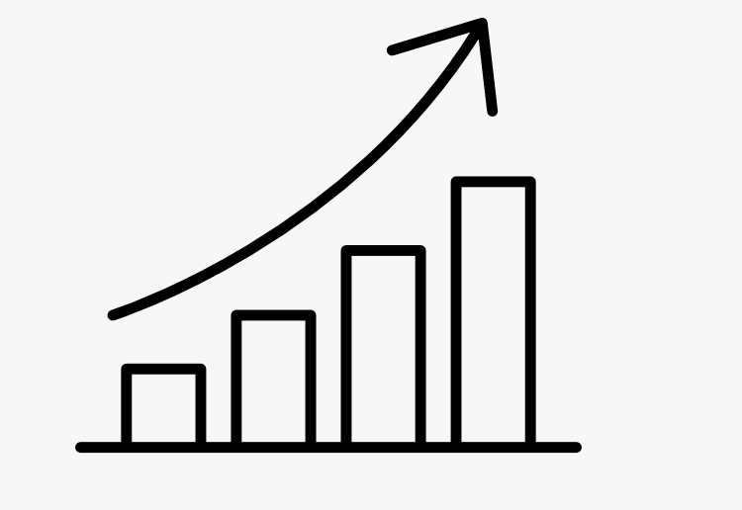


OBJECTIVE
To Provide insight into the current market situation
Enhance our understanding of property and host acquisition, operation , and customer preferences
Provide early recommendation to our marketing and operation team

Slide 4
BACKGROUND
For the past few months,Airbnb has seen a major decline in revenue.
Now that the restrictions have started lifting and people have started to travel more.
Airbnb wants to make sure that it is fully prepared for this change.

Slide 5



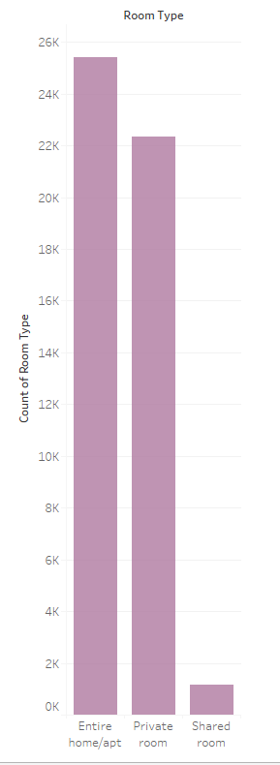
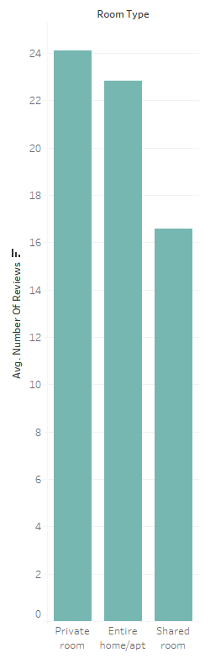
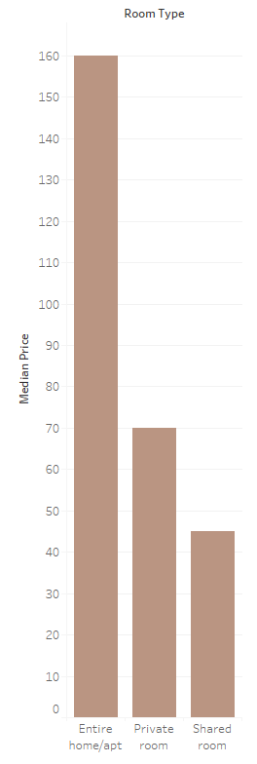
THE PROBLEMS WITH SHARED ROOMS
Shared rooms only account for 2 % of the
total types of rooms.
They are less likely to be reviewed.
Median rates for shared rooms are significantly lower.

Slide 6
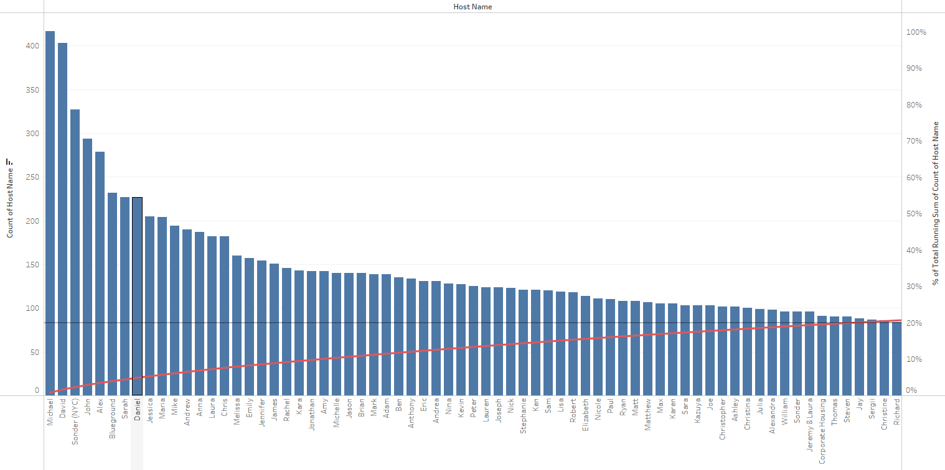
EVERY HOST MATTER
The top 60 hosts only make up 20% of the total host count!

Slide 7
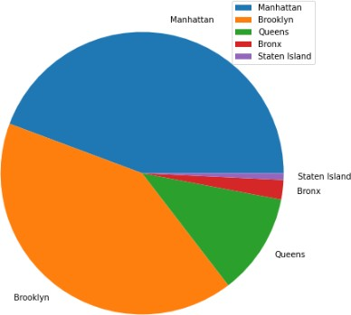


MOST CONTRIBUTING NEIGHBORHOODS
Neighborhood group percentages
81 % of the listing are Manhattan and Brooklyn neighborhood group
Staten Island has the lowest contribution.

Slide 8
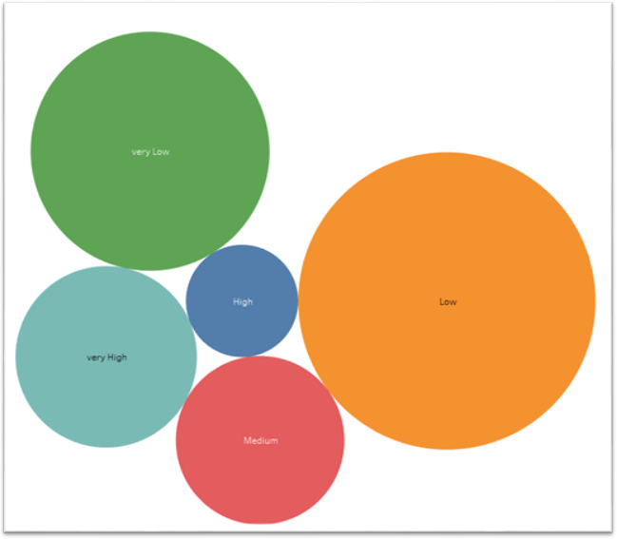


MINIMUM NIGHT CATEGORIES
Minimum night category percentages
Low category in minimum night feature contributes 40 %

Slide 9
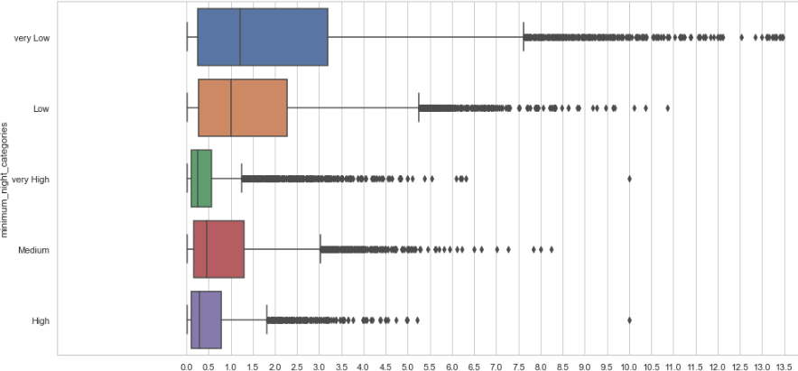
EFFECT OF MINIMUM NIGHT ON REVIEWS
Customers are more likely to leave reviews for lower number of minimum nights.

Slide 10
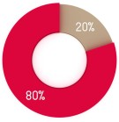

CONCLUSION
& RECOMMENDATIONS
Shared rooms need to be inspected upon.
The cumulative contribution of all hosts is better than a few hosts doing
well.
More than 80 % of the listing are Manhattan and Brooklyn neighborhood
group
Minimum nights threshold should be on the lower side to make properties
more customer-oriented

Slide 11

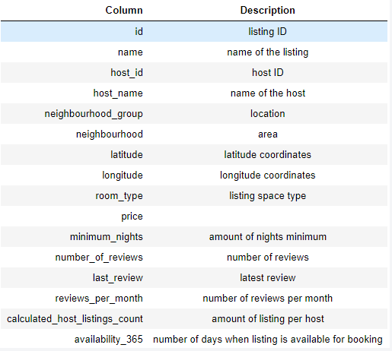
APPENDIX - DATA SOURCES
The columns in the dataset are self-explanatory. You can refer to the diagram given below to get a better idea of what each column signifies.

Slide 12
APPENDIX –DATA METHODOLOGY
Conducted a thorough analysis of NewYork Airbnbs Dataset.
Cleaned the data set using python.
Derived the necessary features.
Used group aggregation, pivot table and other statistical methods.
Created charts and visualizations using Tableau.

Slide 13

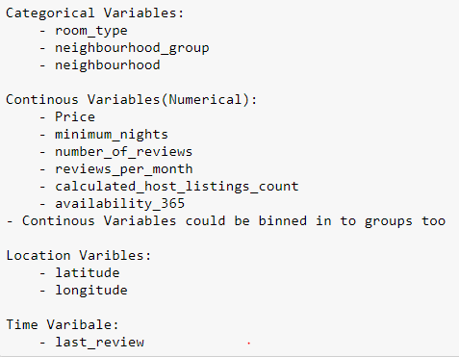
APPENDIX - DATA ASSUMPTIONS

