Slide 1
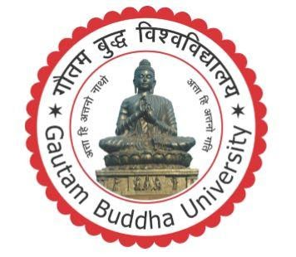
MINOR PROJECT ON OPTICAL IMAGE RECOGNITION USING COMPUTER VISION
Master in Computer Application in Artificial Intelligence
UNIVERSITY SCHOOL OF INFORMATION AND COMMUNICATION TECHNOLOGY, GAUTAM BUDDHA UNIVERSITY, GREATER NOIDA-201312, UTTAR PRADESH INDIA
NOVEMBER 2023
Presented by :-
NITISH BHARDWAJ(225/PCA/007)
PRASHANT KUMAR(225/PCA/009)
BRIJ KISHORE SINGH YADAV(225/PCA/004)
Under the Guidance of :-
Ms. Sindhu Sujata

Slide 2
Optical Mark Recognition using Computer Vision
By- NITISH BHARDWAJ(225/PCA/007)
PRASHANT KUMAR(225/PCA/009)
BRIJ KISHORE SINGH YADAV(225/PCA/004)

Slide 3
Table OF Contents
Introduction
Problem Statement
Technologies to be used
Project Description
Results & Conclusion
Future Scope

Slide 4
Intoduction
This project focuses on providing a portable and convenient solution to the OMR sheet checking with the help of Computer Vision and proposing a application software made with python that allows you to upload OMR and get it evaluated accurately without the hassle of huge OMR scanners.
We propose a software where you can post image of OMR sheet taken from different angles yet our application can detect the bubbles marked and evaluate the answers accordingly as per the answer scheme. It generates a .csv file as output with all the necessary fields such as roll no., question no., etc.

Slide 5
Problem Statement
In today’s world most of the competitive exams are based on MCQ (Multiple Choice Questions). The responses of these MCQ based exams are recorded in the Optical Mark Reader (OMR) sheet. Evaluation of the OMR sheet requires separate specialized machines for scanning and marking. The sheets used by these machines are special and costs more than a normal sheet.
OMR (Optical Mark Reader or Optical Mark Recognition) is the process of gathering information from human beings by recognizing marks on a document. OMR is accomplished by using a hardware device (scanner) that detects a reflection or limited light transmittance on or through a piece of paper.
OMR analyzing is process of automatically analyzing human marked sheets used to record answers and interpreting their results. Candidates filling their OMR sheets using pencil or Ball-Point Pens. These hardware device lacks in portability and are expensive to use. Thus, limits the usage of OMRs widely which end up in lack of opportunities or say, we are unable to make the best out of this technology.

Slide 6
Technologies To Be Used
Software Platform
a)Front-end
•Python 3
b)OMR Checker
•Pyhton 3
•Opencv
•Rich – table generation
•Numpy
•Pandas
•Matplotlib
•Jsonschema
•dotmerge
Hardware Platform
Camera for Capturing Images

Slide 7
Project Description
We propose a full-fledged OMR checking software that can read and evaluate OMR sheets scanned at any angle and having any color.
Specs
Accuracy | Currently nearly 94% accurate on good quality document scans; and about 90% accurate on mobile images.
Robustness | Supports low resolution, xeroxed sheets. Minimum resolution 640x480
Fast | Current processing speed without any optimization is 100 OMRs/minute.
Customizable | Easily apply to custom OMR layouts, surveys, etc.
Visually Rich | Get insights to configure and debug easily.
Lightweight | Very minimal core code size.
Large Scale | Tested on a large scale.

Slide 8
Once we capture and configure the OMR layout and image, we just need to throw images of the sheets at the software and you'll get back the marked responses in an excel sheet.
Images can be taken from various angles as shown
Figure 1: Input Images captured at various angles

Slide 9
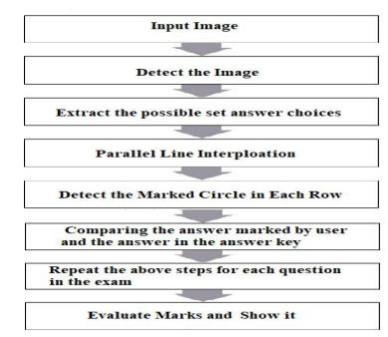
Project Modules: Design/Algorithm
Figure 2: Workflow of the project

Slide 10
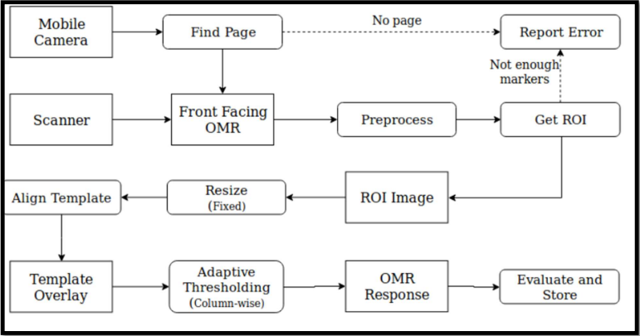
Project Modules: Design/Algorithm
Figure 3: Workflow of the project

Slide 11
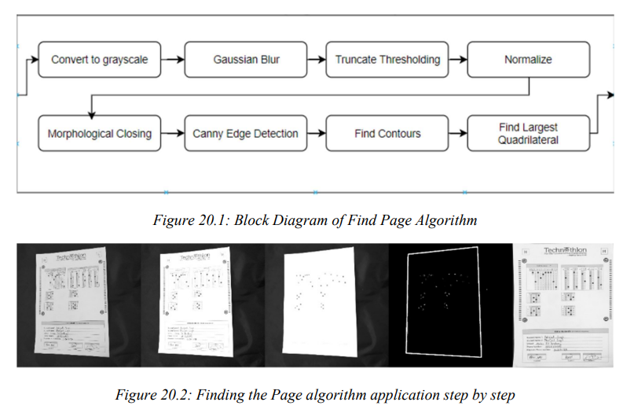
Project Modules: Design/Algorithm

Slide 12
Output generated would be of the form of a .csv file which can be later on taken into various applications such as data analysis, surveys, etc.
Figure 4: Screenshot of Output .csv file generated from OMR sheet

Slide 13
Result & Conclusion
Our Proposed model is Currently nearly 94% accurate on good quality document scans and about 90% accurate on mobile images.
OMR scanners are faster and more accurate than OCR scanners for processing OMR sheets, and that they can provide timely feedback to students. OMR scanning systems have been successfully implemented in various academic settings, with studies reporting high levels of accuracy and efficiency. These systems have the potential to save time and reduce the risk of errors compared to manual data entry or scanning. Additionally, OMR software that allows users to upload images directly without a scanner can offer convenience, flexibility, cost savings, improved accuracy, time savings, and data security.
Overall, OMR checkers offer a reliable and efficient solution for grading multiple choice exams and evaluating student performance in large classes.

Slide 14
Future Scope of the Project
The integration of artificial intelligence (AI) with OMR software can significantly improve the accuracy and speed of processing OMR sheets. With AI, the software can learn from past data and optimize the processing of future sheets.
Cloud-based OMR solutions can offer more flexibility, accessibility, and scalability. Users can access the software from anywhere and scale up or down as per their requirements.
With the increasing use of smartphones and tablets, mobile-based OMR applications can be developed. Users can scan the OMR sheets using their mobile devices and process the data in real-time.
With globalization, there is a growing need for OMR software that supports multiple languages. Multi-lingual support can help to process OMR sheets in different languages without any errors.

Slide 15
Thank You
NITISH BHARDWAJ(225/PCA/007)
PRASHANT KUMAR(225/PCA/009)
BRIJ KISHORE SINGH YADAV(225/PCA/004)

