Slide 1

AIR TRAVEL DATA ANALYSIS
DETAILED PROJECT REPORT

Slide 2
Project details:
Project Title | AIR TRAVEL DATA ANALYSIS
Technologies | Business Intelligence
Domain | TRAVEL
Difficulties level | Intermediate

Slide 3
Objective:
The primary objective of this project is to analyze comprehensive air travel data to derive actionable insights that can enhance decision-making for airlines and stakeholders. This includes examining flight operations, route efficiency, and traffic volume to identify key trends and performance metrics. The project aims to improve operational efficiency by identifying factors contributing to delays and on-time performance. Additionally, it seeks to provide valuable marketing insights by analyzing airline promotional activities and market positioning. Overall, the project strives to enhance customer satisfaction by understanding passenger preferences and service quality.

Slide 4
Problem Statement:
Airlines face challenges in optimizing their operations, marketing strategies, and customer satisfaction due to the vast amount of complex and unstructured data. Identifying key trends in route efficiency, traffic volume, and on-time performance requires comprehensive data analysis. Delays and inconsistent punctuality rates further complicate operational efficiency. Additionally, understanding market positioning and passenger preferences remains a critical hurdle. This project aims to address these challenges by leveraging data analytics to derive actionable insights for improving airline performance and decision-making.

Slide 5
Dataset information:
The dataset contains detailed information regarding flight operations and events, captured across various columns:
Actual Timestamp: The actual timestamp when a specific event or action occurred during the flight.
Airline: The airline responsible for operating the flight.
Arrival Latitude: The latitude coordinates of the arrival airport.
Arrival Longitude: The longitude coordinates of the arrival airport.
Base Airline: The primary airline associated with the flight operation.
Base Flight Number: The base identifier for the flight within the airline's scheduling system.
Date: The date of the flight or event.

Slide 6
Departure Latitude: The latitude coordinates of the departure airport.
Departure Longitude: The longitude coordinates of the departure airport.
Destination: The final destination of the flight.
Distance: The distance covered during the flight.
Estimated Timestamp: The estimated timestamp for events or actions during the flight.
Event Type: Type of event or action occurring during the flight (e.g., departure, arrival, delay).
Flight Number: The unique identifier assigned to the flight.
Flights Type: Type of flight (e.g., domestic, international).
Gate: The gate assigned to the flight at the departure or arrival airport.
Geometry Type: Type of geometric data representation (e.g., point, line).
Route: The specific path or route taken by the flight.
Source: The starting point or origin of the flight.

Slide 7
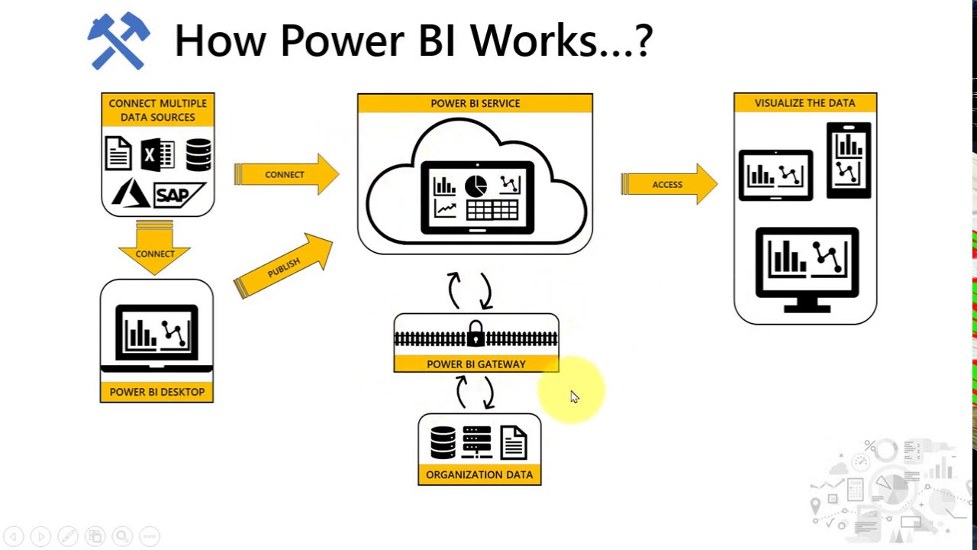
ARCHITECTURE

Slide 8
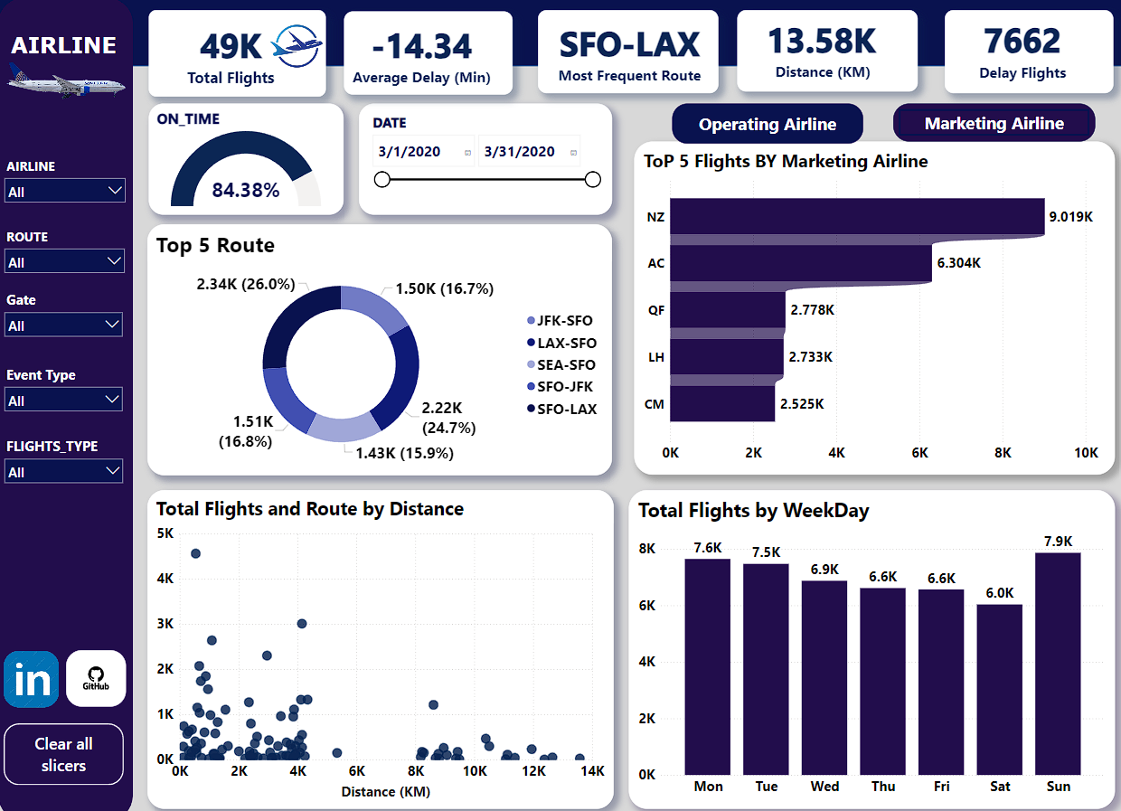
INSIGHTS:

Slide 9
Route Analysis:
What are the busiest domestic routes in the United States based on departure and arrival volumes?
How does the distance between major city pairs influence flight frequency and passenger demand?
Marketing Insight:
How does Air New Zealand's extensive flight promotion strategy impact market visibility and passenger bookings?
What marketing tactics are effective in increasing airline brand awareness and passenger engagement?
Operational Insight:
What factors contribute to United Airlines' ability to manage over 26,000 flights efficiently?
How does an airline's operational capacity affect its market competitiveness and customer satisfaction?
Longest Route:
How do airlines manage operational challenges on long-haul routes like San Francisco to Singapore?
What are the economic implications of operating ultra-long-haul flights compared to shorter routes?
Traffic Volume:
How does the day of the week impact air traffic volume, especially regarding departure and arrival frequencies?
What strategies can airlines employ to manage peak travel times and optimize flight schedules?
Punctuality Analysis:
What are the main reasons behind delays for airlines like Singapore Airlines despite their moderate on-time arrival rate?
KPI'S:

Slide 10
QUESTIONS:
Q1) What’s the source of data?
The dataset is taken from PWSKILLS
Q2) What was the type of data?
The data was the combination of numerical and Categorical values.

Slide 11
Q 3) What techniques were you using for data pre-processing?
Removing unwanted attributes.
Visualizing relation of independent variables with each other and output variables.
Checking and changing Distribution of continuous values.
Removing outliers.
Cleaning data and imputing if null values are present.

Slide 12

Thank you

