Slide 1
Inventra – Intelligent Inventory Management System
Nitish kumar chaudhary

Slide 2
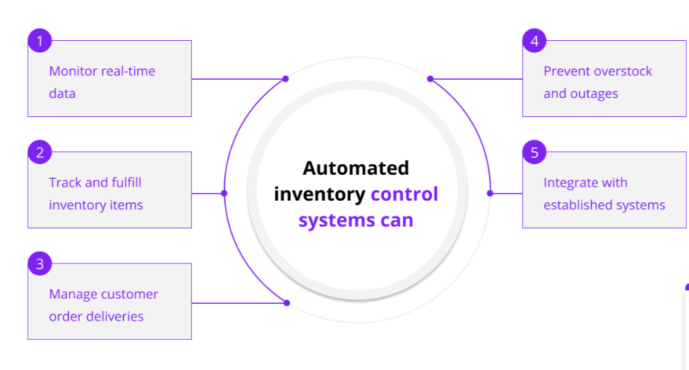
Inventra = Inventory + Intelligent Automation
A smart, automated system that continuously monitors stock, handles routine tasks, and enhances decision-making for efficient inventory management..

Slide 3
Agenda
Inventra-Intelligent Inventory Management System

Slide 4
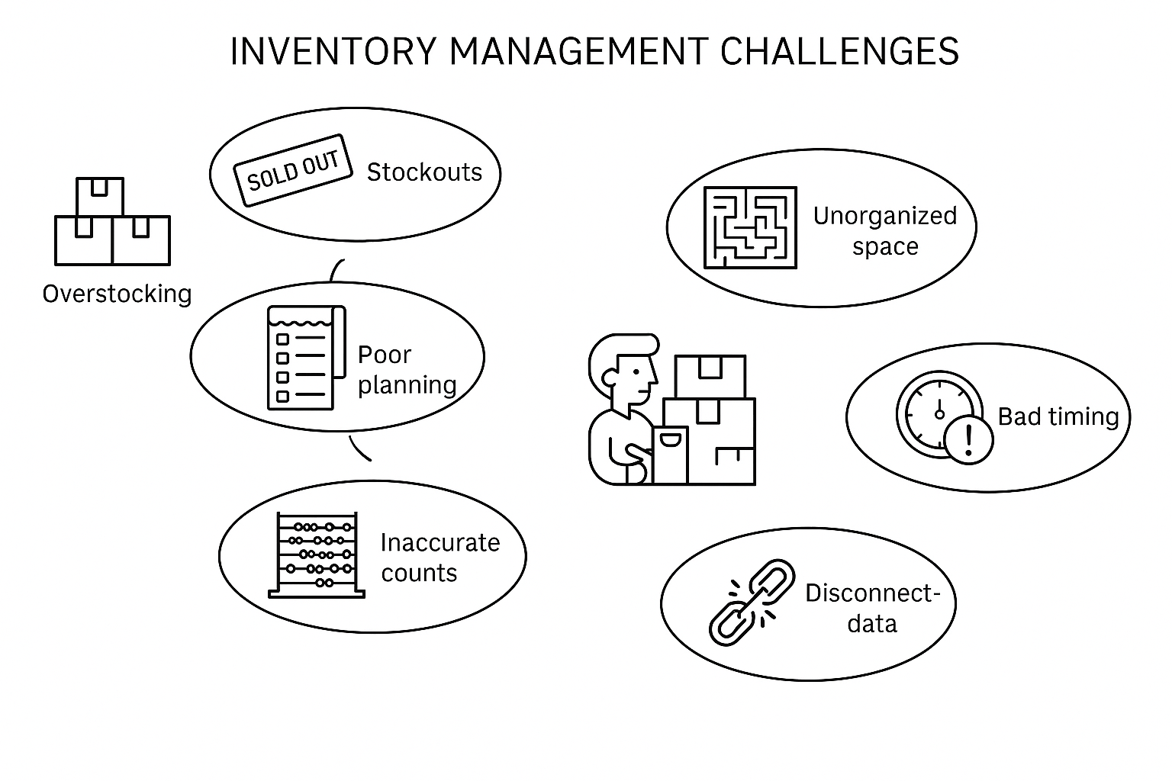
Existing System -(Challenges Faced)
Poor demand forecasting
Overstock
Understock
Inefficient tracking and ordering systems
Poor visibility into inventory
Manual Documentation

Slide 5
Smart Proposed System to Resolve Key Issues
Focus Area | Smart Solutions by Inventra
Automation & Tech | Automates stock updates, billing, and tracking with real-time syncing.
Data-Driven Decisions | Provides dashboards, analytics, and real-time reports.
Inventory Control | expiry alerts, batch tracking, alert when stock becomes low
Warehouse / Store Optimization | Improves item arrangement, fast retrieval, and automated location tracking.
Supporting two roles | Admin & Employee

Slide 6
Number of Modules
Authentication & Role Control
Product Management & Stock Updates
Low-Stock Alerts
Transaction Logs & Movement Tracking
Reports & Data Export

Slide 7
Authentication & Role Control
WORKING
JWT –based authentication working
Admin can create employee accounts
Restrict access on role
Admin can access user management page.
Employee cannot access admin –only screen
Product Management & Stock Updates
Add/Edit/Delete products
Store product,name , supplier,category,price
Stock –in stock –out screens
Log every stock update
When a new carton of noodles arrives –stock-in when a customer buys 2 units-stock-out
Low-Stock Alerts
Set threshold per product
Show alerts on dashboard
Send email/SMS alerts
Ex:-If bread packet threshold=12 and current stock=9->Alert

Slide 8
Transaction Logs & Movement Tracting
Record purchase / sale
Date , quantity, user , type
Real – time stock update
Show movement history on dashboard.
Ex- on 3 dec , 2025 -> Employee x sold 4 units of product y.
Reports & Export
Current stock report
Low stock report
Date – wise transactions
Export to PDF/CSV
Ex- Owner needs monthly purchase / sale report for accounting

Slide 9
System Configuration
Hardware requirement
Software requirement

Slide 10
ARCHITECTURE
Frontend : - React/Angular/Html
UI for Admin & Employee
Backend : - Java Spring Boot
Business logic
Authentication : JWT
----------Secure communication
Services : Stock, Product, User, Report
Database : - MySQL/PostgreSQL
--------Users, products, stock
Notification engine : Email/SMS

Slide 11

Authentication & Role Control
It manages user authentication, role-based access, and permissions to ensure that only authorized personnel can view or modify inventory operations.
This module acts as the security backbone of the system, protecting sensitive stock data and controlling what each user is allowed to do inside the application.

Slide 12



USER CLASS
Represents each person who uses the system.
Stores essential user information used during login and role assignment.
Purpose: Identify users, validate credentials, and map them to roles.
ROLE CLASS
Defines different types of system access levels such as Admin, Manager, or Staff.
Purpose: Control what features each user is allowed to perform inside the inventory system.
AUTHENTICATION CLASS
Handles the complete authentication workflow such as verifying credentials, encrypting passwords, and managing user sessions.
Purpose: Ensure secure login and protect inventory data from unauthorized access.

Slide 13

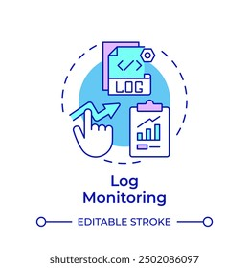
USER-CONTROLLER CLASS
Acts as the API layer between frontend and backend.
Receives login/registration requests and communicates with authentication service.
Purpose: Manage user-related operations like login, logout, and user creation.
ACTIVITY LOG CLASS
Captures every user action such as logging in, updating stock, adding products, or viewing reports.
Purpose: Maintain transparency, traceability, and audit history within the inventory system.

Slide 14
DATABASE SCHEMA
USER TABLE
ROLE TABLE

Slide 15
USER TABLE
Field Name | Type | Description
user_id | INT (PK, AUTO INCREMENT) | Unique ID for each user
name | VARCHAR | User full name
email | VARCHAR | Login email (unique)
password | VARCHAR | Encrypted password
contact | VARCHAR | Mobile number
role_id | INT (FK) | Links user to their role (Admin/Employee)
status | VARCHAR | Active / Inactive
ROLES TABLES
Field Name | Type | Description
role_id | INT (PK, AUTO INCREMENT) | Unique Role ID
role_name | VARCHAR | Role type (Admin / Employee)

Slide 16
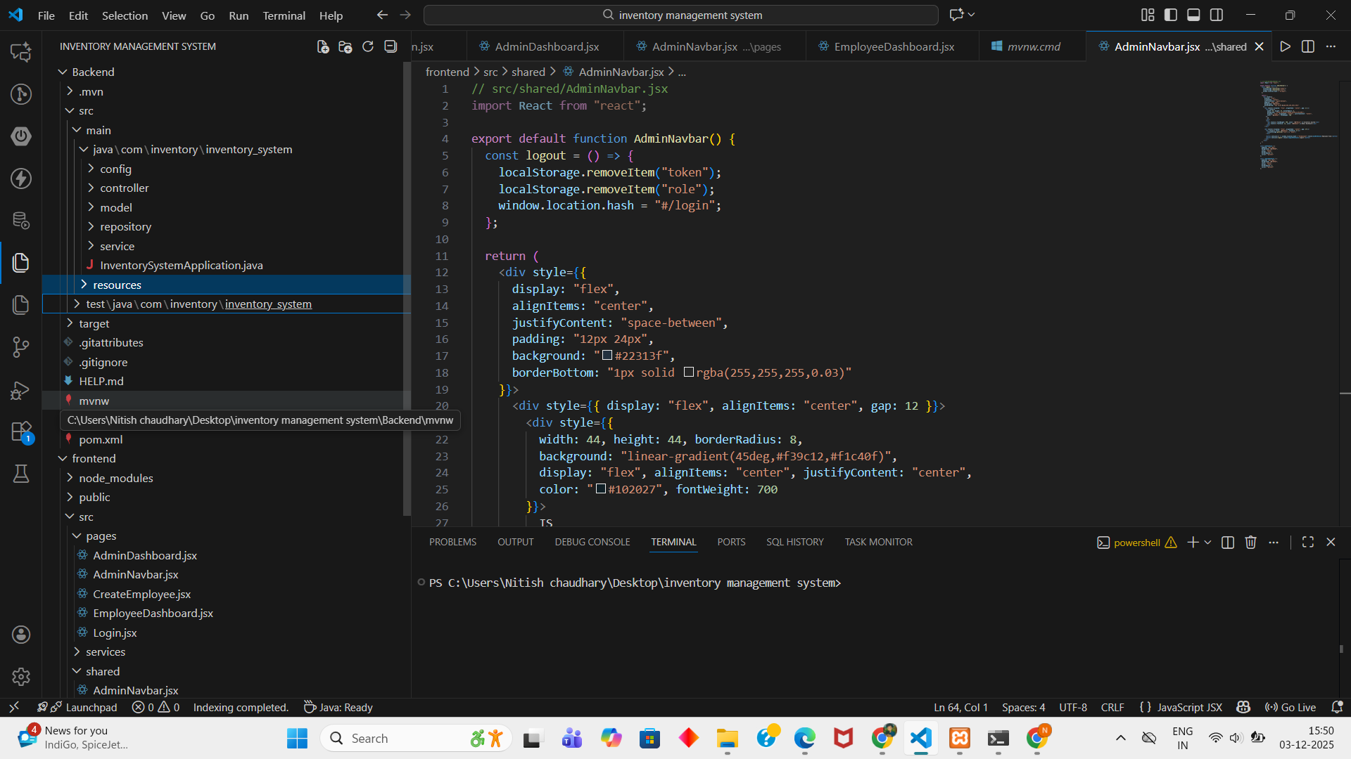
CODE SCREENSHOT

Slide 17
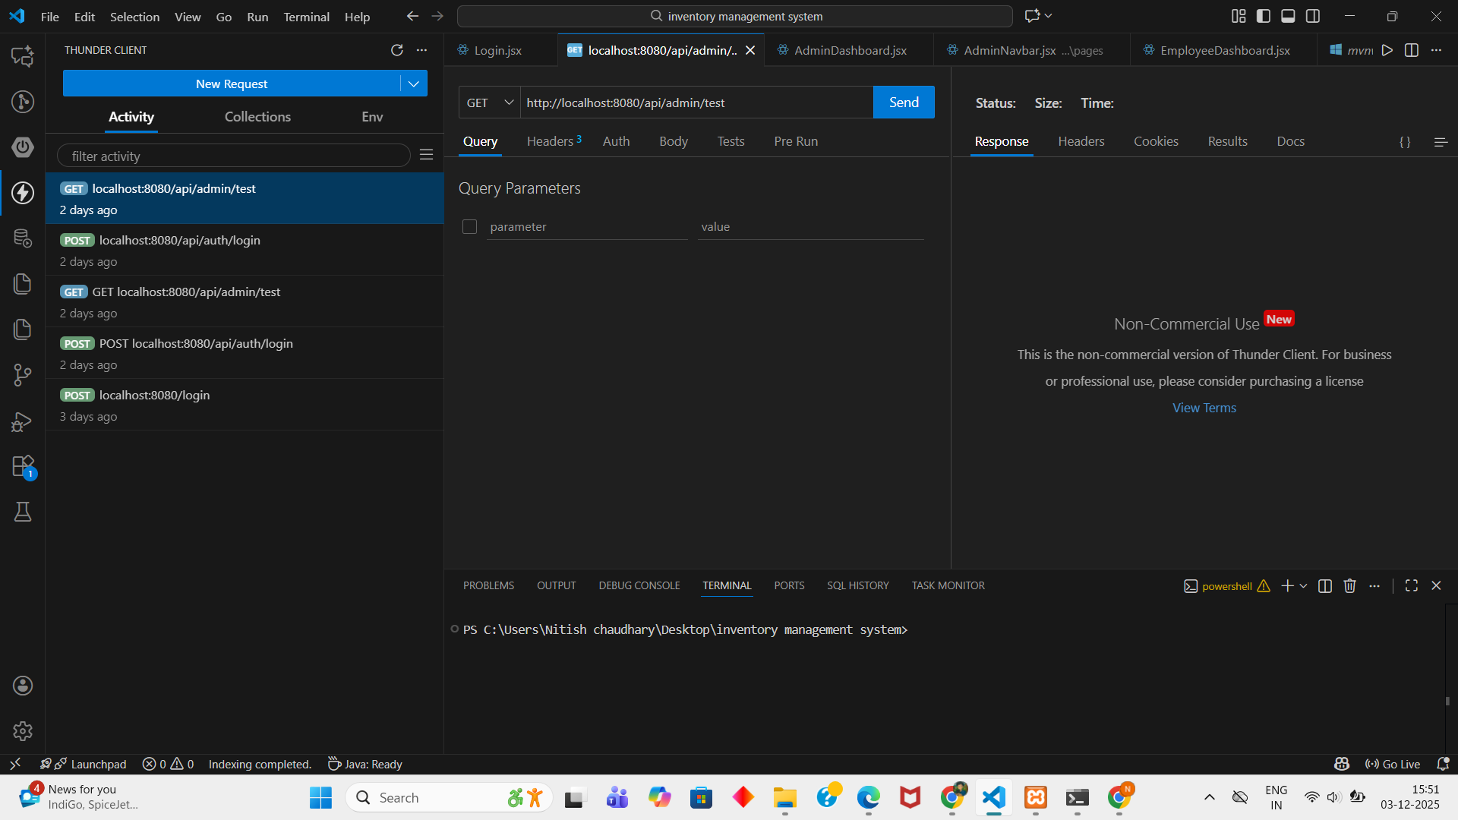
Testing GET & POST APIs Using Thunder Client

Slide 18
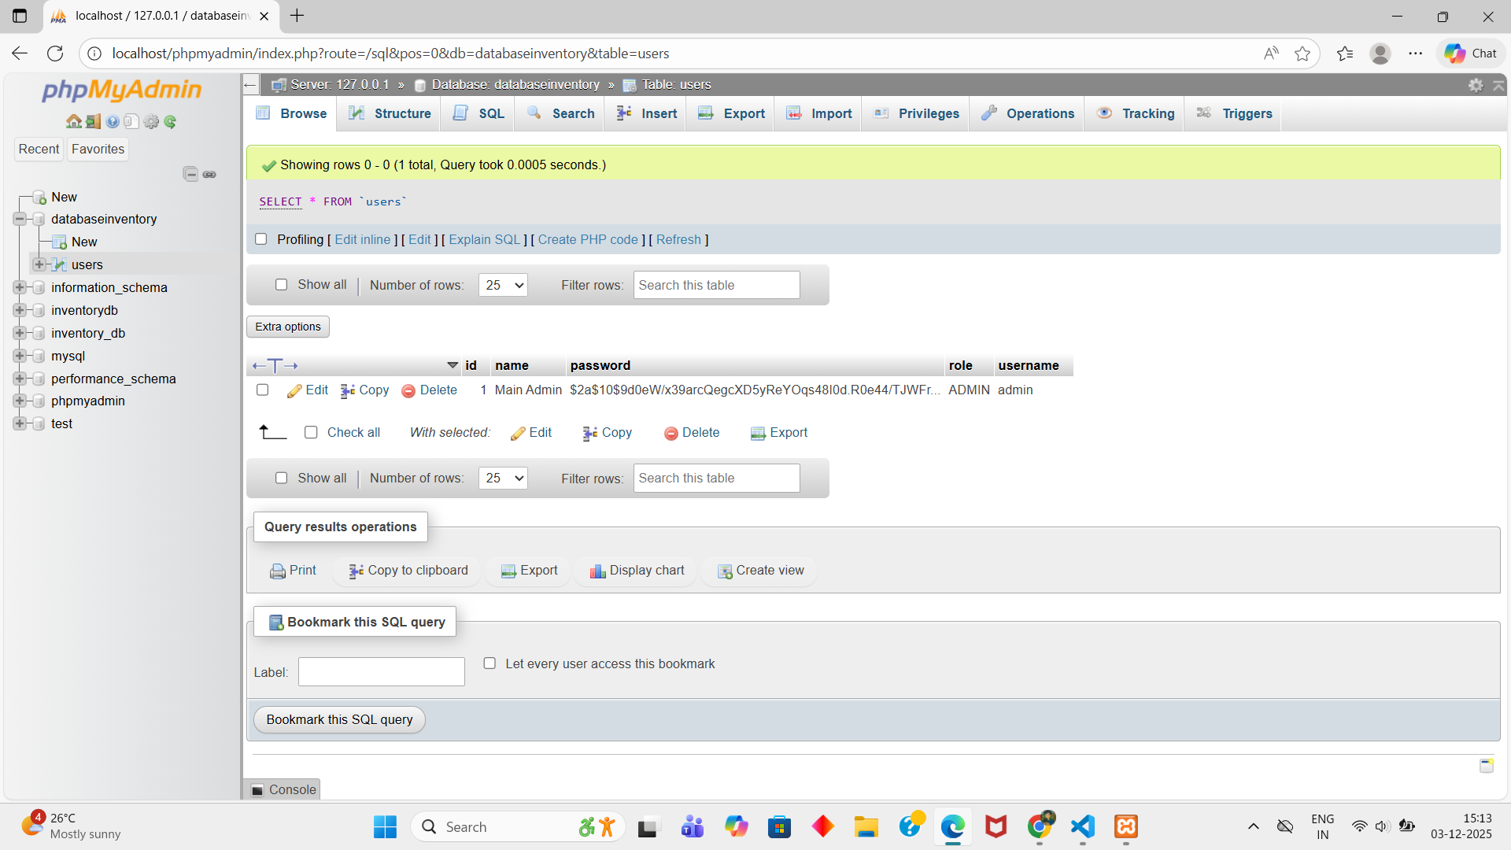
DATABASE

Slide 19
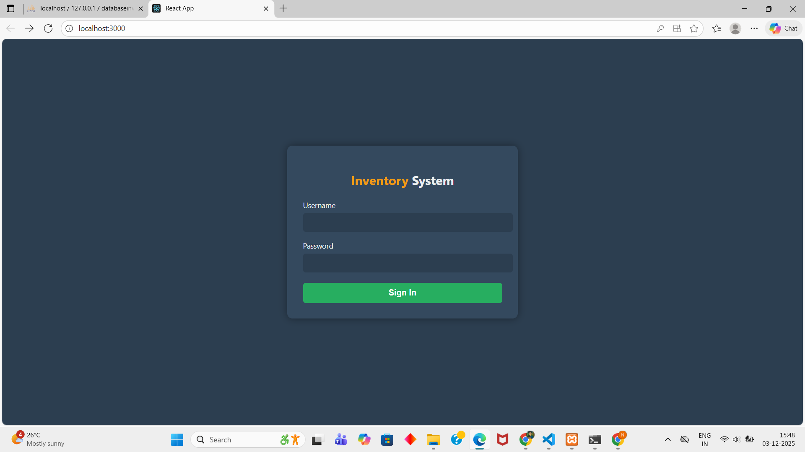
SIGN IN

Slide 20
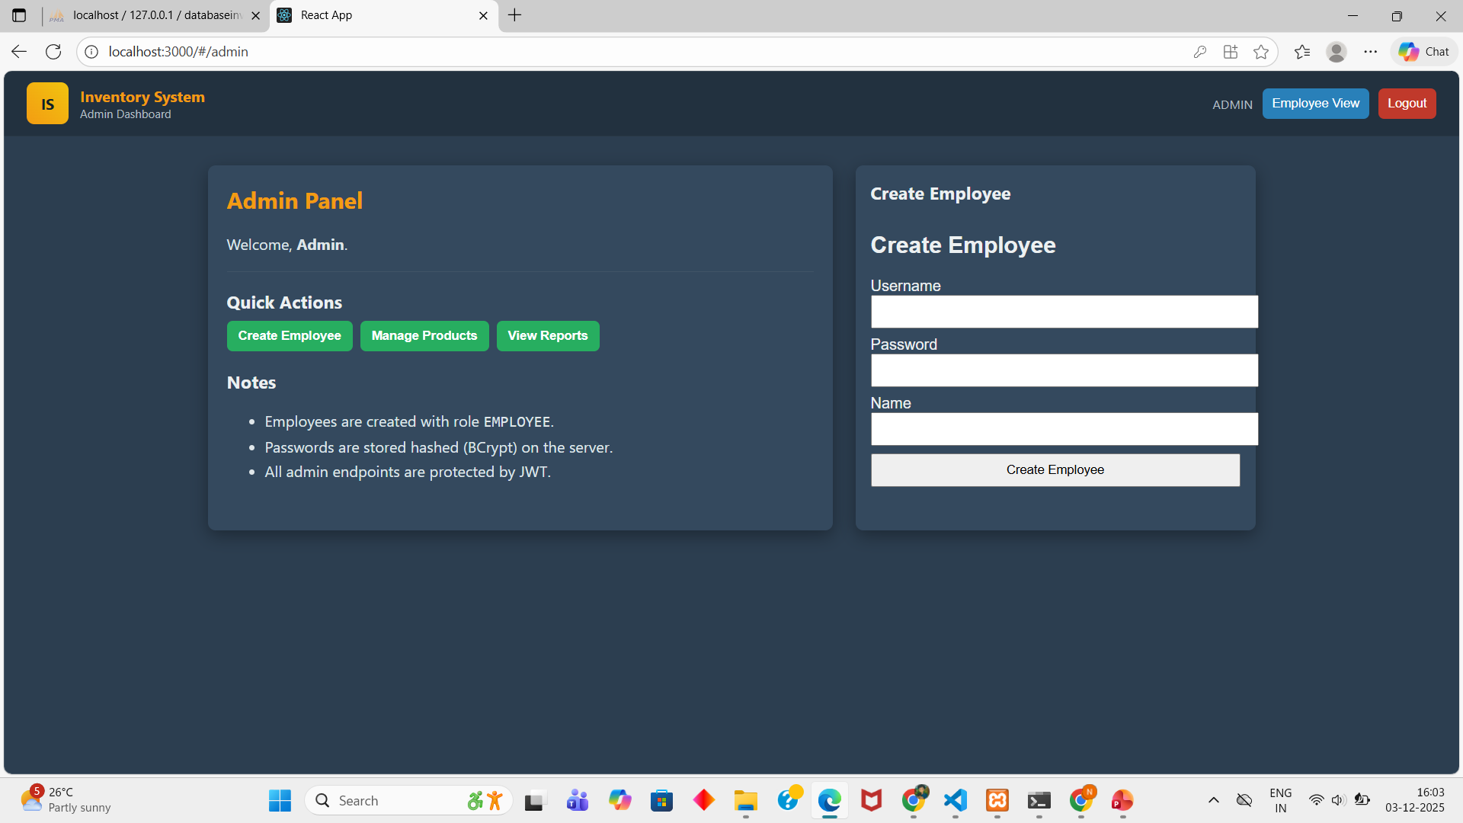
ADMIN DASHBOARD

Slide 21
THANKU

