Slide 1
My City
NINJA-NOMADS@6
Leader: Nitish Shrivastava
Members: Nishi Anand, Amisha, Megha Sinha, Raima, Iffat Naaz.

Slide 2
Problem Statement
My City Information Mobile Application.
Currently, it is a challenge for anyone to find useful information about a city at a single place.

Slide 3
Solution
Consolidating the informations regarding a city for users’ convenience.
Applicable for multiple cities.
Provides the current location.
Information like:
Banks/ATM
Hotels and restaurants
Mode of transportation (Airport, Railway Station etc)
Help line numbers (Ambulance, Fire brigade, Police, etc.)
Medical services (Hospitals , Medical Store, Blood Banks, etc.)
Places to visit (City Attractions, Malls, Theaters, Parks, etc.)
Maps(near by locations) and many more.
Uses Google APIs for data fetching.

Slide 4
Technology Stack
Android
Google APIs
Google Places API
Google Maps API
Firebase
Google Login Authentication

Slide 5


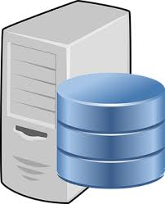
User
Interaction
Login Authentication
Google Login Auth
Restaurants
Education
Hospitals
Bank
Google Map API
Park
…
Internet
App

Slide 6
Algorithm
Login authentications using Google Account.
Manual selection and GPS location selection.
Home Fragment contains different sections which fetches data via Google APIs.
Mapping of the data with the application using Firebase.

Slide 7
Cost Estimation
Digital Ocean Server
Min $160/Month(7TB)
Max $960/Month(12TB)
Firebase
Flame Plan $25/Month
Max will Depend On Usage
Google API
Free Up to 25000 Hits Per Day
$0.5 per 1000 Additional Cost(Up to 1 Lac Hits Daily)

Slide 8
Features
Nearby Locations
Hospitals
Schools
Restaurants
Routing location on map
Could be expanded to cover more cities
Dynamic in nature
Light weight

Slide 9
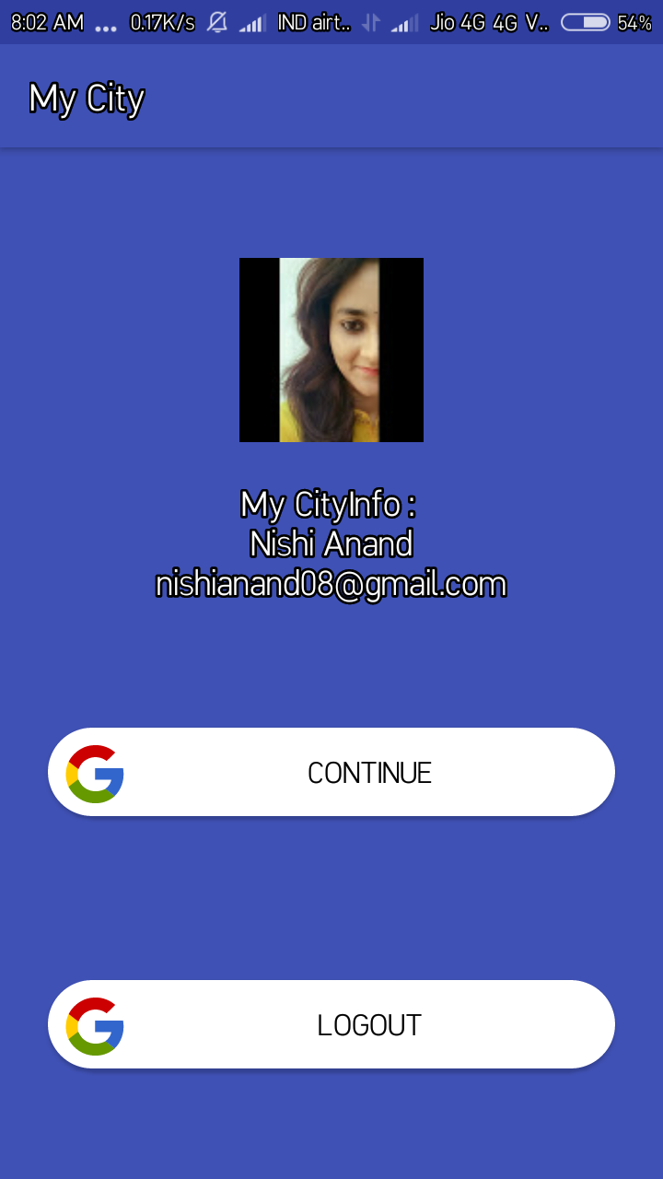
Login Panel

Slide 10
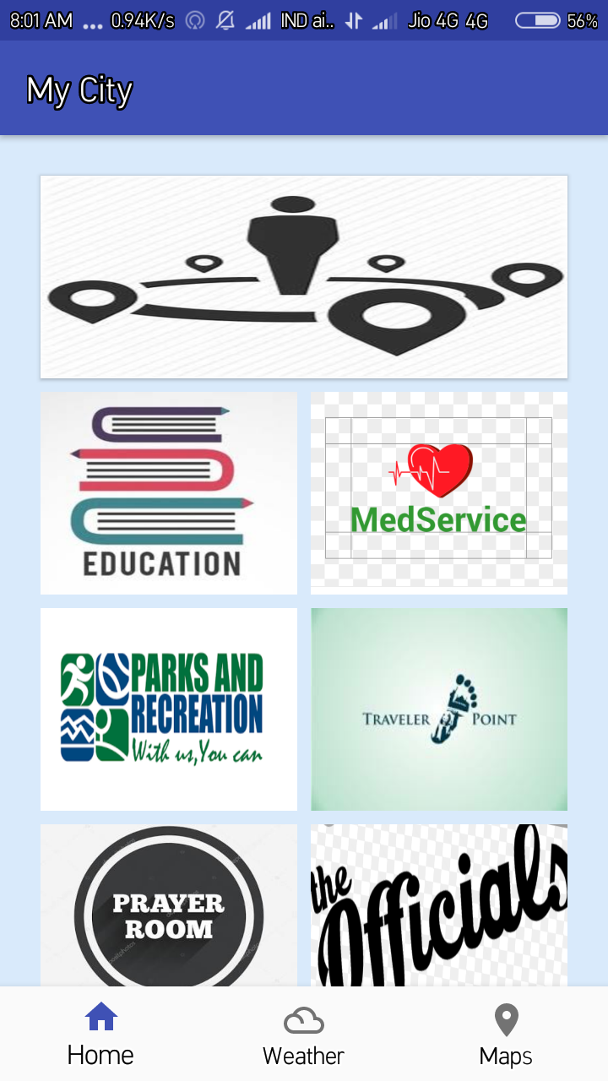
Menu

Slide 11
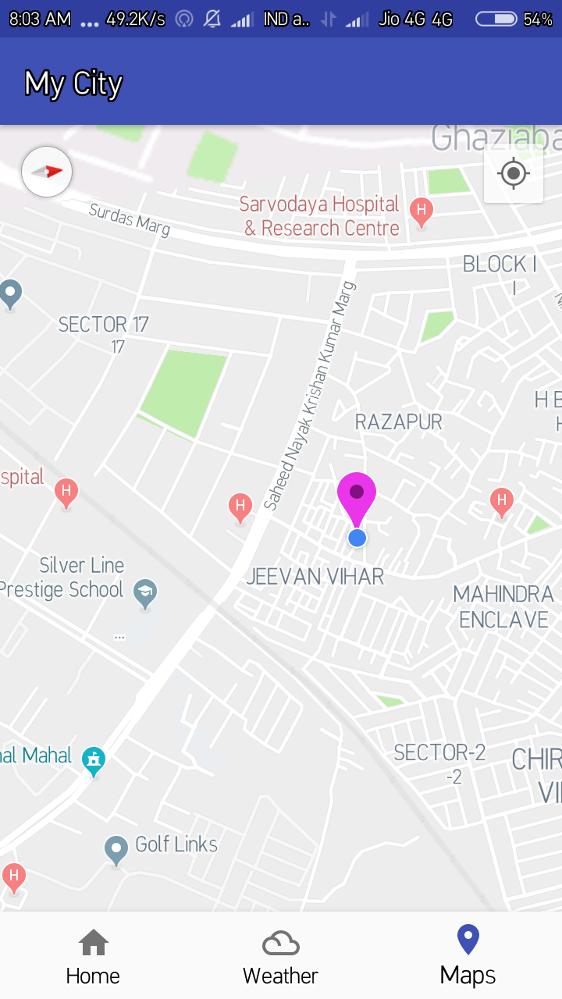
Current Location

Slide 12
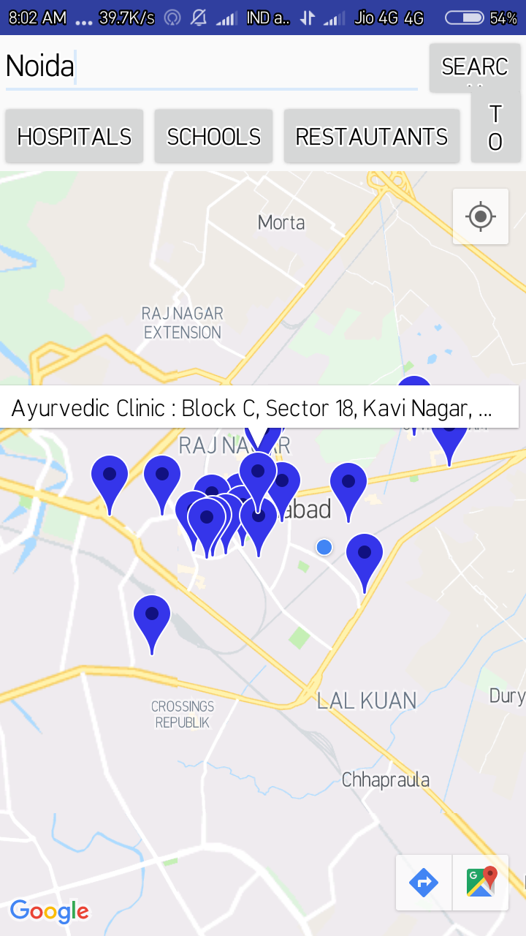
Nearby Locations

Slide 13
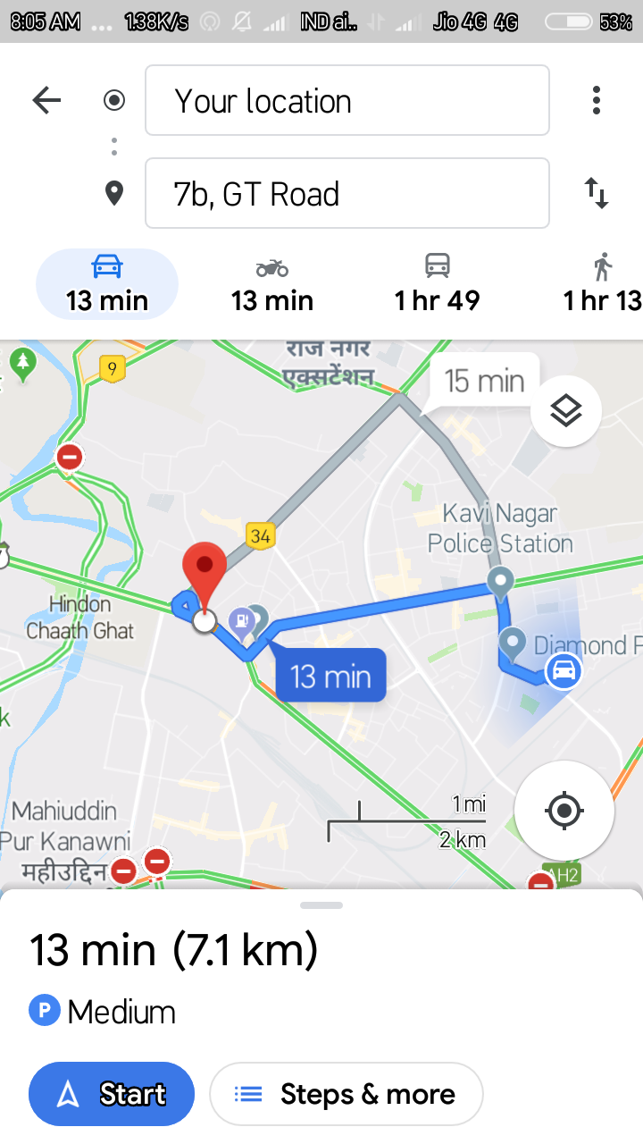
Routing On Google Map

Slide 14
Improvements
Weather
User Reviews
Hotel Bookings
Rental Properties
Travel Booking

Slide 15
Thank You

