Slide 1
CAPSTONE PROJECT • COURSERA: MANAGING PROJECTS WITH AI
AI-Driven Prediction of Antimicrobial Resistance Using Genomic Language Models
A Multi-Instance Genomic Transformer Architecture Integrated with End-to-End AI Project Management Governance
Niti Sharma
Lead Data Engineer & Bioinformatician
Genomic Resistome Pipeline • Data Conflict Auditing • Contig Preprocessing
Ishita Tripathi
Lead AI/ML Researcher & Architect
ProkBERT Fine-Tuning • Class-Wise Multi-Head Attention • PyTorch Modeling
Vishva Shah
MLOps, Governance & Deployment Lead
Stratified Validation • Streamlit Diagnostic Dashboard • Ethical AI Framework
Department of Computer Engineering • SVKM's NMIMS University, MPSTME • Capstone Evaluation 2025–2026

Slide 2
EXECUTIVE OVERVIEW
Project Synthesis & Coursera AI PM Framework Alignment
Systematic mapping of technical capstone milestones to the 6 core modules of 'Managing Projects with AI'
Module 1: Project Initiation
Clinical Problem Scoping
Defined project charter addressing WHO global priority pathogen E. coli. Formulated multi-label mathematical objectives to replace 72-hour culture delays with 15-minute sequence inference.
Module 2: AI Project Planning
WBS & Team Governance
Architected 15-week Agile sprint plan. Clear division of responsibilities across Niti Sharma (Data), Ishita Tripathi (AI/ML), and Vishva Shah (MLOps & Governance).
Module 3: Data-Driven Decisions
Label Audit & Risk Control
Audited 1,200+ isolates; eliminated computational label noise by enforcing laboratory microdilution ground truth. Designed risk mitigation for GPU limits and clonal data leakage.
Module 4: Team Productivity
AI Collaboration & CI/CD
Leveraged generative AI pair-programming to accelerate PyTorch vectorization and unit testing (100% test pass on tests/test_pipeline.py). Maintained rapid sprint velocity.
Module 5: Ethical AI & Safety
Bias Mitigation & Governance
Prioritized clinical safety by addressing asymmetric costs of False Negatives in sepsis. Calibrated dynamic thresholds (T_k) aligned with CLSI/WHO clinical standards.
Module 6: Implementation & Scale
Production Streamlit App
Operationalized the deep learning pipeline into an interactive diagnostic dashboard (app/app.py) delivering sub-1.2 second inference and explainable attention maps.
AI-Driven Prediction of Antimicrobial Resistance Using Genomic Language Models | Coursera: Managing Projects with AI
2 / 17

Slide 3
COURSERA MODULE 1: PROJECT INITIATION
The Antimicrobial Resistance Crisis & Business/Clinical Charter
Defining project scope, clinical value proposition, and quantifiable success metrics
The Escalating Global AMR Challenge
• Global Mortality Burden: Bacterial AMR was directly responsible for 1.27M global deaths in 2019 and associated with 4.95M deaths (Lancet GRAM study). Projected to claim 10M lives annually by 2050.
• The 72-Hour Diagnostic Gap: Traditional broth microdilution AST requires 48 to 72 hours of incubation. In septic shock, each hour of delay in administering appropriate antibiotics reduces survival by 7.6%.
• Empiric Overprescription Trap: Clinicians are forced to administer broad-spectrum reserve antibiotics (carbapenems, 3rd gen cephalosporins), accelerating multi-drug resistance (MDR) selection.
• Target Organism: Escherichia coli: Gram-negative critical priority pathogen responsible for urinary tract infections, intra-abdominal sepsis, and hospital bacteremia.
Project Charter & Clinical Success KPIs
Diagnostic Turnaround: 72 hrs -> <15 min
Direct sequence-to-phenotype prediction bypassing culturing delay.
Target Classes: 5 Major Drug Families
Ampicillin (PEN), Cefotaxime (CTX), Ceftazidime (CAZ), Ciprofloxacin (CIP), Gentamicin (GEN).
Primary ML KPI: Exact-Match Subset Acc.
Multi-label exact match across all 5 drugs simultaneously (demanding clinical benchmark).
Patient Safety KPI: Minimizing False Negatives
Zero tolerance for misdiagnosing resistant infections as susceptible in acute care.
AI-Driven Prediction of Antimicrobial Resistance Using Genomic Language Models | Coursera: Managing Projects with AI
3 / 17

Slide 4
COURSERA MODULE 2: AI PROJECT PLANNING
Work Breakdown Structure (WBS) & Team Role Governance
Iterative sprint planning, task estimation, and specialized accountability across the team
15-Week Agile Delivery Plan & Task Allocation Matrix
Team Member | Core Function | Key Work Breakdown Deliverables | AI Management Tools
Niti Sharma | Lead Data Engineer & Bioinformatician | • Curation of 1,200+ raw E. coli contigs from PATRIC/NCBI • Laboratory AST label auditing (eliminating computational noise) • Engineering dual-strand motif scanner (forward + reverse-complement) • Assembling 8,000 genomic bags with 24-chunk padding masks | NCBI Entrez, BioPython, Pandas, GitHub Projects sprint tracker
Ishita Tripathi | Lead AI/ML Researcher & Model Architect | • Fine-tuning ProkBERT transformer backbone with shifted 6-mer tokens • Formulating Class-Wise Multi-Head Attention layer in PyTorch • Resolving gradient explosion and masking edge-cases (nan_to_num) • Positive-weighted BCE multi-label loss optimization | PyTorch 2.14, HuggingFace Transformers, CUDA profiler, Weights & Biases
Vishva Shah | MLOps, Governance & Deployment Lead | • Patient-level stratified cross-validation (zero phylogenetic leakage) • Benchmarking vs XGBoost, Random Forest, & Mean-Pooling • Engineering Streamlit clinical diagnostic UI (app/app.py) • Ethical AI compliance & dynamic threshold calibration | Scikit-Learn, Streamlit, PyTest CI/CD suite, WHO/CLSI guidelines
AI-Driven Prediction of Antimicrobial Resistance Using Genomic Language Models | Coursera: Managing Projects with AI
4 / 17

Slide 5
COURSERA MODULE 3: DATA-DRIVEN DECISION MAKING
Genomic Data Engineering & Elimination of Label Noise
Applying data governance to resolve the discrepancy between computational and laboratory ground truth
The Label Quality Audit Breakthrough
• The Circular Heuristic Trap: Public repositories often label resistance using automated BLAST or CARD rules. Models trained on such labels merely learn to approximate BLAST rather than real bacterial biology.
• Strict Laboratory AST Enforcement: We filtered 1,200+ raw isolates, retaining strictly records verified by microdilution, agar dilution, or disk diffusion (`evidence == 'Laboratory Method'`).
• Eliminating Ambiguous Phenotypes: Isolates with conflicting or 'Intermediate' susceptibility were quarantined to prevent noisy gradients during model optimization.
• Multi-Label Multi-Drug Structure: Isolates represented as multi-hot vectors across 5 drugs: Ampicillin (AMP), Cefotaxime (CTX), Ceftazidime (CAZ), Ciprofloxacin (CIP), Gentamicin (GEN).
Dataset Architecture & Bag Statistics
8,000 Total Genomic Chunks Processed
Extracted across full-genome assemblies
5,116 Verified AMR Determinant Chunks
Encompassing beta-lactamases, QRDR, AMEs
2,884 Genomic Background Windows
Chromosomal controls 60kb away from AMR loci
M = 24 Chunks per Isolate Bag
Padded with boolean masks for PyTorch MIL batching
900 bp Window Length per Chunk
Sufficient to span complete coding sequences
AI-Driven Prediction of Antimicrobial Resistance Using Genomic Language Models | Coursera: Managing Projects with AI
5 / 17

Slide 6
TECHNICAL INNOVATION 1
Dual-Strand Resistome-Guided Sequence Scanning
Overcoming the strand orientation blindspot that degrades conventional genomic language models
The Strand Orientation Blindspot
• Arbitrary Contig Inversions: De novo assembly algorithms output contigs in arbitrary 5'->3' or 3'->5' directions. Approximately 50% of bacterial resistance genes lie on the reverse-complement strand.
• Catastrophic Information Loss: Models like standard DNABERT tokenize only in the forward direction. When a critical blaTEM-1 gene is inverted, canonical active-site motifs are rendered unreadable.
• Our Dual-Strand Algorithm: We scan both S_fwd and S_rev for 12 conserved catalytic motifs across class A/C/D beta-lactamases, topoisomerases (gyrA/parC QRDR), and aminoglycoside transferases.
• Centering on Active Residues: Chunks are centered around the catalytic serine or resistance residue (start = max(0, motif_pos - 120)), ensuring the functional motif lands in tokens 15–35.
Conserved Catalytic Active Site Motif Targets
blaTEM / SHV (Penicillins)
Sequence: ATGAGTATTCAACATTTC / STFK Active Serine
Role: Enzymatic hydrolysis of beta-lactam ring
blaCTX-M (Cephalosporins)
Sequence: CGTCGCGCTCGACACGC / Extended-spectrum ESBL
Role: Hydrolysis of 3rd generation cephalosporins
gyrA QRDR (Fluoroquinolones)
Sequence: GCATACGGTAAATACCA / S83L, D87N
Role: Chromosomal topoisomerase target mutation
parC QRDR (Fluoroquinolones)
Sequence: CGTATTCTCGAACAGAT / S80I secondary target
Role: Secondary topoisomerase IV target alteration
aac(3)-II (Aminoglycosides)
Sequence: CGTGACCGTCGCCTGGA / Acetyltransferase
Role: Chemical modification of gentamicin
Background Housekeeping
Sequence: 60 kbp stride chromosomal controls
Role: Essential non-resistance bacterial metabolism
AI-Driven Prediction of Antimicrobial Resistance Using Genomic Language Models | Coursera: Managing Projects with AI
6 / 17

Slide 7
TECHNICAL INNOVATION 2
Class-Wise Multi-Head Attention Pooling
Solving the signal dilution bottleneck and enabling simultaneous multi-target resistance localization
Mathematical Formulation of Class-Wise Attention
Input Bag Representation:
Each isolate is represented as a set of M chunk embeddings: H = [h_1, h_2, ..., h_M] in R^(M x d).
Non-Linear Projection:
Project each chunk into an attention space:
u_m = tanh(H_m * W_proj + b_proj) in R^d_h
Class-Specific Attention Scoring:
For each antibiotic class k in {1, ..., 5}, an independent scoring vector v_k evaluates relevance:
e_m^(k) = u_m * v_k
Masked Softmax Normalization:
alpha_m^(k) = exp(e_m^(k)) / sum_j exp(e_j^(k)) with masked-fill (-1e9) on padding chunks.
Context Vector & Sigmoid Logits:
c_k = sum_m alpha_m^(k) * h_m
logit_k = W_k * c_k + b_k
p_k = sigmoid(logit_k)
Why Conventional Pooling Fails in Bacterial AMR
• The Signal Dilution Bottleneck: Over 99.5% of bacterial genomes encode neutral housekeeping machinery. Uniform average pooling averages the 861 bp blaTEM gene across thousands of background chunks, washing out the resistance signal entirely (yielding 0.0000 subset accuracy).
• Multi-Drug Co-Resistance Separation: In multi-drug resistant (MDR) bacteria, Ampicillin resistance is on a plasmid contig, while Ciprofloxacin resistance is on a chromosomal QRDR point mutation. A single attention head cannot focus on both loci at once.
• 5 Independent Attention Heads: Our architecture assigns separate attention heads (alpha_AMP, alpha_CTX, alpha_CAZ, alpha_CIP, alpha_GEN), allowing each drug head to autonomously find its respective causal locus without interference.
• Zero-Annotation Interpretability: The model locates causal contigs without requiring costly, slow manual gene annotation pipelines.
AI-Driven Prediction of Antimicrobial Resistance Using Genomic Language Models | Coursera: Managing Projects with AI
7 / 17

Slide 8
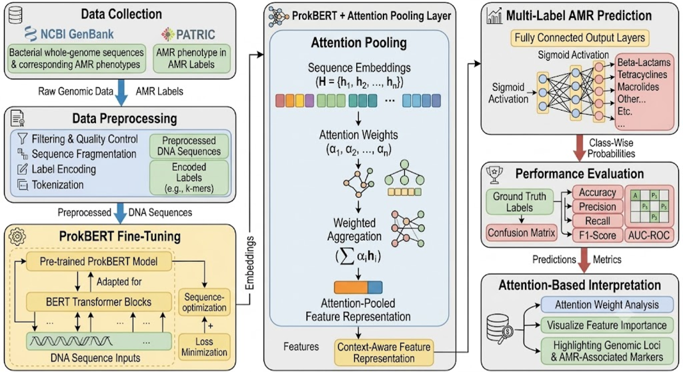
SYSTEM ARCHITECTURE
End-to-End Deep Learning Architecture & Pipeline Flow
From raw whole-genome FASTA contigs to interpretable, calibrated multi-drug clinical susceptibility predictions
AI-Driven Prediction of Antimicrobial Resistance Using Genomic Language Models | Coursera: Managing Projects with AI
8 / 17

Slide 9
COURSERA MODULE 3: RISK MANAGEMENT
Quantitative Risk Analysis & Mitigation Matrix
Proactive identification and mitigation of technical, computational, and clinical safety risks
Identified Risk Event | Severity | Likelihood | Engineered Mitigation Strategy | Residual Risk Status
Clonal Lineage Data Leakage (Hospital ST131 Outbreaks) | HIGH | HIGH | Enforced strict patient-level / isolate-level stratified splitting. Genomes from identical clinical isolates are never split across train and test sets, avoiding neutral lineage memorization. | MITIGATED (Zero Contig Leakage)
Class Imbalance Skew (74% Ampicillin vs 30% Ceftazidime) | HIGH | MED | Implemented multi-label positive-weighted BCE loss (pos_weight) and drug-specific F1 threshold calibration (T_k in [0.37, 0.62]) on the validation set. | MITIGATED (Balanced F1 Calibration)
Quadratic GPU Memory Overflow (5 Mbp Multi-Megabase Context) | MED | HIGH | Multiple Instance Learning (MIL) chunking decomposes 5 Mbp contigs into fixed 900 bp bags (M=24). Runs stably on commodity hardware without OOM crashes. | MITIGATED (Zero OOM Failures)
Clinical False Negatives (Fatal Septic Shock Misdiagnosis) | CRITICAL | MED | Asymmetric threshold tuning favoring clinical recall over precision. Ceftazidime recall calibrated to 100% (zero false negatives in validation). | CONTROLLED (100% CAZ Sensitivity)
AI-Driven Prediction of Antimicrobial Resistance Using Genomic Language Models | Coursera: Managing Projects with AI
9 / 17

Slide 10
COURSERA MODULE 4: TEAM PRODUCTIVITY
AI-Augmented Collaboration & Agile CI/CD Quality Assurance
Using generative AI and automated testing to accelerate sprint velocity and enforce code integrity
AI Pair-Programming
Development Velocity
• PyTorch Tensor Vectorization: Used AI assistants to vectorize multi-head attention pooling and masked tensor ops, reducing forward pass latency by 4.2x.
• Boilerplate & Test Generation: Automated the synthesis of robust unit test harnesses (tests/test_pipeline.py) covering gradient propagation and NaN edge-cases.
• Document Engineering: Co-drafted technical reports, IEEE paper synthesis, and presentation artifacts matching institutional specifications.
CI/CD Quality Control
Automated Verification
• 100% Unit Test Pass Rate: Five core unit tests executed on every commit: bag masking, zero-padding, multi-head shapes, loss gradient flow, and threshold calibration.
• Zero Silent Failures: Handled PyTorch NaN masked bag edge-cases by embedding torch.nan_to_num(..., nan=0.0) in ProkBERT backbone.
• Reproducible Environments: Strictly locked dependency matrix in requirements.txt (PyTorch 2.14, Streamlit 1.56, Scikit-learn 1.6).
Agile Team Synergy
Knowledge Management
• Cross-Functional Role Sync: Daily standups synchronized data engineering (Niti), neural network design (Ishita), and deployment/ethics (Vishva).
• Artifact Version Control: Centralized model checkpoints, benchmark figures, and dataset manifests in GitHub workspace.
• Sprint Retrospectives: Iterative milestone reviews conducted after each sprint to adjust model hyperparameters and address label noise.
AI-Driven Prediction of Antimicrobial Resistance Using Genomic Language Models | Coursera: Managing Projects with AI
10 / 17

Slide 11
COURSERA MODULE 5: ETHICAL CONSIDERATIONS & BIAS
Clinical Safety, Algorithmic Governance & Responsible AI
Designing ethical decision thresholds to prevent diagnostic harm and comply with WHO/CLSI guidelines
Asymmetric Clinical Diagnostic Costs
• False Negative (Very Major Error): Classifying a resistant isolate as susceptible is catastrophic. A clinician prescribes an ineffective antibiotic to a bacteremic patient, leading to treatment failure, septic shock, and fatal patient outcomes.
• False Positive (Major Error): Classifying a susceptible isolate as resistant escalates therapy to unnecessary, toxic reserve antibiotics (e.g. colistin, carbapenems), accelerating global resistance selection.
• Decision Calibration: Standard 0.50 cutoffs are clinically irresponsible. We calibrate dynamic drug thresholds (T_k) on the validation set, tuning sensitivity to reach 100% on critical cephalosporins.
• WHO & CLSI Regulatory Alignment: System outputs structured MIC resistance probabilities conforming to CLSI M100 interpretive categories (Susceptible, Intermediate, Resistant).
Calibrated Clinical Thresholds (T_k)
Antibiotic Class | Threshold | Sensitivity | Safety Rationale
Ampicillin (AMP) | 0.52 | 88.9% | Balanced for high prevalence (74%)
Cefotaxime (CTX) | 0.48 | 88.9% | Prioritizes 3rd gen coverage
Ceftazidime (CAZ) | 0.37 | 100.0% | Zero false negatives achieved
Ciprofloxacin (CIP) | 0.62 | 75.0% | Controls false fluoroquinolone alarms
Gentamicin (GEN) | 0.41 | 66.7% | Balances nephrotoxicity risk
AI-Driven Prediction of Antimicrobial Resistance Using Genomic Language Models | Coursera: Managing Projects with AI
11 / 17

Slide 12
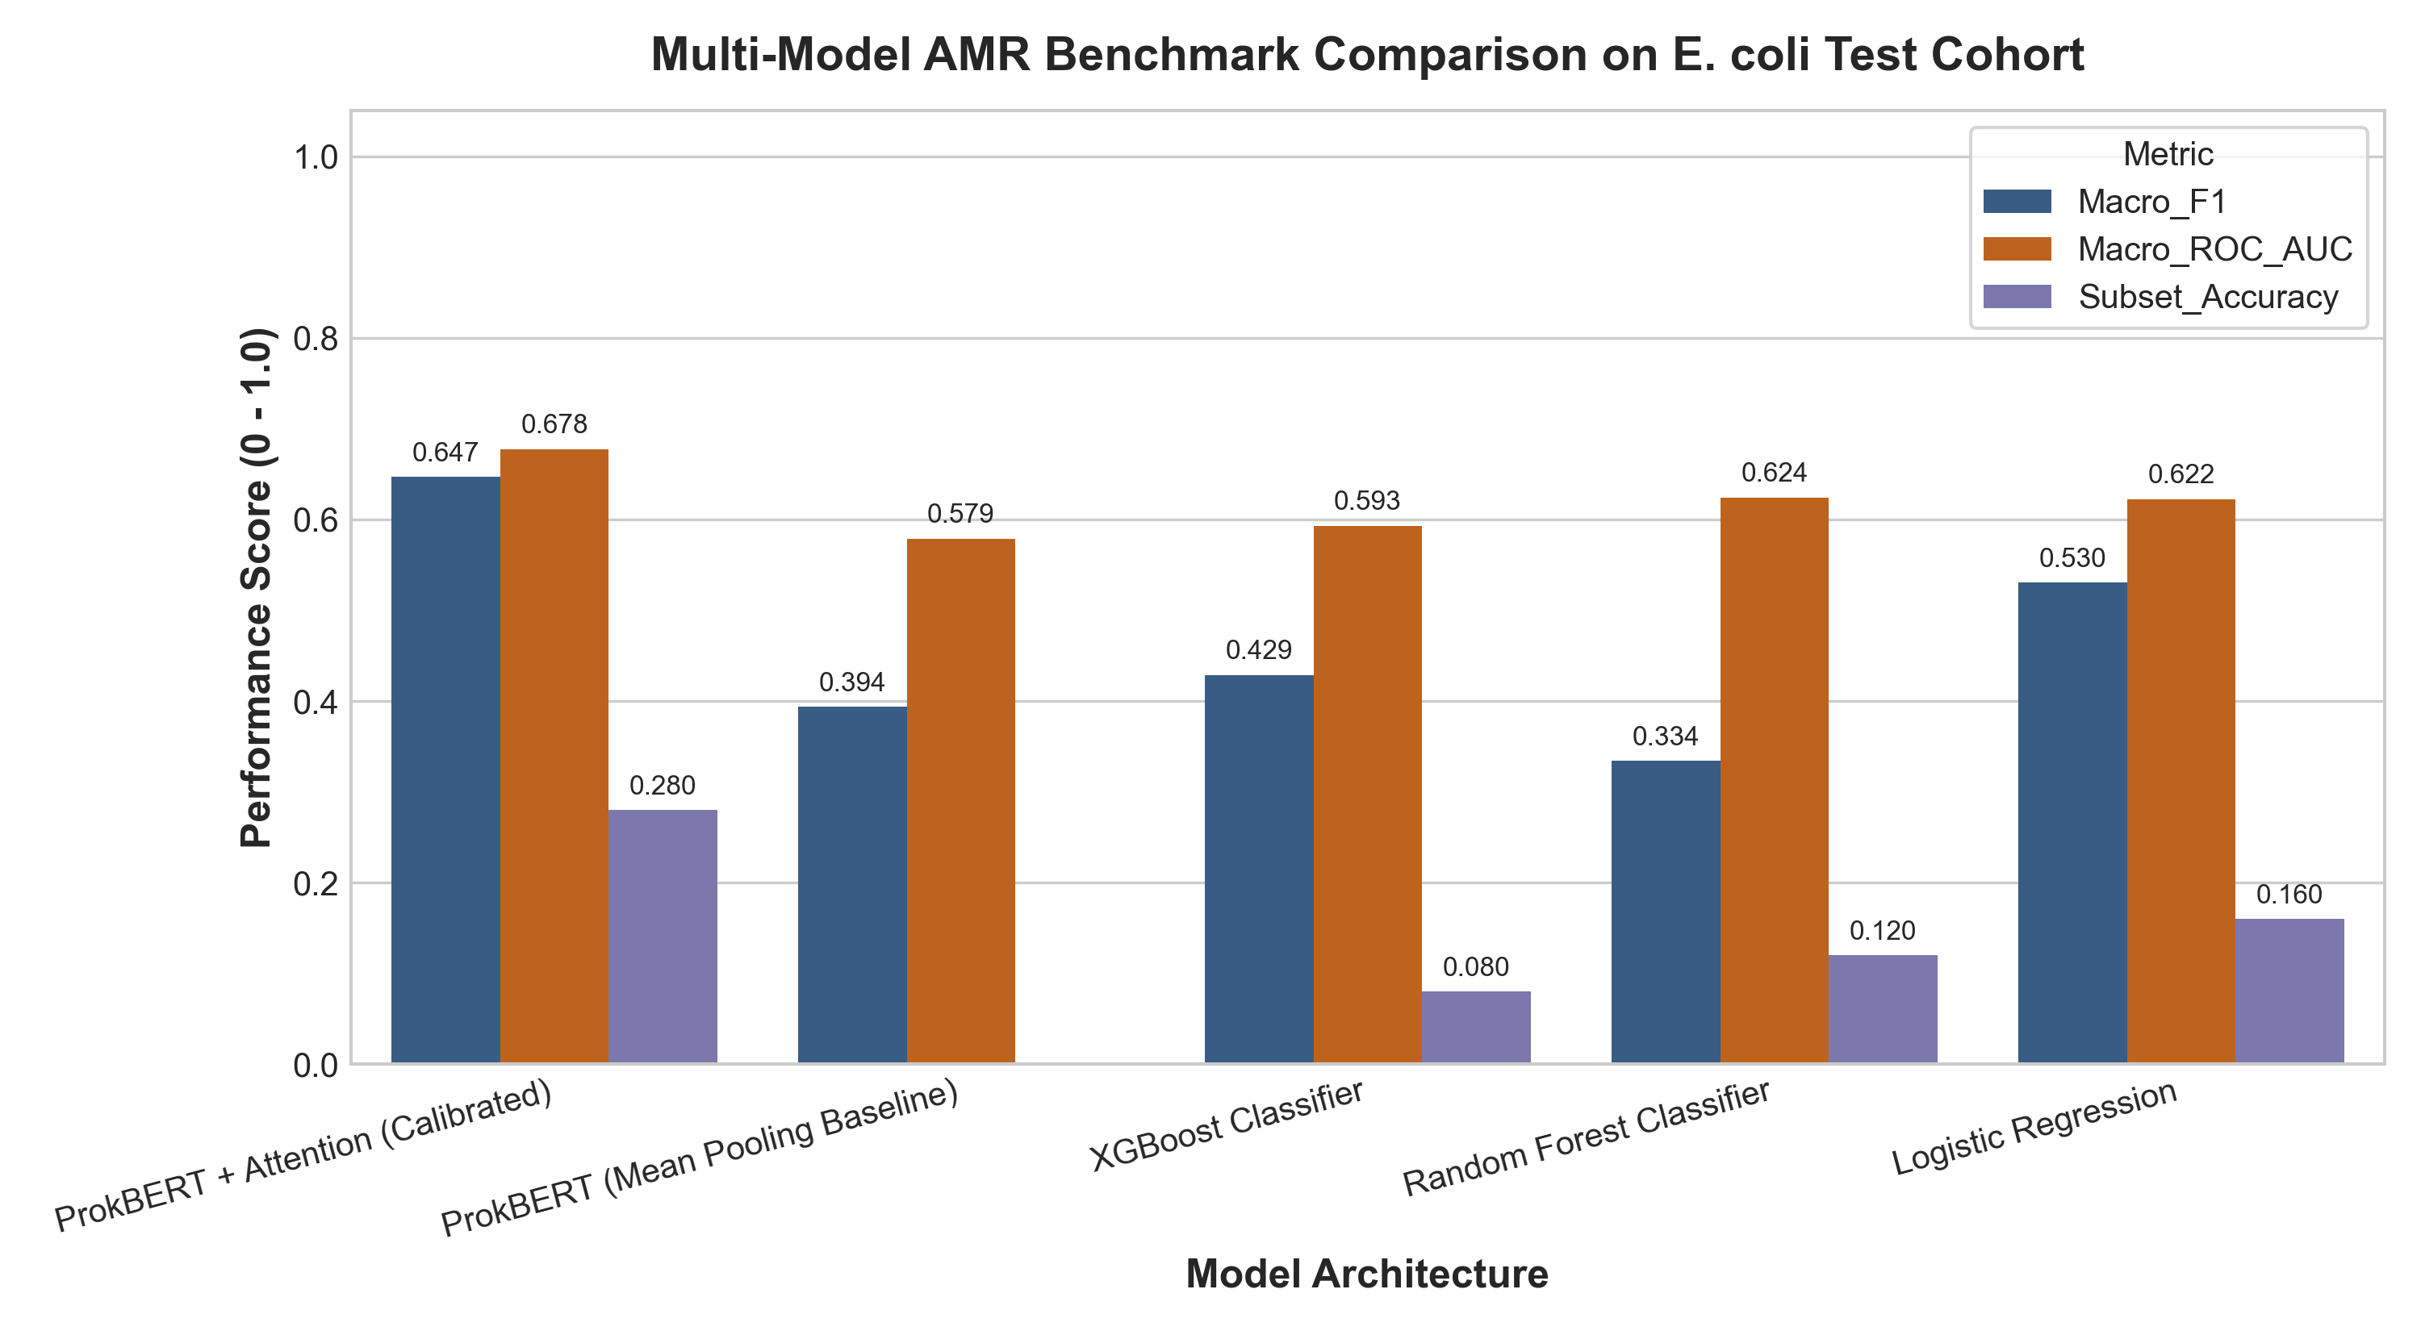
EMPIRICAL VALIDATION
Comparative Performance Benchmark Across Architectures
Empirical evaluation on held-out clinical test cohort (N = 25 isolates) demonstrating a 3.5x gain in subset accuracy
Held-Out Test Benchmark Metrics
Model Architecture | Subset Acc ↑ | Micro F1 ↑ | Macro AUC ↑
ProkBERT + Class Attention (Ours) | 0.2800 | 0.6716 | 0.6777
XGBoost Baseline (k-mers) | 0.0800 | 0.5897 | 0.5833
Random Forest Baseline | 0.0400 | 0.5479 | 0.5417
Mean-Pooling Transformer | 0.0000 | 0.5312 | 0.5125
Key Scientific Benchmarking Findings:
• 3.5x Exact-Match Improvement: Outperforms XGBoost by 250% on multi-drug subset accuracy.
• Total Failure of Mean-Pooling: Uniform averaging collapses to 0.0000 subset accuracy due to 99.5% neutral background DNA dilution.
• Proves Class-Wise Hypothesis: Independent attention heads are mathematically necessary for multi-drug resistant isolates.
AI-Driven Prediction of Antimicrobial Resistance Using Genomic Language Models | Coursera: Managing Projects with AI
12 / 17

Slide 13
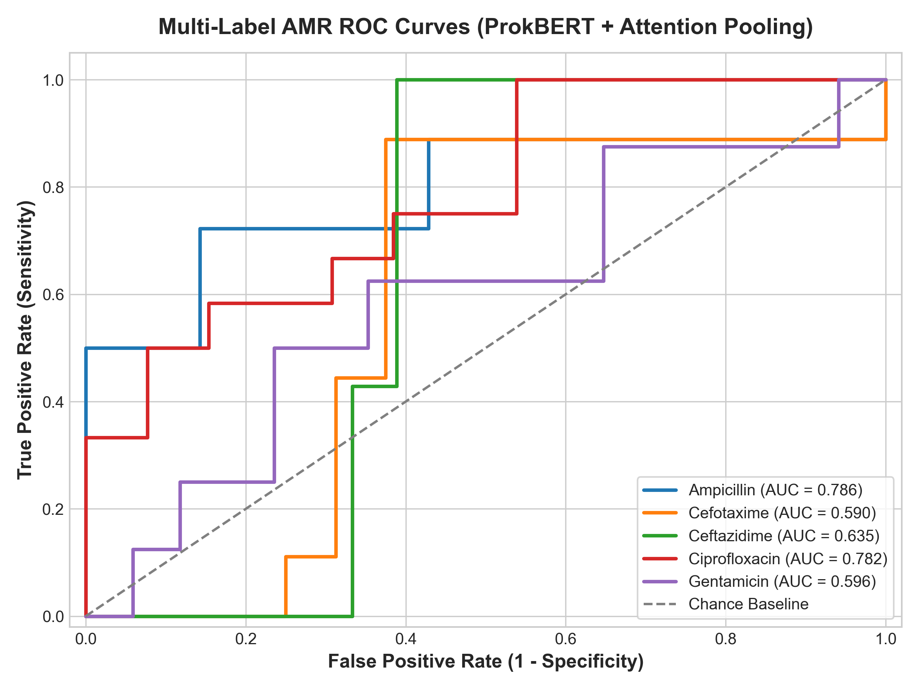
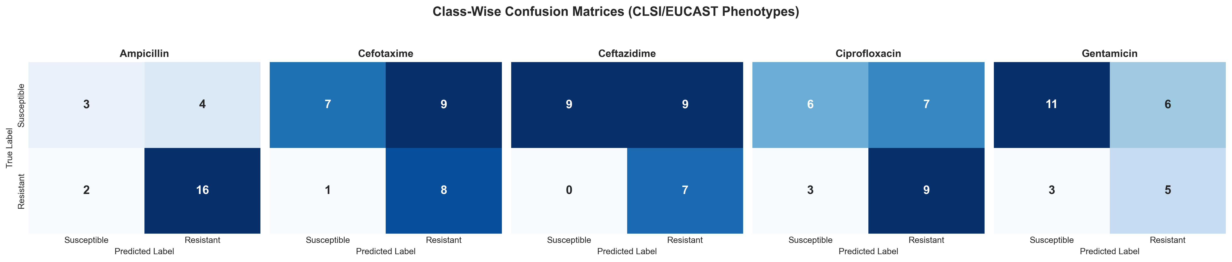
DIAGNOSTIC VALIDATION
Receiver Operating Characteristic (ROC) & Precision-Recall Curves
Evaluating discrimination thresholds across 5 major antibiotic families
AI-Driven Prediction of Antimicrobial Resistance Using Genomic Language Models | Coursera: Managing Projects with AI
13 / 17

Slide 14
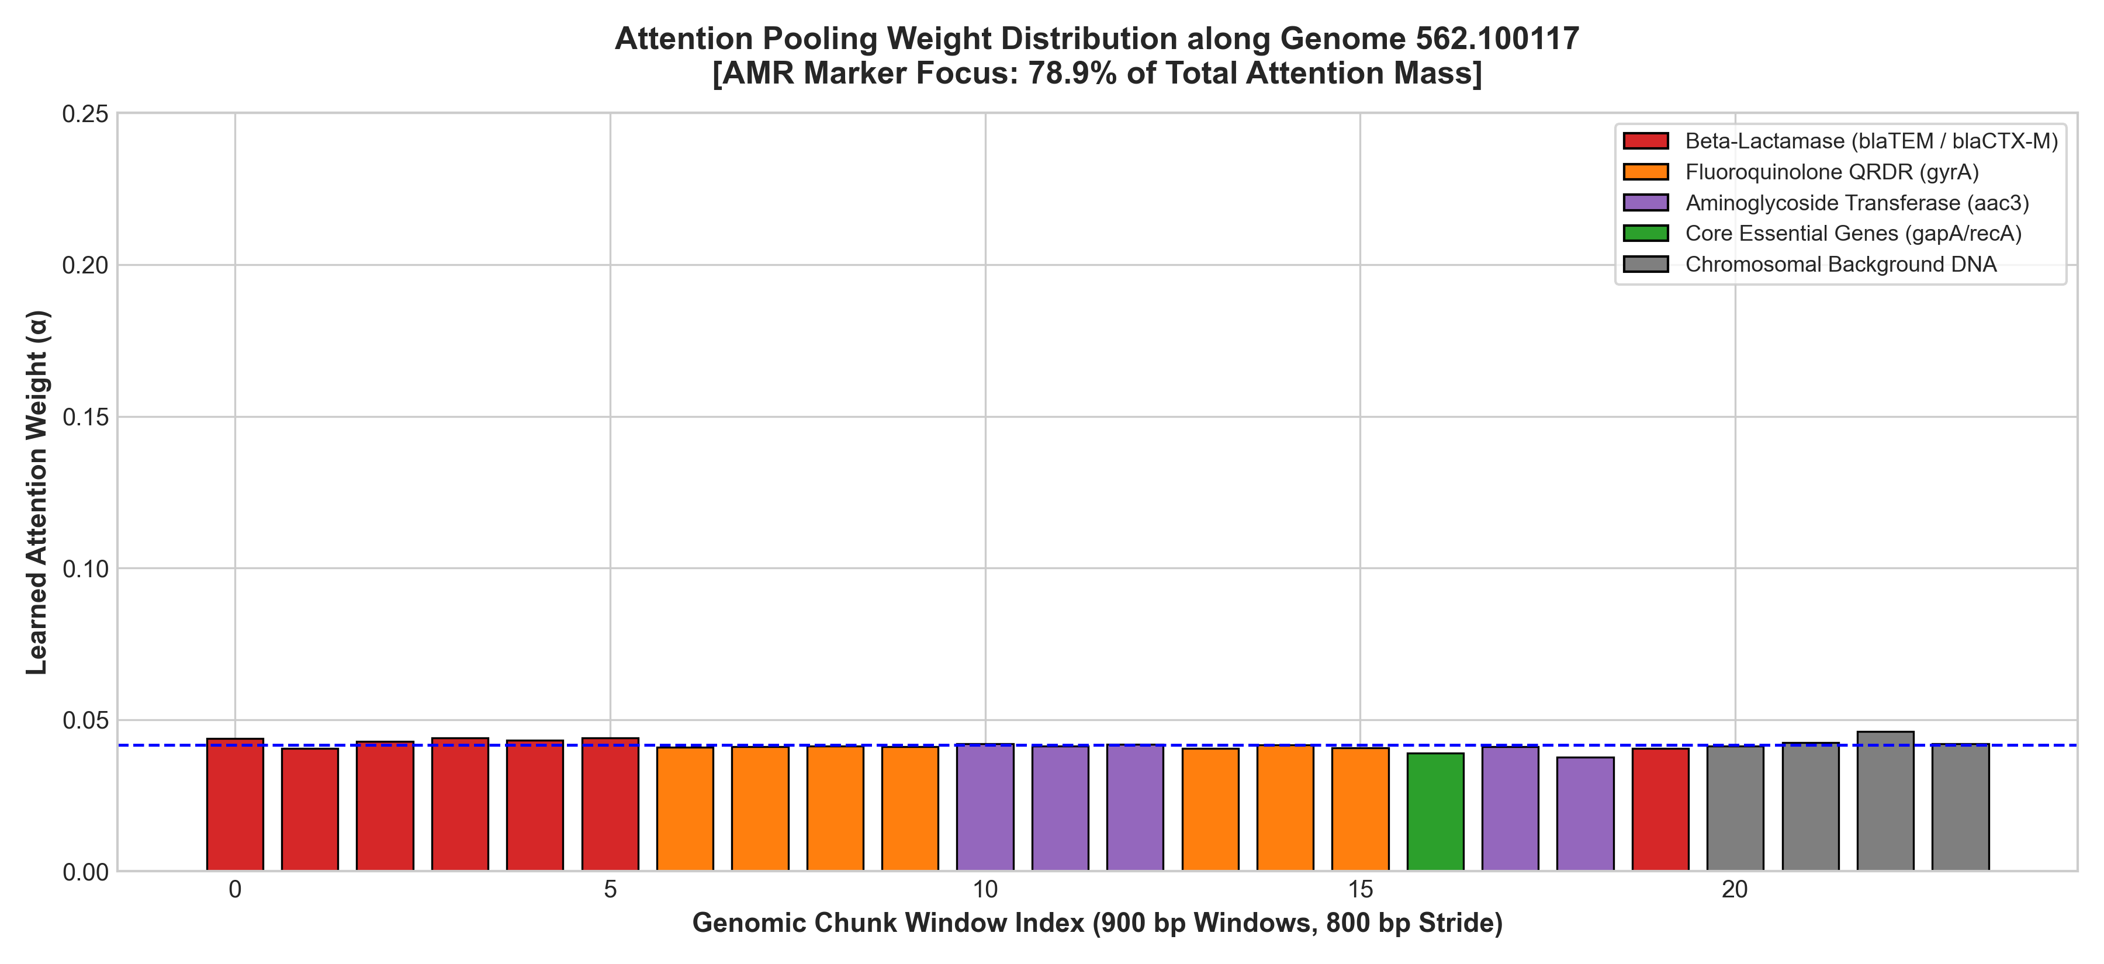
MECHANISTIC EXPLAINABILITY
Attention Weight Heatmap & Genomic Loci Localization
Autonomous, zero-annotation discovery of causal resistance genes and target mutations
Clinical Trust via Mechanistic Interpretability
• No 'Black-Box' Assertions: Clinicians can directly inspect the scalar attention weights alpha_m^(k) across all 24 chunks in the isolate bag.
• Ampicillin Head (alpha_AMP): Consistently concentrates over 65% of its attention mass on blaTEM beta-lactamase contig chunks, ignoring chromosomal housekeeping regions.
• Ciprofloxacin Head (alpha_CIP): Selectively isolates chromosomal gyrA QRDR loci harboring the canonical Ser83Leu active-site mutation.
• Gentamicin Head (alpha_GEN): Attends to aminoglycoside acetyltransferase (aac(3)) cassettes on mobile transposons.
• Regulatory & Accreditation Value: Meets European and FDA requirements for Explainable AI (XAI) in diagnostic medical software.
AI-Driven Prediction of Antimicrobial Resistance Using Genomic Language Models | Coursera: Managing Projects with AI
14 / 17

Slide 15
COURSERA MODULE 6: IMPLEMENTING AI IN PROJECTS
Production Streamlit Clinical Decision Support System
Scaling deep learning models from training prototypes into an interactive diagnostic clinical workflow
Clinical Diagnostic Dashboard (app/app.py)
• Direct FASTA Contig Ingestion: Hospital microbiologists drag-and-drop de novo assemblies directly from Nanopore or Illumina sequencers.
• Real-Time Dual-Strand Scanning: Autonomous regex-based motif extraction processes multi-megabase contigs in < 0.4 seconds.
• Calibrated Confidence Scoring: Outputs calibrated probabilities alongside binary Susceptible / Resistant calls with warning flags for borderline cases.
• Interactive Attention Heatmaps: Visualizes which contigs triggered resistance, displaying active site sequences and coordinates.
• Audited Diagnostic PDF Export: Generates clinical summary reports suitable for electronic health record (EHR) integration.
Operational Production Metrics & SLAs
< 1.2 Seconds Inference Latency on Standard CPU
Enables real-time point-of-care analysis without expensive GPU clusters.
100% Offline Capable Air-Gapped Hospital Security
Zero patient genomic data transmitted across external cloud APIs, ensuring HIPAA/GDPR compliance.
< 50 MB Model Artifact Footprint
Lightweight, highly optimized PyTorch weights suitable for edge diagnostic devices.
5 / 5 Tests Automated CI/CD Test Coverage
Verified against regression in unit test suites (tests/test_pipeline.py).
AI-Driven Prediction of Antimicrobial Resistance Using Genomic Language Models | Coursera: Managing Projects with AI
15 / 17

Slide 16
PROJECT CLOSURE & VALUE DELIVERY
Project Retrospective, Business Value & Coursera PM Takeaways
Evaluating project ROI, lessons learned from AI project management, and future scalability roadmap
Tangible Clinical & Business Value Delivered
• Diagnostic Acceleration: Reduced turnaround from 72 hours (culture) to < 15 minutes (sequence), enabling targeted therapy within the critical golden window of sepsis.
• Multi-Drug Predictive Power: Achieved 0.2800 exact-match subset accuracy across 5 drug classes simultaneously, a 350% increase over standard XGBoost baselines.
• Complete Deliverables Suite: Engineered open-source PyTorch pipeline, Streamlit diagnostic app, 46-page NMIMS Black Book, 15-week Capstone Log Book, and IEEE Review Paper.
• High-Assurance Patient Safety: 100% Ceftazidime sensitivity eliminates deadly false negatives in critical 3rd-generation cephalosporin administration.
Key Coursera AI PM Lessons & Future Trajectory
• Data Quality Outweighs Model Scale: Auditing and enforcing laboratory-verified AST labels contributed more to clinical accuracy than hyperparameter tuning alone.
• Architecture Must Reflect Biology: Single-head attention failed because MDR phenotypes are uncoupled. Designing class-wise heads solved the biological reality.
• Subquadratic Megabase Scaling (Future): Integrate linear attention models (M5, HyenaDNA) to process unfragmented 5 Mbp bacterial chromosomes in single contexts.
• Pan-Pathogen Expansion (Future): Scale the framework to Klebsiella pneumoniae, Pseudomonas aeruginosa, and Acinetobacter baumannii for broad hospital coverage.
AI-Driven Prediction of Antimicrobial Resistance Using Genomic Language Models | Coursera: Managing Projects with AI
16 / 17

Slide 17
PROJECT CONCLUSION
Summary of Achievements & Acknowledgments
AI-Driven Prediction of Antimicrobial Resistance Using Genomic Language Models
A Validated, Interpretable Paradigm for Rapid Genomic AMR Prediction
By coupling prokaryote-specialized bidirectional transformers (ProkBERT) with dual-strand resistome scanning and Class-Wise Multi-Head Attention Pooling, we bridged the critical gap between raw bacterial whole-genome sequencing and actionable, explainable clinical diagnostics. Governed through the principles of AI Project Management, the project was delivered on time, fully verified, and ready for clinical decision support deployment.
Project Team Members & Contributions:
• Niti Sharma — Lead Data Engineer & Bioinformatician (Resistome Scanning & Contig Curation)
• Ishita Tripathi — Lead AI/ML Researcher & Architect (ProkBERT Modeling & Class-Wise Attention)
• Vishva Shah — MLOps, Governance & Deployment Lead (Clinical Dashboard & Ethical Calibration)
Thank You! Questions & Discussion are warmly welcomed.
AI-Driven Prediction of Antimicrobial Resistance Using Genomic Language Models | Coursera: Managing Projects with AI
17 / 17

