Slide 1
CSS
Beangate IT Solutions Pvt.Ltd.
Bhopal (M.P)

Slide 2
What is CSS?
CSS stands for Cascading Style Sheets.
CSS describes how HTML elements are to be displayed on screen, paper, or in other media
CSS saves a lot of work. It can control the layout of multiple web pages all at once

Slide 3
Three Ways to Insert CSS
External style sheet
<link rel="stylesheet" type="text/css" href="mystyle.css">
Internal style sheet
Inline style

Slide 4
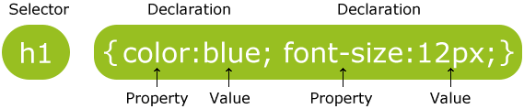
CSS Syntax
CSS Comments
p { color: red; /* This is a single-line comment */ text-align: center; }

Slide 5
CSS Selectors
CSS selectors are used to "find" (or select) HTML elements based on their element name, id, class, attribute, and more.
Types of Selectors
The element Selector
The id Selector
The class Selector
Grouping Selectors

Slide 6
CSS Background Properties:
background-color
background-image
background-image: url("paper.gif");
background-repeat
background-repeat: repeat-x;
background-attachment
background-attachment: scroll|fixed|local|initial|inherit;
background-position
left top ,left center, left bottom, right top, right center, right bottom center top, center center, center bottom

Slide 7
CSS Border
dotted - Defines a dotted border
dashed - Defines a dashed border
solid - Defines a solid border
double - Defines a double border
groove - Defines a 3D grooved border. The effect depends on the border-color value
ridge - Defines a 3D ridged border. The effect depends on the border-color value
inset - Defines a 3D inset border. The effect depends on the border-color value
outset - Defines a 3D outset border. The effect depends on the border-color value
none - Defines no border
hidden - Defines a hidden border

Slide 8
Border - Shorthand Property
border-width
border-style (required)
border-color

Slide 9
CSS Margins
margin-top
margin-right
margin-bottom
margin-left

Slide 10
Tables
border-collapse: separate; border-spacing:10px;

Slide 11
CSS Padding
padding-top
padding-right
padding-bottom
padding-left

Slide 12
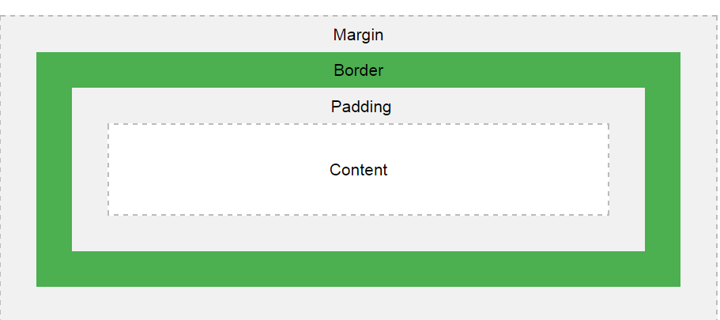
The CSS Box Model
All HTML elements can be considered as boxes. In CSS, the term "box model" is used when talking about design and layout.
The CSS box model is essentially a box that wraps around every HTML element. It consists of: margins, borders, padding, and the actual content. The image below illustrates the box model:
Notes:
Content - The content of the box, where text and images appear
Padding - Clears an area around the content. The padding is transparent
Border - A border that goes around the padding and content
Margin - Clears an area outside the border. The margin is transparent

Slide 13
CSS Height and Width
height
max-height
min-height
min-width
width

Slide 14
Color Values
In HTML, colors can also be specified using RGB values, HEX values, HSL values, RGBA values, and HSLA values:
RGB Value rgb(red, green, blue)
Each parameter (red, green, and blue) defines the intensity of the color between 0 and 255.
HEX Value #rrggbb
Where rr (red), gg (green) and bb (blue) are hexadecimal values between 00 and ff (same as decimal 0-255).

Slide 15
HSL Value hsl(hue, saturation, lightness)
Hue is a degree on the color wheel from 0 to 360. 0 is red, 120 is green, and 240 is blue.
Saturation is a percentage value, 0% means a shade of gray, and 100% is the full color.
Lightness is also a percentage, 0% is black, 50% is neither light or dark, 100% is white
Alpha
It specifies the opacity for a color.
The alpha parameter is a number between 0.0 (fully transparent) and 1.0 (not transparent at all):
rgba(red, green, blue, alpha)
hsla(hue, saturation, lightness, alpha)

Slide 16
Fonts
font-size:medium|xx-small|x-small|small|large|x-large|xx-large|smaller|larger|length|initial|inherit;
font-style: normal|italic|oblique|initial|inherit;
font-variant: normal|small-caps|initial|inherit;
Text
color: color|initial|inherit;
direction: ltr|rtl|initial|inherit;
letter-spacing: normal|length|initial|inherit;
line-height: normal|number|length|initial|inherit;(No Negative val.)
text-decoration: none|underline|overline|line-through|initial|inherit;
text-transform: none|capitalize|uppercase|lowercase|initial|inherit;
text-indent: length|initial|inherit;

Slide 17
CSS Display
The display property is the most important CSS property for controlling layout.
Every HTML element has a default display value depending on what type of element it is. The default display value for most elements is block or inline.
Properties------- display | visibility
display: inline | block | none | inline-block | and many more…..
visibility: visible | hidden | collapse | initial | inherit;

Slide 18
CSS Overflow
The CSS overflow property controls what happens to content that is too big to fit into an area.
The overflow property specifies whether to clip content or to add scrollbars when the content of an element is too big to fit in a specified area.
overflow: visible|hidden|scroll|auto|initial|inherit;
overflow-x: visible|hidden|scroll|auto|initial|inherit;
overflow-y: visible|hidden|scroll|auto|initial|inherit;

Slide 19
CSS Layout - Float and Clear
Float: This property specifies how an element should float.
float: none|left|right|initial|inherit;
Clear: The clear property lets specifies what elements can float beside the cleared element and on which side.
The most common way to use the clear property is after you have used a float property on an element.
clear: none|left|right|both|initial|inherit;

Slide 20
CSS Position
position: static | absolute | fixed | relative | sticky | initial | inherit;
Example ….
element {
position:sticky;
left:20px;
top:12px;
bottom:15px;
right:15px;
}

Slide 21
CSS Animations
An animation lets an element gradually change from one style to another.
You can change as many CSS properties you want, as many times you want.
To use CSS animation, you must first specify some keyframes for the animation.
Keyframes hold what styles the element will have at certain times.

Slide 22
Basic Steps of Animation
Step 1: Define animation name in a element.
div{ animation-name : demo }
Step 2: Define animation duration for that particular element in which animation applied.
Note: The animation-duration property defines how long time an animation should take to complete. If the animation-duration property is not specified, no animation will occur, because the default value is 0s (0 seconds).
Step 3: Start coding in @keyframes.

Slide 23
The @keyframes Rule
When you specify CSS styles inside the @keyframes rule, the animation will gradually change from the current style to the new style at certain times.
To get an animation to work, you must bind the animation to an element.
@keyframes example { from {background-color: red;} to {background-color: yellow;} }
The keywords "from" and "to" (which represents 0% (start) and 100% (complete)).

Slide 24
Delay in Animation
We can change both the background-color and the position of the element of the animation.
The animation-delay property specifies a delay for the start of an animation. It defines in animated element ‘s properties.
e.g. animation-delay:4s;
Note : Negative values are also allowed. If using negative values, the animation will start as if it had already been playing for N seconds.
e.g. animation-delay: -2s;

Slide 25
How Many Times an Animation Should Run
The animation-iteration-count property specifies the number of times an animation should run.
e.g. animation-iteration-count: 2;
animation-iteration-count: number | infinite | initial | inherit;
animation-direction
The animation-direction property can have the following values:
normal - The animation is played as normal (forwards). This is default
reverse - The animation is played in reverse direction (backwards)
alternate - The animation is played forwards first, then backwards
alternate-reverse - The animation is played backwards first, then forwards
e.g. animation-direction: reverse;

Slide 26
animation-timing-function
The animation-timing-function property specifies the speed curve of the animation.
ease - Specifies an animation with a slow start, then fast, then end slowly (this is default)
linear - Specifies an animation with the same speed from start to end
ease-in - Specifies an animation with a slow start
ease-out - Specifies an animation with a slow end
ease-in-out - Specifies an animation with a slow start and end
e.g. animation-timing-function: ease;

Slide 27
Animation Shorthand Property
animation-name: animation-duration: animation-timing-function: animation-delay: animation-iteration-count: animation-direction:
e.g. animation: example 5s linear 2s infinite alternate;

