Slide 1
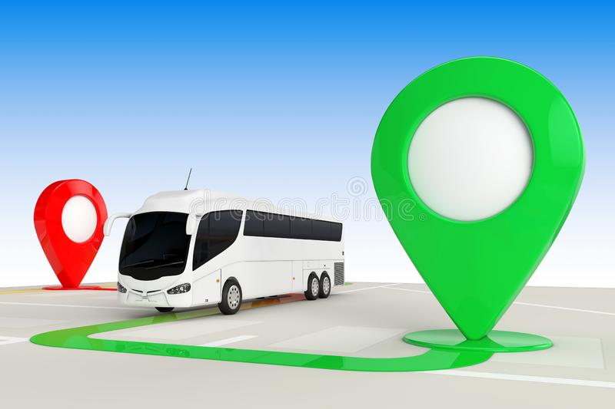
BUS TRACKING APPLICATION Guided By: Ms. B. Suvarna
Submitted By:
201FA04433
201FA04423
201FA04438
201FA04463

Slide 2

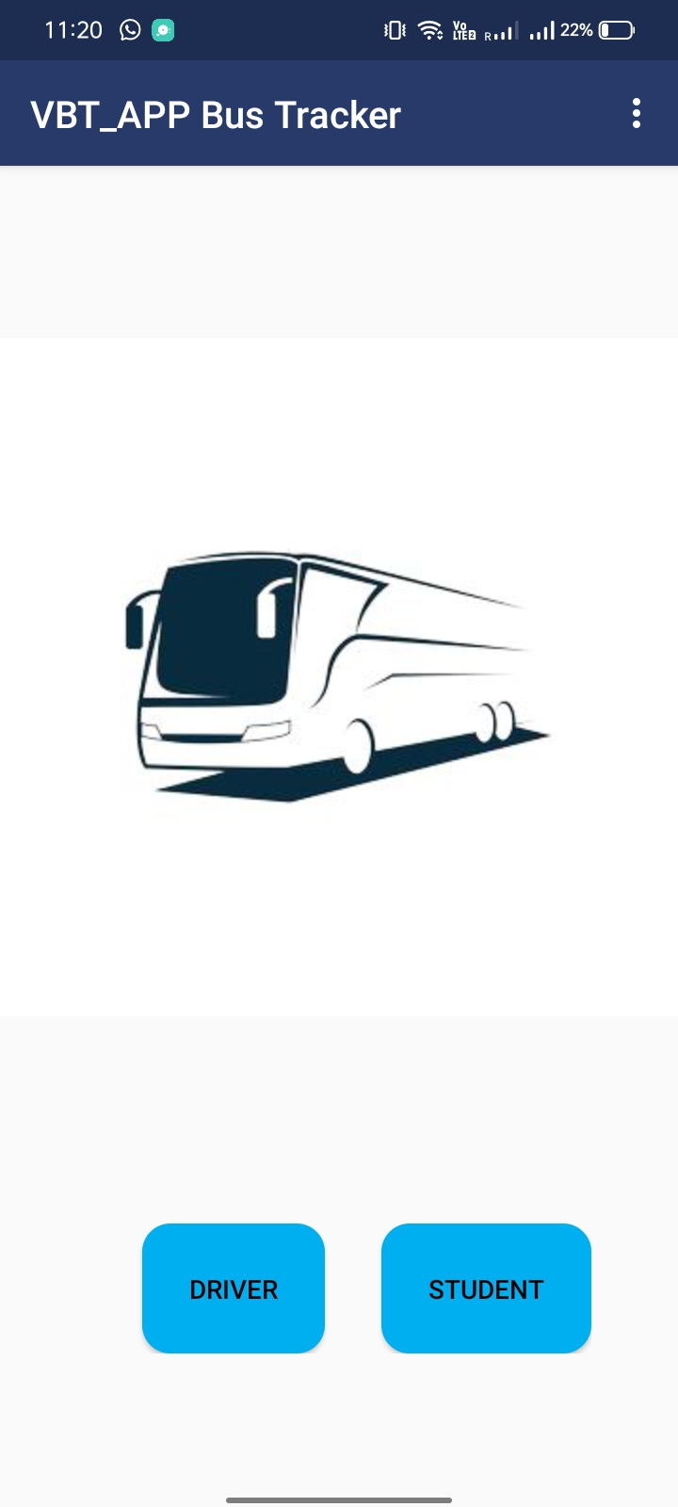
Description:-In this application initial will show first interface only for 2 seconds and then new interface will open with two buttons one for driver login and another for student. After selecting the driver button it will take data from the driver like name, email, id etc.

Slide 3

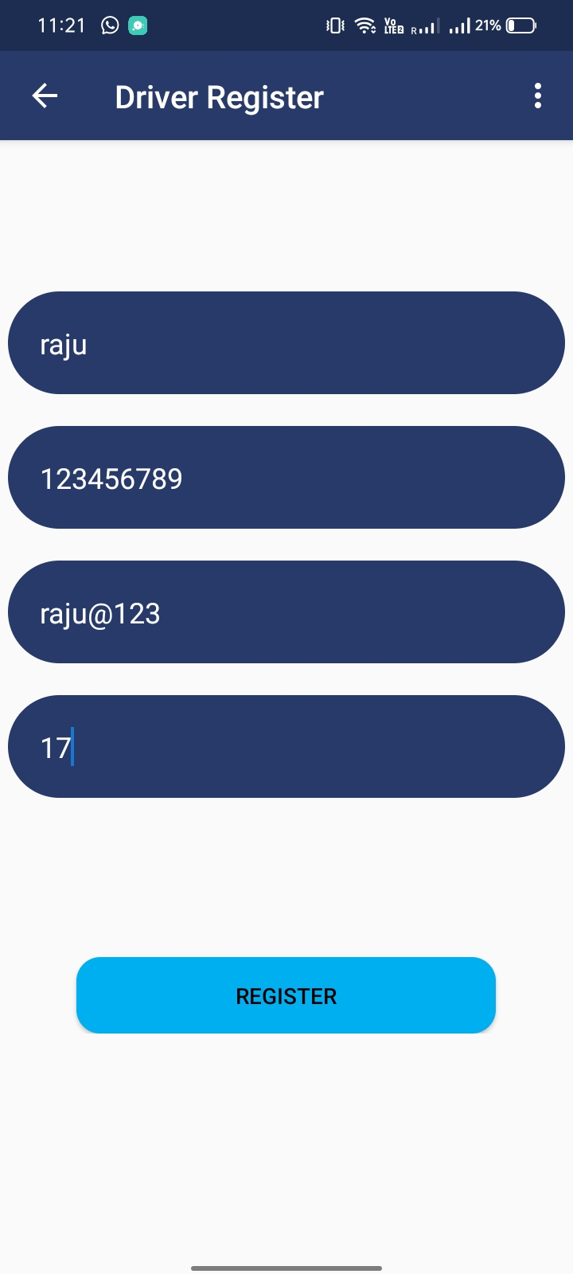
Description:- After selecting the Driver button next activity will open like as given image which includes some attributes from the driver . And for register we need to click on REGISTER button .

Slide 4
Description:-If any student select the student button then it will open with new activity which gives the option to select the root location which is shared by the driver.

Slide 5
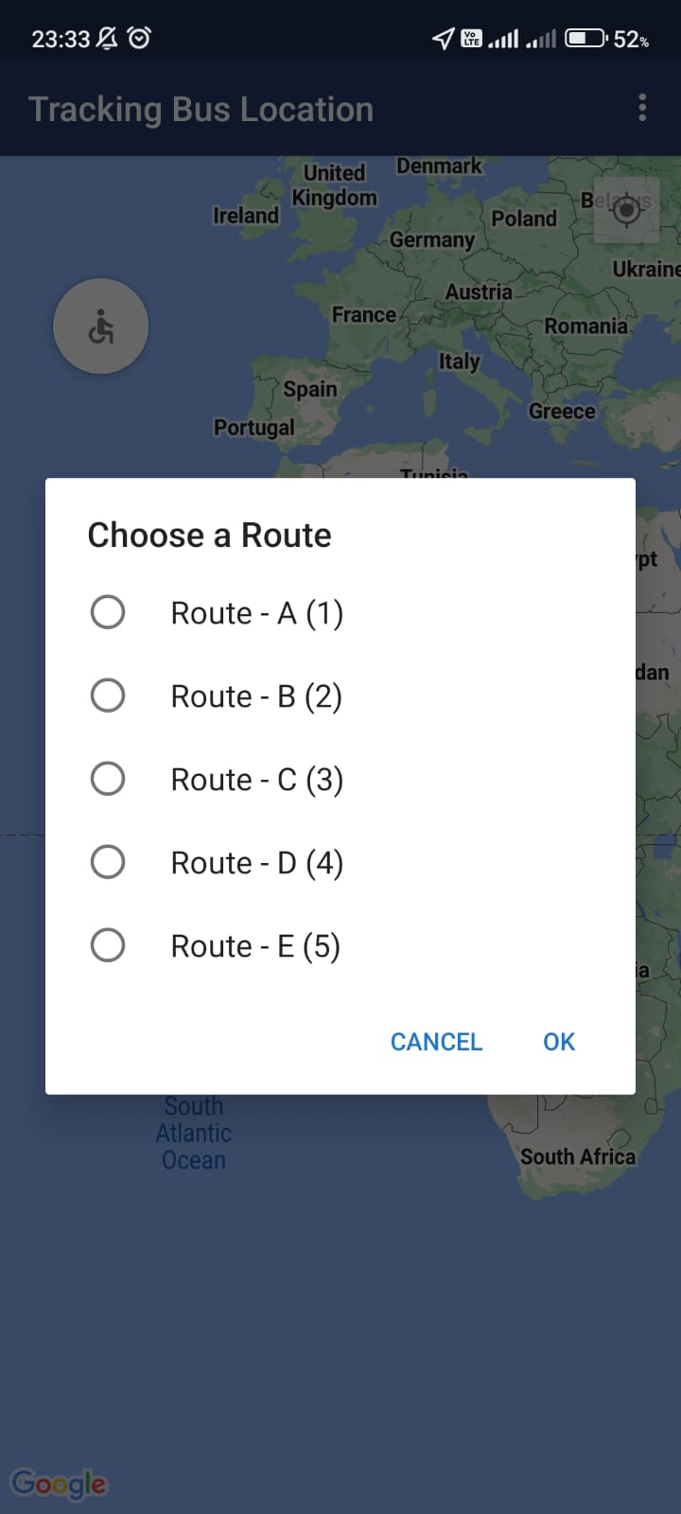
Description:-To selecting student button from the home activity it gives option to choose the route for the student. And after the clicking on the any of the button student can see the location of the bus.

Slide 6
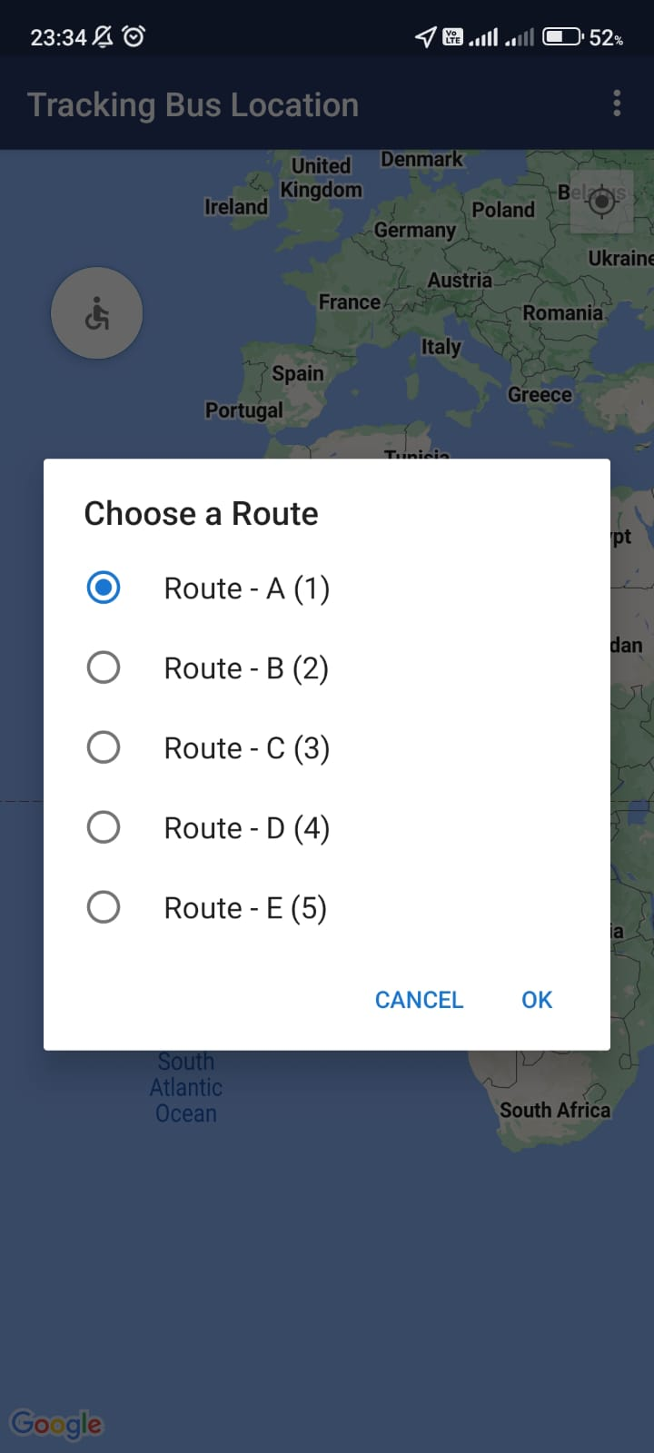
Description:-Here student can select any option and access the current location of the bus.

Slide 7
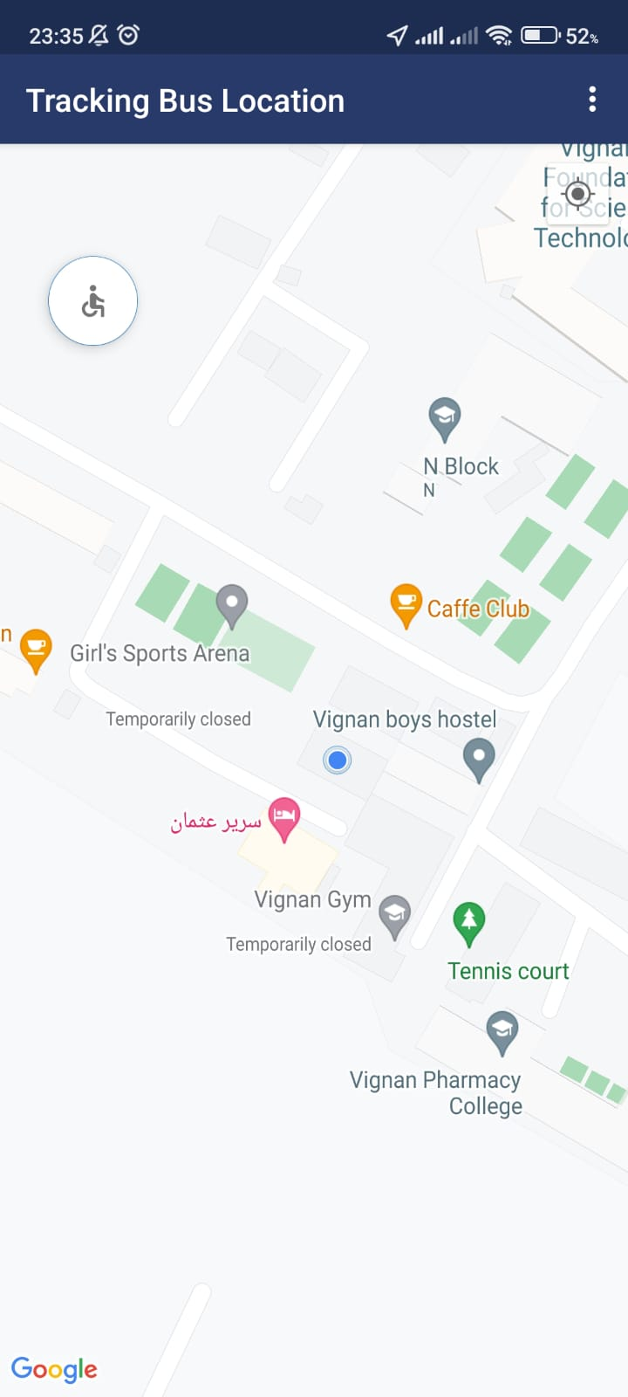
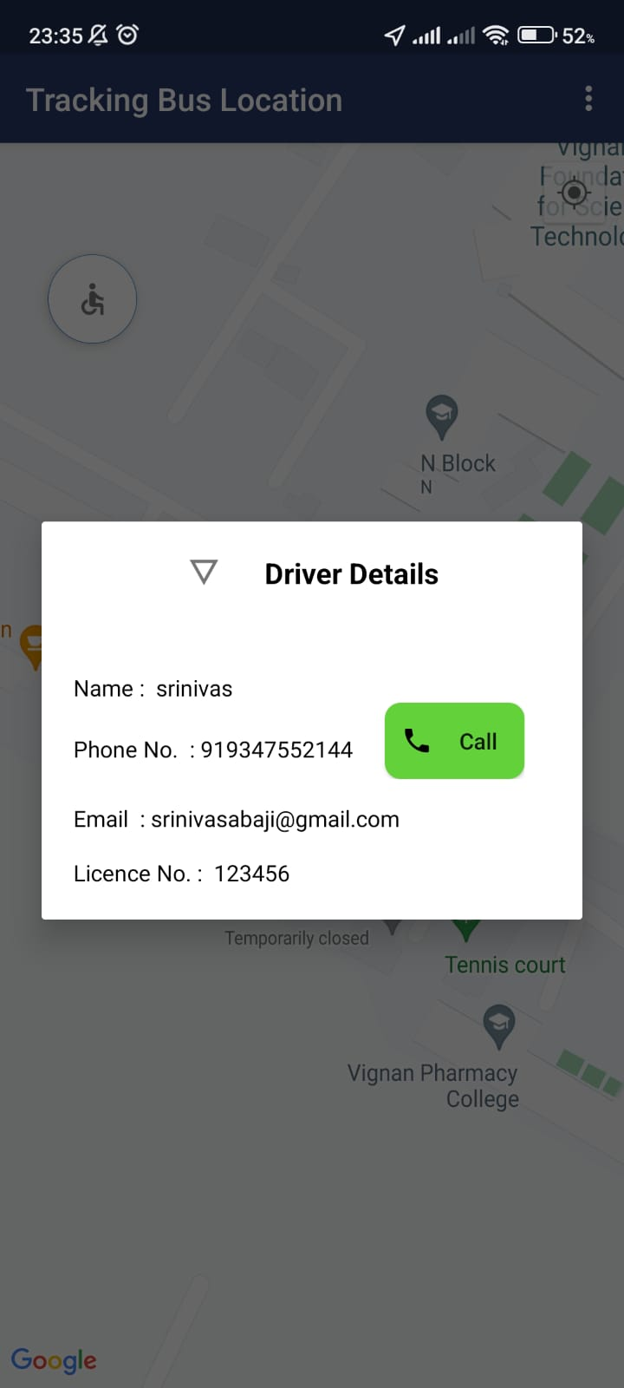
Description:-Here the pink colour is showing current location of the bus . When route selected by the students.

Slide 8
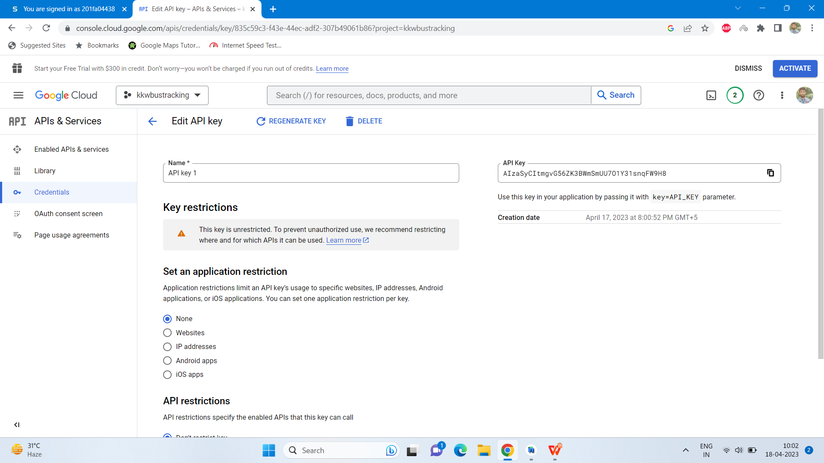
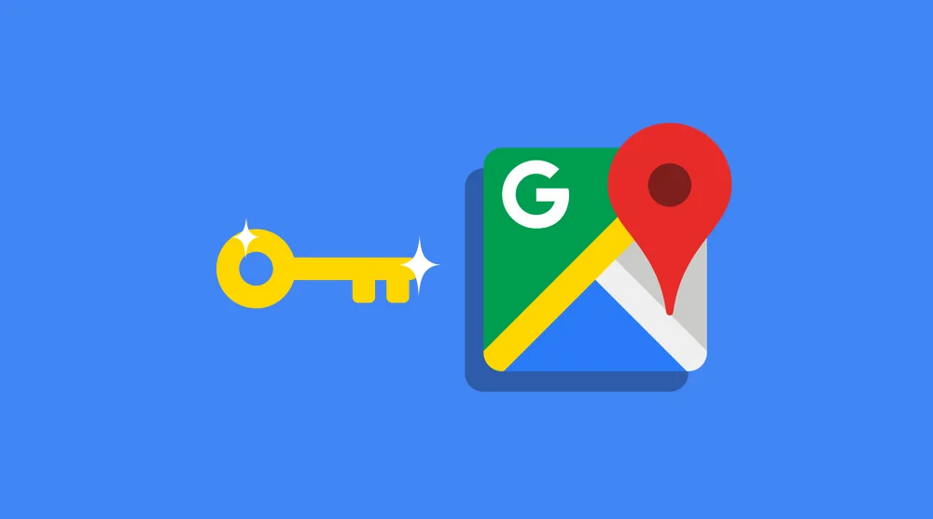
GCP API key

Slide 9
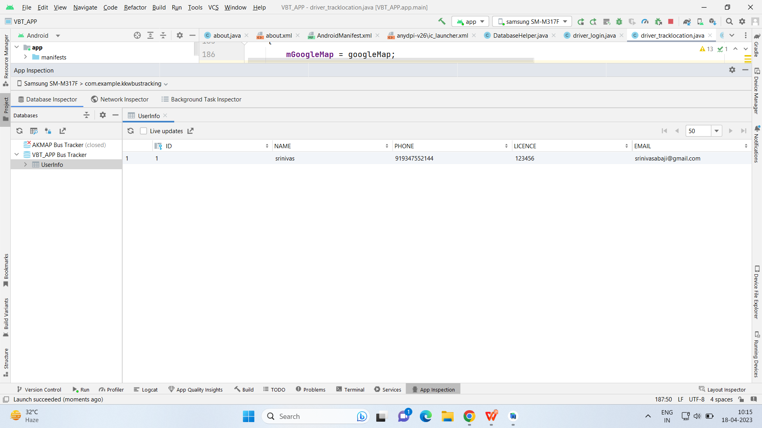
SQL-LITE DATABASE
DATABASE_NAME = "VBT_APP Bus Tracker"

Slide 10
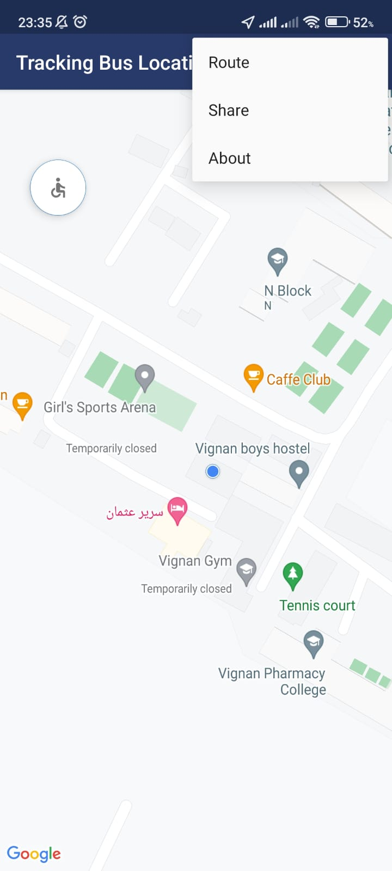
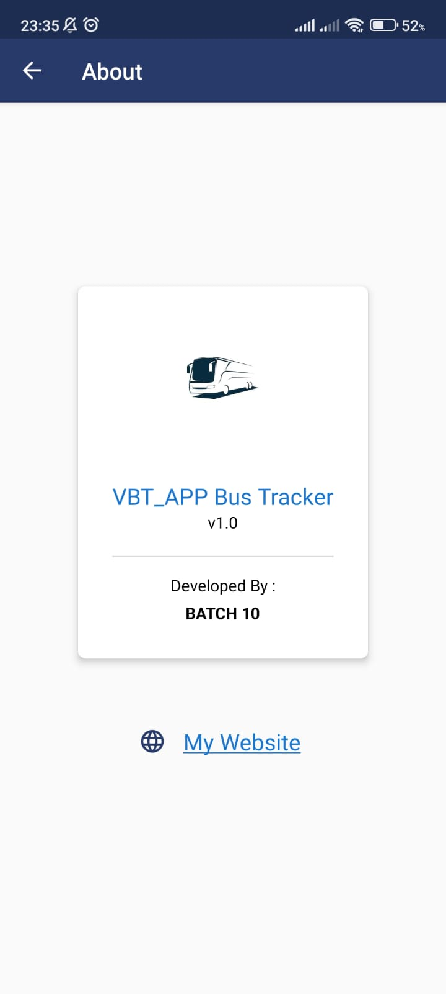
Conclusion:- This activity gives the option of menu button with many option like Route, Share, and About etc. From here student can share the location and can select another root also and in about can see about the App which looks like next image.

