Slide 1


HOSTEL MANAGEMENT SYSTEM
Submitted to:-
Mrs S. Radharani (Assistant Prof.)
Mrs M. Bhargavi (Assistant Prof.)
PRESENTED BY :-
SURAJ PATEL(201FA04431)
DIPU KUMAR (201FA04432)
NITISH KUMAR(201FA04433)

Slide 2
Abstract :-
“Hostel Management Information System” should maintain all the Hostel Student information. The Hostel environment consists of students, Room etc. so the Hostel Management information system should maintain details of all students I.e., their bio-data ,their personal Information etc. Fee details like Room rent ,Mess ,Management ,amount etc. and also details like Room to which a particular student belong, their attendance, their Refund etc.
Therefore it is obvious that system maintains vast amounts of data. In such cases computerization of the system is inevitable. The ideal reasons for computerizing Hostel Management system are as follows.

Slide 3
User Menu: Provides a way to give any commands to the Hostel Management System, the options include in the menu are
1. Student
2. Hostel
3. Room
4. Visitor
5. Administrator

Slide 4
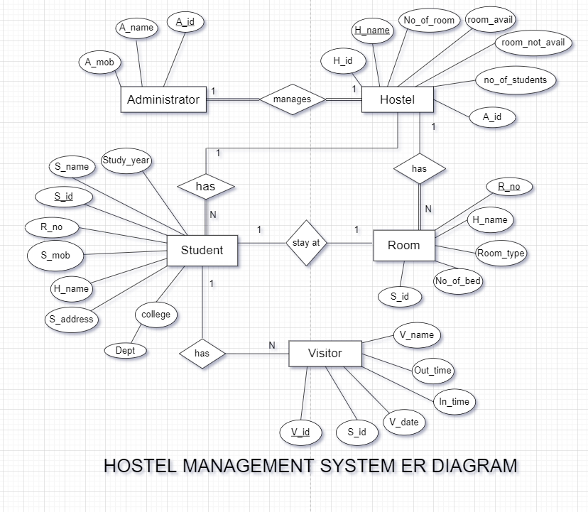
ER MODEL OF HOSTEL MANAGEMENT SYSTEM

Slide 5
Database Design:-
Table name: Administrator
FIELD NAME | DATA TYPE | SIZE | KEY | DESCRIPTION
A. id | number | NO |  | Administrator id
A.name | varchar | NO | PRI | Administrator name
A_mob | number | NO |  | Mobile number
H_name | Varchar(42) | YES | MUL | Hostel name

Slide 6
Table name: Hostel
FIELD NAME | DATA TYPE | NULL | KEY | DESCRIPTION
H. Id | int | NO |  | Hostel Id
H_name | varchar(42) | NO | PRI | Hostel name
No. of room | int | NO |  | No. of room
No. of student | int | NO |  | No. of student
Room_avail | int | NO |  | Room available
Room_not_avail | int | NO |  | Room not available
A_name | Varchar(42) | NO | MUL | Administrator name

Slide 7
Table Name: Student
FIELD NAME | DATA TYPE | NULL | KEY | DESCRIPTION
S_id | Int | NO | PRI | Student Id
S_name | varchar(42) | NO |  | Student name
R_no | Int | NO | MUL | Roll number
S_mob | varchar(10) | NO |  | Mobile number
H_name | varchar(42) | NO | MUL | Hostel name
S_address | varchar(60) | NO |  | Address
College | varchar(300) | NO |  | College name
Dept | char(10) | NO |  | Department
Study_year | int | NO |  | Study year

Slide 8
Table Name:- Room
FIELD NAME | DATA TYPE | NULL | KEY | DESCRIPTION
R_no | int | NO | PRI | Room number
R_type | varchar(10) | NO |  | Room type
No. of bed | int | YES |  | Number of bed
H_name | Varchar(42) | YES | MUL | Hostel name

Slide 9
Table Name:- Visitor
FIELD NAME | DATA TYPE | NULL | KEY | DESCRIPTION
V_name | int | NO |  | Visitor name
V_date | date | NO |  | Date of entry
S_id | int | NO | MUL | Student Id
In_time | time | NO |  | In time
Out_time | time | NO |  | Out time
Relation_name | varchar(42) | NO |  | Relation name
V_id | int | NO | PRI | Visitor Id

Slide 10
Future Work:-
Employee Payroll: We can include the facility in this system that will generate payroll for all the employees of the hostel.
Resident Attendance: The attendance of resident will be marked each time the resident enters or leaves the hostel premises.
Accounting Details except Hosteller's Fee Details: All the other accounting details can be maintained in addition to the details.

Slide 11
Conclusion:-
The project titled as "Hostel Management Information System " been designed with much care, with the intention easier and the more complexity involved is presented in a simple and lucid style.
The Hostel Management System works in a similar fashion as that of an Hotel Management System. The various Department student information is to be stored and retrieve any time when required.

Slide 12


