Slide 1
Acquiring Comparative Commonsense Knowledge from the Web Niket Tandon, Gerard de Melo, Gerhard Weikum 28th AAAI Conference on Artificial Intelligence, 2014
Aishwarya Singh (aish2503@seas.upenn.edu)
03/18/2019

Slide 2
Problem & Motivation
Genuine machine intelligence requires drawing commonsense inferences from large amounts of data.
This was the first attempt to harvest large amounts of disambiguated comparative knowledge from the Web.
Steel is sharper than wood.
Done by extracting triplets from the Web corpora of the form (Noun, Adjective, Noun): (steel, sharper, wood).
These triplets are sense-disambiguated using WordNet: (steel-noun-2, sharper-adj-2, wood-noun-1)
Notes:
Genuine machine intelligence requires drawing commonsense inferences from large amounts of data.
This was the first attempt to harvest large amounts of disambiguated comparative knowledge from the Web.
Say we have the example, steel is sharper than wood
-- extracting triplets of the form (Noun, Adj, Noun). This isn’t enough as it’s still ambiguous which meaning of sharp we’re referring to.
-- disambiguation is done using WordNet senses where each of these numbers is the sense id.

Slide 3
Problem & Motivation
Not just restricted to WordNet nouns- Ad-hoc concepts
Disambiguated adjective-noun and noun-noun combinations
young lions, vegetable dumpling
Covers a wider range of commonsense phenomena: “lions can be young”, “dumplings can be made of vegetables”
Notes:
They try to cover a wider range of commonsense phenomena by using ad hoc concepts.
These are disambiguated adjective-noun and noun-noun combinations that do not occur in wordnet such as young lions and vegetable dumplings. This tells us that lions can be young and that dumplings can be made of vegetables.

Slide 4
Contents:
Previous approaches
Contributions of this work
Methodology
Open Information Extraction
Disambiguation
Local Model
Joint Model
Triple Organization
Experiments
Baselines and Results
Conclusions
Shortcomings and Future Work
Notes:
I’ll speak about the methodology in the first half and then move on to the evaluation.

Slide 5
Previous approaches (SoTA)
Knowledge Harvesting:
YAGO (Hoffart et al. 2011), OpenIE (Banko et al. 2007)
cover only a small amount of relations
Need for more domain specific knowledge:
Temporal (Kozareva et al. 2011), Psychology (Rashkin et al. 2018), Spatial (Collell et al. 2018)
Comparative Knowledge:
Until this paper, large scale data had not been used.
Jindal and Liu (2006) identified potential comparative sentences and their elements using sequence mining techniques.
Cao et al. (2010) extracted comparative observations using manually defined patterns.
Notes:
We have already seen Quite a few state of the art models in the field of knowledge harvesting such as YAGO And TextRunner.
A big shortcoming was that they covered a small amount of relations only which calls for more domain specific knowledge. We’ve seen extraction of psychology and temporal knowledge already and will see a paper on Spatial knowledge next week.
In the field of comparative knowledge up until this paper, large scale data had not been used to mine knowledge.
Other works used sequence mining techniques and manually defined patterns.

Slide 6
Contributions of this work
Constructed a comparative knowledge base by:
Using Open Information Extraction from Web corpus to obtain observed textual facts
Developed a Joint Optimization Model using ILP to disambiguate and semantically organize this extracted data with respect to a lexical knowledge base: WordNet.
Notes:
The main contribution of the work was the comparative knowledge base they created using Open IE from Web corpus to obtain textual facts
They also disambiguated and organized this data with respect to WordNet using a Joint Optimization Model.

Slide 7
METHODOLOGY

Slide 8
Open Information Extraction
All triples matching the template: (Noun Phrase) + (Comparative Phrase) + (Noun Phrase) extracted from the corpus
Noun Phrases: WordNet nouns (water, dark chocolate), adjective-noun pairs (cold water) and noun-noun pairs (football manager)
Comparative Phrases: Adjectives. Also captures negation, modifiers.
Based on Hadoop MapReduce (distributed hardware clusters) due to large size of Web corpora.
Output: (Noun-1 + Relation + Noun-2 + Frequency + Direction)
(car, bigger, dog, 10, >)
Notes:
- In the first phase of OpenIE, all triples matching the template (NP, Comp Phrase, NP) were extracted.
- Noun phrases could be word net nouns such as water/dark chocolate or ad-hoc concepts (cold water/football manager)
- Comparative phrases were adjectives and their extraction phase also accounted for negation and modifiers.
- It was based on Hadoop MapReduce owing to the large size of the web corpora
- The output of this phase is given as a quintuple consisting of (Noun-1 + Relation + Noun-2 + Frequency + Direction)

Slide 9
Disambiguation
Original extractions have ambiguity.
“richer than”: money or calories
Goal of this phase:
Original Triple (string) → Relevant Grounded Triple (disambiguated word sense IDs)
Achieved using:
Local Model: assumes independence between triples.
Joint Optimization Model: does not assume independence between triples.
Notes:
The second phase is that of disambiguation
Original extractions have a certain degree of ambiguity
The goal of this phase is to take the original triple and give the relevant grounding for it in the form of disambiguated word sense IDs.
This is achieved through 2 methods
A local model that assumes that triples are independent of each other
A Joint Optimization Model that tries to leverage the fact that triples can be related and depend on each other

Slide 10
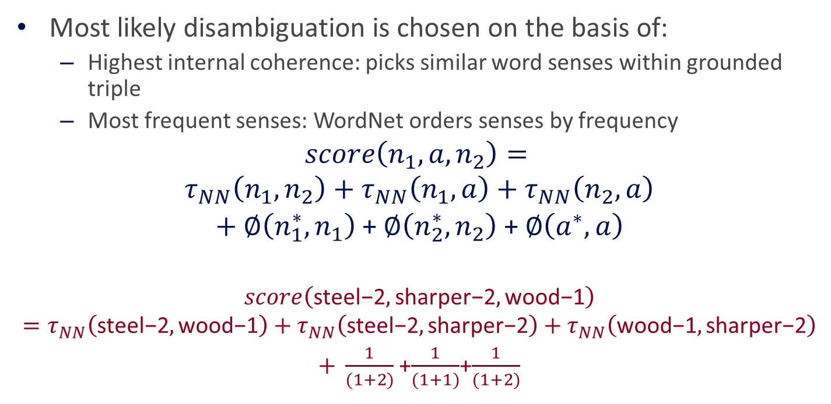

Local Model
Most likely disambiguation is chosen on the basis of:
Highest internal coherence: picks similar word senses within grounded triple
Most frequent senses: WordNet orders senses by frequency
$$score\left(n_{1}, a, n_{2}\right)=$$
$$τ_{NN}\left(n_{1}, n_{2}\right)+τ_{NN}\left(n_{1}, a\right)+τ_{NN}\left(n_{2}, a\right)$$
$+ ∅\left(n_{1}^{∗}, n_{1}\right)$ + $∅\left(n_{2}^{∗}, n_{2}\right)$ + $∅\left(a^{∗}, a\right)$
$$score\left(\text{steel}\text{−2},\text{sharper}\text{−2},\text{wood}\text{−1}\right)=τ_{NN}\left(\text{steel}\text{−2},\text{wood}\text{−1}\right)+τ_{NN}\left(\text{steel}\text{−2},\text{sh}\text{arper}\text{−2}\right)+τ_{NN}\left(\text{wood}\text{−1},\text{sharper}\text{−2}\right)$$
$+ \frac{1}{(1+2)}$+$\frac{1}{(1+1)}$+$\frac{1}{(1+2)}$
Internal Coherence (Taxonomic relatedness)
$$Prior=\frac{1}{1+Sense Rank}$$
Notes:
The local model chooses the most likely disambiguation on the basis of
highest internal coherence which picks senses that have similar context within the triple.
- Also wordnet ranks senses by the frequency with which they are used so the model gives priority to popular senses
- Internal coherence for two nouns assumes that if words occur in the same context, the appropriate senses will have minimimum distance between them.
E.g. the correct disambiguation steel-2 and wood-1 will have shortest path
- Internal coherence between nouns and adjectives is given by the overlap between their WordNet glosses
E.g. The gloss of key could say “metal device that can be inserted into an appropriate lock” so we know that key, insert, lock can occur in the same context.
- The prior to prioritize most frequent sense is computed as 1/1+wordnet sense rank.

Slide 11
Local Model
Shortcomings:
Two or more groundings could have same score
Does not consider dependency between triples
(car, faster, bike) highly correlated with disambiguation of related triples (bike, slower, automobile)
Solution: Joint Model
Similarly grounded triples collectively aid in disambiguation.
Encourages high coherence across chosen grounded triples
Notes:
There are shortcomings of the local model where two or more groundings can have the same score without a winner.
Does not consider dependency between triples. (car, faster, bike) is closely related to the disambiguation of (bike, slower, automobile)
The solution proposed is that of a joint model which encourages not just high internal coherence within the triple but also high coherence across all chosen groundings.

Slide 12
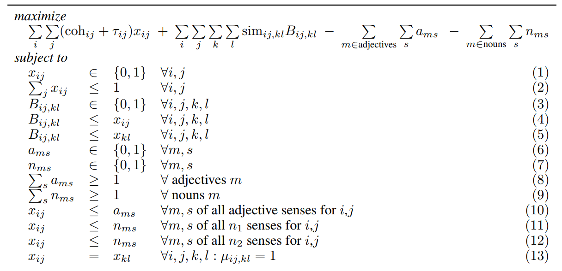

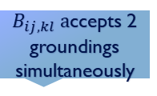
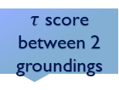

Joint Model
Local model score
If $x_{ij}=1 a$ccept grounding
$τ$ score between 2 groundings
$B_{ij,kl} a$ccepts 2 groundings simultaneously
Prefer fewer senses of adj/noun across the graph
Grounding can be accepted or rejected
Accept at the most one grounding (0 or 1)
I$f x_{ij}$= $x_{kl}=1$( i.e, coherence is highest), ensures $B_{ij,kl}=1$
Ensures at least one word sense per word is chosen
If grounding is accepted, mark senses as accepted.
Ties semantically equivalent groundings together by accepting them
Notes:
This objective is maximized subject to these constraints and groundings where xij =1 are selected
- The first component encodes the local model through the internal coherence score and frequent senses. Xij is the variable that captures where a grounding is accepted or not.
The second component allows for dependency between triples by encouraging that the grounding accepted is similar to other groundings that have been accepted.
Sim-ij,kl is similar to internal coherence but calculates the coherence between two groundings.
Bijkl reflects whether two groundings have been simultaneously accepted.
The third and fourth encourage us to pick fewer senses across the graph, thus increasing dependency between groundings.
Resultant are disambiguated inherently coherent triples as well as coherent with groundings selected for related observations.

Slide 13
Triple Organization
All semantically equivalent grounding grouped together in csynsets (analogous to WordNet synsets)
(car, faster, bike), (bicycle, slower, automobile), (car, speedier, cycle)
Cars are generally faster than bikes
Equivalent triplets are determined using:
Synonymy: (car, faster, bike), (car, speedier, cycle)
Antonymy: (car, faster, bike), (bicycle, slower, automobile)
Negation: treat negated adjectives like antonyms
Notes:
- All semantically equivalent grounding grouped together into csynsets analogous to wordnet synsets
- All triples basically encode Cars are generally faster than bikes
- These triples are grouped together on the basis of synonymy, antonymy and negation

Slide 14
Experiments
The extraction system was run on two Web corpora to compile triples from each:
ClueWeb09 (504 million web pages) → 488,055 triples
ClueWeb12 (773 million web pages) → 781,216 triples
To evaluate, 100 observations were sampled for each of three sampling sets:
WN: both noun phrases of the triple appear in WordNet
Ad-hoc: both noun phrases do not occur in WordNet
WN/ad-hoc: One noun phrase in WordNet, other isn’t.
Manual disambiguation was performed for each triple by selecting the best WordNet sense according to the annotators.

Slide 15
Baselines and Results
Baselines considered for evaluation:
Most-frequent sense heuristic (MFS): Standard baseline for disambiguation tasks.
Local model: Incorporates intra-grounding coherence. Ignores coherence across triples.
Accuracy scores (95% Wilson confidence intervals)
Local model outperforms the MFS baseline by a small margin
Failure case: (tiger, fast, auto) → (tiger-1 (strongperson) , fast-1, auto-1)
Joint ILP model is the clear winner!!
Takes into account additional information about other related triples.
E.g. (pork, more tender, beef)
Model can infer that the ambiguous adjective “tender”, with 8 total senses in Wordnet, is not used in its initial senses but in its fifth sense.
Approach | Accuracy (All sets)
MFS | 0.43±0.05
Local Model | 0.47±0.09
Joint Model | 0.83±0.04

Slide 16
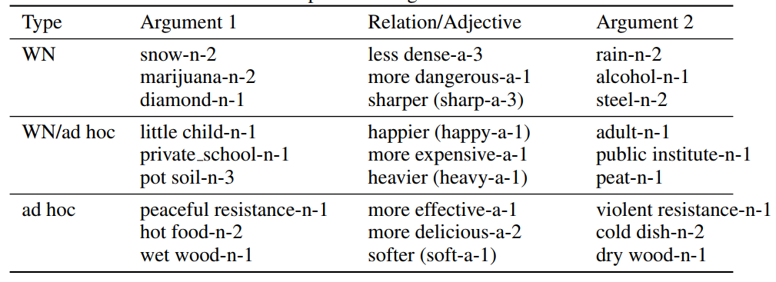
Conclusions
Utilized open information extraction methods to obtain large amounts of disambiguated comparisons from the Web.
The knowledge base provides a million disambiguated comparative assertions.
Scalable and does not require any labeled data.
Could work with any corpora and lexical resource

Slide 17
Shortcomings and Future Work
Performed poor evaluation on the disambiguated triples
Used only 100 triples each for 3 sample sets even though they harvested a million triples.
Limitation of Web extraction and their model:
Most trivial commonsense knowledge is rarely stated explicitly in text on the Web
Unlikely to find a sentence that says: “car is bigger than an orange”
Their model does not extend to zero-shot settings for never seen before instances.
Will not be able to give relation (car, bigger, orange)
Future Work:
Extend model to work for zero-shot settings.
Supplementing with methods that mine comparable commonsense from numerical data
Computational Advertisement: Querying against adjective to retrieve noun arguments and create metaphors.

