Slide 1
Relation Extraction with Matrix Factorization and Universal Schemas Sebastian Riedel, Limin Yao, Andrew McCallum, Benjamin M. Marlin NAACL 2013
Rachit Saluja (rsaluja@seas.upenn.edu)
03/20/2019

Slide 2
Problem & Motivation
This paper tries to tackle the problem of Relation Extraction.
Relation extraction involves determining relations between predicates.
Text: Mark works in the history department at Harvard.
Relation extraction: [Mark, Relation: is a historian, Harvard]
More Traditional Techniques use Supervised Learning which is very time consuming to annotate.
Multiclass classification on a closed set of relations.

Slide 3
Problem and Motivation (cont.)
Why do the algorithms not perform well?
The dataset used to train the supervised learning algorithm may not even have that context. (works in history dept. -- > professor)
Even if people did figure out a way to find all these relations, it would be impossible to annotate all of them.
This paper tries to solve these problems!

Slide 4
Contents:
Previous approaches and how did we get there?
Matrix Factorization and Universal Schemas
Contributions of this work
How does the Matrix look like?
Objective Function and Matrix Factorization
Data Used
Evaluation
Shortcomings
Conclusions and Future Work

Slide 5
Previous approaches and how did we get here?
Approach 1: Culotta and Sorensen (2004)
Uses a predefined, finite and fixed schema of relation types, usually some textual data is labeled, and then we use Supervised Learning.
Problem: Labelling it is very difficult, and time consuming, doesn’t generalize.
Example: Culotta and Sorensen (2004) use SVMs to find the similarity between dependency trees and detect relations on the Automatic Content Extraction (ACE) corpus.

Slide 6
Previous approaches and how did we get here?
Approach 2: (Distant Supervision)
One aligns existing database records with the sentences, creates the labels in a semi supervised form (distantly supervised) and then we use Supervised Learning.
Example: (Mintz et al., 2009) For each pair of entities that appears in some large semantic relation database (Freebase), they find all sentences containing those entities in a large unlabeled corpus and extract textual features to train a relation classifier.
/location/location/contains ---- > Paris, Montmartre

Slide 7
Previous approaches and how did we get here?
Problems:
1. Does not include surface patterns
2. large databases are hard to get.
3. Its extent to capture relations only remain to the pair of predicates that are present in database.
“Mozart was born in 1756.” “Gandhi (1869 -1948)...”
“<NAME> was born in <BIRTHDATE>

Slide 8
Previous approaches and how did we get here?
Approach 3: (Etzioni et al., 2008) [Getting Better]
The need for pre-existing datasets can be avoided by using language itself. Here surface patterns between mentions of concepts serve as relations. (OpenIE)
Problem: extracts facts mentioned in text, but does not predict potential facts not mentioned in text.
For example, OpenIE may find
Name–historian-at–HARVARD but does not know Name–is-a-professor-at– HARVARD. Because this fact was not explicitly mentioned.

Slide 9
Previous approaches and how did we get here?
Approach 4: (Yao et al., 2011)
Way to improvement is to cluster textual surface forms that have similar meaning based on given database.
Example:
Cluster could have (historian-at, professor-at, scientist- at, worked-at)
But that scientist-at does not necessarily imply professor-at
and worked-at certainly does not imply scientist-at.

Slide 10
Matrix Factorization and Universal Schemas
Step 1: Defining the schema to be the union of all source schemas: original input forms, e.g. variants of surface pat- terns similarly to OpenIE, as well as relations in the schemas of many available pre-existing structured databases.
Schema is defined as the database + corpus that the system uses to extract relations.

Slide 11
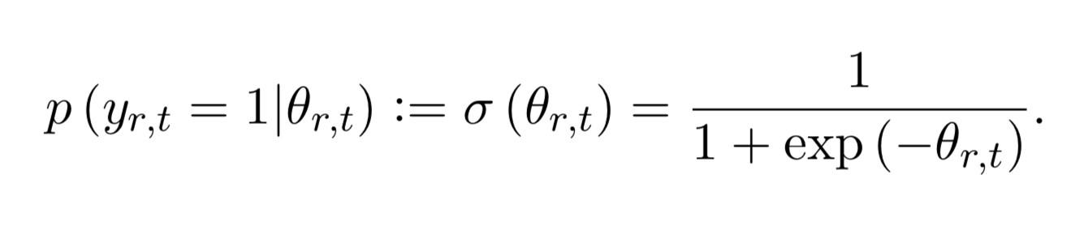
Matrix Factorization and Universal Schemas
Step 2: Represent the probabilistic knowledge base as a matrix with entity-entity pairs in the rows and relations in the columns. The probabilities are obtained by the logistic function on the scores obtained for a tuple and relation.

Slide 12
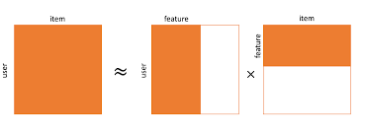
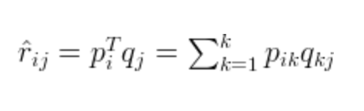
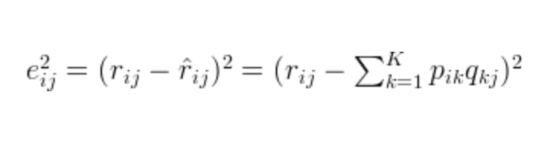
Matrix Factorization and Universal Schemas
Step 3: Matrix factorization and collaborative filtering
Intuition to use Matrix Factorization is to find the missing relations that previous models can’t capture. (Like recommendation systems)

Slide 13
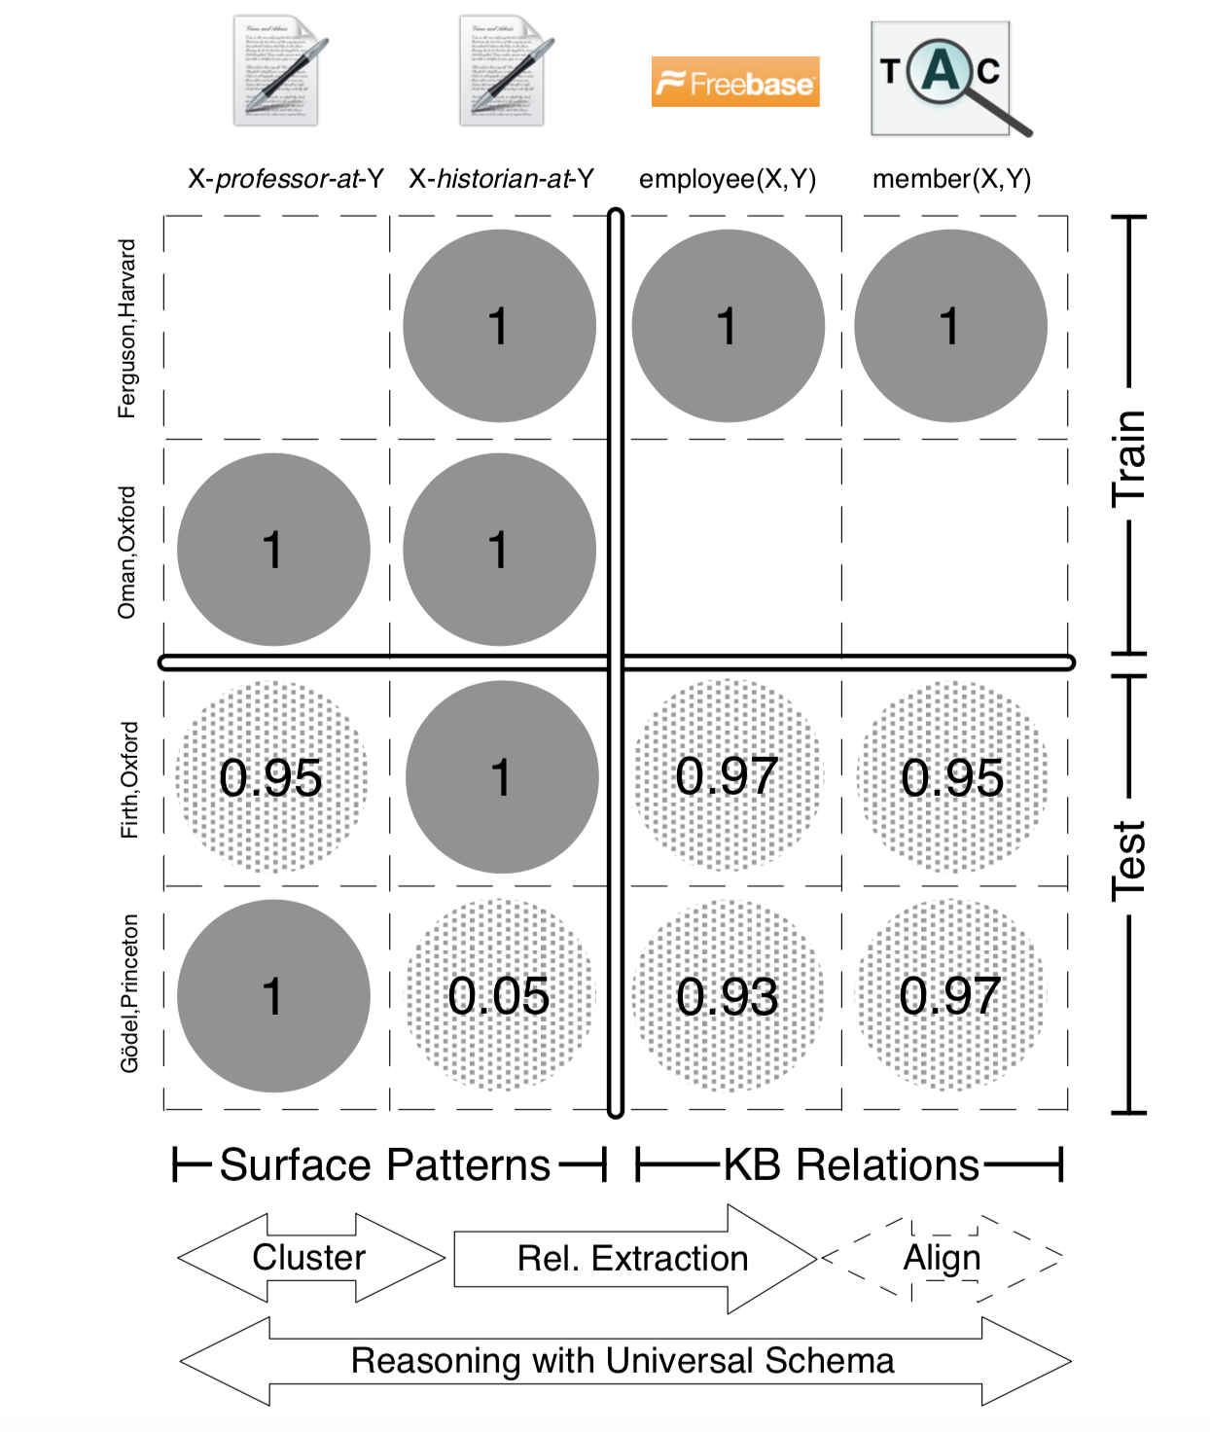
How does the Matrix look like?
The rows are a pair predicates
or words. (like user ratings )
The columns are the relations.
(like move names)
We try to predict which
relation(movie) would be applicable
(liked by) to a pair (user)

Slide 14
Contributions of this work
Latent Features in Matrix Factorization.
Captures missing relationships (like missing values in RecSys)
Neighborhood approach.
Captures features that are analogous to genre.
(historian-at, professor-at, scientist- at, worked-at)

Slide 15
Contributions of this work
Entity Model
Captures understanding that (p1 – relation – p2), can only have a small set of (p1 and p2) which helps in learning.
[(Name) – scientist – Penn] and we know that it can never be
[(Place) – scientist – Penn ]

Slide 16
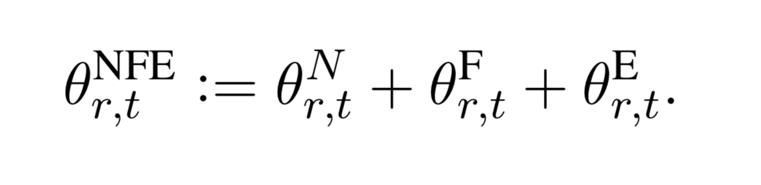
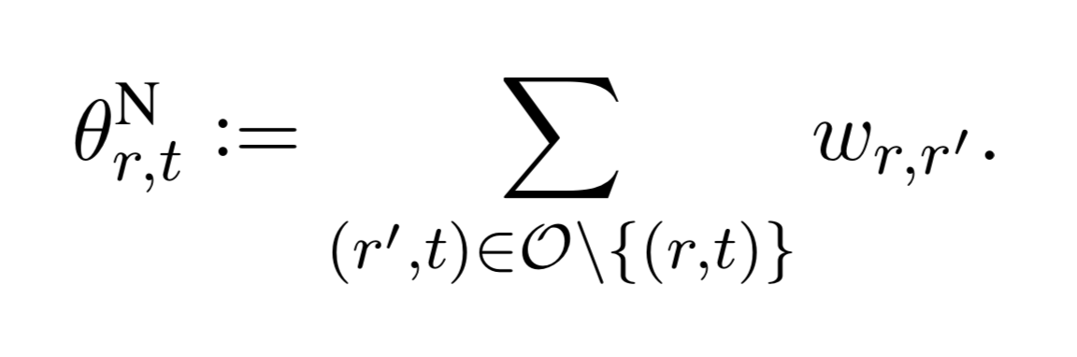
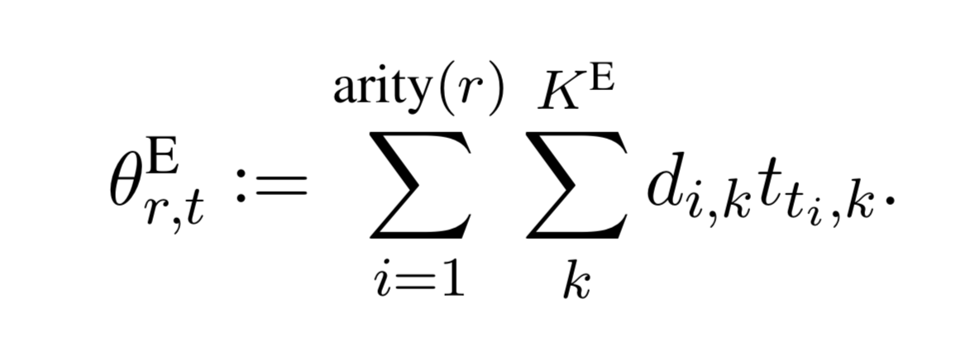
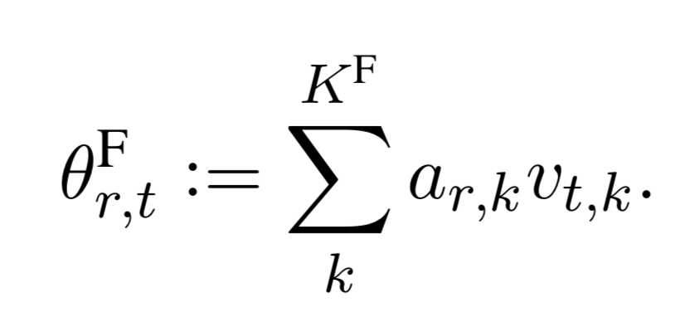
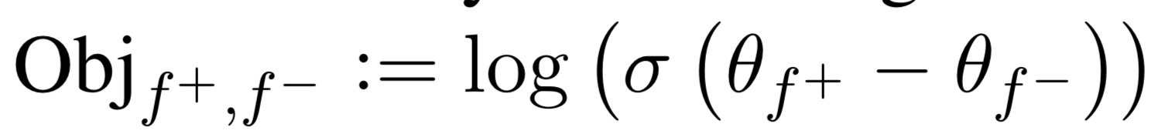
Objective Function and Matrix Factorization
Neighborhood features
Latent features Entity Model
r = relation, t = tuple

Slide 17
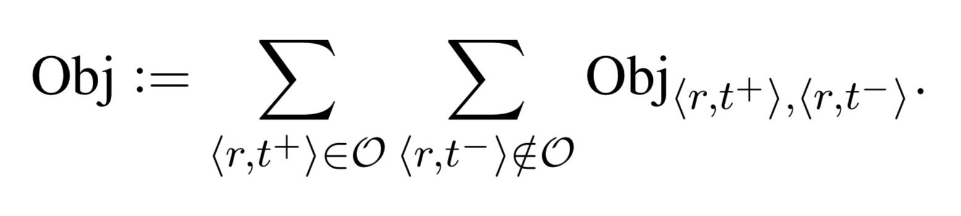
Objective Function
Bayesian Personalized Ranking. SGD
Used to provide more weight to positive examples and less to negative examples.

Slide 18
Data
They use Freebase here, with NYT corpus.
Freebase helps to capture the relations and predicate pairs easily. Easier to make the Matrix in Matrix Factorization.
NYT corpus, has a lot text, which helps to build a very big dataset.

Slide 19
Data and Preprocessing
Freebase Evaluation: Articles from NYT after 2000 are used as training corpus, articles from 1990 to 1999 as test corpus. Freebase facts 50/50 into train and test facts, and their corresponding tuples into train and test tuples. Coupled together. 200k Training set, 200k Test set (10k For evaluation)
Surface patterns: Extract lexicalized dependency paths between predicates to produce 4k more examples.
They take the union of both.

Slide 20
Evaluation on Freebase Dataset
Lorem | MAP | Weighted MAP
MI09 | 0.32 | 0.48
YA11 | 0.42 | 0.52
SU12 | 0.56 | 0.57
N | 0.45 | 0.52
F | 0.61 | 0.66
NF | 0.66 | 0.67
NFE | 0.63 | 0.69

Slide 21
Evaluation on Surface Patterns

Slide 22
Shortcomings:
Haven't done any comparative analysis with any other algorithm for Surface Patterns.
Have not released an explicit dataset, for future competitions and benchmarks, even though it is a very big dataset.
They claim that the algorithm moves closer to generalization, but don’t explicitly define what generalization is.
Have not discussed about transitivity relations.

Slide 23
Conclusions and Important Contributions
Populating a database using Matrix Factorization.
Well done experiments to show how neighborhood and entity feature maps can affect the accuracy.
Great tool for information extraction.
Because it captures more relations between predicates than any other algorithm at the time
Code is available.
Uses surface patterns to improve the accuracy.
This is key, it helps capture relation like:
“Mozart was born in 1756.” “Gandhi (1869 -1948)...”
“<NAME> was born in <BIRTHDATE>

Slide 24
Future Work
Matrix Factorization can be used for Textual Entailment too! As graphs can be written in the form of an adjacency matrix.
Autoencoders? Instead of traditional Matrix Factorization.
Could it use Scalable ILPs (Berant et al.)?

