Slide 1
A Simple Method for Commonsense Reasoning Trieu H Trinh and Quoc V Le Arxiv, 2018
Nidhi Sridhar (nidhi16@seas.upenn.edu)
18 March, 2019

Slide 2
Problem
Problem: Supervised learning needs lots of training data but this is scarce

Slide 3
Problem
Problem: Supervised learning needs lots of training data but this is scarce
Can we solve problems with less training data? For example, a task in commonsense reasoning: Winograd Schema Challenge?
Winograd Schema Data The trophy doesn’t fit in the suitcase because it is too big. What is too big?
Answer 0: the trophy. Answer 1: the suitcase - Very little training data! Can this be solved using neural networks?

Slide 4
Motivation
Can language models(LM) capture commonsense knowledge like word vectors captured analogies or contextually similar words?
Would a simple unsupervised learning method to train a LM on massive amounts of unlabeled data work?
Solve both the MCQ style Pronoun Disambiguation problem and the Winograd Schema Challenge(Less training data)

Slide 5
Contents:
Previous Approaches
Method
Experimental Setting
Results
Analysis
Conclusion, Shortcomings and Future Work

Slide 6
Previous approaches
Winograd Schema Challenge Attempts: - Supervised Learning through annotated knowledge bases and hand-crafted features - Semantic Parsing through rule based reasoning or using Google Search API results
All these attempts are expensive in terms of annotation or manual laying down of rules

Slide 7
Previous approaches
Winograd Schema Challenge Attempts: - Supervised Learning through annotated knowledge bases and hand-crafted features - Semantic Parsing through rule based reasoning or using Google Search API results
All these attempts are expensive in terms of annotation or manual laying down of rules
Current SoTA: Uses a skip-gram model to learn word representations - 3 knowledge bases to get Knowledge Enhanced Embeddings (KEE) - Semantic Similarity Scorer+ Deep Neural Network Classifier - Supervised + Unsupervised Learning with 3 knowledge bases

Slide 8
Contributions
Uses unsupervised learning to solve problem of commonsense reasoning
Significant improvement on accuracy on both PDP-60 and Winograd Schema Challenge with the use of customized data
Successfully able to identify the special word in a Winograd schema The trophy doesn’t fit in the suitcase because it is too big. What is too big?
Answer 0: the trophy. Answer 1: the suitcase
Special word

Slide 9
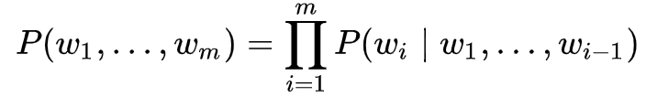
Overview
Substitute pronoun with candidate answers
In this case, Replace it with trophy and suitcase
Compute the probability of both the sentences
Sentence with higher probability is the right one
Identify special word by looking at probability ratios
Look at every word position
The trophy doesn’t fit in the suitcase because it is too big. What is too big?
Answer 0: the trophy Answer 1: the suitcase

Slide 10
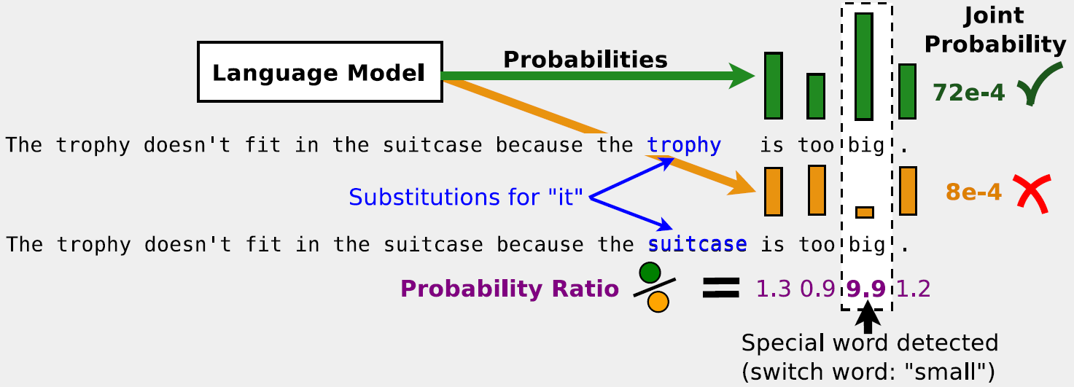
Illustration
The trophy doesn’t fit in the suitcase because it is too big. What is too big?

Slide 11
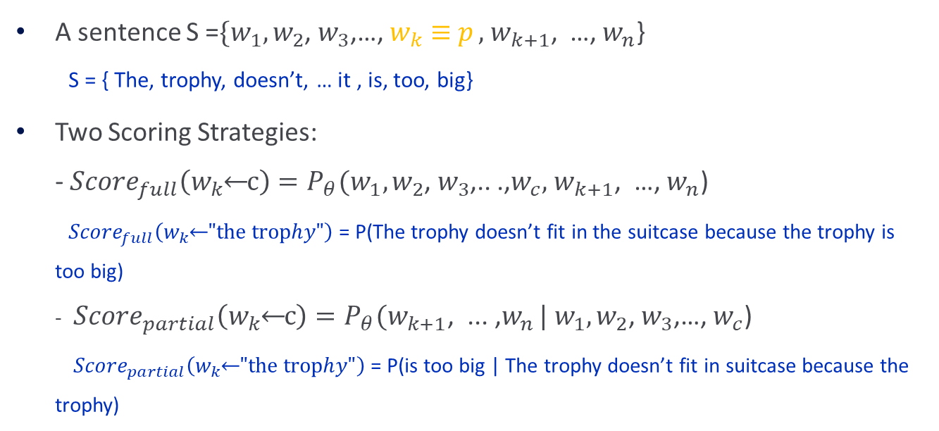
Method
The trophy doesn’t fit in the suitcase because it is too big. What is too big?
A sentence S =$\{w_{1},w_{2}$, $w_{3}$,…, $w_{k}≡$ $p_{ },$ $w_{k+1}$, …, $w_{n}$} S = { The, trophy, doesn’t, … it , is, too, big}
Two Scoring Strategies: - ${Score}_{full}\left(w_{k}⃪c\right)=P_{θ}(w_{1},w_{2}$, $w_{3}$,.. .,$w_{c},$ $w_{k+1}$, …, $w_{n}$) ${Score}_{full}\left(w_{k}⃪"the trophy"\right)$= P(The trophy doesn’t fit in the suitcase because the trophy is too big) - ${Score}_{partial}\left(w_{k}⃪c\right)=P_{θ}(w_{k+1}\text{, }\text{.}\text{.. }\text{,}w_{n }|{ w}_{1},w_{2}$, $w_{3}$,…, $w_{c}$) ${ Score}_{partial}\left(w_{k}⃪"the trophy"\right)$= P(is too big | The trophy doesn’t fit in suitcase because the trophy)

Slide 12
Experimental Setting
Datasets for Tasks
Pronoun Disambiguation: PDP60
Winograd Schema Challenge: WSC 273
Language Model
2 types of RNNs: Word & Character
2 LSTM Layers
Corpus for Training
LM-1-Billion
Common Crawl
Stanford Question-Answering Dataset (SQuAD)
Notes:
task, we use the original set of 60 questions (PDP-60) as the main benchmark3. Later
analysis augments this test with 62 questions from the development set to avoid bias presented in
the original smaller set.4 The second task (WSC-273) is qualitatively much more difficult5. Its
recent best reported result is only 3% of accuracy above random guess [27]. This task consists of
273 questions and is designed to work against techniques such as traditional linguistic restrictions,
common heuristics or simple statistical test over text corpora ("Google-proof ") [1

Slide 13
Results
Single Model: Gutenberg dataset
Ensemble for PDP: 5 variants of LMs
Ensemble for WSC: 9 variants of LMs

Slide 14
Customised Data(STORIES)
Use a similarity score rank based system to pick relevant documents to the WSC sentences based on number of overlapping n-grams
Use the top 0.1% of these documents to train 4 more LMs and add it to the ensemble
This improves performance from 60 to 63.7%

Slide 15
Analysis
Importance of Training Corpus - LMs trained on ensemble of 5 datasets significantly outperforms individual datasets ( Indicates the importance of a diverse dataset) - STORIES does slightly better than the others when trained individually (Due to high similarity with sentences in the Challenge)

Slide 16
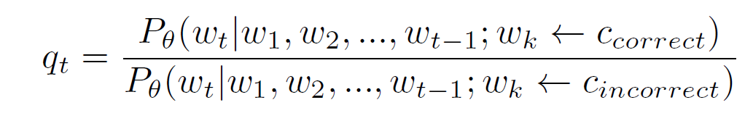
Analysis
Discovery of Special words: - Use probability ratio defined as follows to predict special word for each word t: - Successfully predict 115/178 special words
Partial Scoring better than Full Scoring: - Partial scoring corrects predictions made by full scoring that is biased by the number of occurrences of the candidate answers

Slide 17
Conclusions, Shortcomings and Future Work
Learnings: - Simplicity is key, the power of Language Models - The idea to create a dataset like STORIES is interesting
Shortcomings: - Commonsense reasoning is loosely defined Is any problem with less training data a commonsense problem? - Qualitative analysis on failure cases is missing and understanding if complex language models is the right way to go
Future Work: - Identify problems that this simple method can be extended to solve and analyze their performance

