Slide 1
VERB PHYSICS: Relative Physical Knowledge of Actions and Objects Maxwell Forbes and Yejin Choi ACL, 2017
Nidhi Sridhar (nidhi16@seas.upenn.edu)
18 March, 2019

Slide 2

Problem
John threw a rock
The trash landed in the bin
He put the ball into the basket
Is John bigger than the rock? Is the trash smaller than the bin?
Is the bin more rigid than the trash?
Is the basket smaller than the ball?
Can we learn the hidden physical knowledge in these sentences?

Slide 3
Motivation
Some physical knowledge cannot be captured using current Computer Vision techniques Speed, rigidness of objects, etc
These physical properties are rarely stated directly(Reporting bias) No one says “People are bigger than houses” or “Cars are faster than humans”

Slide 4
Problem
Mary threw the ball
Given a sentence frame 1. Can we determine the physical properties between the two objects Mary and the ball? Mary is bigger than the ball, Mary weighs more than the ball? 2. Do the above implications hold true every time we see the same frame for a verb v? A threw B ⇒ A > B in size, weight, etc

Slide 5
Contents:
Related Work
Contributions
Method
Results
Analysis
Conclusion, Shortcomings and Future Work

Slide 6
Related Work
Similar work seen in class: - Comparative Commonsense Knowledge Learning patterns like is bigger than or is longer than - Temporal Learning duration, start time of events - Numerical Attributes Learning what the scale of numerical mention can be compared to - Information Extraction Learning triples of relations between objects

Slide 7
Contributions of this work
Introduces a new commonsense reasoning task to identify inherent physical attributes and their relations between objects and verbs
Proposes a model to infer relations between object pairs when occurred with a particular verb
Develop a new dataset called VERBPHYSICS, a crowdsourced knowledge base for actions and objects

Slide 8
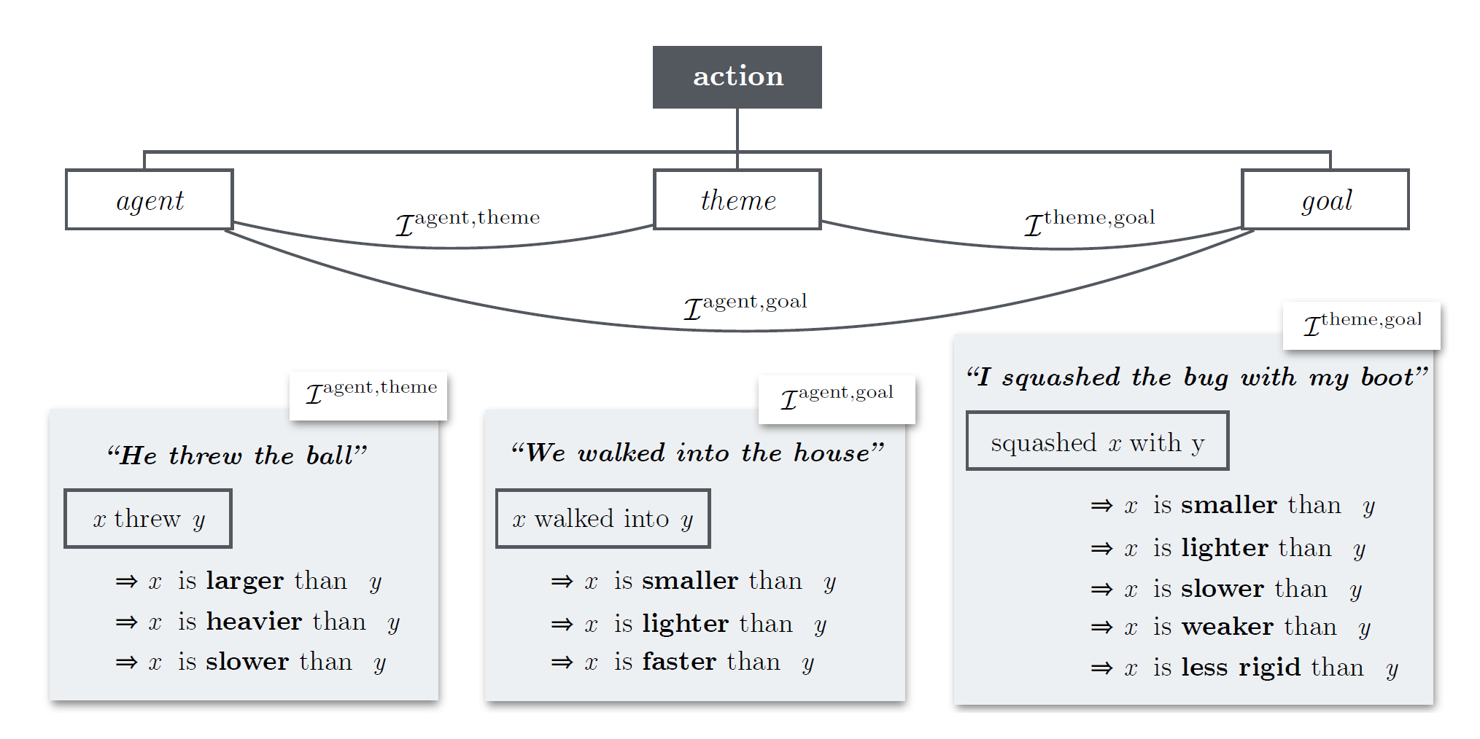
Overview
DIRECT OBJECT
PREPOSITIONAL OBJECT
SUBJECT

Slide 9
Overview
DIRECT OBJECT
PREPOSITIONAL OBJECT
SUBJECT

Slide 10
Problem Definition
Objects: x, y Attribute a: {Size, Speed, Rigidness, Strength, Weight}
Labels: { > , < , ≃}

Slide 11
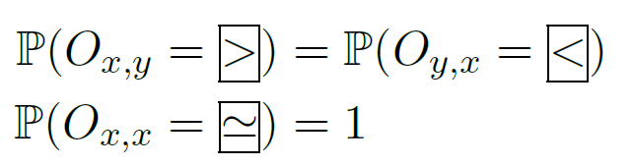

Problem Definition
Objects: x, y Attribute a: {Size, Speed, Rigidness, Strength, Weight}
Labels: { > , < , ≃}
Relative Physical Knowledge
Random Variable: ${ O}_{x,y}^{a}$ $Predict P(O_{x,y}^{a}$ = r) where r ⋲ { > , < , ≃}
Relative Physical Knowledge
Random Variable: 〖 O〗_(x,y)^a Predict P(O_(x,y)^a = r) where r ⋲ { > , < , ≃}
Person $>^{size}$ Basketball

Slide 12
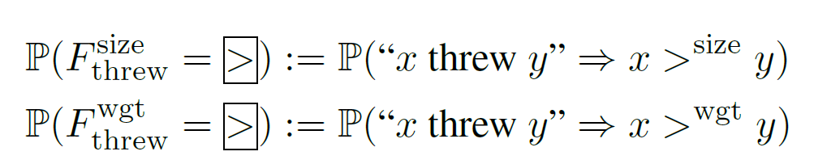
Problem Definition
Objects: x, y Attribute a: {Size, Speed, Rigidness, Strength, Weight}
Labels: { > , < , ≃}
Relative Physical Knowledge
Random Variable: ${ O}_{x,y}^{a}$ $Predict P(O_{x,y}^{a}$ = r) where r ⋲ { > , < , ≃}
Relative Physical Knowledge
Random Variable: 〖 O〗_(x,y)^a Predict P(O_(x,y)^a = r) where r ⋲ { > , < , ≃}
Physical Implication of Verbs
Random Variable ${ F}_{v}^{a}$
Predict $P({ F}_{v}^{a}$ = r) where r ⋲ { > , < , ≃}
Physical Implication of Verbs
Random Variable 〖 𝐹〗_𝑣^𝑎
Predict 𝑃(〖 𝐹〗_𝑣^𝑎 = r) where r ⋲ { > , < , ≃}
Person $>^{size}$ Basketball

Slide 13
Crowdsourced Data Collection
813 Frame templates generated through PPMI from Google Syntax N-gram corpus
Crowd workers asked to list plausible object pairs for a give frame template Ex: X threw Y -> List objects X and Y Further, they are asked to label one of { > , < , ≃ or no general relation} for the five attributes
Collected object pairs are further asked to compare relations and only labels with > 2/3 majority for any given object pair are kept

Slide 14
Model
Probabilistic Inference Problem over a factor graph of knowledge
Graph has multiple components: - Knowledge Dimensions (For each of the 5 attributes) - Verb Subgraphs - Object Subgraphs Each of these subgraphs contains nodes that are connected through various random variables

Slide 15
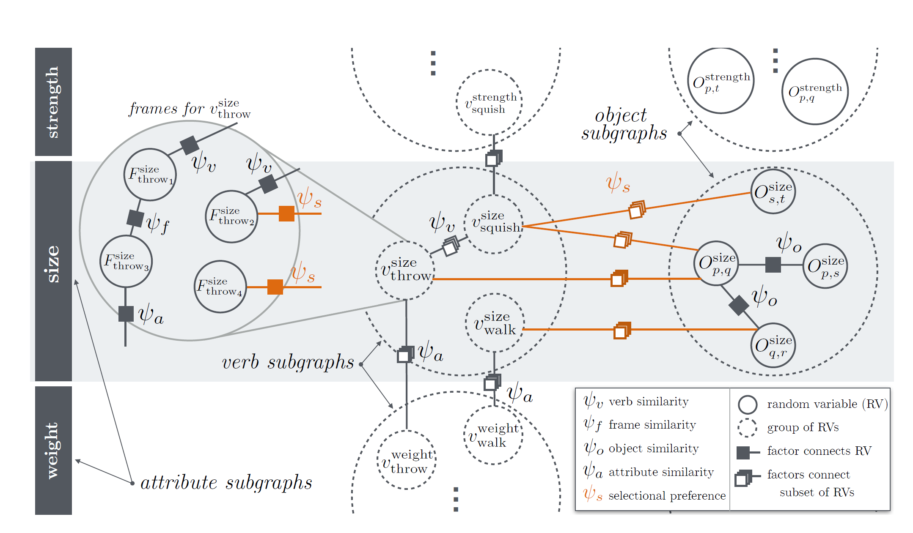
High Level View of Factor Graph

Slide 16

Types of Nodes
Frame Nodes denoting Random Variable ${ F}_{v}^{a}$

Slide 17
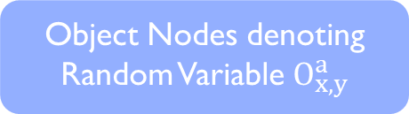
Types of Nodes
Object Nodes denoting Random Variable $O_{x,y}^{a}$

Slide 18
Types of Relationships
(walk, run) are similar verbs
Verb Similarity

Slide 19
Types of Relationships
Object Similarity
O(x,z) and O(y, z) then x and y are similar

Slide 20
Types of Relationships
He eats an apple
He is eating a fruit
Frame Similarity

Slide 21
Types of Relationships
Attribute Similarity
Throws implies size and weight are corelated

Slide 22
Types of Relationships
Relation between objects and verbs occurring in certain frames
Selectional Preference

Slide 23
Types of Relationships
Relation between objects and verbs occurring in certain frames
He eats an apple
He is eating a fruit
(walk, run) are similar verbs
Selectional Preference
Frame Similarity
Verb Similarity
Object Similarity
Attribute Similarity
O(x,z) and O(y, z) then x and y are similar
Throws implies size and weight are corelated

Slide 24
Results and Analysis

Slide 25
Analysis
Quantitative:
Frame and attribute similarity features hindered the performance for prediction for the size attribute
Qualitative :
Failure cases:
- Ambiguity: “for” a purpose or a duration “Drove the car for work/ for 2 hours”
- Complex Physics: Stop car with the brake (We know the car is bigger than a brake but model learns brake is bigger than car)

Slide 26
Conclusions, Shortcomings and Future Work
Conclusion: The paper introduces an interesting problem and proposes an elegant solution
Shortcomings: - Model is still unable to compare objects that never cooccur together Ex: A deer and a frisbee [Yang et all solves this issue] - Problems in the data
Future Work: - Analysis of relationships between verbs - Incorporate language nuances to get better results

Slide 27
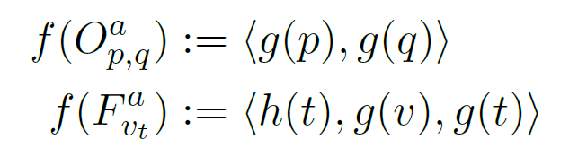
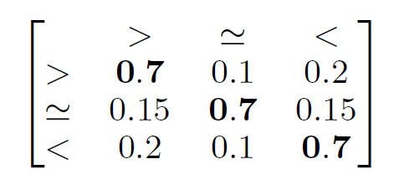
Model
Potential Functions - Unary Factors: - Binary Factors:
Loopy Belief Propagation and probabilistic inference to predict the value of the random variable for each of the nodes - Use a sum product propagation till convergence

