Slide 1
A Fundamental Tradeoff in Knowledge Representation and Reasoning Hector J. Levesque and Ronald J. Brachman CSCSI, 1984
Deniz Beser (dbeser@seas.upenn.edu)
02.04.2019

Slide 2
Problem & Motivation
What is the optimal representational language to reason correctly?
What are the difficulties of various representational languages?
The tradeoff between the expressiveness and the tractability of a Knowledge Representation scheme
Computational limits of reasoning

Slide 3
Problem & Motivation
It can be more difficult to reason correctly with one representational language than with another.
This difficulty increases as the expressive power of the language increases.
Bottleneck: Due to computational limitations, systems will either be limited in what knowledge they can represent or unlimited in the reasoning effort they require.

Slide 4
Contents:
KR systems & Reasoning Correctly
Representational Formalism
First Order Logic
Databases
Logic Program Form
Semantic Networks
Frame description Form
Conclusions & Discussion

Slide 5
Knowledge Representation Systems
Manage knowledge bases to reason and infer information about the world.
We can use these systems for tasks such as Question Answering
Retrieval and Inference
Answering by retrieving information from the KB
Reasoning through inference on the KB

Slide 6
Reasoning Correctly
A KR system should:
Select appropriate symbolic structures to represent knowledge
Select appropriate reasoning mechanisms
With the proper KR structures and mechanism:
We can answer questions based on KB
Assimilate new information through reasoning
This is all performed in accordance with the truth theory of the underlying a representation language.

Slide 7
First Order Logic
Using facts, declarative knowledge and procedural knowledge to form a KB.
Fact: “Joe is married to Sue.”
Declarative: “Brother is sibling restricted to males”
Procedural: “To see if x is an ancestor of y, it is better to search up for y than down from x.”

Slide 8
Problems with FOL Reasoning
We can represent all this knowledge as logical structures, then compute implications.
Questions can be answered by checking whether a certain sentence is a theorem of FOL.
Problem
Practically almost impossible to compute this.
Solutions are intractable
High expressivity but intractability

Slide 9


Examples
Henry’s friends are Bill’s cousins (fact):
Brother is sibling restricted to males (declarative):

Slide 10
Databases
Restricting logical form of KB allows tractability, so only certain kinds of information can be represented.
Imposing additional structure on the KB
Limiting uncertainty
Less expressivity
Better tractability

Slide 11
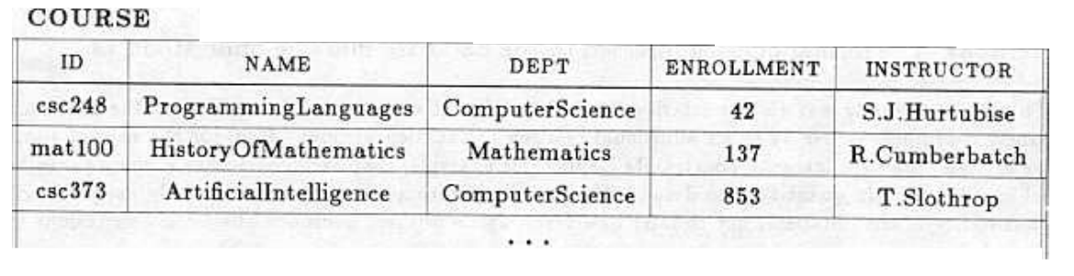
Databases
Consider the question:
How many courses are offered by the Computer Science Department?
Answering with FOL vs a Database

Slide 12
Logic Program Form
A logic program allows explicit and implicit parts
Explicit declarations of information
Implicit computation and reasoning
The reasoning as execution of the program
Retrieval and search
Search component is partially under user control, increasing optimality of reasoning
Limiting the necessary inference

Slide 13
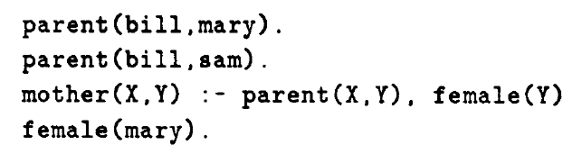
Prolog
We now mary is bill’s mother only after executing the program.

Slide 14


Semantic Networks
A KB with unary and binary predicates
Instead of:
We can define:

Slide 15
Semantic Networks
A collection of function free ground atoms, sentences stating the uniqueness of constants.
Main function: treatment of unary and binary predicates with proper taxonomy and attributes.
We can do inference using simple graph-search methods.
Tractable!
Using “spreading activation” to answer questions
Ability to add special representational objects (e.g. Grade)

Slide 16
Frame Description Form
An elaboration of Semantic Network form.
Emphasis on the structures of types, and their attributes
Values: specifying attributes,
Restrictions: constraints on values
Attached procedures: how to use the attribute
Subsumption and disjointness
Additional properties to enhance inference

Slide 17
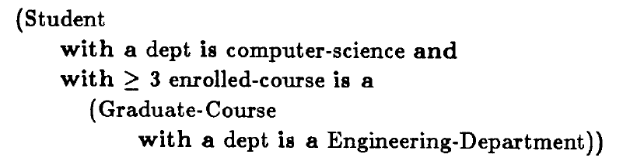
Example

Slide 18
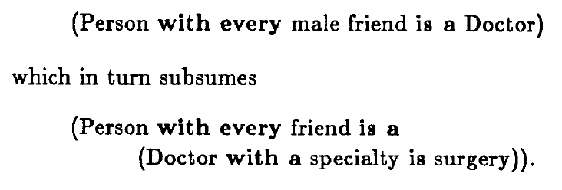
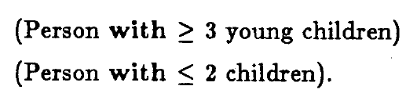
Subsumption & Disjointness
Subsumption:
Disjointness:

Slide 19
Conclusions & Directions
There are numerous ways to form knowledge bases, with varying functionality.
Reasoning is inference using the knowledge base, and there is a significant tradeoff between expressivity of the KB language and tractability of reasoning
Using hybrid systems (e.g. KRYPTON) can help optimizing based on task

Slide 20
Discussion
Expressivity vs. tractability in state of the art models?
How much expressivity is necessary for common sense reasoning?
Are these KB systems (with facts, attributes, procedures...) appropriate for common sense reasoning?
The paper presents reasoning as inference on a KB. We have discussed expressivity of a KB; could there be constraints on expressivity of reasoning as well?

