Slide 1
​ A Linear Programming Formulation for Global Inference in Natural Language Tasks​ Dan Roth Wen-tau Yih CoNLL, 04
Soham Dan (sohamdan@seas.upenn.edu)
2/6/2019

Slide 2
Problem & Motivation
Problem : Entity and Relation Recognition
Oswald was murdered at JFK after his assassin, KFJ…
kill (KFJ, Oswald)
Inference with Classifiers
Models inference as an optimization problem
Cast as a linear program which can be solved by LP packages

Slide 3
Contents:
SoTA
High level contributions
Details of the contributions
Results and Analysis
Conclusions

Slide 4
Previous approaches
Previous approaches were only able to handle sequential constraints (Dietterich, 2002)
Learning global models : HMMs, MRFs
Training is efficient via dynamic programming only if the nature of the constraints is sequential. Otherwise the inference is intractable.

Slide 5
Contributions of this work
New way to represent knowledge
Formulates the inference problem as an ILP that works even when the constraint structure is fairly general.
This framework is very flexible and it is possible to incorporate classifiers learnt from other contexts.

Slide 6
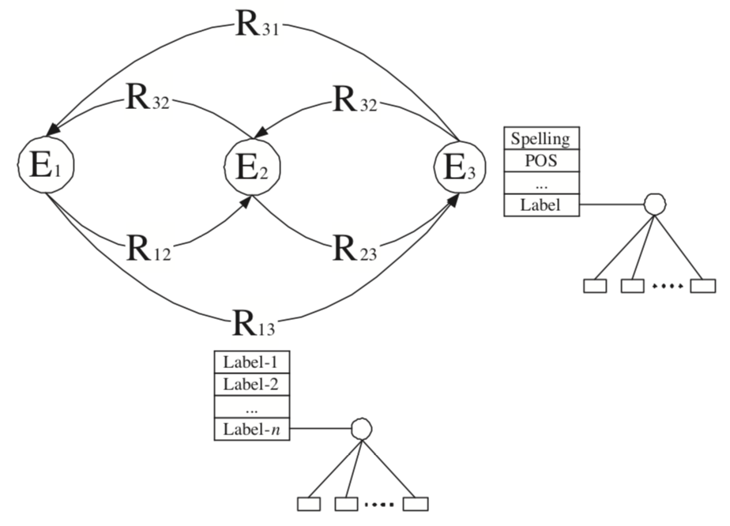
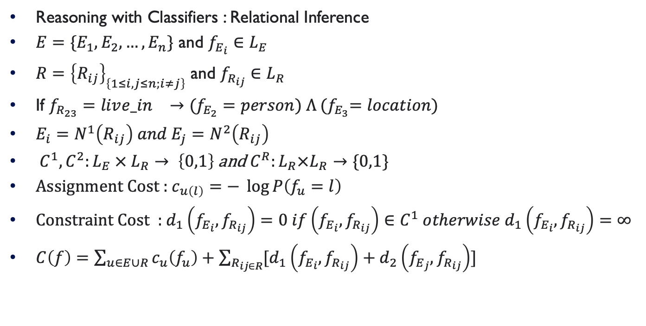
Details of the contributions
Reasoning with Classifiers : Relational Inference
$E=\{E_{1},E_{2},…, E_{n}\}$ and $f_{E_{i}}∈L_{E}$
$R={\left\{R_{ij}\right\}}_{\left\{1≤i,j≤n;i≠j\right\}}$ and $f_{R_{ij}}∈L_{R}$
If $f_{R_{23}}=liv{e_in}_{}→(f_{E_{2}}=person) Λ {(f}_{E_{3}}=location)$
$E_{i}=N^{1}\left(R_{ij}\right)$ $and E_{j}=N^{2}\left(R_{ij}\right)$
$C^{1},C^{2}:L_{E} × L_{R}→ \left\{0,1\right\}$ and $C^{R}:L_{R}×L_{R}→\{0,1\}$
Assignment Cost : $c_{u\left(l\right)}=−\log{P\left(f_{u}=l\right)}$
Constraint Cost : $d_{1}\left(f_{E_{i}}, f_{R_{ij}}\right)=0 if\left(f_{E_{i}}, f_{R_{ij}}\right)∈C^{1} otherwise{ d}_{1}\left(f_{E_{i}}, f_{R_{ij}}\right)=∞$
$C\left(f\right)=\sum_{u∈E∪R}{c_{u}\left(f_{u}\right)+\sum_{R_{ij∈R}}{[d_{1}\left(f_{E_{i}}, f_{R_{ij}}\right)+d_{2}\left(f_{E_{j}}, f_{R_{ij}}\right)]}}$

Slide 7
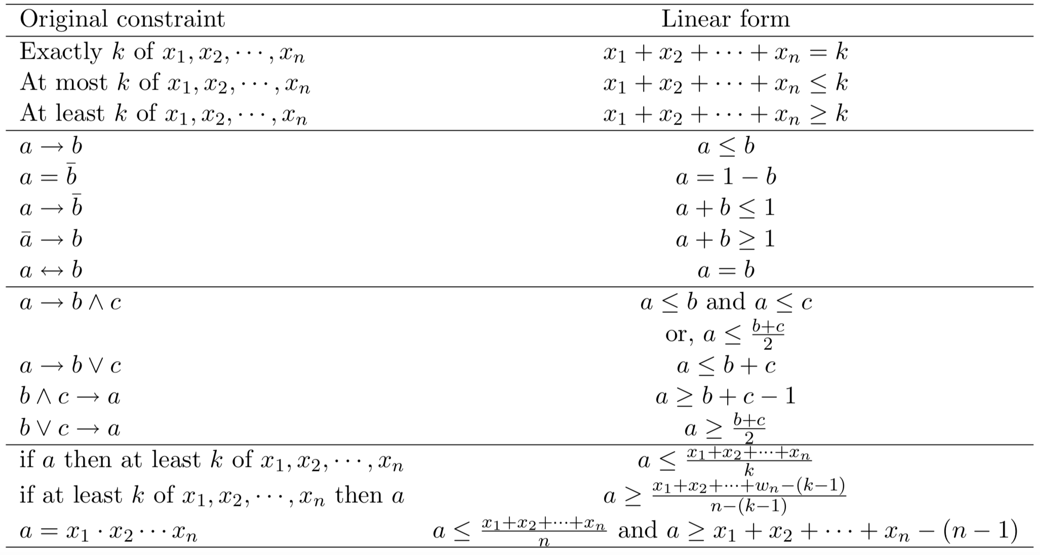
Details of the contributions (Constraints)
Global Inference Using Integer Linear Programming , Yih, 04

Slide 8
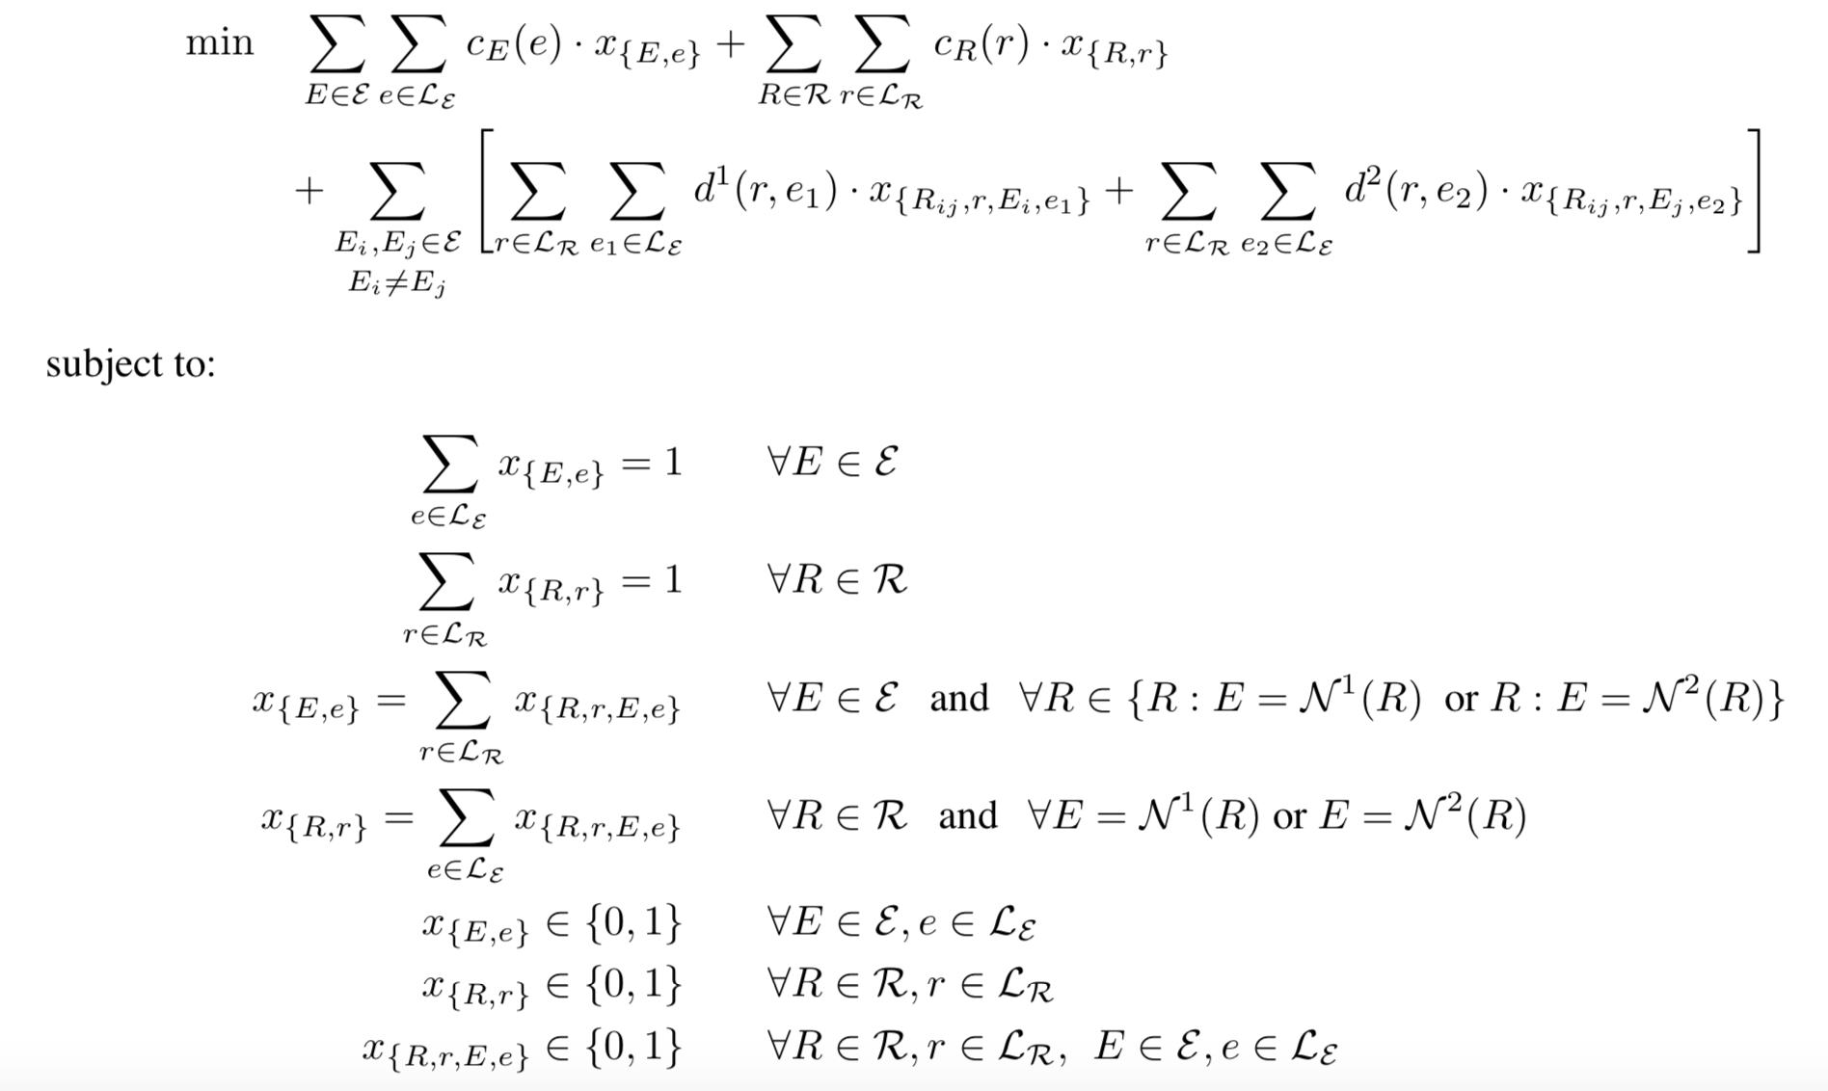
Details of the contributions (ILP)

Slide 9
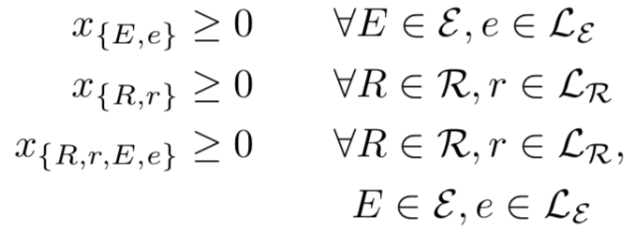

Details of the contributions
Linear Programming Relaxation
Relax the integral constraints
Rounding : good approximations
Branch and Bound and Cutting Plane
BB :$\min\left\{cx :x∈S, x∈{\left\{0,1\right\}}^{n}\right\}|→\min\left\{cx :x∈S, x_{i}=0\right\}$ and $\min\left\{cx :x∈S, x_{i}=1\right\}$
Gomory’s fractional cutting plane method : only finite number of additional constraints are needed

Slide 10
Details of the contributions
Unimodularity :
A matrix A of rank m is called unimodular if all the entries of A are integers, and the determinant of every square submatrix of A of order m is in 0,+1,-1.
Theorem (Veinott & Dantzig) Let A be an (m, n)- integral matrix with full row rank m. Then the polyhedron {x | x ≥ 0; Ax = b} is integral for each integral vector b, if and only if A is unimodular.
Although the coefficient matrix in the problem is not unimodular here, LPR still produces integer solutions
Coefficient matrix shares many properties of a unimodular matrix.
The particular cost function makes the solution integral

Slide 11
Results and Analysis
Input : entity boundaries in the sentence with at least one active relation
Entity Classifier : words, part-of-speech tags, and conjunctions of them, bigrams and trigrams of the mixture of words and tags.
Relation Classifier : features similar to those used in the entity classification are extracted from the two argument entities of the relation, conjunctions of the features from the two arguments, some patterns extracted from the sentence or between the two arguments.
Basic – only tests the above classifiers which are trained independently using only local features
Pipeline – entity classifier remains same but now, the relation classifier uses the predicted entity labels
LP- global inference procedure which can enhance the performance of the entity classifier
Omniscience – tests upper bound of this problem where the Entity classifier knows correct Relation label and the Relation classifier knows the correct Entity label

Slide 12
Results and Analysis
Approach | Person |  |  | Organization |  |  | Location
 | Rec | Prec | F1 | Rec | Prec | F1 | Rec | Prec | F1
Basic | 89.4 | 89.2 | 89.3 | 86.9 | 91.4 | 89.1 | 68.2 | 90.9 | 77.9
Pipeline | 89.4 | 89.2 | 89.3 | 86.9 | 91.4 | 89.1 | 68.2 | 90.9 | 77.9
LP | 90.4 | 90.0 | 90.2 | 88.5 | 91.7 | 90.1 | 71.5 | 91.0 | 80.1
Omniscience | 94.9 | 93.5 | 94.2 | 92.3 | 96.5 | 94.4 | 88.3 | 93.4 | 90.8
Approach | located_in |  |  | work_for |  |  | orgbased_in |  |  | live_in |  |  | kill
 | Rec | Prec | F1 | Rec | Prec | F1 | Rec | Prec | F1 | Rec | Prec | F1 | Rec | Prec | F1
Basic | 54.7 | 43.0 | 48.2 | 42.1 | 51,6 | 46.4 | 36.1 | 84.9 | 50.6 | 39.7 | 61.6 | 48.3 | 82.1 | 73.6 | 77.6
Pipeline | 51.2 | 51.6 | 51.4 | 41,4 | 55.6 | 47.5 | 36.9 | 76.6 | 49.9 | 42.6 | 62.2 | 50.6 | 83.2 | 76.4 | 79.6
LP | 53.2 | 59.5 | 56.2 | 40.4 | 72.9 | 52.0 | 36.3 | 90.1 | 51.7 | 41.5 | 68.1 | 51.6 | 81.3 | 82.2 | 81.7
Omniscience | 64.0 | 54.5 | 58.9 | 50.5 | 69.1 | 58.4 | 50.2 | 76.7 | 60.7 | 57.0 | 60.7 | 58.8 | 82.1 | 74.6 | 78.2

Slide 13
Results and Analysis
Coherent Prediction : If the relation label and argument entities are predicted correctly
Quality is ratio between coherent predictions and the sum of coherent and incoherent predictions
Basic and Pipeline generates incoherent predictions 5-25% of the time
LP and omniscience never produces incoherent predictions
Forced decision test adds a linear equality and beats omniscience.

Slide 14
Conclusions, Shortcomings and Future Work
Constraints area an effective way of knowledge representation
Constraints help a lot for inference (esp. in limited data regimes)
Shortcomings of the paper
Allowing soft constraints
Needs stronger theory of why LP relaxation works so well
Possible improvements/extensions
Exploring other ways to inject knowledge into the system
Developing guarantees of when the relaxation works

