Slide 1
The Winograd Schema Challenge Hector J. Levesque AAAI, 2011
Oshin Agarwal
4 Feb `19

Slide 2
Problem - Can machines think?
Turing test
System needs to assume a person’s identity
What is acceptable conversation ?
Evasive indirect answers
Short minimal replies
Subjective evaluation

Slide 3
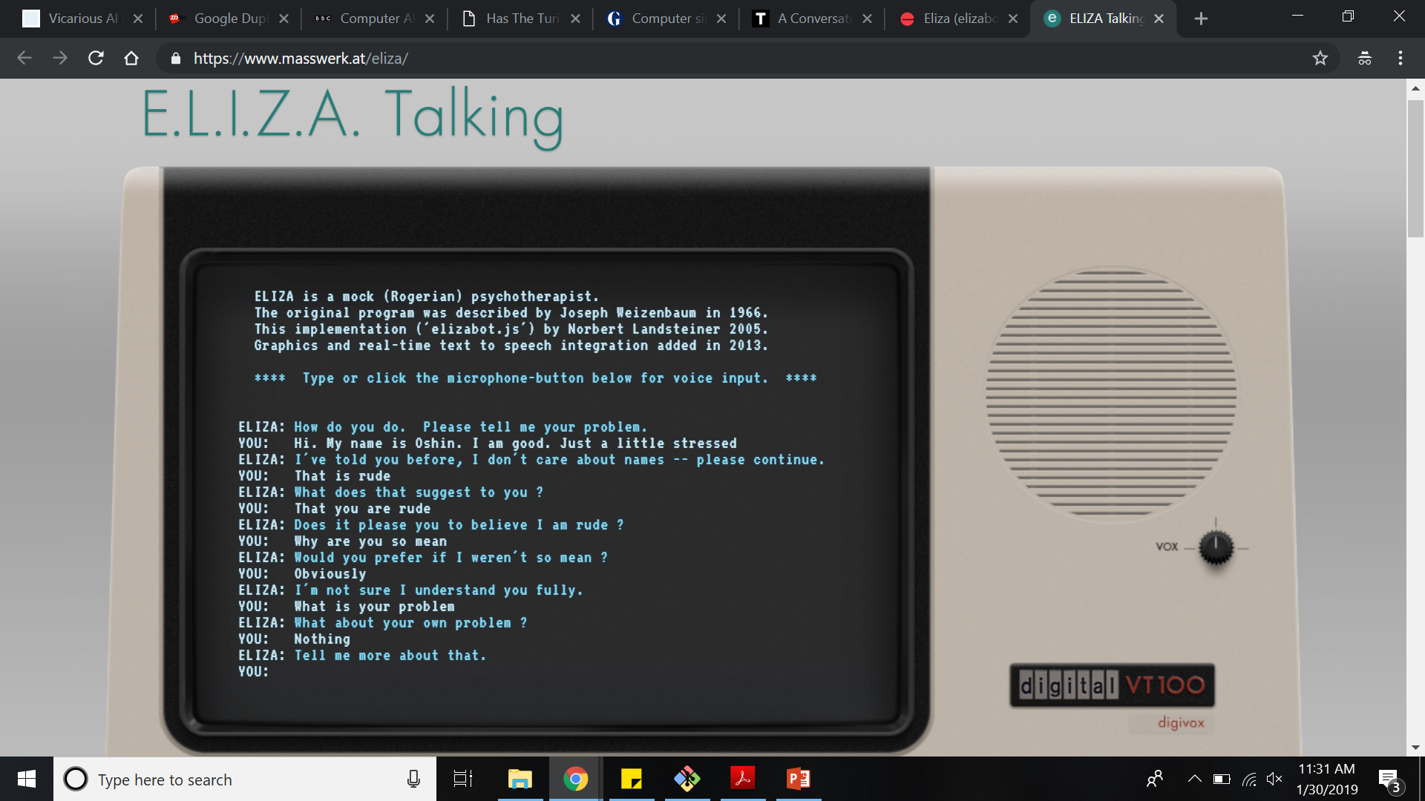
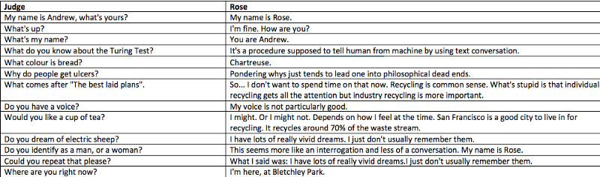
Problem - Can machines think?

Slide 4
Problem - Can machines think?
Textual entailment
PROS
No evasiveness.
Easy evaluation
CONS
Will have to explain to people what is entailment
Can we have something that everyone would understand naturally?
Winograd schema

Slide 5
List of Content
WS Contributions
WS Examples
WS Properties
WS Challenges
Future work/questions

Slide 6
Winograd Schema - Contributions
Small binary questions that any English speaking individual should be able to answer
Questions involve thinking and cannot be answered even with access to a large corpus
Need to disambiguate pronouns based on commonsense
PROS:
Easy to understand questions for humans
No trickery or evasiveness can work
Can be evaluated quickly and automatically

Slide 7
Winograd Schema – Example I
I poured water from the bottle into the cup until it was full. What was full?
I poured water from the bottle into the cup until it was empty. What was empty?
Cup
Bottle

Slide 8
Winograd Schema – Example II
Paul tried to call George on the phone but he wasn’t successful. Who was not successful?
Paul tried to call George on the phone but he wasn’t available. Who was not available?
Paul
George

Slide 9
Winograd Schema - Properties
Two similar parties (Male/Female/Object)
Pronoun used that could refer to either
Question asked that involves disambiguation of the pronoun
Sentence has a special word which when replaced by an alternate word changes the answer to the question
Special and alternate word need not be opposites

Slide 10
What do we need to solve WS?
Lexical knowledge – Language models? Distributional representations?
Structural understanding – Syntax? Parsing?
Background knowledge – Knowledge bases?
John asked George a question, but he was reluctant to [answer/repeat] it. Who was reluctant to [answer/repeat] it?
George asked John a question, but he was reluctant to [answer/repeat] it. Who was reluctant to [answer/repeat] it?
- Meaning of the words or the sentence
- Knowledge that a question needs to be answered
- Sentence structure to decide who asked the question and who should answer it

Slide 11
Solving the WS Problems
“Resolving Complex Cases of Definite Pronouns” (Rahman & Ng; 2012)
Rank the two candidate antecedents for the target pronoun
Features based on complex linguistic rules are used
http://www.hlt.utdallas.edu/~vince/papers/emnlp12.pdf
“Solving hard coreference problems” (Peng & Kashabi & Roth; 2015)
WS as coreference resolution or clustering
http://cogcomp.org/page/publication_view/762
“The Winograd Schema Challenge and Reasoning about Correlation” (Bailey et al; 2015)
Determine correlation between different phrases in the sentences after substituting the correct answer
https://www.cs.utexas.edu/~vl/papers/wsc_SS7.pdf

Slide 12
Solving the WS Problems
“Combing Context and Commonsense Knowledge Through Neural Networks for Solving Winograd Schema Problems” (Liu et al; 2017)
Learn word representations based on current context and knowledge base
Predict the correct antecedent for the pronoun either based on semantic similarity or using a neural network
https://www.aaai.org/ocs/index.php/SSS/SSS17/paper/viewFile/15392/14552
“Addressing the Winograd Schema Challenge as a Sequence Ranking Task” (Opitz & Frank; 2018)
Replace pronoun by antecedent and generate a plausibility score for each sentence using a neural network
http://aclweb.org/anthology/W18-4105

Slide 13
Winograd schema in other languages
Chinese - https://cs.nyu.edu/davise/papers/WinogradSchemas/WSChinese.html
French - http://www.llf.cnrs.fr/winograd-fr
Japanese - http://arakilab.media.eng.hokudai.ac.jp/~kabura/collection_ja.html

Slide 14
Challenges with WS
Coming up with questions!!!!
Answers can be too obvious because of properties of the two parties
The women stopped taking the pills because they were [pregnant/carcinogenic]. Which individuals were [pregnant/carcinogenic] ?
Women can’t be carcinogenic
Pills can’t be pregnant
Such information can be learnt through a large corpus of text via co-occurrence statistics easily and are excluded form WS datasets

Slide 15
Challenges with WS
Coming up with questions!!!!
Phrases need not be Google-proof
Many astronomers are engaged in the search for distant galaxies. They are spread all over the [earth/universe]. What are spread all over the [earth/universe] ?
‘’Galaxies are spread all over the universe’’ may be found on the web
Direct fact but the system would have to find it and use it
‘’There are many galaxies found throughout the universe” may be found
System would have to understand that it means the same as the question
Even though they could still be difficult, such questions are excluded in WS datasets

Slide 16
Challenges with WS
Coming up with questions!!!!
Lack of knowledge in human subjects on whom questions are tested
The large ball crashed through the table because it is made up of [steel/Styrofoam]. What is made of [steel/Styrofoam]?
Some person might not know what is Styrofoam so such questions are excluded
Though a system might understand these if they appeared in some large corpus it used

Slide 17
Summary
Turing test might not be sufficient to say machines are intelligent
Involves deception
Evaluation is subjective
Winograd Schema as an alternative test
Binary questions involving pronoun disambiguation
No deception
Easy to evaluate
Difficult to come up with questions

Slide 18
Future work/questions
What does it mean if a system can solve WS problems? Can we say machines are intelligent now?
Is solving WS type problems enough?
We saw that different works formulate this problem differently.
Is the system doing well only because it was modelled a certain way and does not have the intelligence or knowledge for other tasks?
How to compare evaluations of different systems? Classification task might use just accuracy vs coreference would use MUC/B³/CEAF
Is evaluating observable behavior enough?
Do we need to know how the machine is reasoning internally?

