Slide 1

Quick Introduction to Structured Prediction for Natural Language Understanding
Dan Roth
Computer and Information Science
University of Pennsylvania
February 2019
Notes:
Title

Slide 2
Learning with Declarative Representations
We talked about Declarative Representations, and Probabilistic Representations.
Most of the progress in both paradigms was still done in the Knowledge Representation & Reasoning Court. Learning was not involved.
Clearly, there is room to learn Prolog Statements
(and a field, called Inductive Logic Programming (ILP) devoted to it.
There is room to learn probabilistic extensions of Prolog, and Bayes Nets
and there were efforts in all these directions.
However, most of these were still not main-stream, not integrated and, for the most part, theoretical.
The first area where people thought together on learning and (some form of) reasoning
(not exactly in the Learning to Reason approach mentioned (see in the Classical papers)
was in the area of Structured Prediction.

Slide 3
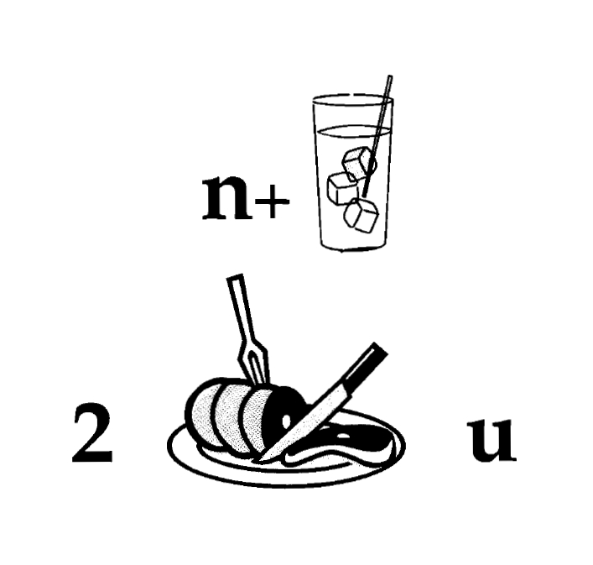
Nice to Meet You
Identify units
Consider multiple
representations and
interpretations
Pictures, text, layout, spelling, phonetics
Put it all together:
Determine “best” global interpretation
Satisfy expectations
Slide; puzzle

Slide 4
Joint Inference with General Constraint StructureEntities and Relations
Joint inference gives a good improvement
other | 0.05
per | 0.85
loc | 0.10
other | 0.10
per | 0.60
loc | 0.30
other | 0.05
per | 0.50
loc | 0.45
other | 0.05
per | 0.85
loc | 0.10
other | 0.10
per | 0.60
loc | 0.30
other | 0.05
per | 0.50
loc | 0.45
other | 0.05
per | 0.50
loc | 0.45
Key Questions:
How to learn the model(s)?
What is the source of the knowledge?
How to guide the global inference?
An Objective function that incorporates learned models with knowledge (expectation constraints)
A Constrained Conditional Model
Bernie’s wife, Jane, is a native of Brooklyn
E1 E2 E3
R₁₂
R₂₃
irrelevant | 0.05
spouse_of | 0.45
born_in | 0.50
irrelevant | 0.05
spouse_of | 0.45
born_in | 0.50
irrelevant | 0.05
spouse_of | 0.45
born_in | 0.50
irrelevant | 0.10
spouse_of | 0.05
born_in | 0.85
irrelevant | 0.10
spouse_of | 0.05
born_in | 0.85
Not all learning is from examples; communication-driven learning is essential.
Models could be learned separately/jointly; constraints may come up only at decision time.
Notes:
Why not learn it jointly?
Because you can’t always learn things jointly – some constraining information may come up at decision time. Some models may already be there, given to you.
And, not all learning is done from many examples -- most of the learning you do outside perceptual things you did not learn from many examples…but rather by being told or observing single examples.

Slide 5
Structured Prediction: Inference
Placing in context: a crash course in structured prediction (skip)
Inference: given input x (a document, a sentence),
predict the best structure y = {y₁,y₂,…,y_{n}} 2 Y (entities & relations)
Assign values to the y₁,y₂,…,y_{n}, accounting for dependencies among y_{i}s
Inference is expressed as a maximization of a scoring function
y’ = argmax_{y 2 Y} w^{T} Á (x,y)
Inference requires, in principle, touching all y 2 Y at decision time, when we are given x 2 X and attempt to determine the best y 2 Y for it, given w
For some structures, inference is computationally easy.
Eg: Using the Viterbi algorithm
In general, NP-hard (can be formulated as an ILP)
Joint features on inputs and outputs
Set of allowed structures
Feature Weights
(estimated during learning)

Slide 6
Structured Prediction: Learning
Learning: given a set of structured examples {(x,y)}
find a scoring function w that minimizes empirical loss.
Learning is thus driven by the attempt to find a weight vector w such that for each given annotated example (x_{i}, y_{i}):

Slide 7
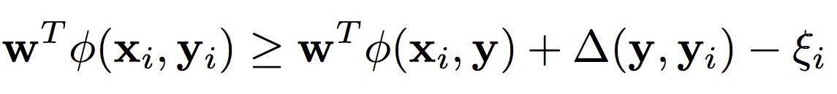
Structured Prediction: Learning
Learning: given a set of structured examples {(x,y)}
find a scoring function w that minimizes empirical loss.
Learning is thus driven by the attempt to find a weight vector w such that for each given annotated example (x_{i}, y_{i}):
We call these conditions the learning constraints.
In most learning algorithms used today, the update of the weight vector w is done in an on-line fashion,
Think about it as Perceptron; this procedure applies to Structured Perceptron, CRFs, Linear Structured SVM
W.l.o.g. (almost) we can thus write the generic structured learning algorithm as follows:
Score of annotated structure
Score of any other structure
Penalty for predicting other structure
8 y

Slide 8
Structured Prediction: Learning Algorithm
In the structured case, prediction (inference) is often intractable but needs to be done many times
For each example (x_{i}, y_{i})
Do: (with the current weight vector w)
Predict: perform Inference with the current weight vector
y_{i}’ = argmax_{y 2 Y} w^{T} Á ( x_{i} ,y)
Check the learning constraints
Is the score of the current prediction better than of (x_{i}, y_{i})?
If Yes – a mistaken prediction
Update w
Otherwise: no need to update w on this example
EndFor

Slide 9
Structured Prediction: Learning Algorithm
Solution I: decompose the scoring function to EASY and HARD parts
For each example (x_{i}, y_{i})
Do:
Predict: perform Inference with the current weight vector
y_{i}’ = argmax_{y 2 Y} w_{EASY}^{T} Á_{EASY} ( x_{i} ,y) + w_{HARD}^{T} Á_{HARD} ( x_{i} ,y)
Check the learning constraint
Is the score of the current prediction better than of (x_{i}, y_{i})?
If Yes – a mistaken prediction
Update w
Otherwise: no need to update w on this example
EndDo
EASY: could be feature functions that correspond to an HMM, a linear CRF, or even Á_{EASY} (x,y) = Á(x), omiting dependence on y, corresponding to classifiers.
May not be enough if the HARD part is still part of each inference step.

Slide 10
Structured Prediction: Learning Algorithm
Solution II: Disregard some of the dependencies: assume a simple model.
For each example (x_{i}, y_{i})
Do:
Predict: perform Inference with the current weight vector
y_{i}’ = argmax_{y 2 Y} w_{EASY}^{T} Á_{EASY} ( x_{i} ,y) + w_{HARD}^{T} Á_{HARD} ( x_{i} ,y)
Check the learning constraint
Is the score of the current prediction better than of (x_{i}, y_{i})?
If Yes – a mistaken prediction
Update w
Otherwise: no need to update w on this example
EndDo

Slide 11
Structured Prediction: Learning Algorithm
Solution III: Disregard some of the dependencies during learning; take into account at decision time
For each example (x_{i}, y_{i})
Do:
Predict: perform Inference with the current weight vector
y_{i}’ = argmax_{y 2 Y} w_{EASY}^{T} Á_{EASY} ( x_{i} ,y) + w_{HARD}^{T} Á_{HARD} ( x_{i} ,y)
Check the learning constraint
Is the score of the current prediction better than of (x_{i}, y_{i})?
If Yes – a mistaken prediction
Update w
Otherwise: no need to update w on this example
EndDo
y_{i}’ = argmax_{y 2 Y} w_{EASY}^{T} Á_{EASY} ( x_{i} ,y) + w_{HARD}^{T} Á_{HARD} ( x_{i} ,y)
This is the most commonly used solution in NLP today

Slide 12
Constrained Conditional Models
Any MAP problem w.r.t. any probabilistic model, can be formulated as an ILP
[Roth+ 04, Taskar 04]
Penalty for violating
the constraint.
Variables are models
y = argmax_{y} ∑ 1_{∅(x,y)} w_{x,y} subject to Constraints C(x,y)
y = argmax_{y} $∈$ _{Y} w^{T}$∅$(x, y) + u^{T}C(x, y)
Knowledge component:
(Soft) constraints
Weight Vector for “local” models
Magic Box(es)
Features, classifiers; NN; log-linear models; a combination (non-linearity comes here)
How far y is from
a “legal/expected” assignment
E.g., an entities model; a relations model.
Training: learning the objective function (w, u)
Decouple? Decompose? Force u to model hard constraints?
There is some understanding for when to do what
Inference: A way to push the learned model to satisfy our output expectations (or expectations from a latent representation)
[CoDL, Chang, Ratinov, Roth (07, 12); Posterior Regularization, Ganchev et. al (10); Unified EM (Samdani & Roth(12), dozens of applications in NLP]
The benefits of thinking about it as an ILP are conceptual and computational.
Decomposition is key for abstraction and transfer

Slide 13
Examples: CCM Formulations
y = argmax_{y 2 Y} w^{T}Á(x, y) + u^{T}C(x, y)
While Á(x, y) and C(x, y) could be the same; we want C(x, y) to express high level declarative knowledge over the statistical models.
Formulate NLP Problems as ILP problems (inference may be done otherwise)
1. Sequence tagging (HMM/CRF + Global constraints)
2. Sentence Compression (Language Model + Global Constraints)
3. SRL (Independent classifiers + Global Constraints)
Sequential Prediction
HMM/CRF based:
Argmax ∑ ¸_{ij} x_{ij}
Sentence Compression/Summarization:
Language Model based:
Argmax ∑ ¸_{ijk} x_{ijk}
Knowledge/Linguistics Constraints
Cannot have both A states and B states in an output sequence.
Knowledge/Linguistics Constraints
If a modifier chosen, include its head
If verb is chosen, include its arguments
Constrained Conditional Models Allow:
Decouple complexity of the learned model from that of the desired output
Learn a simple model (multiple; pipelines); reason with a complex one.
Accomplished by incorporating constraints to bias/re-rank global decisions to satisfy (minimally violate) expectations.

Slide 14
Semantic Role Labeling (SRL) [Extended SRL]
I left my pearls to my daughter in my will .
[I]_{A0} left [my pearls]_{A1} [to my daughter]_{A2} [in my will]_{AM-LOC} .
A0 Leaver
A1 Things left
A2 Benefactor
AM-LOC Location
I left my pearls to my daughter in my will .
Variable y^{a,t} indicates whether candidate argument a is assigned a label t.
c^{a,t} is the corresponding model score
Algorithmic approach:
Learn multiple models, identifying arguments and their types.
Account for interdependencies via ILP inference.
argmax ∑_{a,t} y^{a,t} c^{a,t} = ∑_{a,t} 1_{a=t} c_{a=t}
Subject to:
One label per argument: ∑_{t} y^{a,t} = 1
Relations between verbs and arguments,….
Use the pipeline architecture’s simplicity while maintaining uncertainty: keep probability distributions over decisions & use global inference at decision time.
Notes:
In the context of SRL, the goal is to predict for each possible phrase in a given sentence if it is an argument or not and what type it is.

