Slide 1
Unsupervised Learning of Narrative Schemas and their Participants
Nathanael Chambers and Dan Jurafsky
ACL, 2009
Halley Young (halleyy@seas.upenn.edu)
02/18/2019

Slide 2
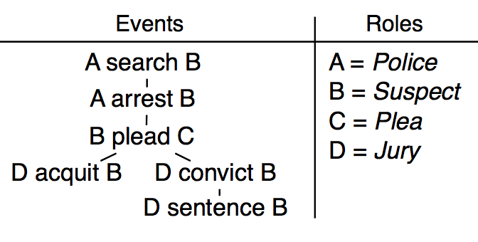
Problem & Motivation
Problem: Discover narrative schemas in an unsupervised manner
Narrative schemas are partial orderings of a set of events which all share one of a finite, small set of arguments, or roles
Text 1:
“The police searched the suspect before they arrested him.
He plead innocent and the jury acquitted him”
…
Text N: “The cops searched the suspect. He plead guilty, and the jury
convicted him and sentenced him to 3 years in prison.”

Slide 3
Why do we care?
Knowing such schema can help with coreference resolution and sense disambiguation
recent (2018) paper uses for improving scores on Winograd schema
Generative models that produce entire narratives should know to generate temporally and thematically appropriate narratives
It’s kind of cool to know that a linguistic hypothesis from the 1950s-70s (Minsky, Filmore) about how meaning arises can be discovered statistically
Can be used for summarization (if P always follows Q, maybe only need to say Q)
Understanding steps to a process that a robot might carry out

Slide 4
Contents:
Previous approaches to this paper
This paper’s approach to this problem
Results from this paper
Approaches since this paper has been published
Conclusions and final questions

Slide 5
Previous approaches prior to this paper
Mostly hand-crafted “scripts” or “frames” (slightly different formulations of a very similar KR problem)
In previous paper by same author, used unsupervised approach, but didn’t learn roles or have event slots with both participants

Slide 6
Contributions of this work
Unsupervised learning of what was before generally an exhausting manual task
Improvements in accuracy and expressivity over previous methods for creating narrative schema which contained only partial schema (i.e., some subject/object positions unfilled) and did not provide role types

Slide 7
How does it work?
Jointly learning chains of events (verbs + argument slot) and roles that fit in argument slots
Assume existence of coreference disambiguation, then try to maximize the similarity (by frequency of co-occurrence) of events and roles connected in a narrative schema

Slide 8
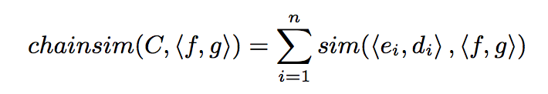
How does it work?
For a given tuple (f :: verb, g :: argument type), and for an existing chain of (tuple, argument pairs), the score
, where similarity is defined by point wise mutual information (proportional to probability of being seen together)
chainsim({(arrest, object), (plead, subject)}, (convict, object)) should be high, since in many texts the object of arrest, subject of plead, and object of convict appear together

Slide 9
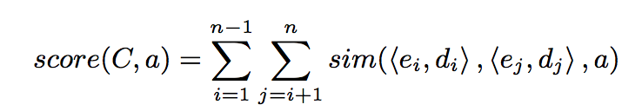
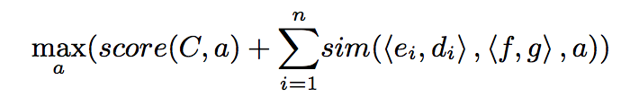
How does it work?
Specific to a given argument,
(again measuring frequency of co-occurence, but this time with a given role value instead of simply argument slots.
Then
chainsim’(C, <f,g>) =
Essentially, a verb-event slot fits a narrative schema if there is an actual role type that it is associated with that it shares between many elements of the schema
This means that, even though there aren’t a lot of instances of {(arrest, object), (plead, subject), (convict, object)} where the role is played by the police, because there exists a role (the suspect) for which there is a high co-occurrence, (convict, object) fits well with the existing narrative chain

Slide 10
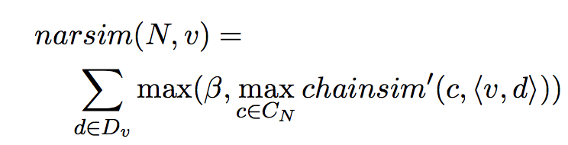
How does it work?
Define another function to maximize:
N = a set of events and mappings from events to argument
Notice that we’re maximizing for a given verb over all possible argument structures
β is a hyperparameter that controls whether to include a verb in a narrative schema or start a new one
As seen before, (convict, object) fits well into the chain containing {(arrest, object), (plead, subject)}, but if we evaluate “chop” before creating any chains relating to cooking, it makes sense to start a new narrative schema

Slide 11
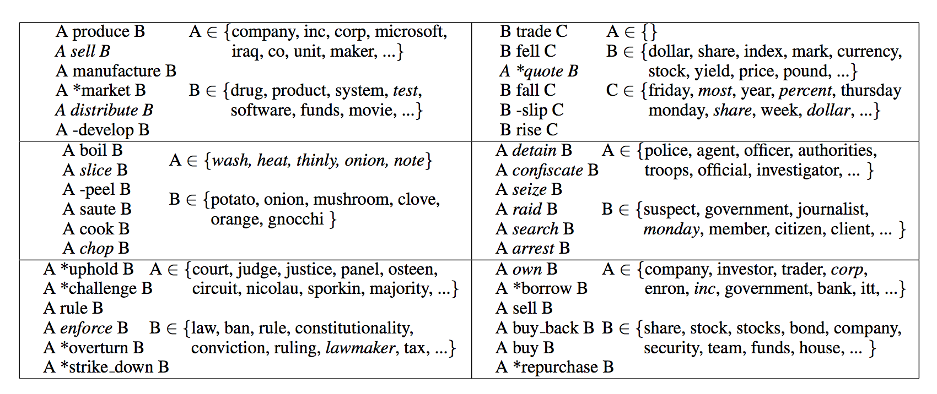
Example Schema Found

Slide 12
Results and Analysis
Compare results of schema generation on a New York Times dataset to the hand-crafted FrameNet schemas
Able to easily map 13/20 narrative schemas to FrameNet frames
Unclear if the other 7 were poorly chosen or a sign that FrameNet is not wide-coverage
78 total verbs, of which 52 occurred in FrameNet
67% of the 52 were grouped similarly in FrameNet
156 argument slots, out of which 96.8% were grouped correctly relative to the other verbs sharing that slot

Slide 13
Results and Analysis - Cloze Test
Task: given human defined narrative chain with one event slot missing, rank position of that event slot on the list of potential new event slots to add to the chain
10.1% improvement using the argument roles

Slide 14
Work since then
“NASTEA: Investigating Narrative Schemas through Annotated Entities” by Simonson and Davis, 2016
use document categories and topic modeling
Authors of this paper (Jurafsky and Chambers, 2011) recently wrote a new paper which gives richer roles than subject/object (e.g., an “embassy” is the “target” of a “bombing”)

Slide 15
Conclusions
Tasks that before we assumed required human annotation may be possible to learn in an unsupervised fashion
Joint learning of different types of variables can improve accuracy over creating two distinct learning tasks
There are a fairly large number of sets of events with roles which reoccur together with high frequency, given a certain (newspaper) corpus

Slide 16
Questions to think about
Moving past 2009 - word vectors? LSTMs?
Whatever you think about whether FrameNet has been a success or not, would you assume that a set of frames based solely on verbs that actually co-occur with similar arguments often in practice would be more or less useful?
Arguments for more usefulness: relate to the texts the machine will actually see, has the possibility of scaling beyond human annotation
Arguments for less usefulness: Consider the frame “Activity_ready_state”

Slide 17
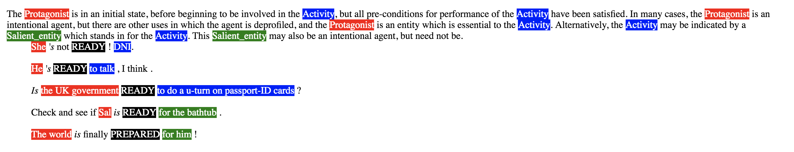
(FrameNet Example)
Could this approach be extended to take “to do a u-turn on passport ID cards” as an argument?”
Notice the difference between “for the bathtub” and “for him”

Slide 18
Questions?
Thank you!

