Slide 1
CIS-700 Spring 2019 Commonsense Reasoning
Dan Roth
Computer and Information Science
University of Pennsylvania
Notes:
Title

Slide 2

What’s Important in order to make progress in NLU
How to make progress towards natural language understanding
Learning and Reasoning; knowledge
Dispel with [some] of the currently hot trends
If we want to reach the moon…
What is Commonsense
This class
Notes:
This is my model for natural language comprehension – and I’d like to talk about some of the key issues we need to think about if we want to make progress in NLU
In doing it, I’ll dispel with some of the currently hot trends – they can help up clime trees, but we want to reach the moon.
I will use it to pay tribute to John McCarthy – many of you, I hope, know that he thought a lot about representations and Reasoning, I will discuss some of his thoughts about natural language stories
And I’ll use it to give you a brief tour of some of the relevant, hopefully important, ideas came from my work in these directions, and were we should go.

Slide 3


Natural Language Understanding
visitors
killed
No connective
This is an Inference Problem
At least 14 people have been killed in southern Sri Lanka, police say. The telecoms minister was among about 35 injured in the blast site at the town of Akuressa, 160km (100 miles) south of the capital, Colombo. Government officials were attending a function at a mosque to celebrate an Islamic holiday at the time. The minister said later that the suicide attack was carried out by ….
➔ 49 people were hit by a suicide bomber in Akuressa.
Requires dealing with a large number of phenomena
lexical, quantitative, co-reference, semantic types, discourse convention, knowledge…
Understanding is telling ourselves a story about the story
Notes:
I read this story; but a small part of it got wet; so you will help me figure out if what I heard on National Public Radio is correct given this story, and also, what’s behind this black ink.
Where? …..How do you know?
Cannot be pumpkins -- the minister cannot be a pumpkin; and I cannot add it to people (semantic type);
but can be killed from the semantic types perspective (even though “killed” is a verb), but you probably infer that the argument is missing and can go on.
Killed does not make sense since we think that the seconds sentence elaborates on the first sentence rather than contradicts it – this is part of a convention that we buy into when we read a story – we have some expectations.
It would not fit into our equation – 35 + 14 = 49;
And, this is the telecom minister, and the minister here might be the same one….
Visitors – makes sense since he talked about it later – but doesn’t fit the math.
Injured is good;
But he probably wasn’t injured too seriously, since he was talking about it later.
There is a lot of “what if” when we read a story like that – even at the very low level …..
More than anything else, understanding is telling ourselves a story about the story….

Slide 4
No Magic Box
At least 14 people have been killed in southern Sri Lanka, police say. The telecoms minister was among about 35 injured in the blast site at the town of Akuressa, 160km (100 miles) south of the capital, Colombo. Government officials were attending a function at a mosque to celebrate an Islamic holiday at the time. The minister said later that the suicide attack was carried out by
A lot of “magic boxes” are needed to address NLU.
Induced different ways, at different times, using different resources
Some via learning from examples, some by being told decleartively, by being read, or inferred.
Not everything is an input-output problem
And there is a need to reason over the “boxes”

Slide 5
A Biased View of Common Sense Reasoning
Hayes&McCarthy
Frame Problem
Brooks
Subsumption
Quillian
Semantic Networks
ConceptNet
Minsky, Filmore
Frames
McCarthy
Formalizing Commonsense
Description Logic
Bobrow
STUDENT
Simon&Newell
General Problem Solver
Lenant
Cyc
Winograd
SHRDLU
2000 1990 1980 1970 1960 1950 1940
Common Sense Reasoning was formulated
traditionally as a “reasoning” process, irrespective of learning and the resulting knowledge representation.
Khardon & Roth
Learning to Reason

Slide 6
Learning to Reason
A unifying computational theory of Learning and Reasoning.
Reasoning should be studied together with Learning and the knowledge representation it produces.
Formally showing the benefits in jointly studying Learning and Reasoning
Some hard reasoning tasks become easy if done on top of learning into an appropriate knowledge representation.
[Khardon & Roth JACM’96; 1994—2000]
In some sense, these ideas are now main stream.
But, understanding when to decompose learning and when to decouple it from reasoning is also very important.
At the heart of supporting abstraction and transfer
No better domain to think about this than Natural Langauge

Slide 7
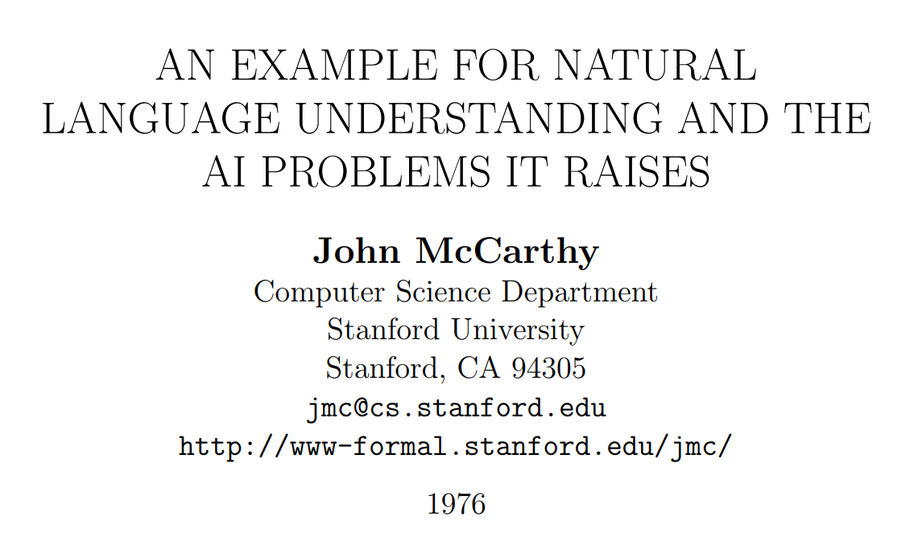
John McCarthy on Natural Language Understanding

Slide 8
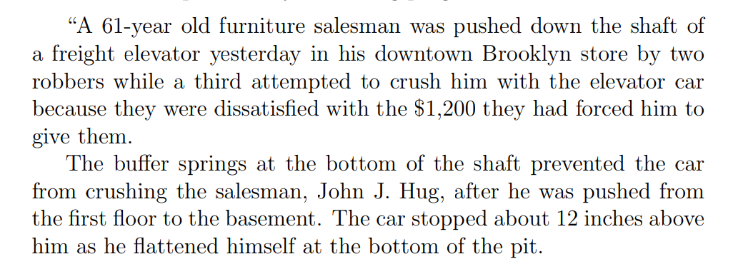
A New York Times Story

Slide 9
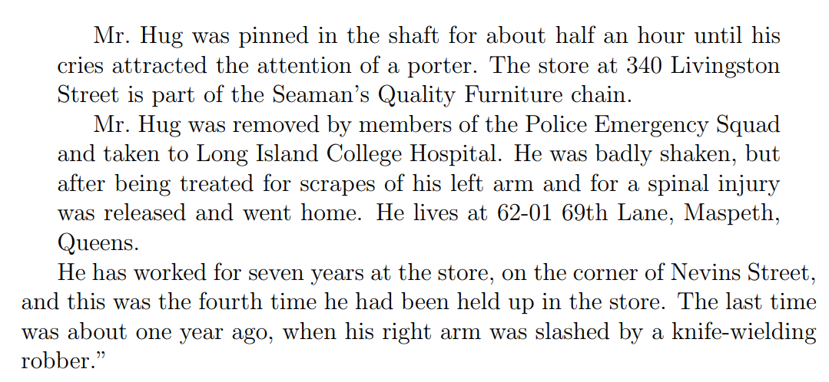
A New York Times Story (Cont.)

Slide 10
New York Times Story: Questions
An intelligent person or program should be able to answer the following questions based on the information in the story:
The article proceeds with 22 questions:
1. Who was in the store when the events began?
Probably Mr. Hug alone, although the robbers might have been waiting for him, but if so, this would have been stated.
2. What did the porter say to the robbers?
Nothing, because the robbers left before he came.
20. Why did Mr. Hug yell from the bottom of the elevator shaft?
So as to attract the attention of someone who would rescue him.
“The above list of questions is rather random. I doubt it covers all facets of understanding the story.”

Slide 11
McCarthy’s Challenges
The QA module is not being trained Once the program knows English, and has the relevant background knowledge, it should answer the questions
A formalism capable of expressing the assertion of the sentences free from dependence on the grammar of the English language. (“Artificial Natural Language”, ANL)
Semantic Parser
An “understander” that constructs the “facts” from the text.
Information Extraction: Entities, Relations, Temporal, Quantities,…
Expression of the “general information” about the world that could allow getting the answers to the questions from the “facts” and the “general information”
Background Knowledge
A “problem solver” that could answer the above questions on the basis of the “facts”.
Question Answering Engine

Slide 12
Lessons
What can we learn from this example?
Difficulties of NLU
Importance of reasoning
Decoupling learning from reasoning

Slide 13
A Biased View of Common Sense Reasoning
One cannot simply map natural language to a representation that gives rise to reasoning
Hayes&McCarthy
Frame Problem
Brooks
Subsumption
Quillian
Semantic Networks
ConceptNet
Minsky, Filmore
Frames
McCarthy
Formalizing Commonsense
Description Logic
Bobrow
STUDENT
Simon&Newell
General Problem Solver
Lenant
Cyc
Winograd
SHRDLU
2000 1990 1980 1970 1960 1950 1940
Common Sense Reasoning was formulated
traditionally as a “reasoning” process, irrespective of learning and the resulting knowledge representation.
Khardon & Roth
Learning to Reason

Slide 14
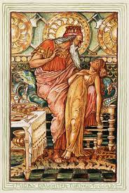
Why is it Difficult?
Midas: I hope that everything I touch becomes gold.
One cannot simply map natural language to a representation that gives rise to reasoning
Meaning
Variability
Ambiguity
Language

Slide 15






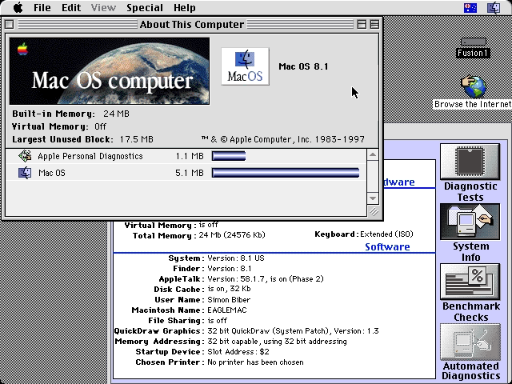
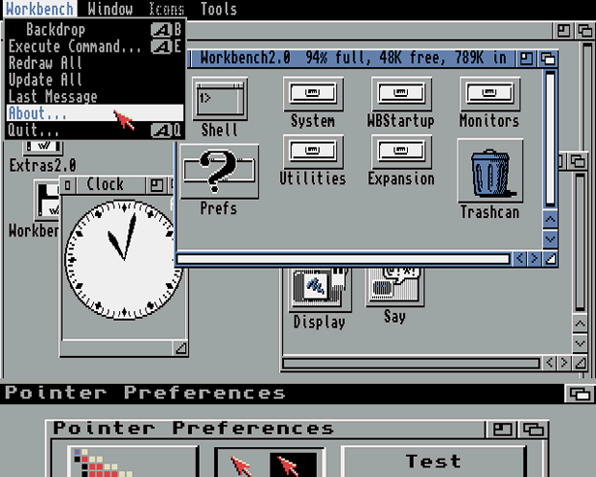
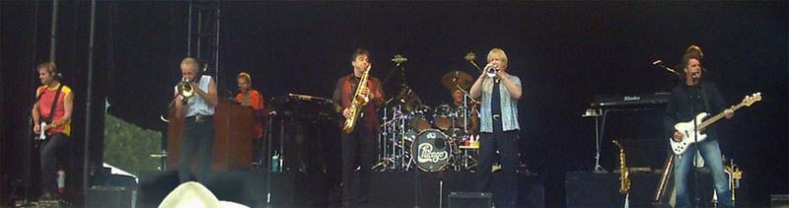
Ambiguity
It’s a version of Chicago – the standard classic Macintosh menu font, with that distinctive thick diagonal in the ”N”.
Chicago was used by default for Mac menus through MacOS 7.6, and OS 8 was released mid-1997..
Chicago VIII was one of the early 70s-era Chicago albums to catch my
ear, along with Chicago II.

Slide 16

Variability in Natural Language Expressions
Determine if Jim Carpenter works for the government
Jim Carpenter works for the U.S. Government.
The American government employed Jim Carpenter.
Jim Carpenter was fired by the US Government.
Jim Carpenter worked in a number of important positions. …. As a press liaison for the IRS, he made contacts in the white house.
Russian interior minister Yevgeny Topolov met yesterday with his US counterpart, Jim Carpenter.
Former US Secretary of Defense Jim Carpenter spoke today…
Conventional programming techniques cannot deal with the variability of expressing meaning nor with the
ambiguity of interpretation
Machine Learning is needed to support abstraction over the raw text, and deal with:
Identifying/Understanding Relations, Entities and Semantic Classes
Acquiring knowledge from external resources; representing knowledge
Identifying, disambiguating & tracking entities, events, etc.
Time, quantities, processes…
Notes:
16

Slide 17



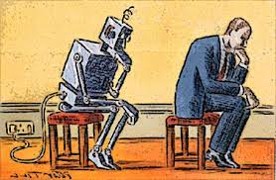
What’s Important?
Learning and Reasoning in the Presence of Knowledge.
Combining the “soft” with the logical/declarative
Scaling Up
Computational Issues
Training Models
With Incidental Supervision
Notes:
In a more abstract way : My research span all these aspects & more; but I’ll focus on providing a framework, present some examples, and some recent, exciting results towards the end.
17

Slide 18

Commonsense?
Did Aristotle have a laptop?

Slide 19
Understanding Language
Automating natural language understanding requires
models that are informed by commonsense knowledge
the ability to reason with it in both common and unexpected situations.
The success of statistical and deep learning methods
has supported significant advances in some aspects of AI,
especially those that depend on learning standalone models
But:
Ask a robot to “get me a piece of cake" -- what’s needed?
How long would it take?
And how long would it take to bake a cake?
Our models don’t even know that NYC is always on the East Coast, while Paul Simon is sometimes there.

Slide 20
What’s Commonsense?
We know things about the physical world
We know a lot about social behavior and norms
…
What? How?
Is it only knowledge, or is reasoning involved?
Aristotle’s laptop example requires reasoning.
If A is contained in B and B in C, A is inside C: deduction
Do we do it in today’s NLP?
If my dog's paws were dry before he went out and they are wet now, he must have stepped into a puddle: abduction
A lot of it happens in NLP; e.g., constrained optimization formulations (ILP)
What other forms of reasoning are needed?

Slide 21
What’s needed?
We need to think about knowledge
What is it? How to represent it? How to acquire it? How to use it?
We need to think about learning and reasoning paradigms
Current machine learning is [all] about “define a task; train for it”
Is this a reasonable way?
We need to think about how to acquire knowledge
And represent it in ways that facilitate reasoning
We need to think about how to make progress in NLU
NLU is hard (is that clear?)
What the field of NLP is doing today is not sufficient?

Slide 22
This class
Understand early and current work in commonsense
Read critically and discuss
Understand some of the difficulties
Conceptual and technical
Try some new ideas
How:
Presenting/discussing papers
Probably: 2 presentation each; 4 discussants
Writing critical reviews
“Small” individual project (reproducing);
Large project (pairs)

