Slide 1
Global Learning of Focused Entailment Graphs Jonathan Berant, Ido Dagan, Jacob Glodberger ACL, 2010
Hangfeng He (hangfeng@seas.upenn.edu)
February 06, 2019

Slide 2
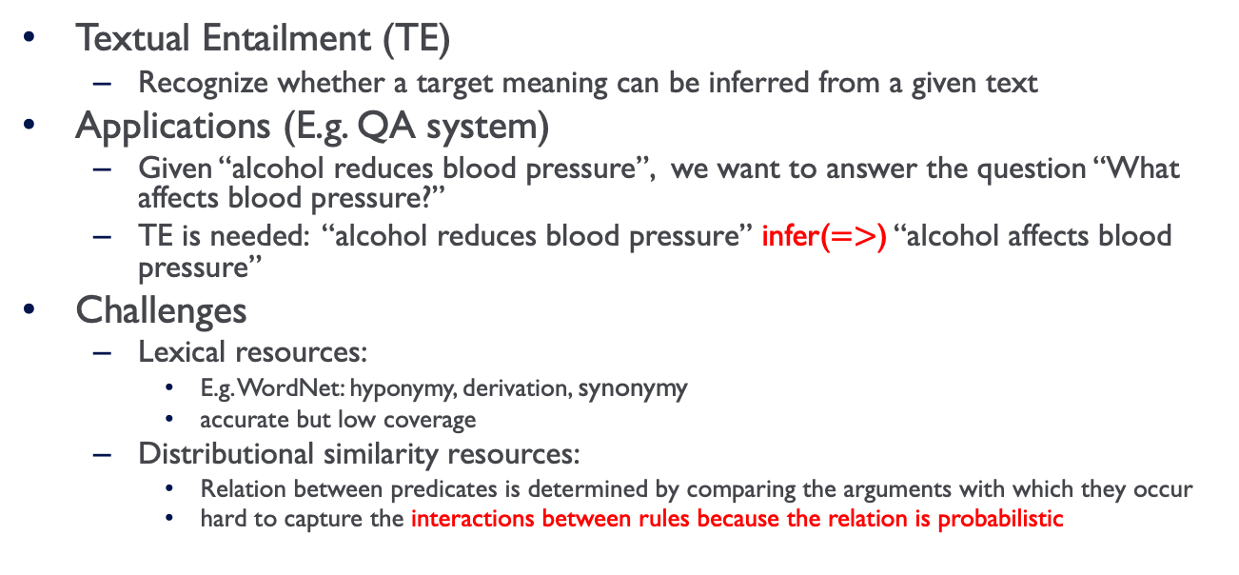
Problem
Textual Entailment (TE)
Recognize whether a target meaning can be inferred from a given text
Applications (E.g. QA system)
Given “alcohol reduces blood pressure”, we want to answer the question “What affects blood pressure?”
TE is needed: “alcohol reduces blood pressure” infer($=>$) “alcohol affects blood pressure”
Challenges
Lexical resources:
E.g. WordNet: hyponymy, derivation, synonymy
accurate but low coverage
Distributional similarity resources:
Relation between predicates is determined by comparing the arguments with which they occur
hard to capture the interactions between rules because the relation is probabilistic

Slide 3
Motivation
Previous work mainly focuses on learning each entailment rule in isolation
Snow et al. (2006) use greedy search to make use of the transitive relation
Can we make use of the knowledge (e.g. transitivity and prior) to learn entailment relations between predicates using a global approach?

Slide 4
Contents
Problem and Motivation
Focused Entailment Graphs
Learning Entailment Graph Edges
Experimental Evaluation
Discussion

Slide 5
Previous approaches
Snow et al.’s algorithm for taxonomy induction (2006)
Constraint: transitive relation
Greedy search: adds at each step the set of hyponyms that maximize the probability of the evidence while respecting the transitivity constraint
Relational view of meaning (class)
A natural inference formulation then becomes that of textual entailment: determining whether one snippet of text (Text; Premise) entails another (Hypothesis)

Slide 6
Contributions of this work
Main Contributions
Focused entailment graphs: a novel hierarchical presentation scheme for corpus propositions referring to a target concept
A global optimization algorithm for learning entailment relations between predicates represented as propositional templates
Extra: provide a medical dataset for evaluating entailment

Slide 7
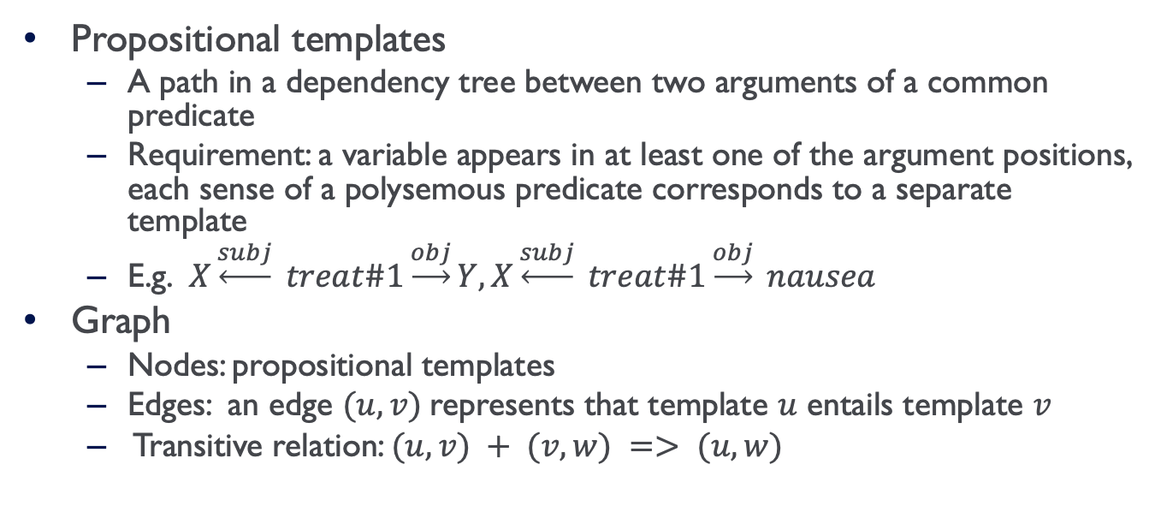
Entailment Graph
Propositional templates
A path in a dependency tree between two arguments of a common predicate
Requirement: a variable appears in at least one of the argument positions, each sense of a polysemous predicate corresponds to a separate template
E.g. $X\underset{←}{subj} treat\#1\underset{→}{obj}Y, X\underset{←}{subj} treat\#1\underset{→}{obj} nausea$
Graph
Nodes: propositional templates
Edges: an edge $(u, v)$represents that template $u$ entails template $v$
Transitive relation: $(u, v) + (v, w) => (u, w)$

Slide 8
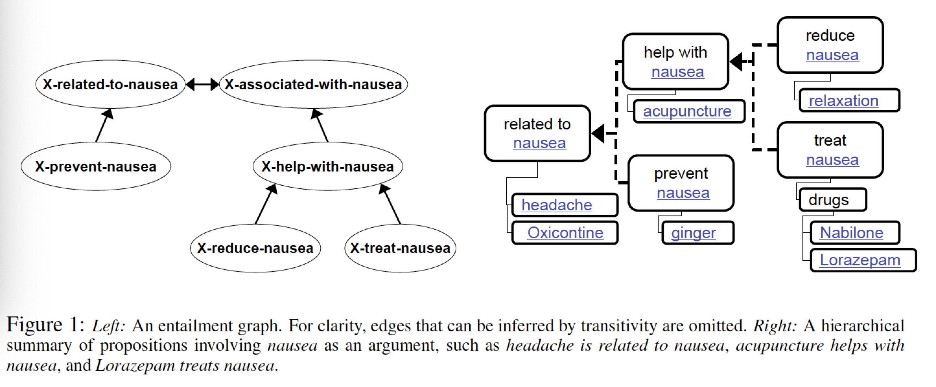
Focused Entailment Graphs
Note: propositional templates have exactly one argument instantiated by the same entity (e.g. nausea)

Slide 9
Global Learning
Interactions + constraints
Local: Each edge (e.g. A=>B, B=>C, C=>A) is determined in isolation
Global:
Each edge is determined by knowing information from other edges
The results are coherent with the knowledge
Integer Linear Programming (ILP)
Knowledge can be represented as constraints
The optimization problem is formulated as an ILP
A
C
B

Slide 10
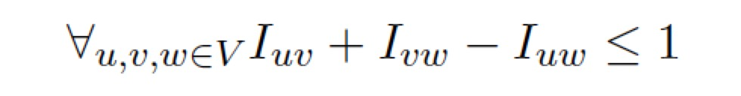
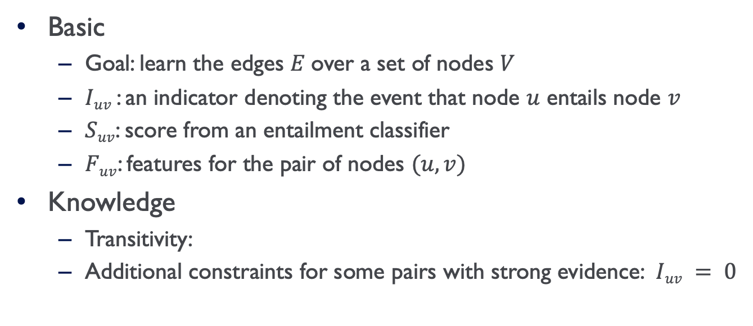
Graph and Knowledge
Basic
Goal: learn the edges $E$over a set of nodes $V$
$Iuv$ : an indicator denoting the event that node $u$ entails node $v$
$Suv$: score from an entailment classifier
$Fuv$: features for the pair of nodes $(u, v)$
Knowledge
Transitivity:
Additional constraints for some pairs with strong evidence: $Iuv = 0$

Slide 11
Learning Entailment Graph Edges
Training an entailment classifier
Template extraction: propositional templates from every parse tree
Distributional similarity representation: predicate presentation, feature representation, similarity function
Training set generation (WordNet):
Positive: direct hypernyms and synonyms
Negative: co-hyponyms
Global learning of edges
Score-based target function
Probabilistic target function

Slide 12
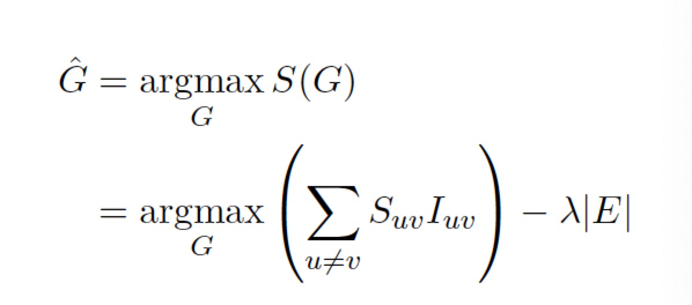
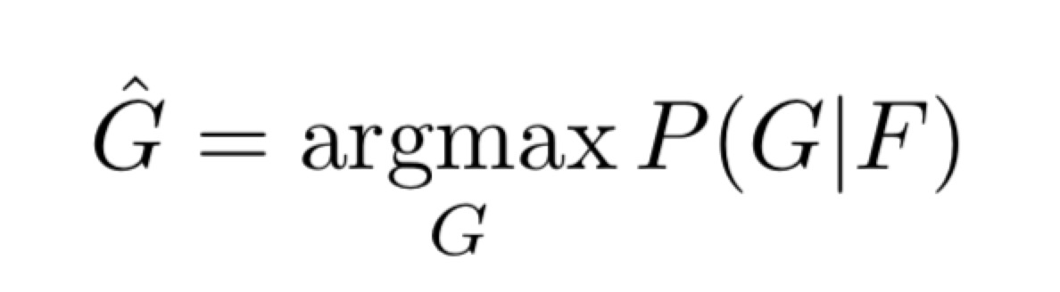
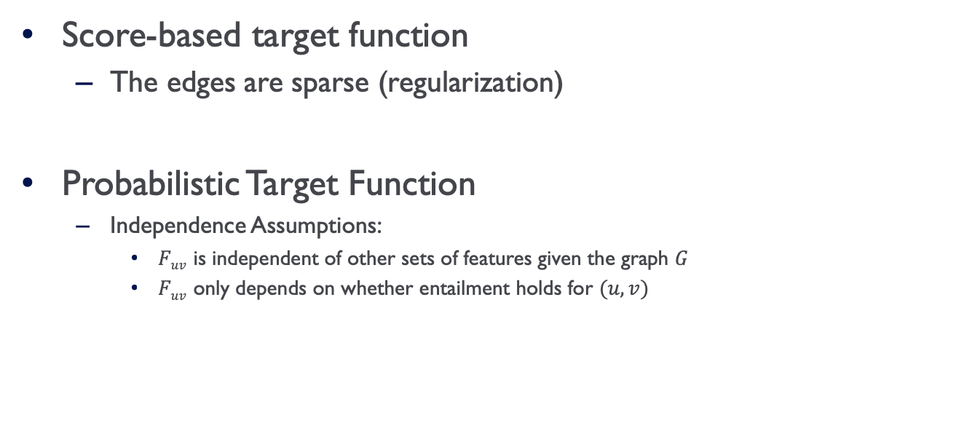
Global Learning of Edges
Score-based target function
The edges are sparse (regularization)
Probabilistic Target Function
Independence Assumptions:
$Fuv$ is independent of other sets of features given the graph $G$
$Fuv$ only depends on whether entailment holds for $(u, v)$

Slide 13
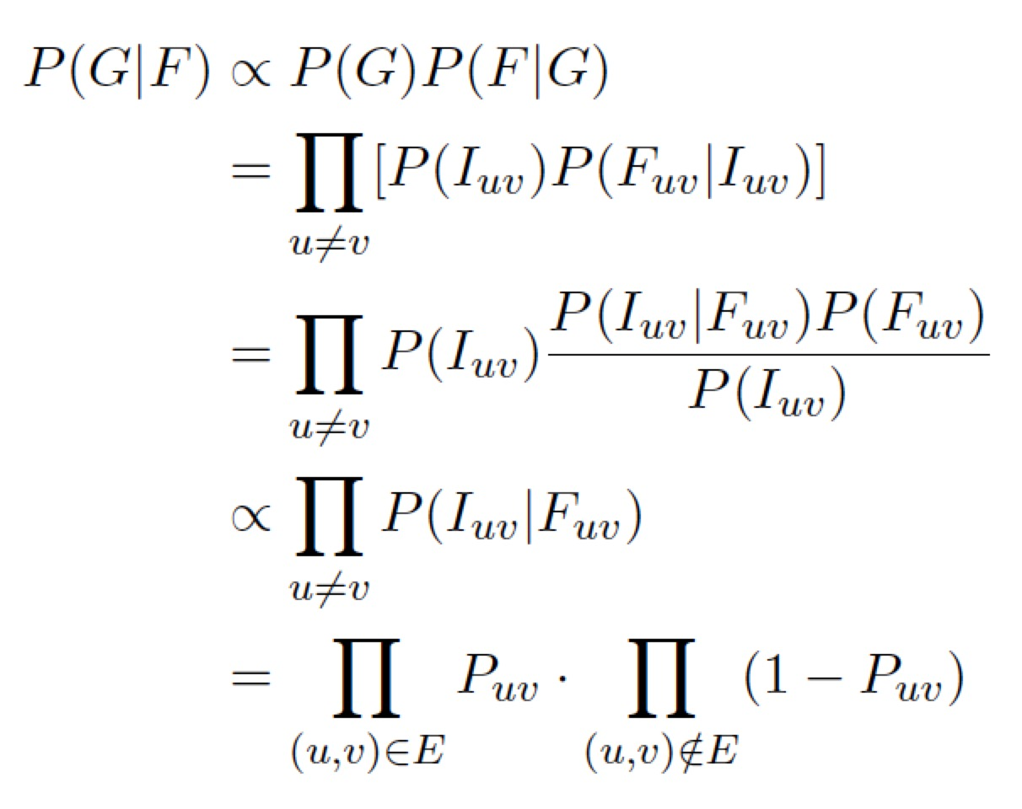
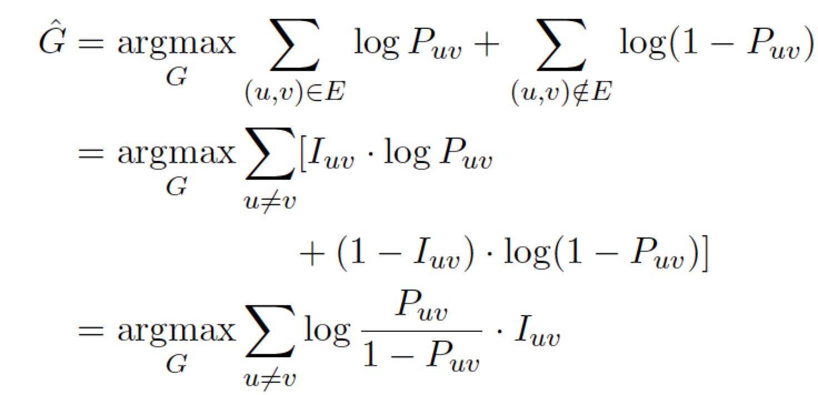
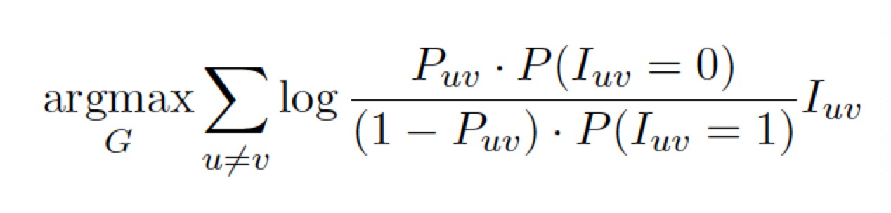
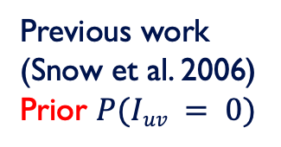
Probabilistic Target Function
Previous work
(Snow et al. 2006)
Prior $P(Iuv = 0)$

Slide 14
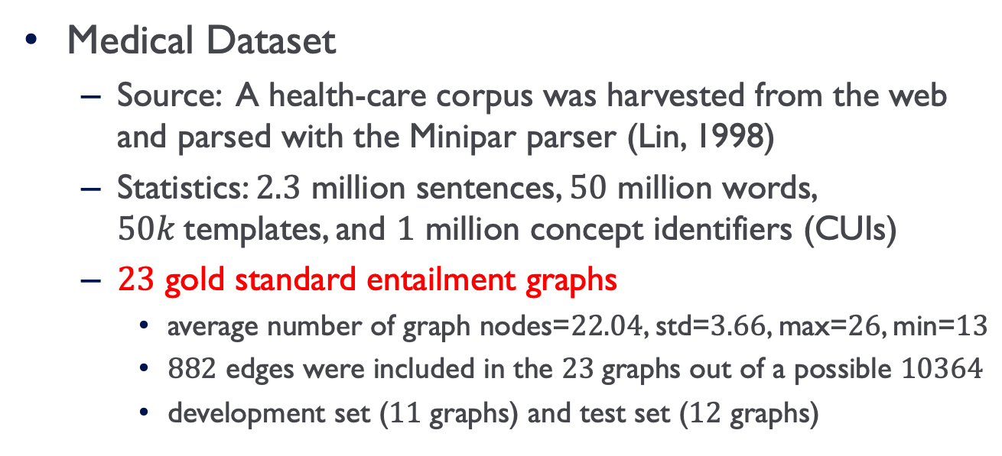
Experimental Setting
Medical Dataset
Source: A health-care corpus was harvested from the web and parsed with the Minipar parser (Lin, 1998)
Statistics: $2.3$ million sentences, $50$ million words, $50k$templates, and $1$ million concept identifiers (CUIs)
$23$ gold standard entailment graphs
average number of graph nodes=$22.04$, std=$3.66$, max=$26$, min=$13$
$882$ edges were included in the $23$graphs out of a possible $10364$
development set ($11$ graphs) and test set ($12$ graphs)

Slide 15
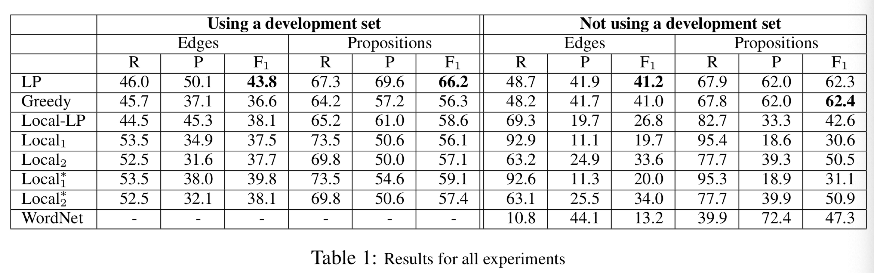
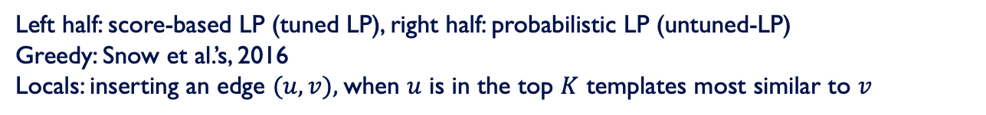
Results
Left half: score-based LP (tuned LP), right half: probabilistic LP (untuned-LP)
Greedy: Snow et al.’s, 2016
Locals: inserting an edge $(u, v),$when $u$ is in the top $K$ templates most similar to $v$
Notes:
Evaluation
$F1$ of the learned edges compared to the gold standard edges
$F1$ for the set of propositions inferred from the learned graph, compared to the set inferred based on the gold standard graph
Note: final score for an algorithm is a macro-average over the $12$ graphs of the test set
Details
Local-LP: omitting global transitivity constraints
Local$1$ (w/o *) v.s. local$2$ (w/o *): Lin similarity function or Binc similarity function
Locals v.s. Local*s: the best similarity function or all similarity functions

Slide 16
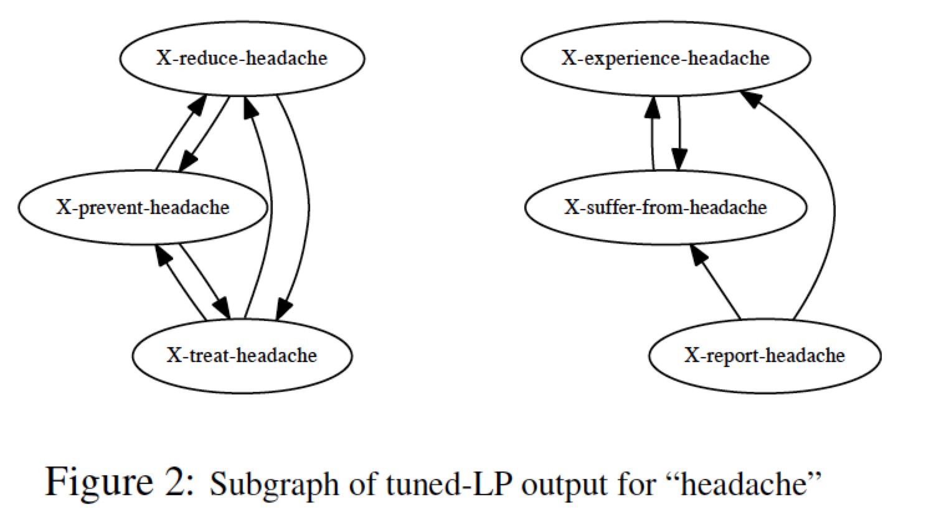
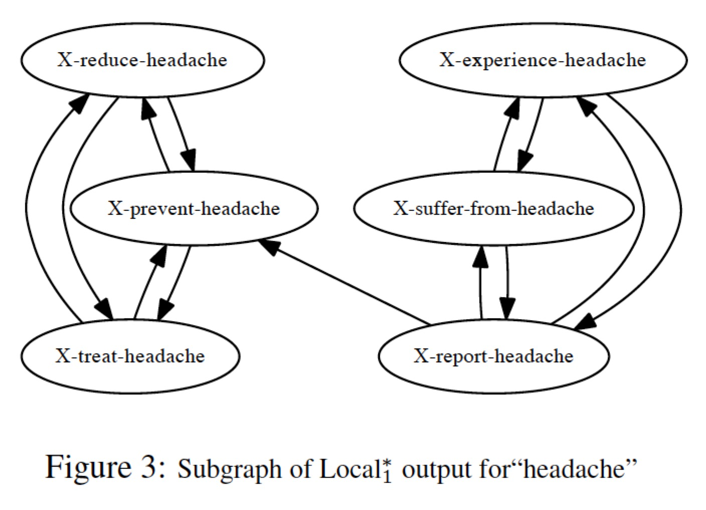
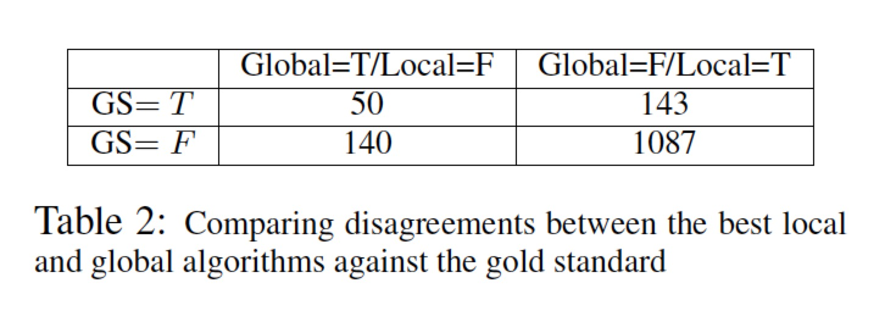
Analysis
Note: tuned-LP refrains from adding edges that subsequently induce many undesirable edges through transitivity.

Slide 17
Conclusions
Take-aways
Focused entailment graphs can represent corpus propositions referring to a target concept, which reduces the size of the entailment graphs
Use Integer Linear Programming (ILP) to solve the optimization problem with constraints for global learning of edges
The medical entailment datasets can be used

Slide 18
Future Work
Main shortcomings
Learn general entailment graphs over a large number of nodes
Possible solutions
First assign edges with high confidence, then do global learning on the remaining edges
The key is to reduce the number of variables

