Slide 1
SWAG: A Large-Scale Adversarial Dataset for Grounded Commonsense Inference Rowan Zeller, Yonatan Bisk, Roy Schwartz, Yejin Choi EMNLP, 2018
Rachit Saluja (rsaluja@seas.upenn.edu)
13th Feb. 2019

Slide 2
SWAG on a higher level
Why do we need dataset like SWAG?
What is the impact of getting good results on such a dataset? Does it mean the algorithm has achieved common sense?
SWAG has two contributions
- An unbiased dataset for Natural Language Inference (NLI)
- A novel algorithm to generate this dataset
What is natural language inference?

Slide 3
What is the paper offering us?
A dataset to enable research for Natural Language Inference (NLI) and commonsense reasoning.
Dataset consists of 113k Multiple Choice Questions (MCQs). These questions are framed to answer ”what could happen in the future?” (for a small instance or time frame)
Made using a novel techniques called Adversarial Filtering to eliminate human bias. (Gu- rurangan et al., 2018; Poliak et al., 2018).
Examples:
On stage, a woman takes a seat at the piano. She -
a. sits on a bench as her sister plays with the doll.
b. smiles with someone as the music plays.
c. is in the crowd, watching the dancers.
d. nervously sets her fingers on the keys.

Slide 4
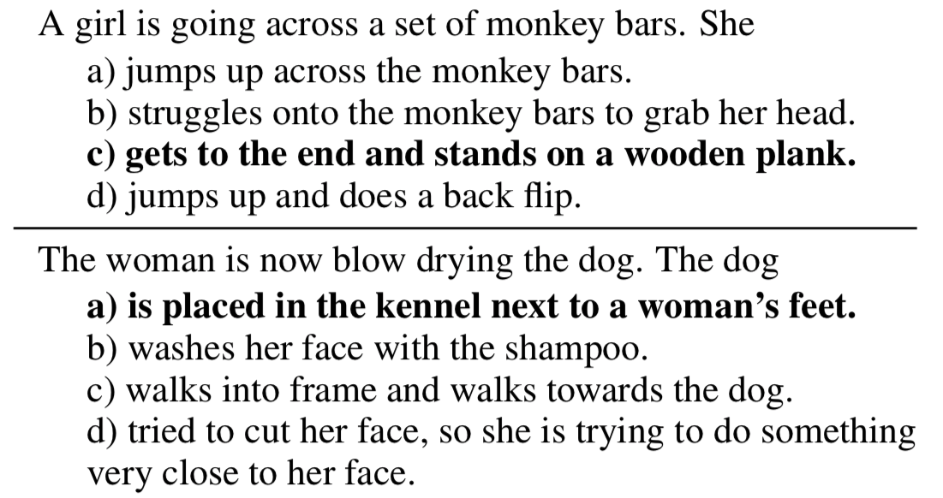
More examples!

Slide 5
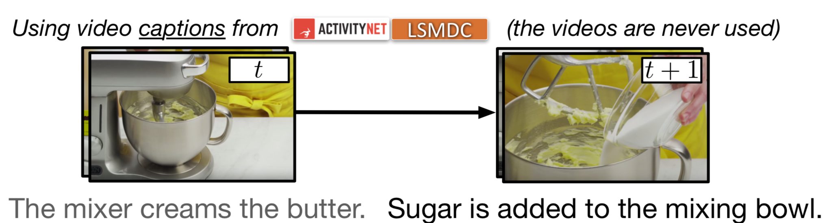
Why do we need this Dataset?
We need to build NLI models that are capable of commonsense reasoning and broadening research and scope of Linguistic Entailment, (Chierchia and McConnell- Ginet, 2000).
Humans - 88%; NLI Models - <60% on SWAG (At the time of the paper publication)
NLI models and types will shown in upcoming slides.
Note: Present day leaderboard – Devlin et al. 2018 [86.28%] B.E.R.T.

Slide 6
Related Works
Entailment NLI
Used for various applications, fails because of annotation artifacts(summarization, video captioning)
(Cooper et al., 1996; Dagan et al., 2006; Marelli et al., 2014; Bowman et al., 2015; Lai et al., 2017; Williams et al., 2018).
Commonsense NLI
Used to infer likely causes and endings given sentences, fails because it’s a small dataset
(COPA; Roemmele et al., 2011; RocStories; Mostafazadeh et al., 2016; Sharma et al., 2018)
Vision Datasets
While the inference problem remains same, fails because of annotation artifacts
(Yu et al., 2015; Huang et al., 2016)
Reducing Gender and Racial Bias (Zhang et al., 2018)
Physical Knowledge

Slide 7
Contents
About SWAG
What is an Adversarial Dataset
Adversarial Filtering Algorithm
Experiments on SWAG
How good is SWAG?
Conclusions

Slide 8
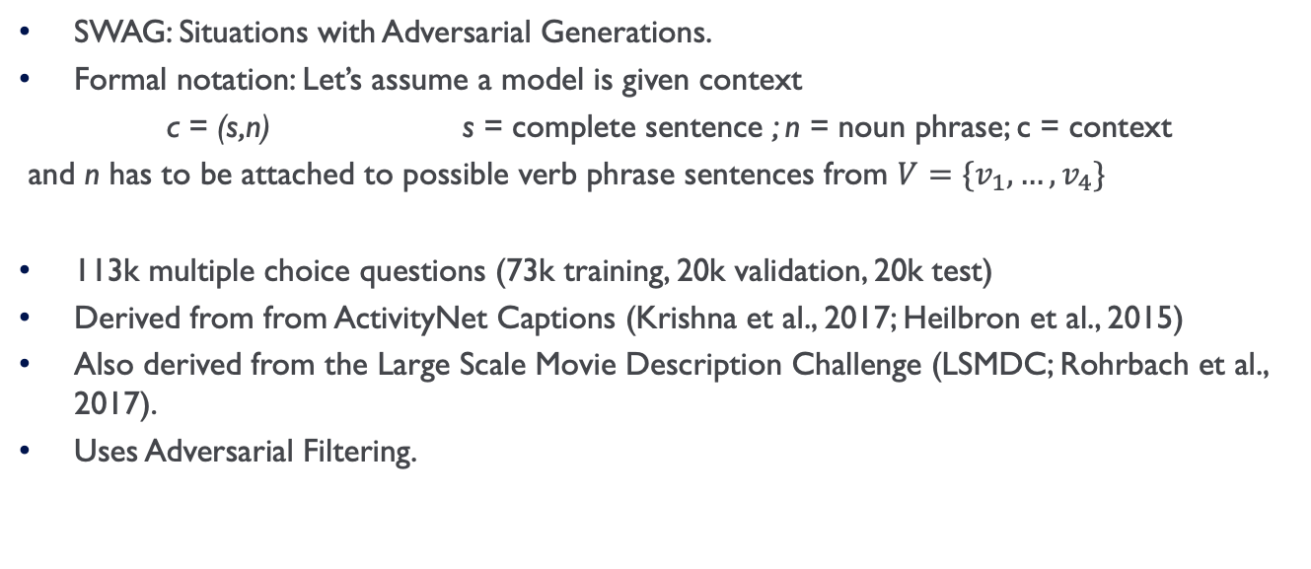
About SWAG
SWAG: Situations with Adversarial Generations.
Formal notation: Let’s assume a model is given context
c = (s,n) s = complete sentence ; n = noun phrase; c = context
and n has to be attached to possible verb phrase sentences from $V=\{v_{1},…,v_{4}\}$
113k multiple choice questions (73k training, 20k validation, 20k test)
Derived from from ActivityNet Captions (Krishna et al., 2017; Heilbron et al., 2015)
Also derived from the Large Scale Movie Description Challenge (LSMDC; Rohrbach et al., 2017).
Uses Adversarial Filtering.

Slide 9
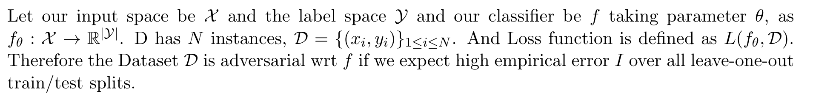
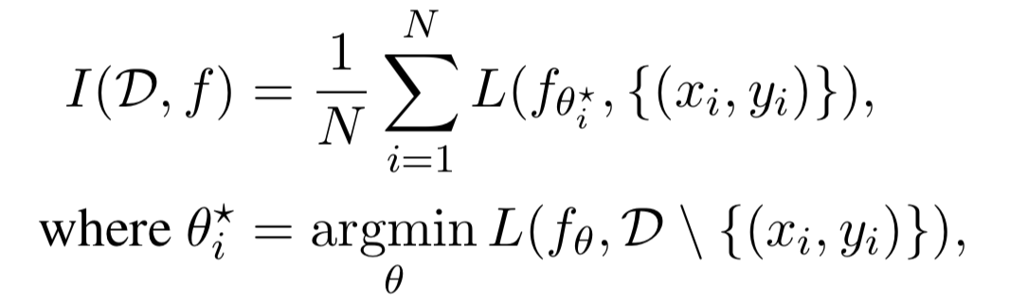
Adversarial Dataset.
Adversarial dataset for a model f is one on which f will not generalize, even if evaluated on test data from the same distribution.

Slide 10
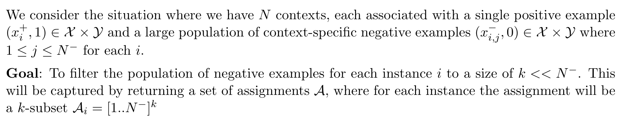
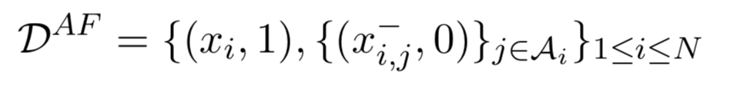
Adversarial Filtering Algorithm

Slide 11
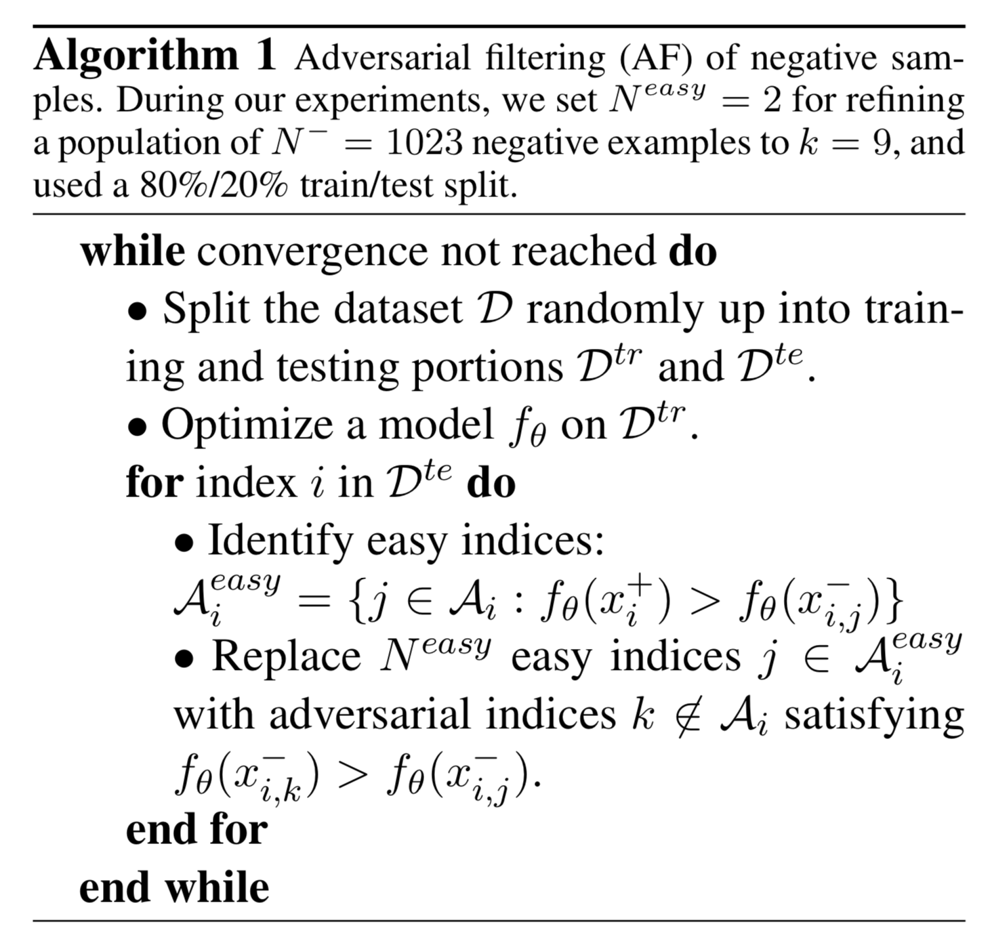
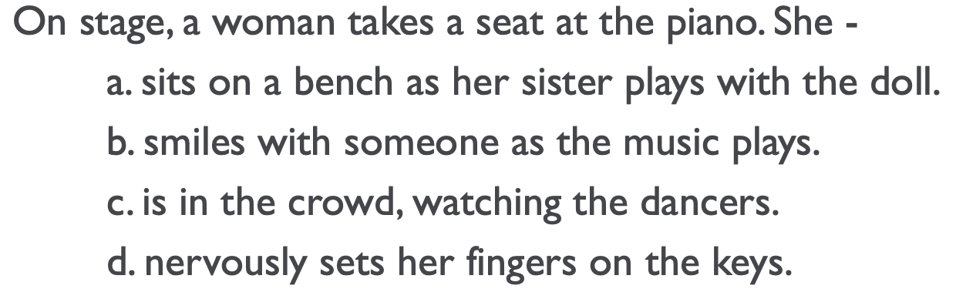
Adversarial Filtering Algorithm (Contd. )

Slide 12
Adversarial Filtering Algorithm
How do we get the N⁻ (Generating the Candidate Endings)?
LSTM Language model. Pretrained on BookCorpus (Zhu et al., 2015), then finetune on the video caption datasets.
We use the LM to sample N⁻ =1023 unique endings for a partial caption.
Gives good counterfactuals: the generated endings tend to use topical words, but often make little sense physically, making them perfect for our task.
Stylist features are picked from the ensemble of 4 models.

Slide 13
Experiments on SWAG
Below are the experiments performed on SWAG:
Unary Models
fastText (Joulin et al., 2017)
Pretrained sentence encoders (Kiros et al., 2015, Conneau et al., 2017)
LSTM sentence encoder
Binary Models
Dual bag of words
Dual Pre trained sentence encoders
SNLI inference
SNLI models
Other Models
Length
ConceptNet
Human Performance

Slide 14
Experiments
 | Unary Models | Binary Models | Human
Ending only | 43.6 | - | -
2nd Sentence Only | 47.4 | 46.0 | -
Context+ 2nd Sentence | 51.4 | 59.1 | 88

Slide 15
SWAG versus other Datasets
Swag requires a unique type of temporal reasoning, which is not there in other datasets.
Swag has more active verbs like ‘pull’ and ‘hit,’ and fewer static verbs like ‘sit’ and ‘wear’, Compared with SNLI
Dataset suffers from few lexical biases.

Slide 16
Conclusions
Made a Dataset for research in commonsense inference that broadens the scope of natural language inference (NLI) with commonsense reasoning.
Constructed the Adversarial Filtering Algorithm, for constructing datasets and reducing annotation artifacts.

Slide 17
Thoughts and Future Work
I believe it should not be considered as the gold standard dataset for NLI, because it can be beaten (BERT).
A strong need to define what can be used for NLI.
Dataset in general is very good.
Can make extensions to Vision Datasets (with same idea)

Slide 18
Questions?

