Slide 1
Montague Meets Markov: Deep Semantics with Probabilistic Logical Form Islam Beltagy, Cuong Chau, Gemma Boleda, Dan Garrette, Katrin Erk, Raymond Mooney Proceedings of the Second Joint Conference on Lexical and Computational Semantics (*Sem-2013) (2013)
Sanjna Kashyap (sanjnak@seas.upenn.edu)
11th March 2019

Slide 2
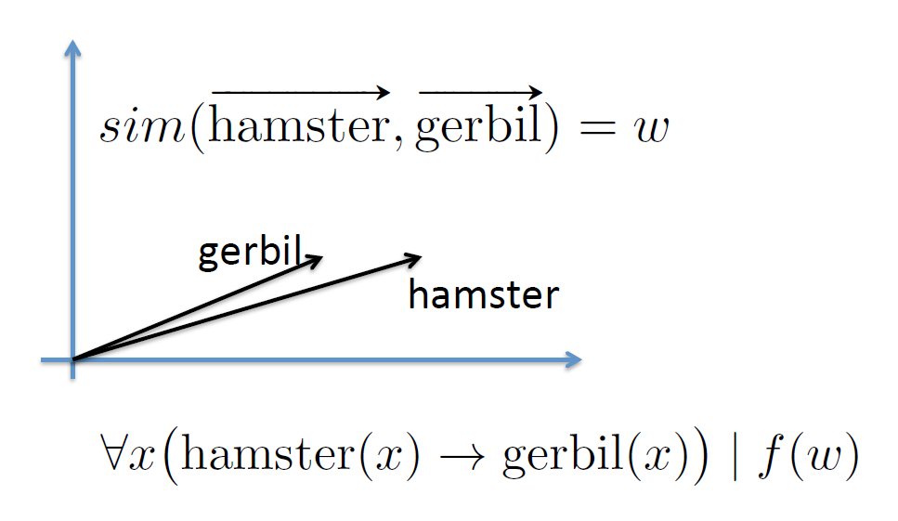





Problem & Motivation
Combining logical and distributional representations of natural language
Recognizing textual entailment
Judging sentence similarity
Logic-based representations
Flexible and expressive
Complex propositions
Distributional semantics
Use contextual similarity to predict semantic similarity
Model polysemy
S1: The man is cutting a cucumber.
S2: The man is cutting a zucchini.
S1: The man is driving.
S2: The man is driving a car.
cucumber,
zucchini
cucumber
zucchini
Cucumber(x)
Zucchini(x)

Slide 3
Contents:
Previous Approaches
Contributions of this work
MLN System
Results and Analysis
Recognizing Textual Entailment
Semantic Textual Similarity
Conclusions
Shortcomings
Future Work

Slide 4
Previous approaches
Distributed Semantics
Thomas Landauer and Susan Dumais, “A solution to Plato’s problem: the latent semantic analysis theory of acquisition, induction, and representation of knowledge”, Psychological Review, 1997
Jeff Mitchell and Mirella Lapata, “Composition in distributional models of semantics”, Cognitive Science, 2010
Semantic relatedness of words defined as similarity of vectors representing the context in which they appear
Add vectors for individual words appearing in a phrase
Component-wise product of word vectors
Logic Based Semantics
Johan Bos. 2008. Wide-coverage semantic analysis with boxer. Semantics in Text Processing. STEP 2008 Conference Proceedings, Research in Computational Semantics
Boxer – Software package for semantic analysis that produces logical forms using Discourse Representation Structures

Slide 5
Previous approaches
Markov Logic Networks
Compactly encode complex undirected probabilistic graphical models
Pedro Domingos and Daniel Lowd, “Markov Logic: An Interface Layer for Artificial Intelligence”, Synthesis Lectures on Artificial Intelligence and Machine Learning, 2009
Consists of a set of weighted first order clauses
Softening first-order logic by allowing situations in which not all clauses are satisfied
Alchemy – Open source software package, computation of probability of a query given weighted clauses as background knowledge and evidence
Stanley Kok, Parag Singla, Matthew Richardson, and Pedro Domingos, “The Alchemy system for statistical relational AI”, Technical report, Department of Computer Science and Engineering, University of Washington, 2005
Weighted inference, and combined structural distributional representations
Dan Garrette, Katrin Erk, and Raymond Mooney, “Integrating logical representations with probabilistic information using markov logic”, In Proceedings of IWCS, Oxford, UK, 2011
Proposed an approach to RTE that uses MLN to combine logical representations with distributional information
Logical form is primary meaning representation

Slide 6
Contributions of this work
Adapts MLN approach to handle recognizing textual entailment (RTE) and semantic textual similarity (STS)
Distributional inference rules for pairs of phrases instead of just words

Slide 7
MLN System
S1: A man is slicing a cucumber.
S2: A man is slicing a zucchini.
Steps:
Construct logical forms for each sentence using Boxer
∃ x0, e1, x2 (man(x0) ^ slice(e1) ^ Agent(e1, x0) ^ cucumber(x2) ^ Patient(e1, x2)) (Used as evidence)
man(x) ^ slice(e) ^ Agent(e, x) ^ zucchini(y) ^ Patient(e, y) → result()
Translates them into MLN clauses using Alchemy
result() is the query for which Alchemy computes probability
However, in normal RTE systems, S1 would not entail S2 and probability of result() = 0

Slide 8
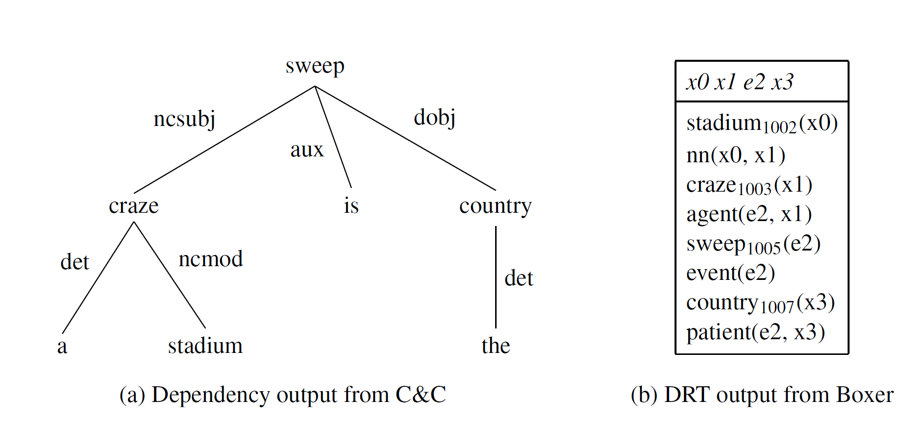
MLN System
Construct logical form (discourse representation structure) for each sentence using Boxer
A stadium craze is sweeping the country.
Output close to
standard first order
logic forms used by
Alchemy.

Slide 9
MLN System
Distributional Similarity!
Let V be a vector space whose dimensions stand for lemmas appearing at least 50 times in Gigaword corpus excluding stop words
Each word is a point in vector space V
Count how many times a word appears in the same sentence as each feature and calculate pointwise mutual information (PMI)
sim: V x V → [0,1]

Slide 10
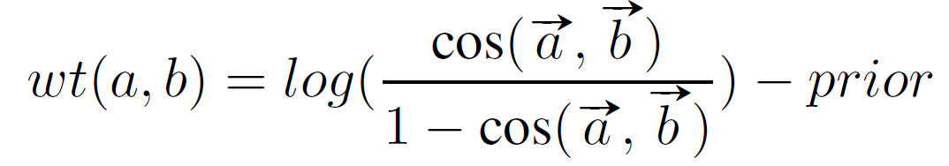
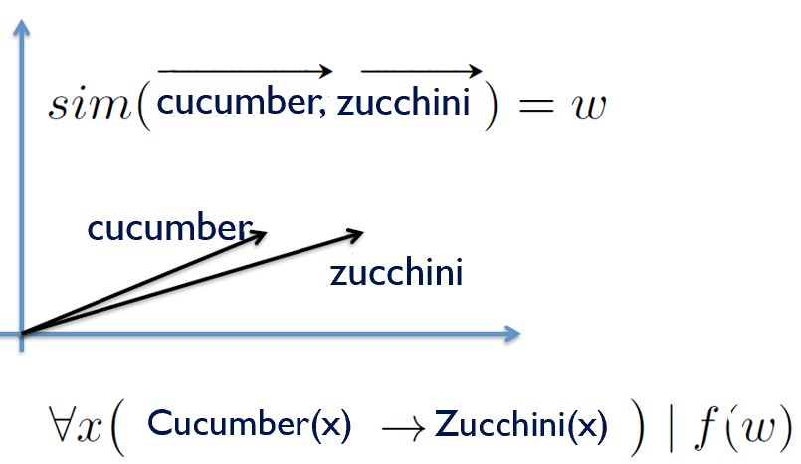
MLN System
Distributional Similarity!
Create background knowledge by computing cosine similarity of words
Similarity → Inference Rule
Similarity is treated as a degree of entailment
.
Prior is a negative weight used to initialize all predicates
Prior = -3
Generate inference rule:
Cucumber(x) → Zucchini(x) | wt (cucumber, zucchini)
Inference rules generated for all pairs of words (a, b)

Slide 11
MLN System
Distributional inference rules for phrase
S1: A boy is riding a bicycle.
S2: A little boy is riding a bike.
E.g. mapping “boy” to “little boy”
Vector addition or component wise vector multiplication
“Little boy” = “little” + “boy”

Slide 12
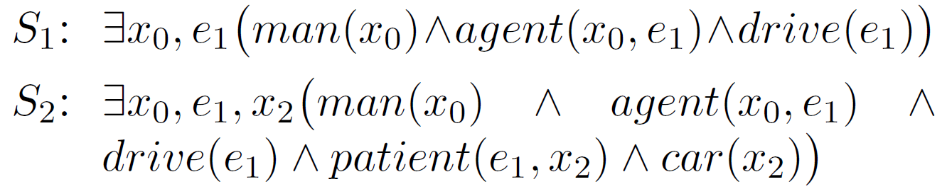
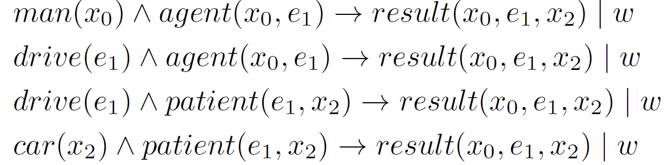
MLN System
Average Combiner
S1: A man is driving.
S2: A man is driving a car.
S1 does not entail S2, but objectively, both can be considered similar for the STS task.
Full logical form broken into clauses
Combiner averages probabilities
.
Variable Binding

Slide 13
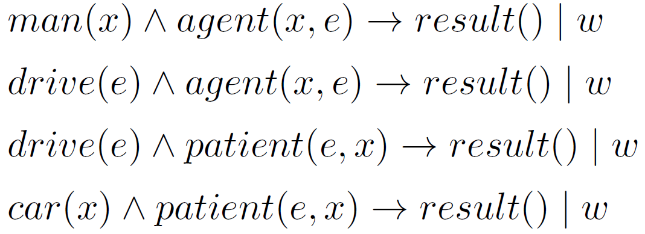
MLN System
This implementation loses a lot of information.
Can’t differentiate between slightly more complex clauses
“A man is driving and a woman is walking.”
“A woman is driving and a man is walking.”
Logical form without variable binding degrades representation
Still useful for STS task
Average combiner without variable binding is fastest and has least memory requirements

Slide 14
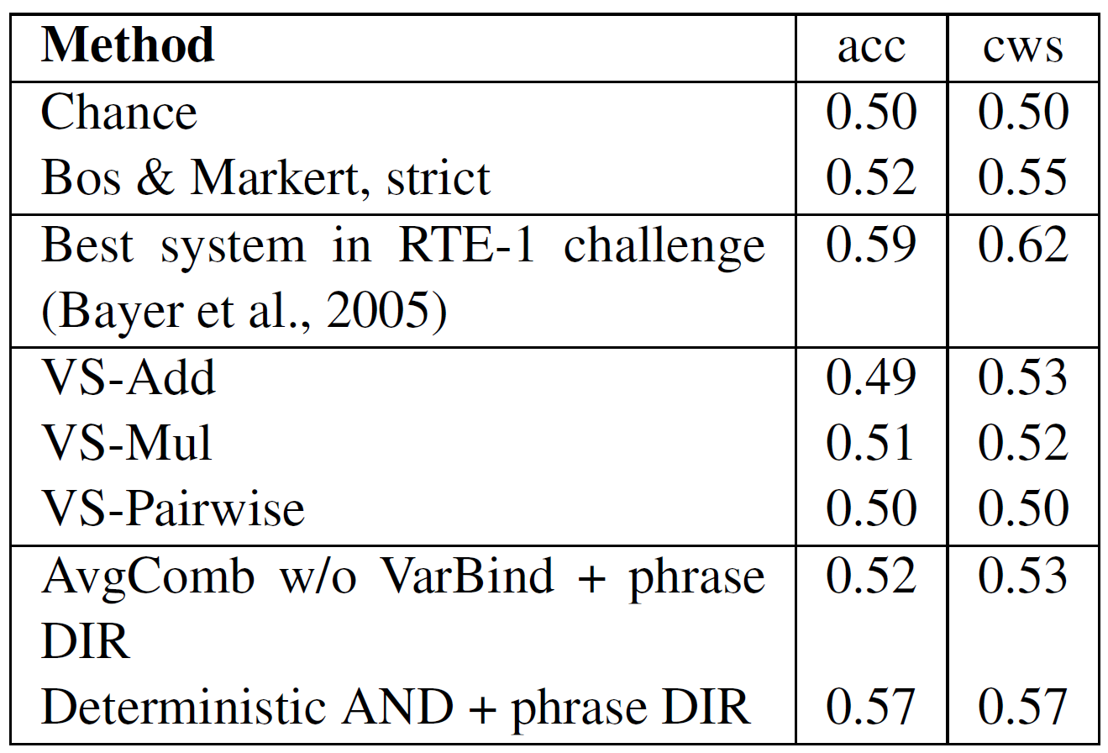
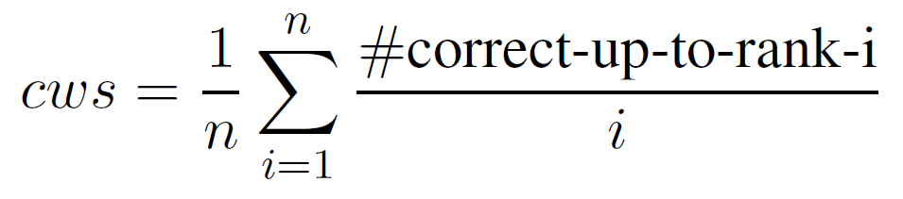
Recognizing Textual Entailment
Dataset - RTE-1:
567 Text-Hypothesis pairs in development set
800 T-H pairs in test set
Balanced sets
n = number of items in dataset
i ranges over sorted items
The best system in the RTE-1 challenge was a statistical machine translation system.
Notes:
CWS

Slide 15
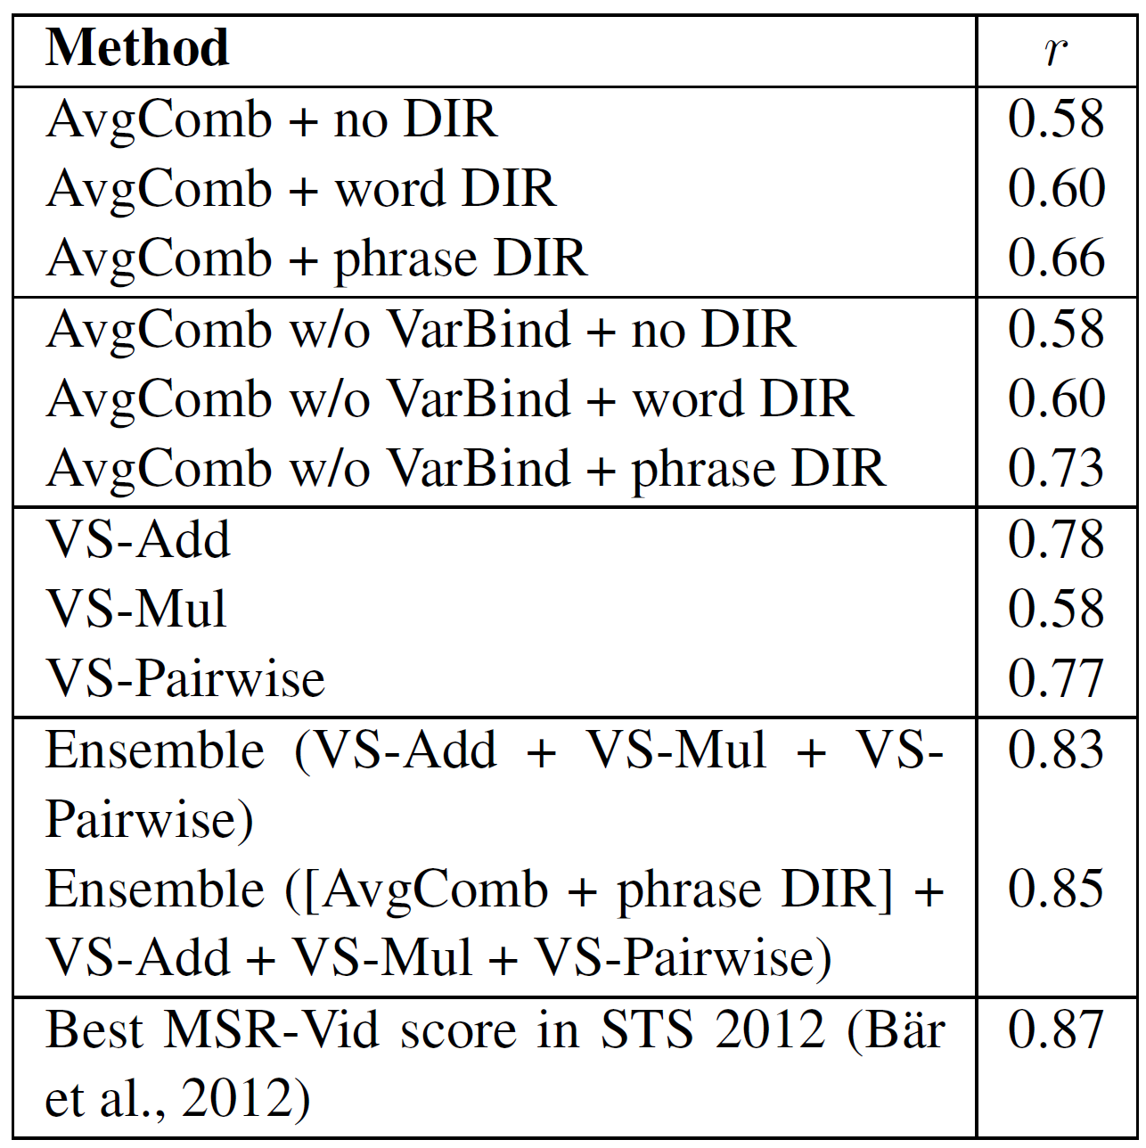
Semantic Textual Similarity
Dataset: MSR Video Paraphrase Corpus (MSR-Vid)
1500 sentence pairs
Built by Amazon Mechanical Turk workers
Similarity scores between 0 to 5
Gold standard score is average of Turkers’ annotations
Evaluate by measuring correlation to gold standard scores
Distributional information improves scores
STS scores better without variable binding
Information sensitive to parsing errors
C&C parser produces several errors even for simple sentences
STS dataset does not bother with syntax or logic
The best system performed linear regression on features that are scores generated by different similarity measures such as longest common subsequence, distributional thesaurus etc.

Slide 16
Conclusions
Developed approach that combines logical and distributional representations
Logic is primary representation, while distributional information transformed to weighted inference rules
Dealt with phrase similarity, not just words
RTE-1 Accuracy = 0.57
STS Correlation = 0.85 in best case

Slide 17
Shortcomings
Initial sentence parse can be very wrong
The authors took care of some errors in a previous paper manually but have not performed any such corrections here
STS dataset does not necessarily have to be syntactically correct or comprise of full sentences
Adding word vectors to create phrase vector is not a very sophisticated method
Alchemy fails to execute on 118 of 800 test cases
Severe inefficiencies in terms of memory requirements and speed
Can’t perform on larger and more complex examples

Slide 18
Future Work
Obtain logical form for top-n parses and create MLN that integrates them as underspecified meaning representation
Use a parser better than C&C or a better version of C&C
Obtain better way for calculating weights for phrase vectors
Test this approach on more complex and longer sentences
Incorporate directional similarity between words and phrases

