Slide 1
Leveraging Linguistic Structure For Open Domain Information Extraction Gabor Angeli, Melvin Johnson Premkumar, Christopher D. Manning ACL 2015
Sandeep Dcunha (sdcunha@seas.upenn.edu)
3/20/2019

Slide 2
Problem & Motivation
Open Information Extraction (IE) has many applications:
Question answering
Relation extraction
Information retrieval
Traditionally search collection of patterns over surface form or dependency tree of sentence

Slide 3
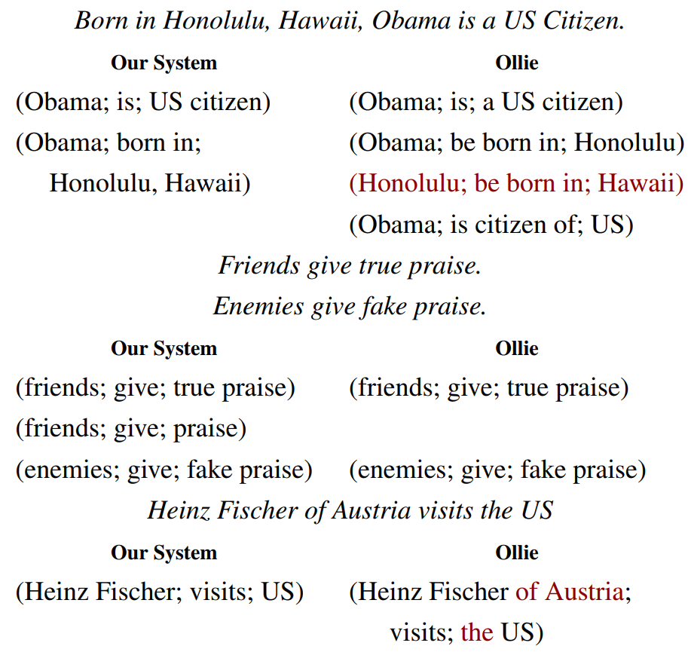
Information Extraction

Slide 4
Problem & Motivation
Classifier to split sentences into shorter utterances
Natural logic to maximally shorten these utterances while maintaining necessary context
Use set of 14 hand-crafted patterns to segment utterance into IE triple

Slide 5
Contents:
Problem and Motivation
Previous Approaches
Contributions of Work
Extracting self-contained clauses
Dataset generation
Training
Inference
Deletions
Open IE triples and mapping to schema
Analysis
Conclusion

Slide 6
Previous Approaches: Open IE
Wikipedia-based Open Extraction (WOE) system (Wu and Weld, 2010)
Ollie uses fast dependency parsers to learn dependency patterns (Mausam et al., 2012)
Easily constructed mapping from Open IE relations to KBP relations (Soderland et al. 2013)

Slide 7
Previous Work: Open IE Triples Uses
Open IE’s concise extractions facilitate efficient symbolic methods for entailment
Learning entailment graphs for triples (Berant et al., 2011)
Structured Relations (e.g. table data)
Matrix factorization for unifying open IE and structured relations (Yao et al., 2012; Riedel et al., 2013)

Slide 8
Contributions
Uses classifier to extract self-contained clauses
Uses natural logic to find maximally compact sentences from extracted clauses
Uses small pattern set for IE due to simplified clauses

Slide 9
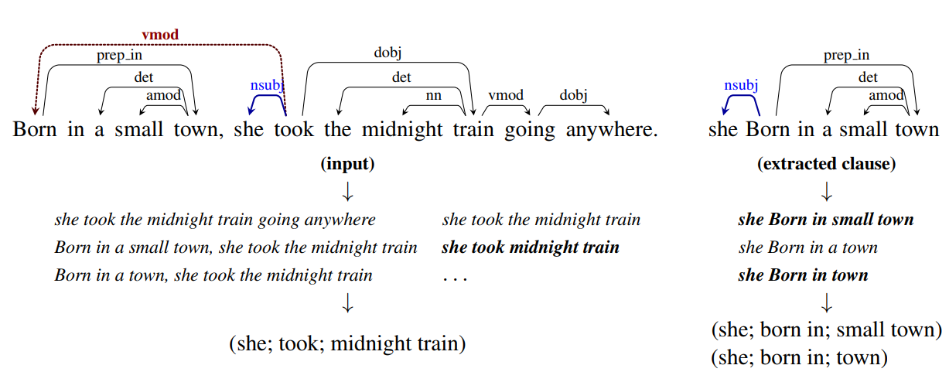
Overview of Approach

Slide 10
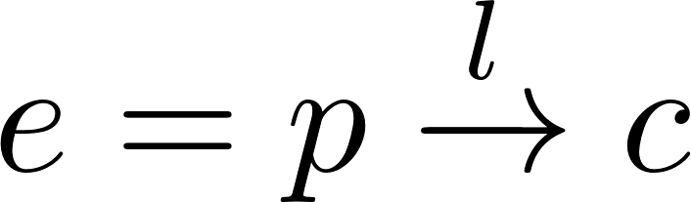
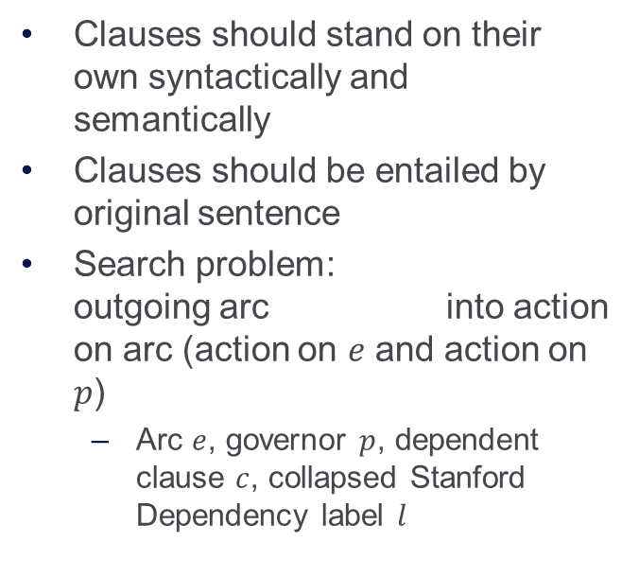
Extract Self-contained Clauses
Clauses should stand on their own syntactically and semantically
Clauses should be entailed by original sentence
Search problem: outgoing arc into action on arc (action on $e$ and action on $p$)
Arc $e$, governor $p$, dependent clause $c$, collapsed Stanford Dependency label $l$

Slide 11
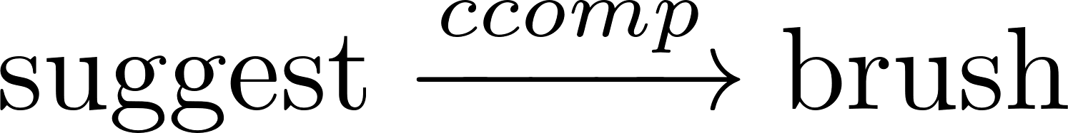
Action Space
Performed on Dependency Edge
Yield: Yields new clause on dependency arc
In sentence Dentists suggest you should brush your teeth,
arc : You should brush your teeth
Recurse: Recurse on dependency arc but don’t yield it.
Faeries are dancing in the field where I lost my bike: recurse on the field where I lost my bike to get to I lost my bike
Stop: Don’t recurse on arc as the subtree under arc is not entailed by parent sentence
Furry cats are cute does not entail furry

Slide 12
Searching
Search path is a sequence of Yield and Recurse terminating in Stop
yields clause rooted at C
yields two clauses with roots at B and C.
Finding all such sequences is exponential in size of tree
Training: collect first 10,000 sequences
Inference: uniform cost search until classifier predictions fall below threshold

Slide 13
Capturing Controller
For Yield and Recurse one commonly wants to capture a controller from the higher clause
Subject Controller: If arc is not subject arc, add subject of parent node as subject
Born in a small town, she took the midnight train.
Object Controller: If arc is not object arc, add object of parent node as object
I persuaded Fred to leave the room.
Parent Subject: If arc is only outgoing arc from a node, take parent node as (passive) subject
Obama, our 44th president becomes Obama [is] our 44th president.

Slide 14
Dataset
Dataset with each sentence containing 1 or more known relations
Annotation is used for distant supervision of actions to take: if sequences recovers known relation, it is correct
Positive sequence: sequence of actions leading to correct extraction of known relation
E.g. if it is known Obama was born in Hawaii, an action sequence which produces (Obama, born in, Hawaii) is positive
Negative sequence: Sequence of actions which results in a clause which produces no relations
Incomplete negatives problem: knowledge base is not exhaustive so validity of other sequences is unknown. These are discarded

Slide 15
Action Classifier
Input
Recurse: All but last actions in positive sequences
Yield: Last action in each positive sequence¹
Stop: Last action in each negative sequence
Output
Positive or negative sequence
1. Paper says Split but from context is probably Yield

Slide 16
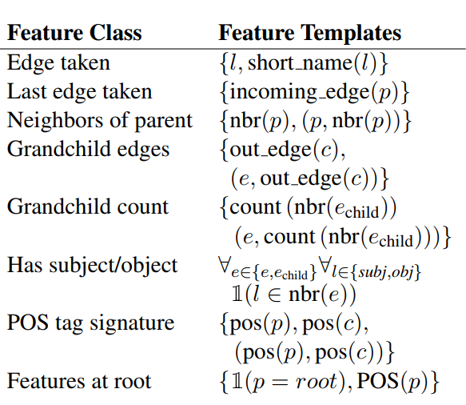
Training
Multinomial logistic regression classifier
Recurse class is given 3x weight
precision errors harmless for accuracy
recall errors are directly harmful to recall

Slide 17
Inference
Search problem: Beginning at root of tree, consider every outgoing edge
For each possible action on parent use classifier to determine:
Split edge off and recurse on child (Yield and Recurse)
Don’t split edge of and recurse on child (Recurse)
Don’t recurse (Stop)
Score of clause is product of action scores taken to reach clause (from classifier)

Slide 18
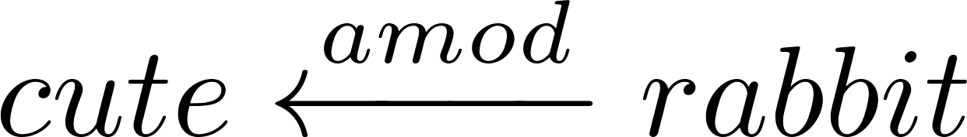
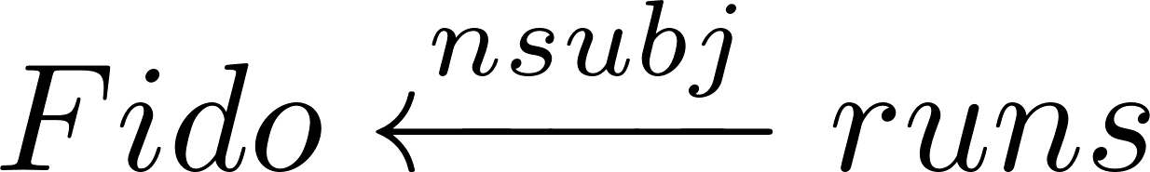
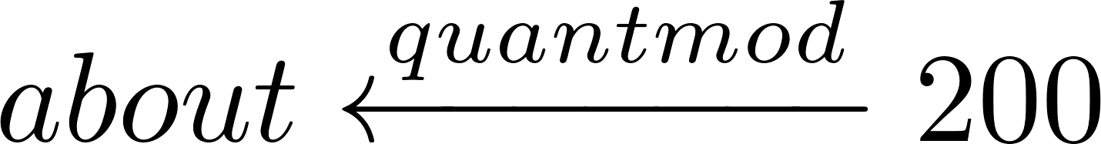
Natural Logic for Deletions
Operators (e.g. all, no, many) have polarity:
Downward polarity: if all rabbits eat vegetables then all cute rabbits eat vegetables
Upward polarity: if some cute rabbits are small then some rabbits are small.
Operator-less items have upwards polarity
Dependency arcs are classified into whether deleting the dependent of the arc makes the governing constituent more general, specific, or neither
More general: becomes rabbit
Neither: becomes runs which is unentailed
More specific (rare): becomes 200

Slide 19
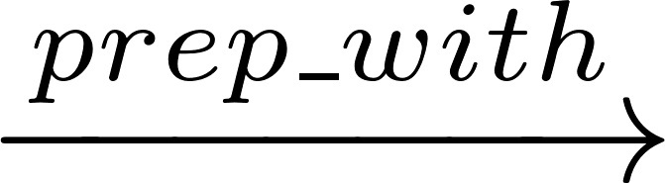
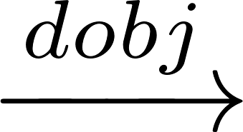
Deletions
Deletions can be automated with high accuracy in most cases
Non-subsective adjectives: a fake gun is not a gun
List of non-subsective adjectives are preserved (Nayak et al. 2014)
Non-meaningful entailment:
Alice went to the playground Bob entails Alice went to the playground but Alice is friends Bob entails Alice is friends.
Alice played baseball on Sunday entails Alice played on Sunday but Obama signed the bill on Sunday entails Obama signed on Sunday.

Slide 20
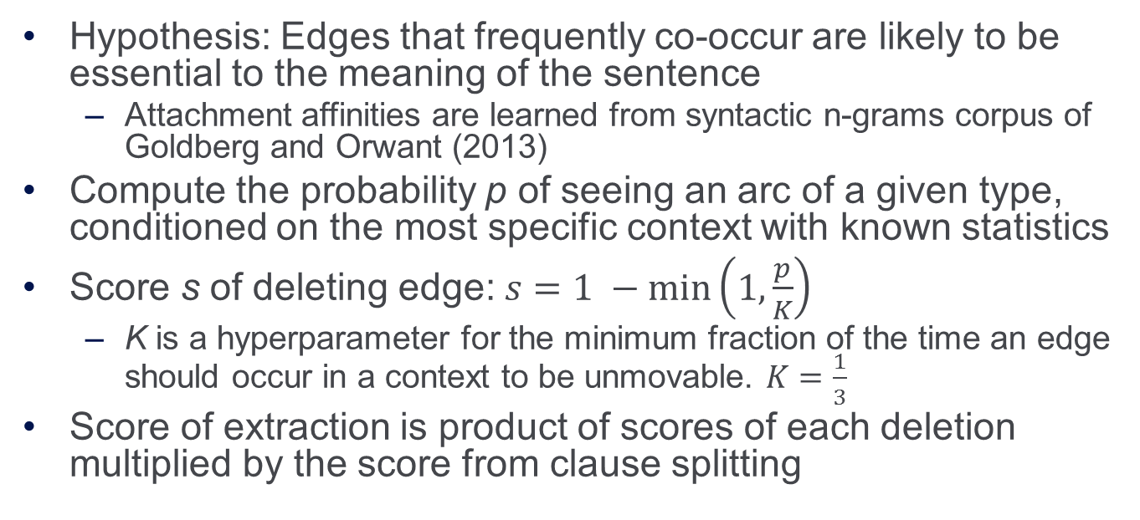
Deletions (cont.)
Hypothesis: Edges that frequently co-occur are likely to be essential to the meaning of the sentence
Attachment affinities are learned from syntactic n-grams corpus of Goldberg and Orwant (2013)
Compute the probability p of seeing an arc of a given type, conditioned on the most specific context with known statistics
Score s of deleting edge: $s=1 −\min\left(1,\frac{p}{K}\right)$
K is a hyperparameter for the minimum fraction of the time an edge should occur in a context to be unmovable. $K=\frac{1}{3}$
Score of extraction is product of scores of each deletion multiplied by the score from clause splitting

Slide 21
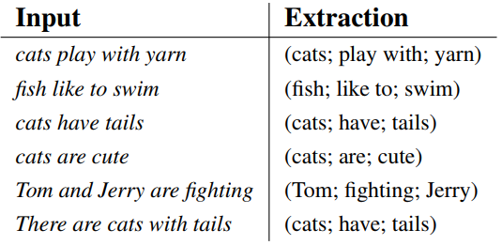
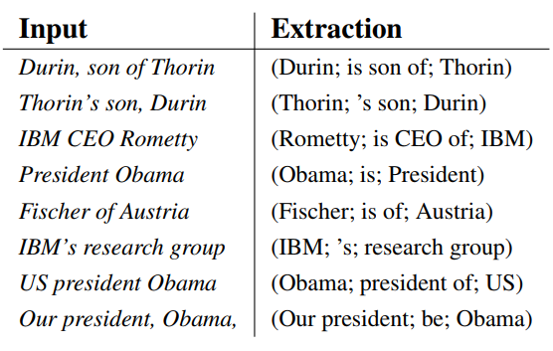
Segmenting into open IE triples
Clause splitting
Noun Phrase Splitting

Slide 22
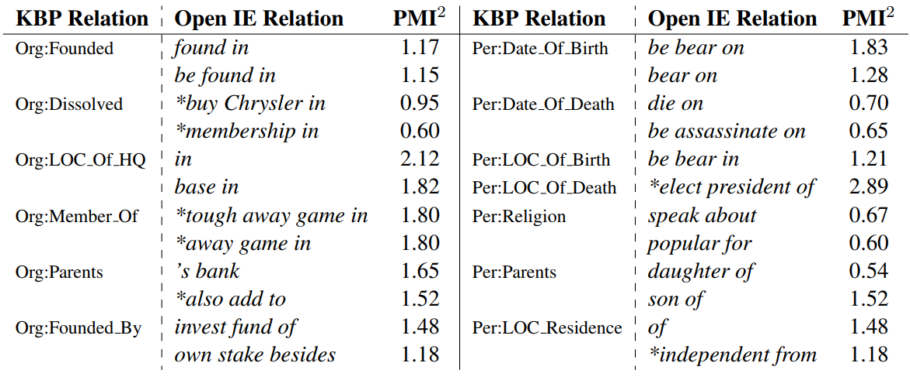
OpenIE to Known Relation Schema

Slide 23
Analysis
TAC KBP Slot Filling
Given: Large unlabeled corpus of text, fixed schema of relations, and set of query entities
Objective: Find all relation triples with query entity as a subject and matching one of the defined relations
Intuitively: Populating Wikipedia Infoboxes from a large unstructured corpus of text.
System compared to:
University of Washington system which used OpenIE 4.0 run over KBP corpus. OpenIE 4.0 utilizes semantic roles in addition to traditional open IE techniques. (Soderland et al., 2013)
Ollie run in an identical framework to this system. Since Ollie does not extract nominal relations, this system’s nominal relation extraction was added to Ollie.
Notes:
Example:
Relation: parents of
Query entity: Obama

Slide 24
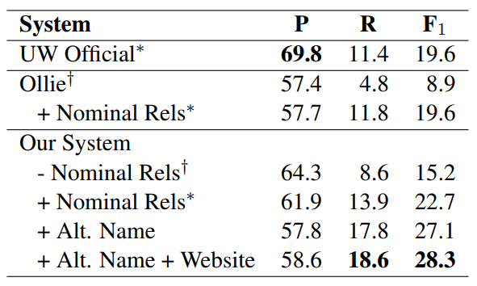
Results
Much better F1 score than University of Washington
Precision is worse: more irrelevant relations
Recall is better: more correct relations were found
Notes:
PR curve: compare system to Ollie
Plotted using confidence of extraction

Slide 25
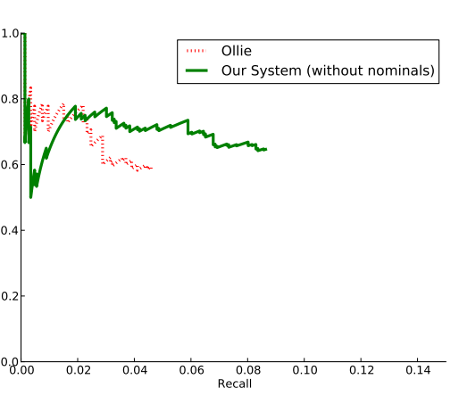
Results: PR Curve
Compare system to Ollie
Plotted using confidence of extraction
If extraction found multiple times, confidence is sum of extractions’ confidences
Low early precision
Theory: systematic errors in clause splitter
Relatively smooth at tail
Learning a reasonable estimate of confidence for extractions that have only one supporting instance in the text (46%)
Notes:
Much better F1 score than University of Washington
Precision is worse: more irrelevant relations
Recall is better: more correct relations were found
PR curve: compare system to Ollie
Plotted using confidence of extraction

Slide 26
Conclusion and Thoughts
Software and code was released under the name Stanford OpenIE
Angeli et. al. built an Open IE system which transformed complex text into simple clauses before performing extraction
State of the art recall value is low (18.6): missing many extractions

Slide 27
Future Work
Test system on producing triples for other tasks (e.g. entailment)
Enhance clause-splitter: The authors speculate that the reason for the low start at the beginning of the PR curve is due to bad splits.
Precision could be improved to state of the art: perhaps extra filtering step

