Slide 1
Learning Temporal Information for States and Events Zornitsa Kozareva, Eduard Hovy 2011 Fifth IEEE International Conference on Semantic Computing
Sanjna Kashyap (sanjnak@seas.upenn.edu)
18th February 2019

Slide 2
Problem & Motivation
Acquiring temporal knowledge about events
Not a lot of work had been done about this particular problem before
Work done on defining order of events with respect to each other
Most previous work done in this field discusses the duration of events and ignores other temporal aspects
Defines six temporal aspects frequently associated with events

Slide 3
Problem & Motivation
Examples:
“The concert lasted for two hours.”
“The concert started at 11 pm.”
“The concert had been sold out for months.”
Proposes an automated procedure to learn, for a set of events, different associated times

Slide 4
Contents:
Previous Approaches
Contributions of this work
Identified Temporal Aspects
Learning states and events from the web
Patterns between e and t
Results and Analysis
Conclusions
Shortcomings
Future Work

Slide 5
Previous approaches
TimeML
J. Pustejovsky, J. Castao, R. Ingria, R. Saur, R. Gaizauskas, A. Setzer, and G. Katz, Fifth International Workshop on Computational Semantics (IWCS-5, 2003
Rich specification language for event and temporal expressions in natural language text
Time stamping of events
Ordering events with respect to each other
Reasoning with contextually underspecified temporal expressions
Reasoning about the persistence of events
“John left two days before the attack.”
Event: left
Duration: two days
Link: before
Event: the attack
TimeBank corpus

Slide 6
Previous approaches
Learning Event Durations from Event Descriptions
F. Pan, R. Mulkar, J. R. Hobbs, G. W. Bush, and V. Putin, Proceedings of the 44th Conference of the Association for Computational Linguistics (COLINGACL, 2006, pp. 393–400
Corpus of news articles in which events are annotated with estimated bounds for their durations
Typical durations for a small set of verbs denoting events
Using query patterns to learn the duration of events
A. Gusev, N. Chambers, D. R. Khilnani, P. Khaitan, S. Bethard, and D. Jurafsky, International Conference on Computational Semantics, 2011
Learn durations of events without annotated training data
Query web with patterns

Slide 7
Contributions of this work
Identified 6 different temporal aspects
Automated learning of temporal information
Learning states and events from the web
Learning patterns between events and temporal units
Mapping between patterns and typical temporal characteristics of an event

Slide 8
Identified Temporal Aspects
Duration (D): Specifies length of time t that event e occurs
“e for t”
Example: “She ran for three hours.”
Time-at (T): Timepoint or frequency t at which event e occurs, or starts occurring.
“e at t”
Example: “The dinner is at 9 pm.”
“e is every t”
Example: “The dance is every two months.”

Slide 9
Identified Temporal Aspects
Interval before or after (BA): t specifies the duration of the preparatory stage leading up to event e or of the subsequent stage following it
“e starts in t”
Example: “The concert starts in two hours.”
“it is t until e”
Example: “It is two days until the eclipse.”
“t since e”.
Example: “It’s been 5 years since the last festival.”

Slide 10
Identified Temporal Aspects
Inclusion during (I): e occurs during the period defined by t.
Intermittent occurrence included (II): e occurs repeatedly during t.
Continuous occurrence included (CI): e occurs without interruption during t.
Negated occurred included (NI): event e does not occur at or during the time t specified.

Slide 11
Identified Temporal Aspects
Speed (S): t expresses the speed or rate at which the event e, or a part of it, occurs.
Example: “The shutter clicked at 30 frames a second”.
Age (A): t specifies length of time since event e first occurred; that is, it provides the age of event e (if e is an often-repeated event), or the starting point of the appearance of e.
“e is t old”
“the first e was t ago”

Slide 12
Learning states and events from the web
Semi-supervised procedure for automatically harvesting states and events from the internet
Use of lexico-syntactic patterns based on the approach of Kozareva et al.
Minimally supervised learning
Requires only one seed example and pattern as input
Built in bootstrapping procedure that retrieves larger quantities of terms
Higher accuracy than other methods

Slide 13
Learning states and events from the web
Doubly anchored lexico-syntactic pattern (DAP)
“semantic-class such as seed and *”
Has a bootstrapping mechanism that takes terms on * and uses them as seed for a new round of learning
New lexico-syntactic patterns automatically created
Implemented as a breadth-first-search
Output is set of terms related to semantic-class
“Events such as earthquakes and *”
Extract the word “hurricanes”
Generate new query:
“Events such as hurricanes and *”
Position on which new input terms are extracted
Class we want to learn
Input Example

Slide 14
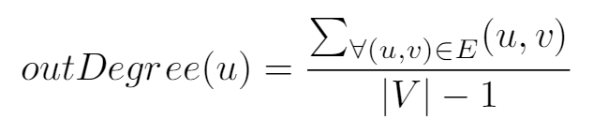

Learning states and events from the web
Assign confidence to each extracted term
u – current term being ranked
– sum of all outgoing edges from u
|V| – number of unique terms extracted during bootstrapping process
Captures how often a term is seen as seed
More often = More likely to belong to same semantic-class

Slide 15
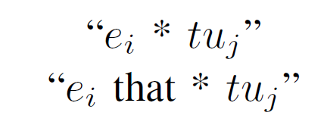
Patterns between e and t
Ten temporal units used
Seconds, minutes, hours, days, weeks, months, years, decades (Pan and Jurafsky)
Centuries and eras
Automated pattern harvesting procedure
Use top 1000 events from previous step to build web queries
Quadruples of the form event, temporal unit, pattern and frequency of the extraction
.
Concert * hours
Concert that * hours
“We only want to participate in a concert that takes two hours.”

Slide 16
Patterns between e and t
TextRunner Corpus
Noun-Verb-Noun
Loosely defined patterns
Output same as querying the web
Example:
“storm” –verb– “hours”
“lasted”, “lasted about”, “raged for”, “continued for” etc.

Slide 17
Results and Analysis
Social Events:
Birthdays
Anniversaries
Concerts
Event Data Collection
16,347 unique event terms
12,135 events seen more than once
Selected top 1000 for manual annotation
Pattern Harvesting
1,187,683 patterns learned
220,315 unique patterns
Disaster Events:
Hurricanes
Tornadoes
Floods
Health Events:
Heart attacks
Strokes

Slide 18
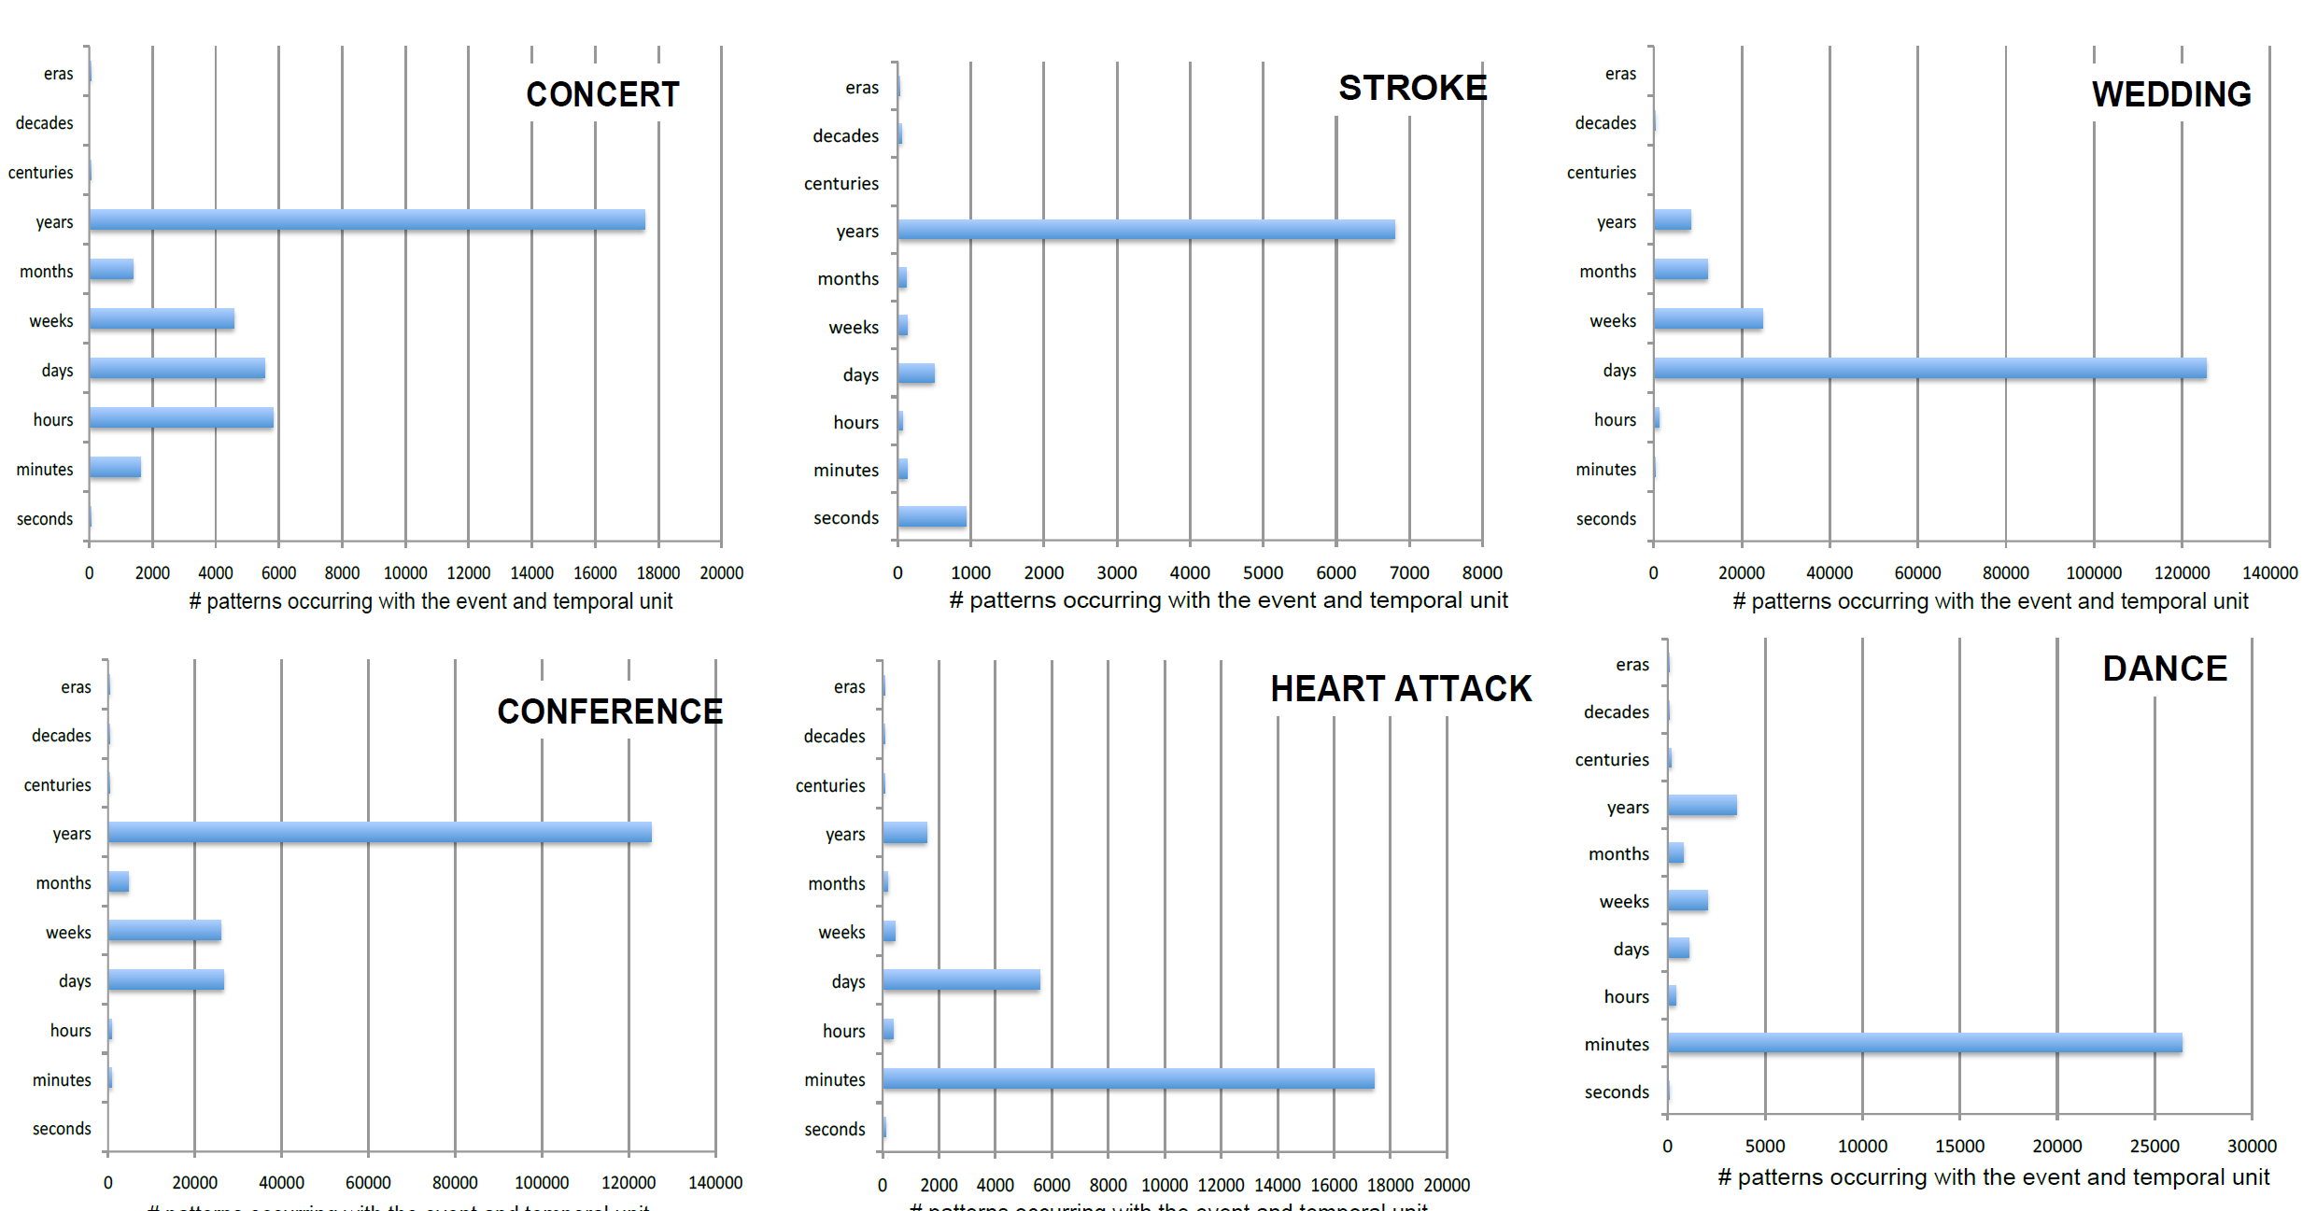
Results and Analysis
It is not just duration that matters.
Preparation time, age of the event etc. clearly occur more times in relation with the event.

Slide 19
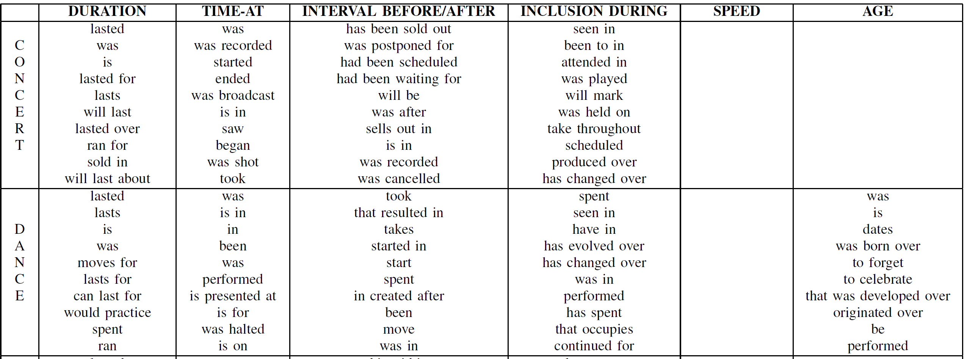
Results and Analysis

Slide 20
Results and Analysis
Manually assigned a small subset of patterns harvested for four events to the different temporal aspects
When unsure, used class “Other”
Concert:
Duration – “lasted”, “lasted for”, “was”, “will last” etc.
Time-at – “was”, “started”, “ended”, “is in” etc.
Interval Before/After – “will be”, “had been scheduled”, “sells out in” etc.
Inclusion During – “seen in”, “attended in”, “has changed over” etc.

Slide 21
Conclusions
Patterns acquired reflect more attention on BA of events rather than duration
Importance of differentiating between different temporal aspects
Some patterns reliably return only a single aspect and can be used for harvesting
Examples:
(D) “lasted for”
(T) “at”
(I) “seen in”, “comes”
etc.
Defined a method that can be used to extract temporal information broadly

Slide 22
Shortcomings
Lack of proper verification or evaluation of results
Very small sample evaluated
No mention of actual number or percentage
Many events may be related to each other
Very explicit pattern harvesting, may miss subtleties
No method for automatically identifying which temporal class extracted snippet belongs to
Some patterns occur across the different aspects

Slide 23
Future work
More manual annotation needed to test accuracy of hypothesis
Create a corpus defining temporal aspects of common verbs
Extracting and modeling durations for habits and events from Twitter – Jennifer Williams and Graham Katz

Slide 24
Thank You!

