Slide 1
Modeling Naïve Psychology of Characters in Simple Commonsense Stories Hannah Rashkin, Antoine Bosselut, Maarten Sap, Kevin Knight and Yejin Choi 56th Annual Meeting of the Association for Computational Linguistics, 2018
Aishwarya Singh (aish2503@seas.upenn.edu)
02/25/2019

Slide 2
Problem & Motivation
Understanding a story involves reasoning about the causal links in the story and mental states of the characters, which are often implicit.
E.g. “I let my cousin stay with me. He had nowhere to go.”
Cousin: alone/lost, satisfied.
Me: concerned, helpful.
This is a trivial task for humans, but not for machines.
Excel at learning local fluency patterns
Lack the ability to grasp complex dynamics of text
E.g. Intuiting a character’s mental state, or predicting their subsequent actions.
Notes:
There are so many things you can infer from the story about the two character’s state of mind? The cousin had nowhere to go, so he must have felt alone and lost and “I” am concerned for him. I am helpful and have let him stay with him so he is satisfied.

Slide 3
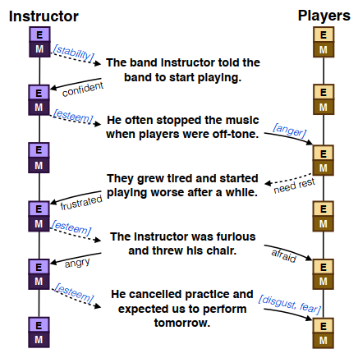
Problem & Motivation
Annotation framework to densely label commonsense short 5-sentence stories explaining the psychology of story characters.
Has fully specified chains of mental states:
motivations behind actions
emotional reactions to events.
Dataset used for two tasks:
To categorize motivations and emotional reactions using theory labels.
To describe motivations and emotional reactions using free text.
Notes:
To solve this problem, they proposed a framework to densely annotate short stories intuiting the psychology of characters. []
Here is an example of a fully annotated story. Mental states were captured through “motivations” behind taking an action labelled M and emotional reaction to events labeled E.

Slide 4
Contents:
Contributions of the work
Building the dataset
Representing Mental States of Character
Annotation Pipeline
Dataset Statistics
Tasks performed
Evaluations of tasks
Conclusion
Shortcomings
Discussion

Slide 5
Contributions of this work: A rich dataset
Annotated chain intuiting psychology of characters crowdsourced from Amazon Mechanical Turks.
: Motivation behind an action
→ : Emotional Reaction to an
[Blue]: Formal Theory Labels
‘Black’ : Free text explanations
Captures state changes for entities not mentioned explicitly.
Features:
15k stories
300k low-level annotations
150k character-line pairs.
There is no mention of the players in this line
Notes:
The annotations were done by Amazon Mechanical Turks.
Here is an example of an annotated story. We have the two characters of the story: Instructor and Players. For each character, motivations are preconditions for sentences and emotional reactions are consequences of sentences. In blue are the formal theory labels given by theories of psychology. In black are free text explanations given by humans. []
One very important feature is that the dataset captures state changes for characters not mentioned in a sentence. It is possible that even though a character is not mentioned in the sentence, they could have an emotional reaction to something happening in the sentence. For e.g. [] here there is no mention of players but they were probably afraid of the instructor throwing his chair.

Slide 6
Building the dataset

Slide 7
Representing Mental States of Characters
Spiritual Growth
Esteem
Love/Belonging
Stability
Physiological needs
Curiosity, serenity, idealism, independence
Competition, honor, approval, power, status
Romance, belonging, family, social contact
Health, savings, order, safety
Food, rest
Maslow’s needs (coarse grained) +
Reiss’ motives (fine grained)
Plutchik’s basic emotions
MOTIVATIONS
EMOTIONAL REACTIONS
Notes:
The formal labels used were derived from theories of psychology.
Maslow’s hierarchy of needs gives us a very broad description of the needs that motivate human behavior. Reiss’ motives provides us with finer grained labels for each Maslow need.
For emotional reactions, Plutchik’s wheel of emotions was used which aims to provide the 8 core emotions.

Slide 8
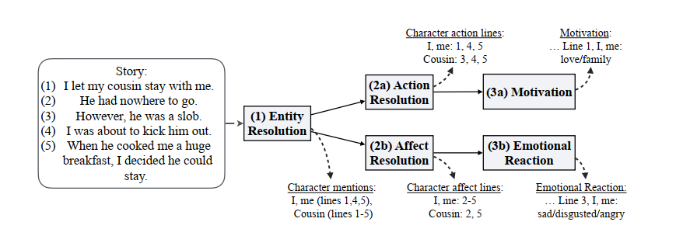
Annotation Pipeline
(1) Entity Resolution: The characters “I/me” and “My cousin” appear in lines {1, 4, 5} and {1, 2, 3, 4, 5}.
(2a) Action Resolution: Identifies lines where character is taking a voluntary action.
- Line (2): cousin is taking an involuntary action→ prune
(3a) Motivation: Given a line (line 1), a character (I/me), and context lines (N/A) :
- select Maslow/Reiss labels {love/family}
- give free response text {want company}
(2b) Affect Resolution: Identify lines where a character has emotional responses.
- need line (2) to capture response of I/me even though not mentioned explicitly.
(3b) Emotional Reaction: Given a line (line 3), a character (I/me), and context lines {1,2} :
- select Plutchik label {sad/disgusted/anger}
- give free response text {feeling annoyed}
Is there motivation?
Is there emotion?
Notes:
Characters in the story are identified and the sentences in which they occur
Going through the motivation branch
We need to check if there is any motivation in the sentence. It is considered that if an action is voluntary, there must be motivation behind it whereas involuntary actions have no motivation associated. E.g. in line 2, “he had nowhere to go”, he is not doing anything on purpose and hence has no motivation. This needs to be removed from our set of sentences
Final set of sentences are annotated for a given character and context lines.
The other branch.
Is there any emotional reaction in these sentences? Easy to identify but the only problem is that often there will be instances where a character is not mentioned in the line but probably has a reaction to the event in the line. E.g. line 2
From the set of sentences, we select theory labels and give free response texts

Slide 9
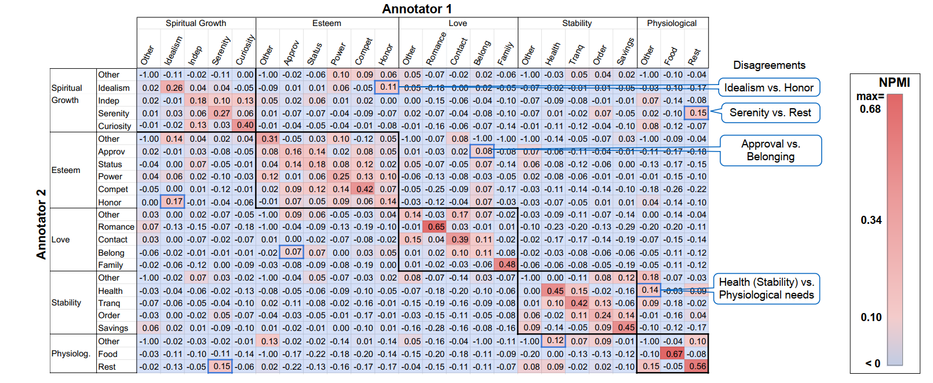
Dataset Statistics: Motivational Categories
Normalized Pair Mutual Information (NPMI) score
- Higher score → more confusion between the two categories.
Black boxes along diagonal
- High disagreements between Reiss motives in the same Maslow category
Green boxes indicate confusion between thematically similar Reiss category
- Problem as annotations are too detailed
Notes:
To evaluate the dataset, The average NPMI score between all pairs of annotators was used. A higher score indicates more confusion between categories.
If you look at the black boxes along the diagonal, you will see high scores. This indicates disagreements between the Reiss motives within the a Maslow category which is expected as the more detailed a label is, the more ambiguity there is. Status and power are very closely related labels.
The green boxes show confusion between thematically similar Reiss categories. Idealism and honor. Approval and belonging.

Slide 10
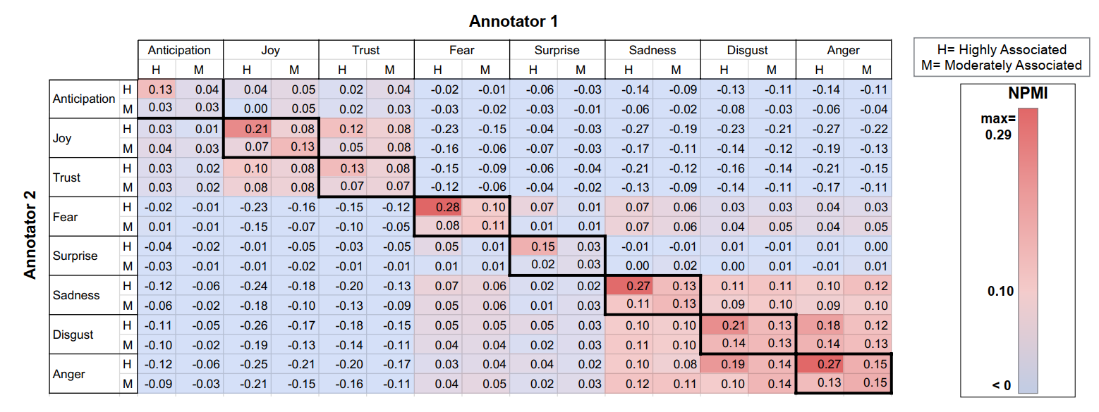
Dataset Statistics: Emotional Categories
Green boxes
- Confusion within strongly positive or strongly negative emotions.
Yellow box
- Slight co-occurrence between fear and other strong negative emotions.

Slide 11
Tasks Performed on the annotated dataset
Notes:
On the final dataset, some tasks were performed.

Slide 12
Tasks
State Classification
Input: Line {“I let my cousin stay with me”}, character {I/me} and optional context lines {N/A}
Model: Logistic Regression
Predict: Motivation label {love/family} and emotional label {joy}.
Annotation Classification:
Input: Free text explanation {to have company}
Model: Logistic Regression
Predict: Motivation label {love/family}, or Emotional label
Explanation Generation:
Input: Line {“I let my cousin stay with me”}, character {I/me} and optional context lines {N/A}
Model: LSTM
Predict: Free text describing motivation {“to have company ”}, or emotion

Slide 13
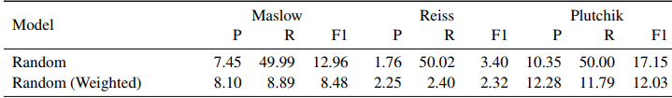
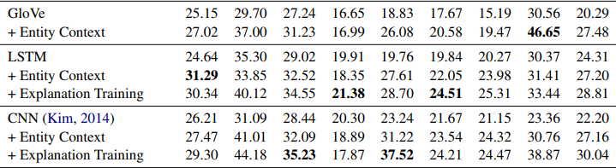
Evaluation of State Classification Task
State Classification:
Metric: Micro-Averaged Precision, Recall, F1
Random baseline is low
Dataset is unbalanced.
Experiments:
All encoders trained without context to test its importance.
Parameters from a pretrained explanation generator used.
Better performance
Best performance by labels with limited set of actions:
Maslow’s Physiological Needs
Reiss’ Food
Plutchik’s Joy

Slide 14
Evaluation of the Annotation Classification and Explanation Generation Task
Annotation Classification
Metric: F1 scores
Simple model has learned to map free text to theory labels.
Explanation Generation
Metric: Vector Average
High random baseline
All models outperform strong random baseline
 | Maslow | Reiss | Plutchik
F1 score | 64.81 | 48.60 | 53.44
Model | Motivation | Emotion
 | Vector Avg | Vector Avg
Random | 56.02 | 40.23
REN | 58.83 | 53.95
NPN | 57.77 | 54.02
Notes:
High random baseline– explanations are very closely tied to emotional and motivation states and therefore the random explanation selected can be very close to the truth in embedding space

Slide 15
Conclusions
The paper provides us with a densely annotated dataset that encodes the psychology of story characters. This is achieved by keeping track of:
motivations for their actions, and
emotional reactions to actions that happen to them (implicitly as well)
The dataset was used for various tasks such as:
Predicting the motivation or emotional reaction of a character given a line.
Predicting the formal label given a free text explanation
Generating free text explanation given a sentence.

Slide 16
Shortcomings
The theory labels do not extensively capture the nuances of human emotions and motivations, and leave room for ambiguity.
E.g. The emotion of shame could fall into both labels: Disgust and Anger
Although all of the Amazon Turk Workers complete a tutorial before attempting the tasks, human annotation still has its flaws.
Only 0.23% of annotators selected free text “bleak” to fall under the label “sadness”.
The dataset is unbalanced and is re-balanced only for the task of emotional explanation.
Rebalancing is done by sampling from the training set evenly among positive examples and negative examples for each category
Due to the cost of annotating theory labels (~$4/story), only a third of the dataset has theory labels.

Slide 17
Future Work and Discussion
What can we use this dataset for?
Enables us to predict what a person’s reaction to an action will be and why a person carries out a particular action.
E.g. The child broke the vase. His mother shouted at him.
Reaction: He will be afraid.
Motivation: She was angry.
Can be used to intuit human psychology in machines and improve discourse coherence.
To improve empathy in conversation related tasks.

Slide 18
Thank You!

