Slide 1
How Much is 131 Million Dollars? Putting Numbers in Perspective with Compositional Descriptions Arun Tejasvi Chaganty & Percy Liang, 2016
Nivedha Sivakumar (nivedha@seas.upenn.edu)
4/1/19

Slide 2
Problem & Motivation
Cristiano Ronaldo was acquired by Madrid for $131 million
How large is $131 million dollars?

Slide 3
Problem & Motivation
Difficult to comprehend scale of large/small absolute numeric mentions
$131 million
Relative comparisons improve comprehension significantly
About the cost to employ everyone in Texas over a lunch period

Slide 4
Problem & Motivation
Numeric mention in a sentence
Difficult to comprehend scale of large/small absolute numeric mentions
$131 million
Relative comparisons improve comprehension significantly
About the cost to employ everyone in Texas over a lunch period
Perspective generated

Slide 5
Problem & Motivation
Difficult to comprehend scale of large/small absolute numeric mentions
601,000 ounces of platinum
Relative comparisons improve comprehension significantly
About 4 times the weight of an elephant

Slide 6
Problem & Motivation
Difficult to comprehend scale of large/small absolute numeric mentions
60 million guns
Relative comparisons improve comprehension significantly
About twice the gun ownership of the population of Texas

Slide 7
Contents:
Previous approaches
Contributions of this work
Process flow
Dataset construction
Formula selection
Description generation
Results & Analysis
Conclusions & Shortcomings
Future work

Slide 8
Previous approaches
Manually generated perspectives
Barrio et al., 2016: Improving the comprehension of numbers in the news
Present facts as is from knowledge base
G. Chiacchieri, 2013: www.dictionaryofnumbers.com
Seq2seq based description generation
Liu et al., 2015: Table-to-text generation by structure-aware Seq2seq learning
Hosseini et al., 2015: Learning to solve arithmetic word problems with verb categorization

Slide 9
Contributions of this work
Approach
Generate perspectives from numeric mentions in sentences by composing facts from a knowledge base (K)
Proposed system
- Formula selection: Given numeric mention and K, select formula over K with same value and unit as mention
- Description generation: Given formula, generate natural language descriptions
Performance analysis
- Formula selection:15.2% F₁ score improvement
- Description generation: 12.5 BLEU point improvement

Slide 10
Contributions of this work
Approach
Generate perspectives from numeric mentions in sentences by composing facts from a knowledge base (K)
Proposed system
- Formula selection: Given numeric mention and K, select formula over K with same value and unit as mention
- Description generation: Given formula, generate natural language descriptions
Performance analysis
- Formula selection:15.2% F₁ score improvement
- Description generation: 12.5 BLEU point improvement
Given: Cristiano Ronaldo was acquired by Madrid for $131 million

Slide 11
Contributions of this work
Approach
Generate perspectives from numeric mentions in sentences by composing facts from a knowledge base (K)
Proposed system
- Formula selection: Given numeric mention and K, select formula over K with same value and unit as mention
- Description generation: Given formula, generate natural language descriptions
Performance analysis
- Formula selection:15.2% F₁ score improvement
- Description generation: 12.5 BLEU point improvement
Given: Cristiano Ronaldo was acquired by Madrid for $131 million
Formula: 131 million ~ 1.0*cost of employee * population of Texas * time taken for lunch

Slide 12
Contributions of this work
Approach
Generate perspectives from numeric mentions in sentences by composing facts from a knowledge base (K)
Proposed system
- Formula selection: Given numeric mention and K, select formula over K with same value and unit as mention
- Description generation: Given formula, generate natural language descriptions
Performance analysis
- Formula selection:15.2% F₁ score improvement
- Description generation: 12.5 BLEU point improvement
Given: Cristiano Ronaldo was acquired by Madrid for $131 million
Formula: 131 million ~ 1.0*cost of employee * population of Texas * time taken for lunch
About the cost to employ everyone in Texas over a lunch period

Slide 13
Contributions of this work
Approach
Generate perspectives from numeric mentions in sentences by composing facts from a knowledge base (K)
Proposed system
- Formula selection: Given numeric mention and K, select formula over K with same value and unit as mention
- Description generation: Given formula, generate natural language descriptions
Performance analysis
- Formula selection:15.2% F₁ score improvement
- Description generation: 12.5 BLEU point improvement

Slide 14
Process Flow
Sentence: The billings-based stillwater mining produced 601,000 ounces of platinum
Formula: 4 x weight of an elephant
That’s about: 4 times the weight of an elephant

Slide 15
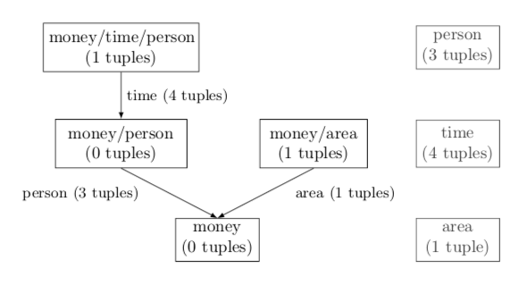
Dataset Construction
Collect knowledge base
142 tuples with 9 fundamental units where t = (t.value, t.unit, t.description) from US Bureau of Statistics and Wikipedia
Collect numeric mentions
2,041 normalized numeric mentions from newswire section of LDC catalog
Generate formulae
With knowledge base as a graph, traverse all paths that yield desired final unit to generate formulae
Collect formulae description
Collect formula preference data
Rated through a simple majority
Train a language generation system
Notes:
S

Slide 16
Dataset Construction
Collect knowledge base
142 tuples with 9 fundamental units where t = (t.value, t.unit, t.description) from US Bureau of Statistics and Wikipedia
Collect numeric mentions
2,041 normalized numeric mentions from newswire section of LDC catalog
Generate formulae
With knowledge base as a graph, traverse all paths that yield desired final unit to generate formulae
Collect formulae description
Collect formula preference data
Rated through a simple majority
Train a language generation system
Input: Knowledge base, final unit - money, time, etc.,
Formula generation is exhaustive!
Notes:
S

Slide 17
Dataset Construction
Collect knowledge base
142 tuples with 9 fundamental units where t = (t.value, t.unit, t.description) from US Bureau of Statistics and Wikipedia
Collect numeric mentions
2,041 normalized numeric mentions from newswire section of LDC catalog
Generate formulae
With knowledge base as a graph, traverse all paths that yield desired final unit to generate formulae
Collect formulae description
Collect formula preference data
Rated through a simple majority
Train a language generation system
Each vertex is a ‘unit’ and includes all tuples with this unit
Notes:
S

Slide 18
Dataset Construction
Collect knowledge base
142 tuples with 9 fundamental units where t = (t.value, t.unit, t.description) from US Bureau of Statistics and Wikipedia
Collect numeric mentions
2,041 normalized numeric mentions from newswire section of LDC catalog
Generate formulae
With knowledge base as a graph, traverse all paths that yield desired final unit to generate formulae
Collect formulae description
Collect formula preference data
Rated through a simple majority
Train a language generation system
Notes:
S

Slide 19
Formula Selection & Ranking Criteria
Given numeric mention and knowledge base K, select formula over K with the same value and unit as mention
Proximity
Perspective same order of magnitude as mention
Familiarity
Perspective should be composed of concepts familiar to reader
Compatibility
Some tuple combinations more natural than others
Similarity
Perspective should be relevant to context
Pick formulae in range [1/100, 100]
Population of Texas VS Angola
Median income x a month VS weight of a person x population of Texas
NASA’s budget of $17 billion = 0.1% of US budget VS amount of money to feed LA for a year

Slide 20
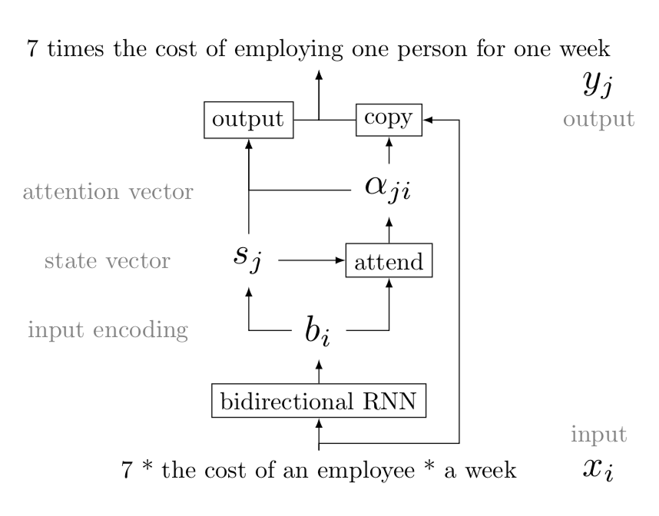
Perspective Generation
Given formula selected & multiplier, generate natural language descriptions with seq2seq RNN
Baseline
Combine tuples in the formula with neutral prepositions
Seq2seq RNN
RNN with an attention-based copying mechanism to generate perspectives
Jia and Lang (2016)*
1/5th of the cost of an employee for the population of Texas for time taken for lunch

Slide 21
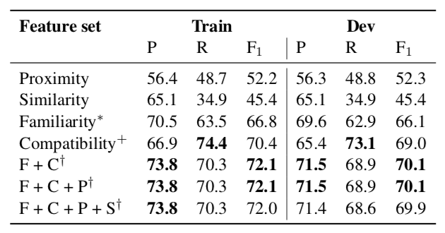
Results and Analysis: Formula Selection
Measure of usefulness of generated formulae: Logistic regression classifier using four ranking criteria discussed
Key Takeaways:
1. Best: Familiarity + compatibility
2. Similarity does not affect performance relative to proximity baseline; due to many unfamiliar formulae in dataset

Slide 22
Results and Analysis: Formula Selection
Training data: 4 ranking features, and perspective ranks as labels
Measure of usefulness of generated formulae: Logistic regression classifier using four ranking criteria discussed
Key Takeaways:
1. Best: Familiarity + compatibility
2. Similarity does not affect performance relative to proximity baseline; due to many unfamiliar formulae in dataset

Slide 23
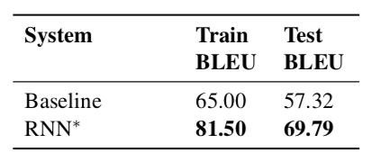
Results and Analysis: Perspective Generation
- Split perspective dataset into non-overlapping sets
- Compare BLEU scores of baseline and trained RNN output
Key Takeaway:
Seq-to-seq RNN gives more ‘natural’ rephrasings
7 x the cost of an employee x a week : 7 times the cost of employing one person for one week
6 x weight of a person x population of California : six times the weight of the people who is worth

Slide 24
Results and Analysis: Perspective Generation
Use of BLEU score to determine overlap between input formula and generated perspective
- Split perspective dataset into non-overlapping sets
- Compare BLEU scores of baseline and trained RNN output
Key Takeaway:
Seq-to-seq RNN gives more ‘natural’ rephrasings
7 x the cost of an employee x a week : 7 times the cost of employing one person for one week
6 x weight of a person x population of California : six times the weight of the people who is worth

Slide 25
Conclusions & Shortcomings
Conclusions
Proposes system to generate natural language descriptions from sentences with numeric mentions
Shortcomings
Collection of knowledge base, formulae, descriptions and corresponding preferences available for future research
Evaluation conclusions not substantiated
Small and biased dataset
Facts in knowledge base – course granularity
Use of BLEU score as an evaluation measure
Upon re-implementation, many re-phrasings not ‘natural’ as claimed

Slide 26
Future Work
Larger knowledge base
Freebase (Bollacker et al., 2008)
OpenIE (Fader et al., 2011)
Semantic compatibility on larger units of text better results than word vectors (Bowman et al, 2015)

