Slide 1
Numeracy for Language Models: Evaluating and Improving their Ability to Predict Numbers George P. Spithourakis and Sebastian Riedel ACL, 2018
Oshin Agarwal (oagarwal@seas.upenn.edu)
April 1, 2019

Slide 2
Problem & Motivation
Which of these sentences is more realistic?
John’s height is 1.75 meters (realistic)
John’s height is 999.999 meters (unrealistic)
But a language model will likely assign similar probability to both sentences because most numerals will most likely be OOV
BERT demo at http://orwell.seas.upenn.edu:4001
- John’s height is ____ meters
- Most probable predicted values are 6, 15 and 5, all of which are unrealistic
We need language models that can understand numerals better and assign higher probabilities to numerals that are more likely and realistic in the given context

Slide 3
Contents:
Language models
Prior work
Contributions
Models
Evaluation metrics
Results
Analysis
Shortcomings

Slide 4
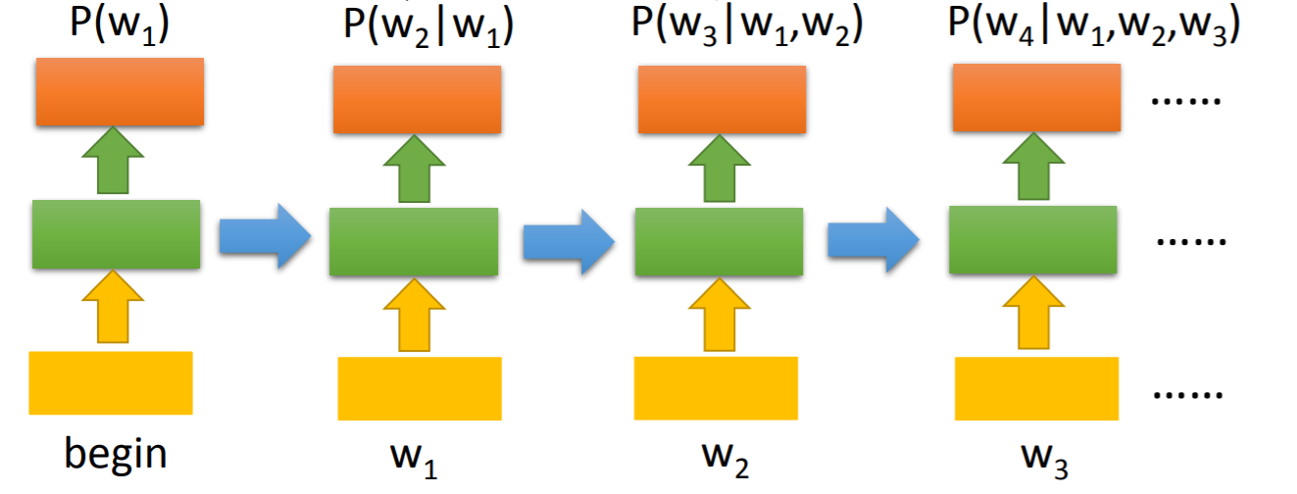
Language models
Compute the probability of a sentence
P(w₁,w₂,….w_{n}) = P(w₁) P(w₂|w₁) P(w₃|w₂,w₁) …… P(w_{n}|w_{n-1},…..w₁)
h₁
h₂
h₃
h₄
Figure based on from slides by Hung-yi Lee

Slide 5
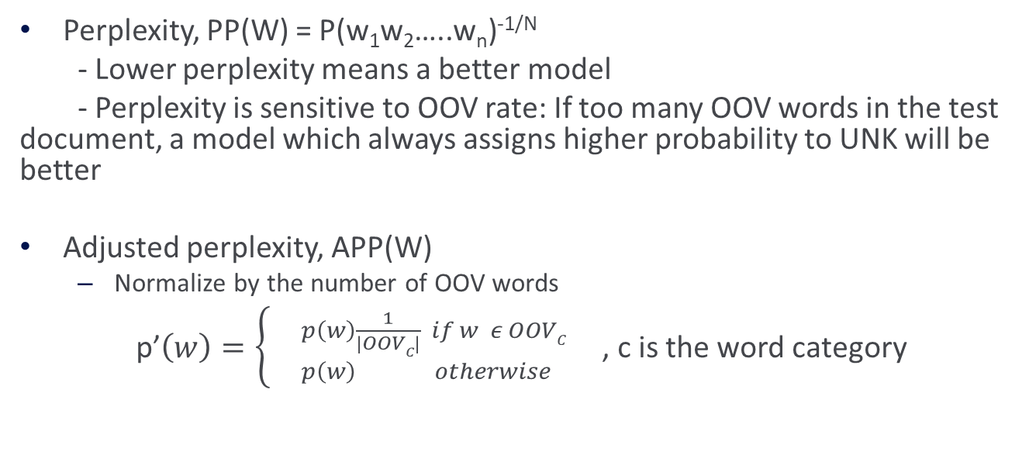
Language models - Evaluation
Perplexity, PP(W) = P(w₁w₂…..w_{n})^{-1/N}
- Lower perplexity means a better model
- Perplexity is sensitive to OOV rate: If too many OOV words in the test document, a model which always assigns higher probability to UNK will be better
Adjusted perplexity, APP(W)
Normalize by the number of OOV words
p’$\left(w\right)=\left\{\begin{matrix}{}_{p\left(w\right) otherwise}^{p\left(w\right)\frac{1}{\left|OOVC\right|} if w ε OOVC }\end{matrix}\right.$ , c is the word category

Slide 6
Prior work
Numerically Grounded Language Models for Semantic Error Correction; Georgios P. Spithourakis, Isabelle Augenstein and Sebastian Riedel; EMNLP 2016
Incorporate numbers in language models for SEC systems. Eg. 99.9 degrees means a slight fever vs 103 degrees means high fever
Probability of word depends on the numbers that have appeared in text
Use simple representation for numbers such as the number itself

Slide 7
Contributions
They model numerals with language models using many techniques i.e. assign probabilities to numerals as well given the context and avoid treating them as OOV usually
Their models are able to distinguish between different numerals much better but each of them are biased towards certain types of numbers
They propose different evaluation metrics for numerals
Unfortunately, their evaluation metrics lead to varying conclusions about each of the models

Slide 8
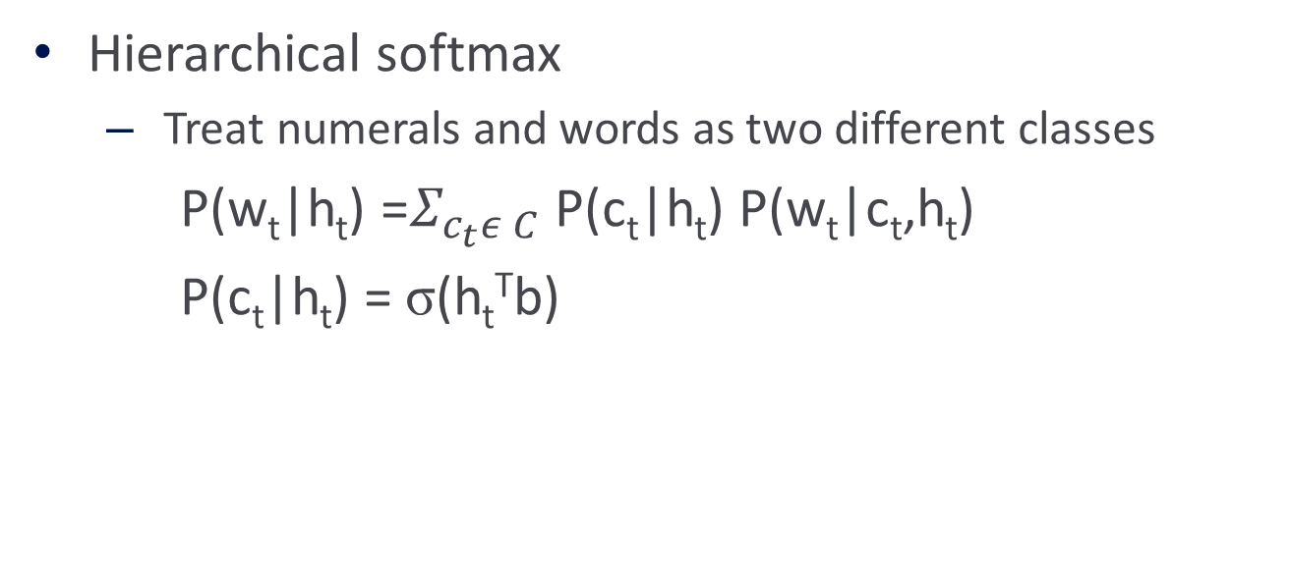
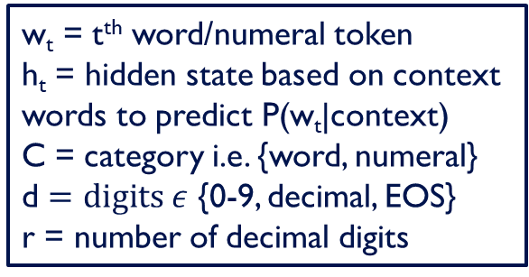
Modelling numerals
Hierarchical softmax
Treat numerals and words as two different classes
P(w_{t}|h_{t}) =$Σ_{c_{t}ε C}$ P(c_{t}|h_{t}) P(w_{t}|c_{t},h_{t})
P(c_{t}|h_{t}) = σ(h_{t}^{T}b)
w_{t} = t^{th} word/numeral token
h_{t} = hidden state based on context words to predict P(w_{t}|context)
C = category i.e. {word, numeral}
d $=digits ε$ {0-9, decimal, EOS}
r = number of decimal digits

Slide 9
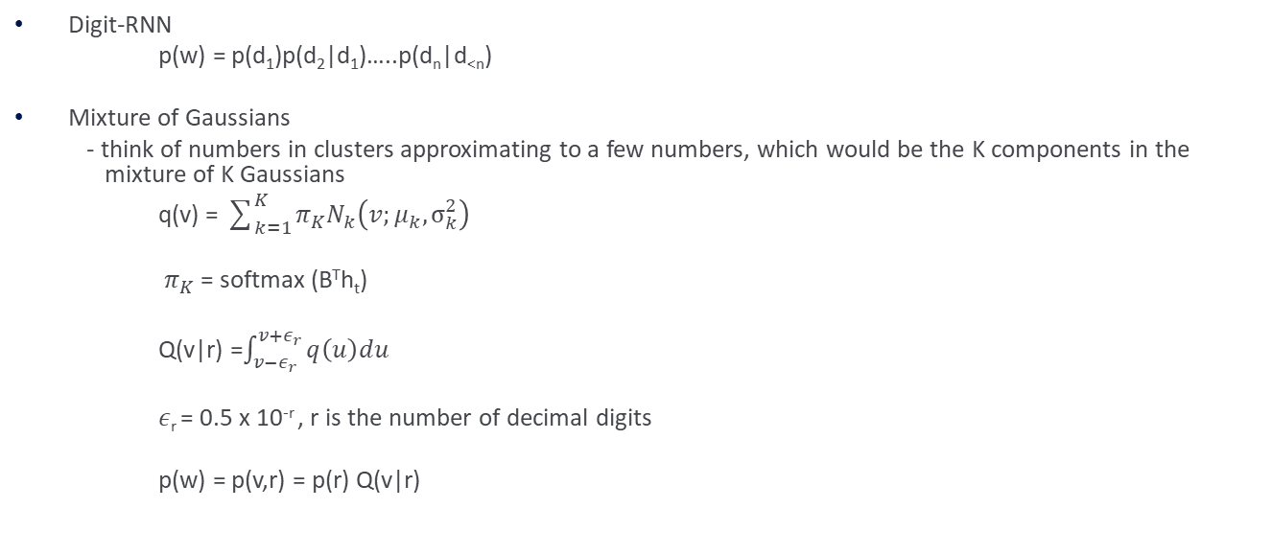
Modelling numerals
Digit-RNN
p(w) = p(d₁)p(d₂|d₁)…..p(d_{n}|d_{<n})
Mixture of Gaussians
- think of numbers in clusters approximating to a few numbers, which would be the K components in the mixture of K Gaussians
q(v) = $\sum_{k=1}^{K}{π_{K}N_{k}\left(v;μ_{k},σ_{k}^{2}\right)}$
$π_{K}$ = softmax (B^{T}h_{t})
Q(v|r) =$\int_{v−ε_{r}}^{v+ε_{r}}{q\left(u\right)du}$
$ε$_{r} = 0.5 x 10^{-r} , r is the number of decimal digits
p(w) = p(v,r) = p(r) Q(v|r)
w_{t} = t^{th} word/numeral token
h_{t} = hidden state based on context words to predict P(w_{t}|context)
C = category i.e. {word, numeral}
d $=digits ε$ {0-9, decimal, EOS}
r = number of decimal digits

Slide 10

Modelling numerals
Combination
p(w) = $\sum_{mεM}{\text{α}\text{m}\text{p}\text{(}\text{w}\text{|}\text{m}\text{)}}$
$\text{α}\text{m}$ = softmax(A^{T}h_{t})
M = {h-softmax, d-RNN, MoG}
w_{t} = t^{th} word/numeral token
h_{t} = hidden state based on context words to predict P(w_{t}|context)
C = category i.e. {word, numeral}
d $=digits ε$ {0-9, decimal, EOS}
r = number of decimal digits

Slide 11
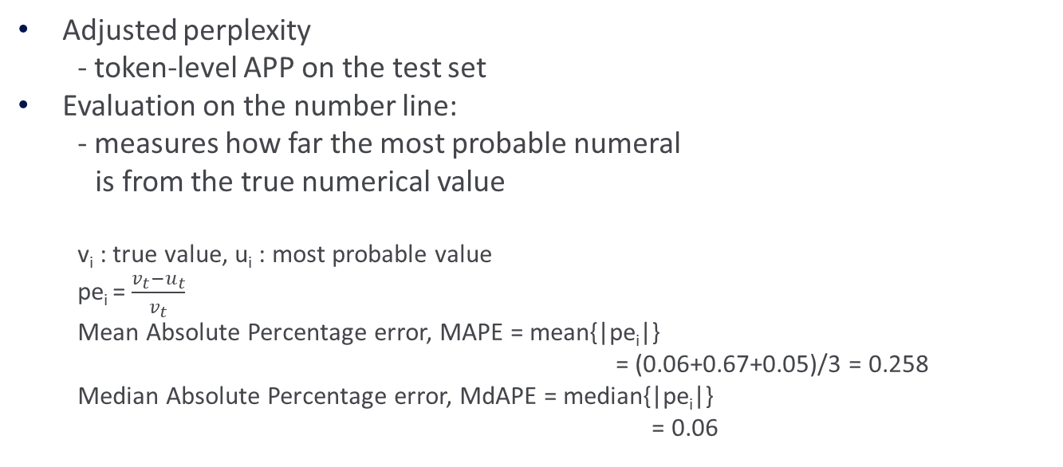
Evaluation
Adjusted perplexity
- token-level APP on the test set
Evaluation on the number line:
- measures how far the most probable numeral
is from the true numerical value
v_{i} : true value, u_{i} : most probable value
pe_{i} = $\frac{v_{t}−u_{t}}{v_{t}}$
Mean Absolute Percentage error, MAPE = mean{|pe_{i}|}
= (0.06+0.67+0.05)/3 = 0.258
Median Absolute Percentage error, MdAPE = median{|pe_{i}|}
= 0.06
v_{i} | u_{i} | pe_{i}
1.75 | 1.85 | 0.06
300 | 500 | 0.67
10 | 10.5 | 0.05

Slide 12
Datasets
Clinical Data
Records from London Chest Hospital
Scientific Data
Papers from arXiv
37 sub-fields

Slide 13
Results (APP)
Lower APP is better
APP will be high if most words are OOV and probability of UNK is low in the model. In fact, normalization by OOV count made the probability even smaller and perplexity even higher.
Treating numerals and words separately helps quite a bit
Major reason for lower APP otherwise below is that numerals aren’t OOV in most of them
Model | Clinical |  |  | Scientific
 | words | numerals | total | words | numeral | total
softmax | 5.99 | 58443.72 | 8.91 | 51.83 | 3505856.2 | 80.62
h-softmax | 4.96 | 495.95 | 6.05 | 49.81 | 550.98 | 54.80
d-RNN | 4.95 | 263.22 | 5.88 | 48.89 | 519.80 | 53.70
MoG | 4.99 | 226.46 | 5.88 | 48.97 | 683.16 | 54.37
Combination | 4.96 | 197.59 | 5.82 | 48.25 | 520.95 | 53.03

Slide 14
Results (Numerals)
MAPE and MdAPE will be low when the most probable numeral is close to the true value
Higher error need not mean incorrect. Eg. John weighs [70/80/90] kg.
Even if an integer is more realistic in a context, a closer decimal num means lower error here. eg. John has [5/7.5/10] books.
No specific trends of which model is better
Model | Clinical |  | Scientific
 | MAPE | MdAPE | MAPE | MdAPE
softmax | 621.78 | 22.41 | 1947.44 | 80.62
h-softmax | 746.5 | 25.00 | 1652.21 | 80.00
d-RNN | 513.81 | 17.90 | 1287.27 | 52.45
MoG | 348.10 | 13.64 | 590.42 | 90.00
combination | 552.06 | 17.86 | 2332.50 | 88.89

Slide 15
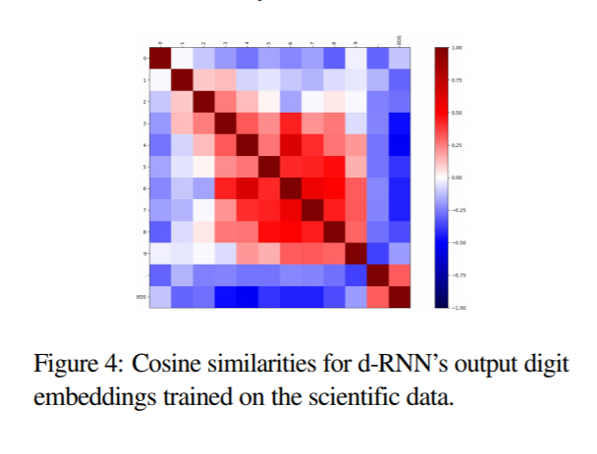
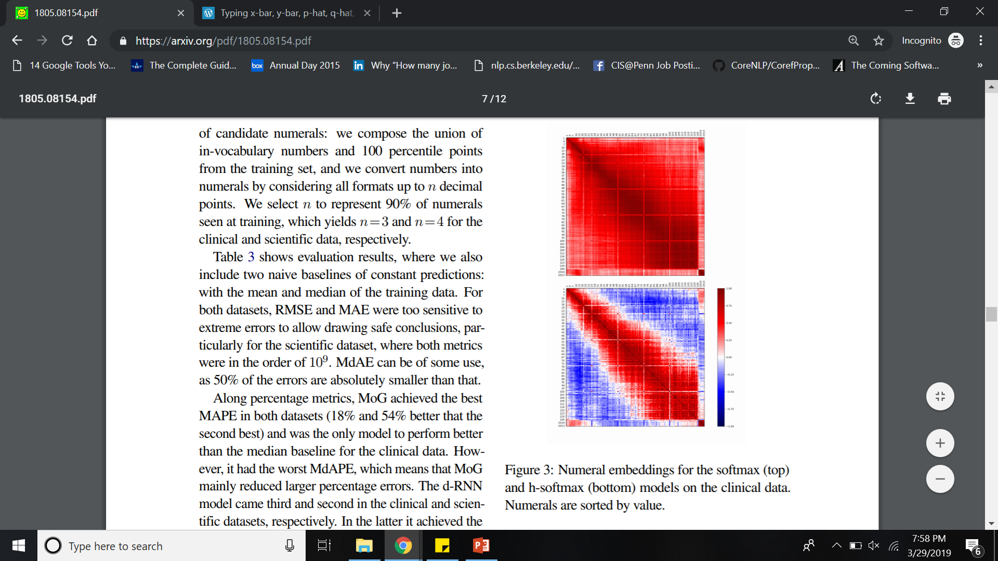
Analysis
Red denotes higher similarity
softmax, where numbers are treated the same as other words gives high similarity for all numbers
In h-softmax and d-rnn, numbers are only similar to other numbers close in magnitude

Slide 16
Analysis
 | Clinical | Scientific
h-softmax | Integers such as doses, years Eg. >75%, <25%, 4 out of 17 segments, 140 mcg | - Integers such as doses, years Eg. sharp et al 2004, 3.5 x 10^4
d-RNN | Two digit integers Eg. 37 x 37 mm, 32 x 31 mm | Specific astronomical object types Eg. ngc 6334 stars, ngc 2366 shoes
MoG | Continuous attributes Eg. 46.1 ml, 99.09 ml | Specific astronomical object types Eg. hip 12961 and gl 676, velocities of hip 12961

Slide 17
Shortcomings
Worked with only non-negative and non-fractions
Limited their vocabulary to most frequent types: unfair to numerals as they are infrequent
The two evaluation methods seem a bit contradictory
If the true value is 1.75, then 1.76 would be better on APP but 1.753447 would be better on MAPE because it is closer to 1.75
MoG does better on MAPE on the clinical data because it gives high probability to continuous attributes
Evaluation on the number line does not seem to be the right metric to determine if a numeral is realistic in the context (refer slide 13)
Even APP seems to be amplified by OOV words. The difference b/w numerals and words isn’t that high on PP (see paper)
Are numerals in different types of data different and don’t transfer?
Does the performance vary in the 37 sub-fields from arXiv also?

