Slide 1
Open Information Extraction from the Web Michele Banko, Michael J Carafella, Stephen Soderland, Matt Broadhead and Oren Etzioni IJCAI, 2007
Nivedha Sivakumar (nivedha@seas.upenn.edu)
Feb-11-2019

Slide 2
Problem & Motivation
Standard Information Extraction (IE):
Yesterday, New York based Foo Inc. announced their acquisition of Bar Corp.
MergerBetween(company₁, company₂, date)
Proposes new self-supervised, domain-independent IE, OpenIE
Information extracted: t = (e_{i} , r_{i,j} , e_{j})
(<proper noun>, works with, < proper noun >)
Notes:
Goal for most standard IE paradigms is to allow logical reasoning to draw inferences on logical content of input data.

Slide 3

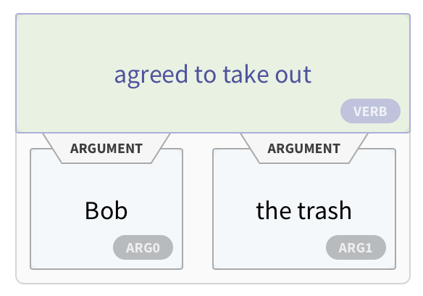
Problem & Motivation
Current works are resource hungry:
Not scalable
Need to pre-specify relations of interest
Multiple passes over corpus to extract tuples
Paper introduces TextRunner:
Scalable & domain-independent
Extracts relational tuples from text
Indexed to support extraction via queries
Input to TextRunner is corpus, output is set of extractions

Slide 4
Contents:
Previous works
Novel aspects of this paper
TextRunner architecture
Self-supervised learner
Single pass extractor
Redundancy-based assessor
Query processing
Results
Comparison with SoTA
Global statistics on facts learned
Conclusions, shortcomings and future work

Slide 5
Previous Works
Entity chunking common in previous work:
Trainable systems with hand-tagged instances as input
DIPRE [Brin, 1998], SNOWBALL [Agichtein & Gravano, 2000], Web-based Q&A [Ravichandran & Hovy, 2002]
Relation extraction with kernel-based methods [Bunescu & Mooney, 2005], maximum-entropy models [Kambhatla, 2004], & graphical models [Rosario & Hearst, 2004]

Slide 6
Previous SoTA: KnowItAll
Previous state of the art: KnowItAll
Self-supervised learning: can label training data with domain-independent extraction patterns
Corpus heterogeneity: use of POS tagger
Parsers are harder mechanisms, hence less scalable
Shortcomings of KnowItAll:
Needs pre-specified relation names as input
Multiple passes over corpus
Can take weeks to extract relational data

Slide 7
Contributions of this work
Paper proposes Open IE
System makes a single data-driven pass over its corpus
Extracts a large set of relational tuples without human intervention
Paper introduces TextRunner
Fully implemented, highly scalable Open IE system
Tuples indexed to support efficient extraction via user queries
Reports qualitative and quantitative results over TextRunner’s 11 million most probable extractions

Slide 8
TextRunner Architecture
TextRunner consists of 3 key modules:
Self-supervised learner: given a corpus sample, learner outputs classifier that labels extractions
Single Pass Extractor: Makes single pass over entire corpus to extract tuples
Self-supervised learner classifies tuples
Redundancy-based assessor: computes probability of correct tuple instance

Slide 9
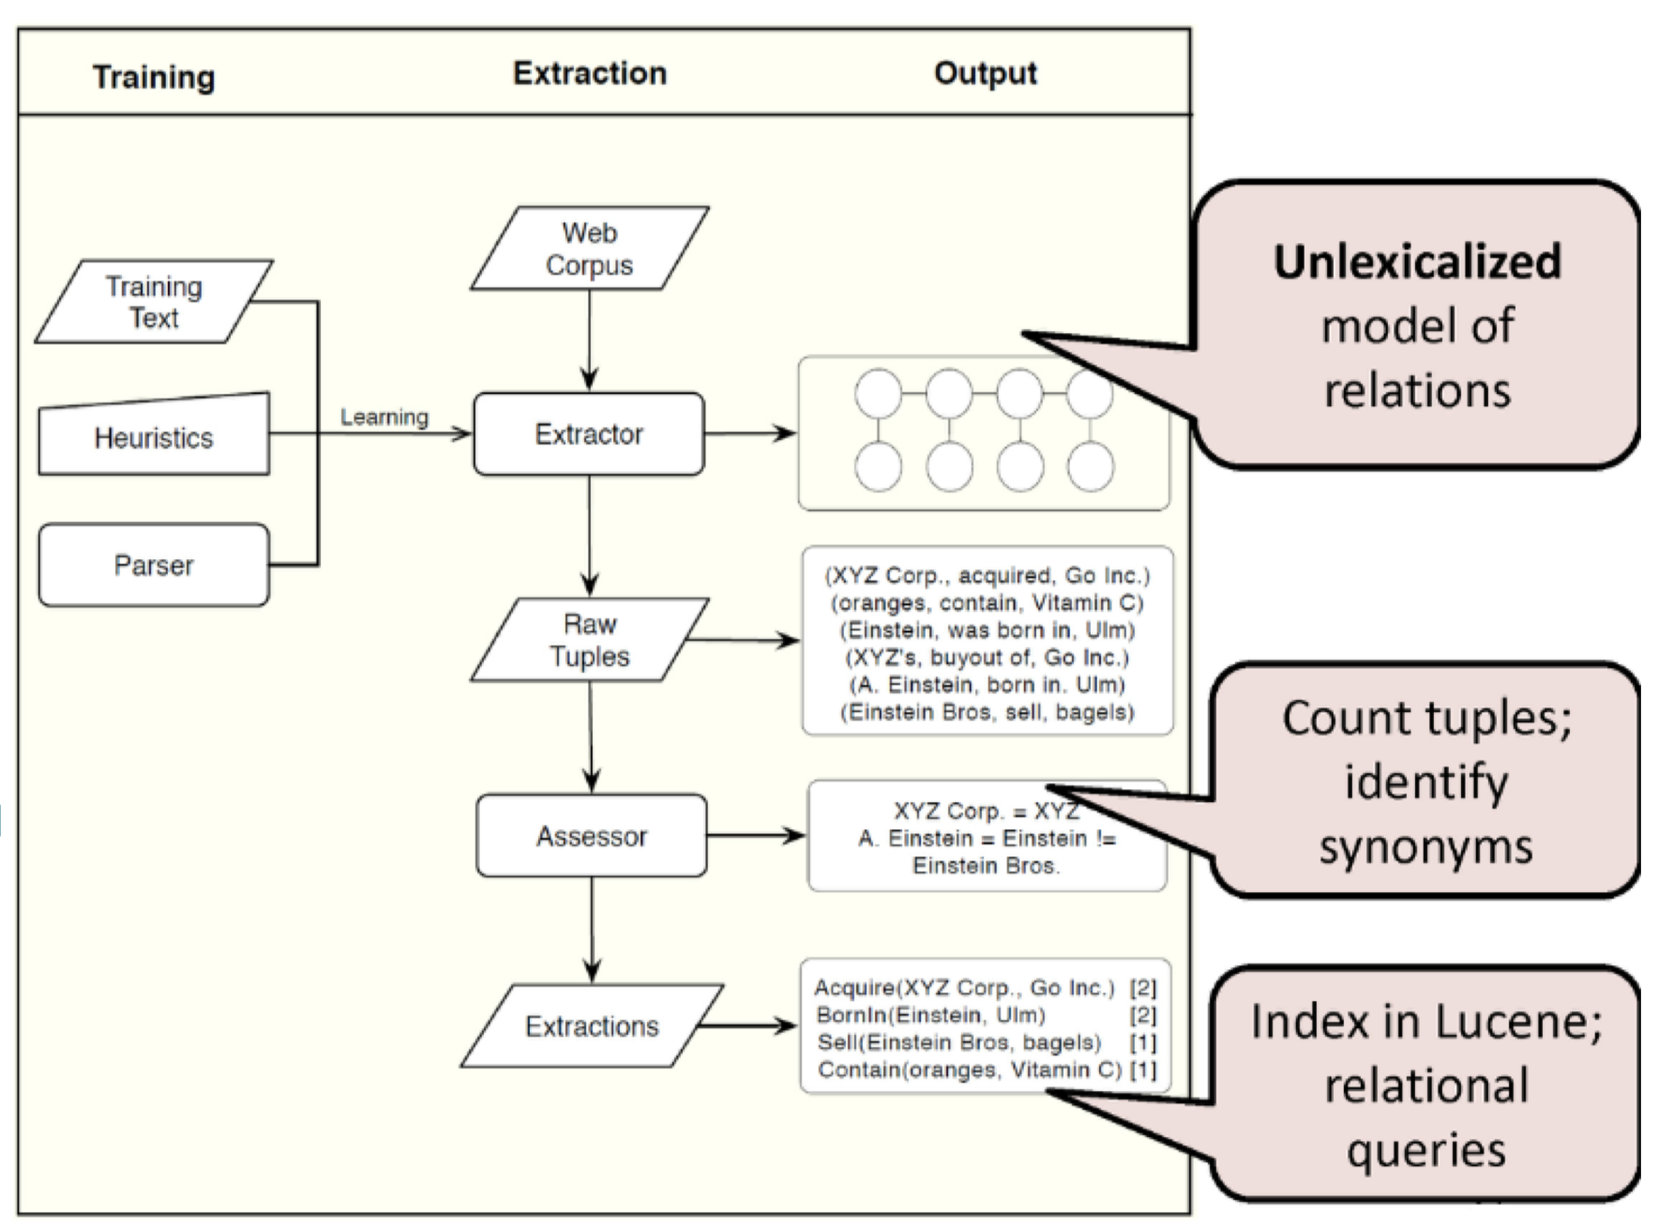
TextRunner Architecture

Slide 10
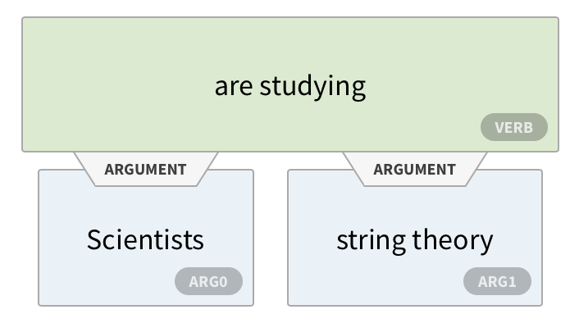
TextRunner Module 1: Self-supervised Learner
Self-supervised learner operates in 2 steps:
Automatic labelling
Train NB classifier
Given tuples, learner labels as positive/negative
Maps tuples to feature vector representation
Classifier output has no lexical features
Domain-independence
Learner checks if:
Relation word length < defined limit
Relation does not cross sentence-like boundary
Entities aren’t pronouns only
If conditions met, classifies tuple as trustworthy

Slide 11
TextRunner Module 2: Single Pass Extractor
Makes single pass over corpus, tagging each sentence with most probable PoS
Entities: noun-phrases with chunker
Relations: by removing over-specifications
Candidate tuples classified by learner module, extracted & stored
Given: Scientists from many universities are studying string theory, but Massachusetts Institute of Tech is one of the pioneers
POS: (noun, prep, adj, noun, verb, verb, noun, noun)
Entities: (Scientists, universities, string theory)
Relation simplification: ‘Scientists from many Universities are studying’ > ‘Scientists are studying’
Output: (Scientists, are studying, string theory)

Slide 12
More TextRunner Modules
Redundancy-based Assessor:
Omits non-essential modifications, merges identical tuples
Was developed by = was originally developed by
With distinct t-counts, can estimate probability of t being a correct instance
Query Processing:
Inverted indexing over pool of machines for quick retrieval
Notes:
Query processing: Each relation found during tuple extraction is assigned to a single machine in the pool
Every machine computes an inverted index over the text of locally stored tuples, ensuring each machine is guaranteed to store all tuples containing a reference to any relation assigned to the machine

Slide 13
Results: Comparison with Traditional IE
Experimental setup:
9 million web page corpus
Pre-specify 10 random relations in >1000 sentences
Performance: 33% lower errors for TextRunner
Higher precision but matches recall
Precision = fraction of retrieved tuple extractions relevant to user query
Recall = fraction of relevant tuple extractions retrieved
Identical correct extractions; improvement by better entity identification
Errors in both due to poor noun phrases:
Truncated arguments/added stray words
Error rate of 32% for TextRunner vs 47% for KnowItAll

Slide 14
Results: Tuple Selection before Global Analysis
Given 9 million web pages, extracted 60.5 million tuples
Restricted analysis to subset of high probability tuples:
Assigned probability of at least 0.8
Relation supported by at least 10 distinct sentences
Relation not found in top 0.1% of relations
Filtered set has 11.3 million tuples with 278K distinct relations

Slide 15
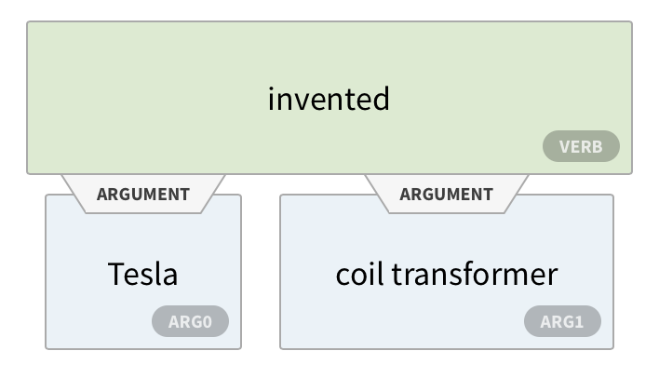
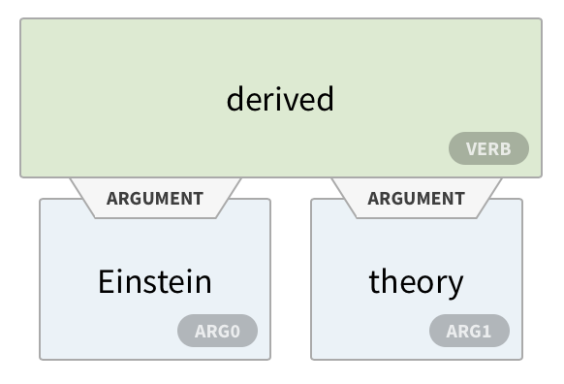
Results: Global Statistics on Facts Learned
Estimating correctness of facts:
Random 400 tuples from filtered set
Are relations well formed? Are entities reasonable?
Classify tuples as concrete/abstract: judge each as T/F
Estimating number of distinct facts:
Merge relations differing by leading/trailing punctuation
Are consistent with = which is consistent with
Metric to evaluate synonyms: Difficult as relations can be used in several senses
Clustering all tuples left – about a third in ‘synonymy clusters’
Notes:
-> Relations are well formed if there is some pair of entities X and Y such that (X,r,Y) is a relation between X and Y
-> X and Y are well-formed arguments for relation r if X and Y are a type of entity that can form a relation (X,r,Y)
-> Concrete – truth of tuple grounded in particular entities
-> Abstract – Underspecified

Slide 16
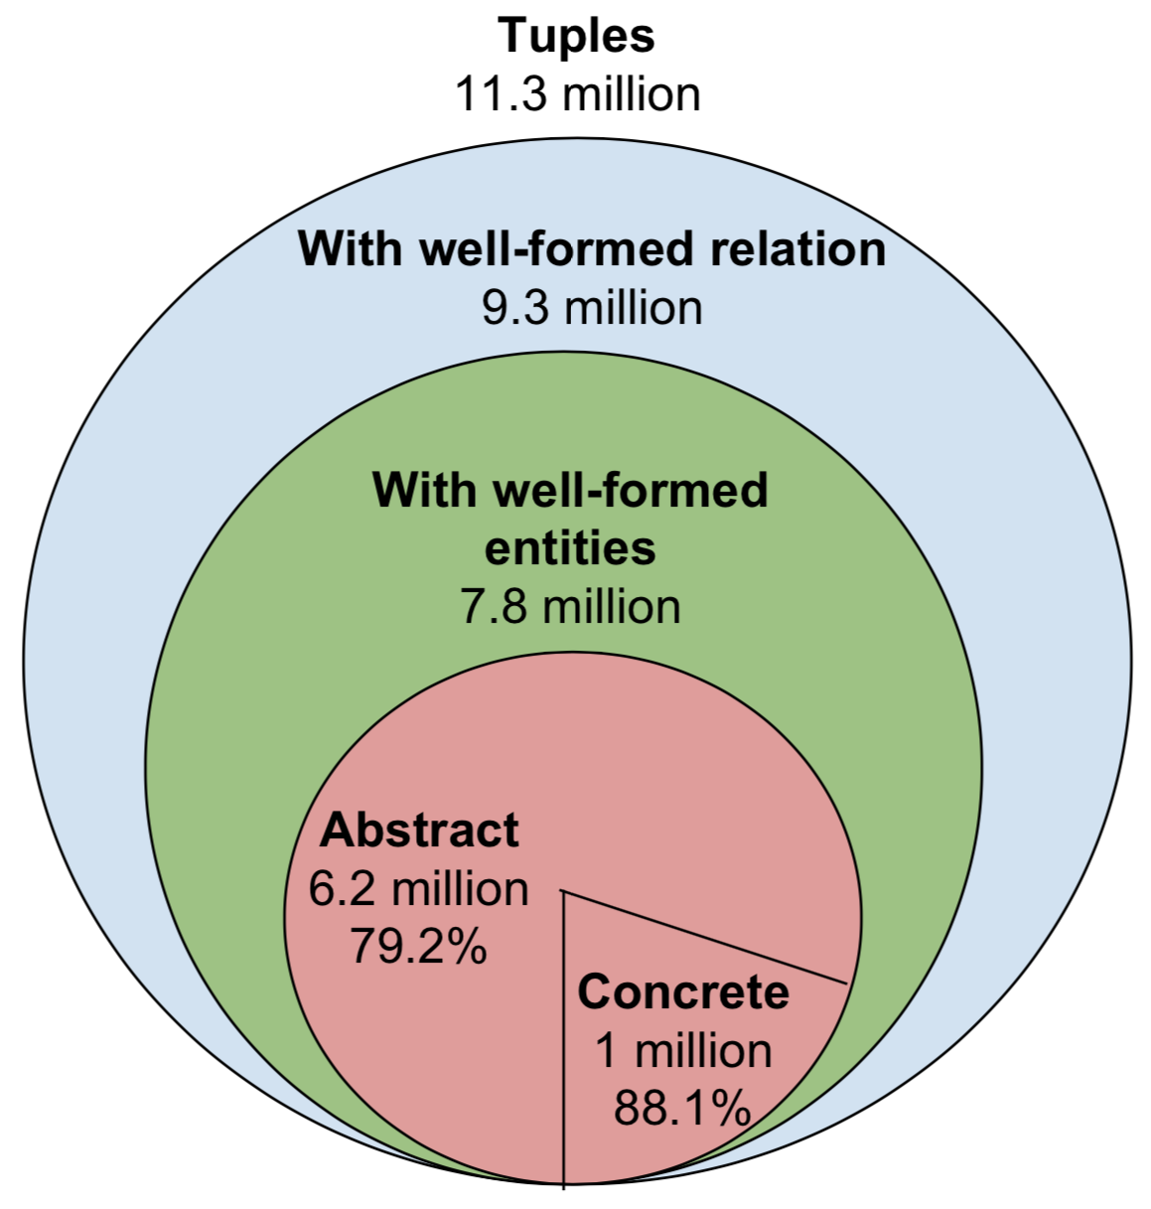
Overview of Global Facts Learned

Slide 17
Conclusions
Novel self-supervised, domain-independent paradigm
Automatic relation extraction for enhanced speeds
TextRunner: OpenIE system for large extractions
Better computing speed and scalability that SoTA
Significance: Textual representation of actual fact as triples
Important but not sufficient for commonsense reasoning

Slide 18
Shortcomings of TextRunner
Scientists from many universities are studying string theory, but Massachusetts Institute of Tech is one of the pioneers
Use of linguistic parser to label extractions not scalable
If Massachusetts Institute of Tech is not defined in parser, learner may not classify as a trustworthy
WOE (Wu and Weld): does not need lexicalized features for self-supervised learning; higher precision & recall
No definition on the form that entities may take
Massachusetts Institute of Tech may not be recognized as one entity
ReVerb (Fader, et al): improves precision & recall with relation-phrase identifier with lexical constrains

Slide 19
Future Work & Discussion
Integrate scalable methods to detect synonyms
Learn types of entities commonly taken by relations
Can distinguish between different senses of relations
Unify tuples into graph-like structure for complex queries
OpenIE visualization in AllenNLP: https://demo.allennlp.org/open-information-extraction

