Slide 1
Robust Handling of Polysemy via Sparse Representations Authors: Abhijit Mahabal, Dan Roth, Sid Mittal
Rushab Munot – CIS700 Presentation 3/25/2019

Slide 2
Problem & Motivation
What is the Ganga of Egypt? What is the New York of India?
Examples
(Donald, Barack) = {George, Ronald, Bill, Gerald….}
(Donald, Mickey) = {Minnie, Daisy, Winnie, …..}
(New York, London, Seattle, Delhi) = {Amsterdam, Washington DC, Beijing, …..}
(New York, Seattle, San Francisco, Austin) = {Los Angeles, Chicago, Houston, …..}
(Google, Wikipedia) != (Google, Apple) … (Websites vs Corporations)
What is the paper trying to achieve?
Proposing a new lexical representation - sparse representations
Context based representation
Two tasks: Set Expansion and Analogies

Slide 3
Contents:
Word Embeddings in general
Some Intuition
The Approach
The Math
Evaluation
Criticism
Future Work

Slide 4
Word Embeddings – previous approaches
Word2vec, glove – Dense representations
One vector per word
Multiple senses? Hard - (feelings, surface, problem?)
Neelakantan et al (2014)
Multiple vectors per word – handles facets but they’re independent
Contextual similarity not possible
Vilnis & McCallum(2014), Athiwaratkun & Wilson(2018)
Probabilistic embeddings (Gaussian per word, GMM per word *)
Li and Jurafsky(2015)
Chinese Restaurant Based multiple vectors per words

Slide 5
Some intuition
How would word2vec proceed for set expansion?
How about multimodal embeddings?
One simple way – Use the sense most relevant to current context
Proceed as above?
A possible problem – essentially doing WSD
Fixed Inventory – Number of senses fixed after training (or before)
How does this work proceed?
From the given set S => get contexts relevant to S and find words relevant to these contexts

Slide 6
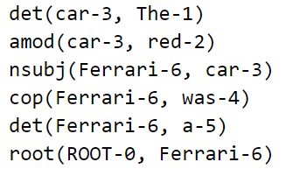
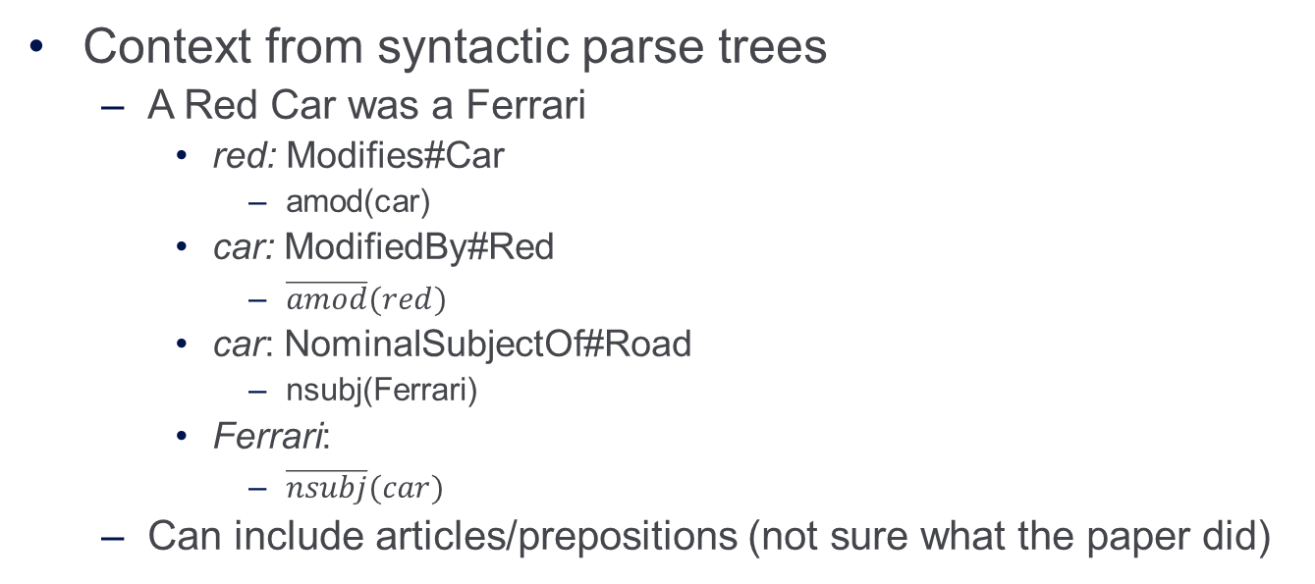
Context Representation
Context from syntactic parse trees
A Red Car was a Ferrari
red: Modifies#Car
amod(car)
car: ModifiedBy#Red
$\overline{amod}(red)$
car: NominalSubjectOf#Road
nsubj(Ferrari)
Ferrari:
$\overline{nsubj}(car)$
Can include articles/prepositions (not sure what the paper did)
* Taken from Stanford NLP parser *In the code documentation, contexts are encoded :/

Slide 7
Tasks
Example: (Blue Whale, Dolphin)
Relevant Contexts: C = (isMarineAnimal, isMammal, ….)
Words similar to C: seal, manatee, walrus, otters, polar bears, …
Task: Set expansion
Vocabulary V, Contexts C, Set of “seeds” S
Asymmetric Metric for word-context similarity
What contexts overlap(?) with S
Use these contexts to rank words in V
Analogies:
Word2vec
US: New York : India : (?) Answer = Mumbai
Category Builder Analogies:
__: New York : India : (?) Answer = Mumbai

Slide 8
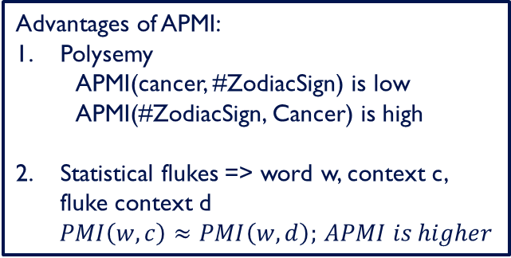
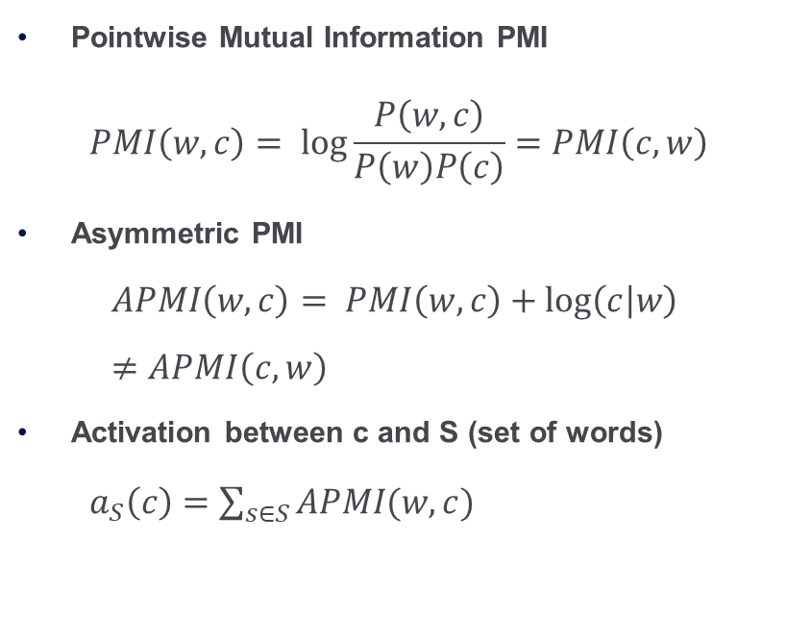
Word-Context Representation & Similarities
Pointwise Mutual Information PMI
$$PMI\left(w,c\right)= log\frac{P\left(w,c\right)}{P\left(w\right)P\left(c\right)}=PMI\left(c,w\right)$$
Asymmetric PMI
$$APMI\left(w,c\right)= PMI\left(w,c\right)+\log\left(c | w\right)≠APMI\left(c,w\right)$$
Activation between c and S (set of words)
$a_{S}\left(c\right)=\sum_{s∈S}{APMI(w,c)}$
Issues of PMI
Lopsided Polysemy
Disproportionately Low PMI(Cancer, #ZodiacSign)
Rare word/ context
Disproportionate increase in PMI with addition of examples
Advantages of APMI:
Polysemy
APMI(cancer, #ZodiacSign) is low APMI(#ZodiacSign, Cancer) is high
Statistical flukes => word w, context c, fluke context d
$PMI\left(w,c\right)≈PMI\left(w,d\right);$ $APMI is higher$

Slide 9

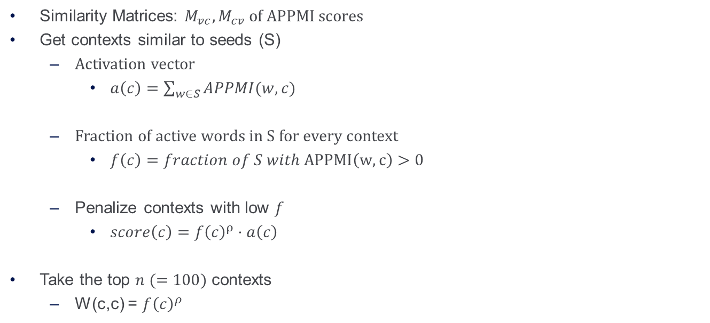
Getting similar contexts and then words
Similarity Matrices: $M_{vc}, M_{cv}$ of APPMI scores
Get contexts similar to seeds (S)
Activation vector
$a\left(c\right)=\sum_{w∈S}{APPMI(w,c)}$
Fraction of active words in S for every context
$f\left(c\right)=fraction of S with APPMI\left(w,c\right)>0$
Penalize contexts with low $f$
$score\left(c\right)=f{\left(c\right)}^{ρ}⋅a\left(c\right)$
Take the top $n (=100)$ contexts
W(c,c) = $f{\left(c\right)}^{ρ}$
Expand (Cancer, Taurus):
$a\left(c\right)$ for the disease sense can still be high
Disease sense not correlated with Taurus
$f\left(c−disease\right)={0.5}^{ρ}$
$f\left(c−StarSign\right)=1$
$c−disease$ doesn’t go away easily
Throw it away explicitly (n=100)

Slide 10
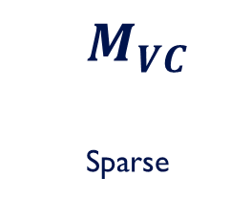
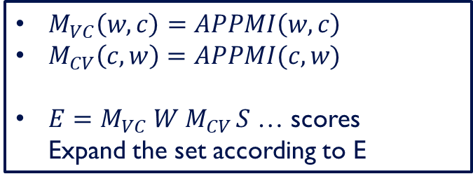


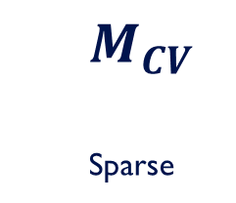
Illustration of matrices
Contexts $→$
W
S
E
0
Words $→$
$M_{VC}$
Sparse
0
$M_{CV}$
Sparse
=
$M_{VC}\left(w, c\right)=APPMI\left(w,c\right)$
$M_{CV}\left(c,w\right)=APPMI(c,w)$
$E=M_{VC} W M_{CV }S$ … scores Expand the set according to E

Slide 11
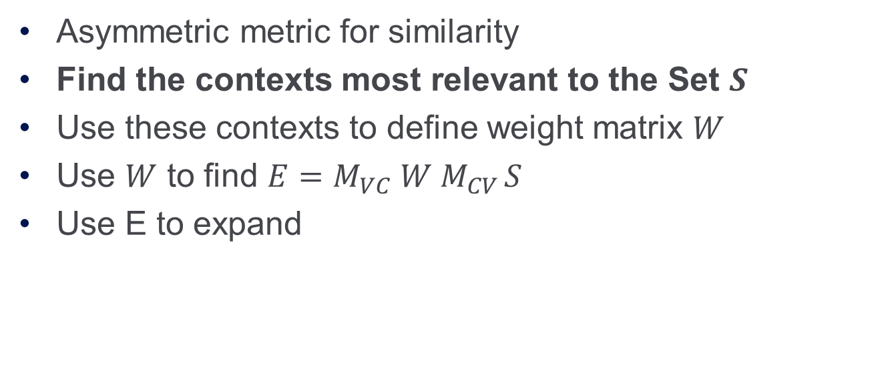
Summary – till now
Asymmetric metric for similarity
Find the contexts most relevant to the Set $S$
Use these contexts to define weight matrix $W$
Use $W$ to find $E=M_{VC} W M_{CV }S$
Use E to expand

Slide 12
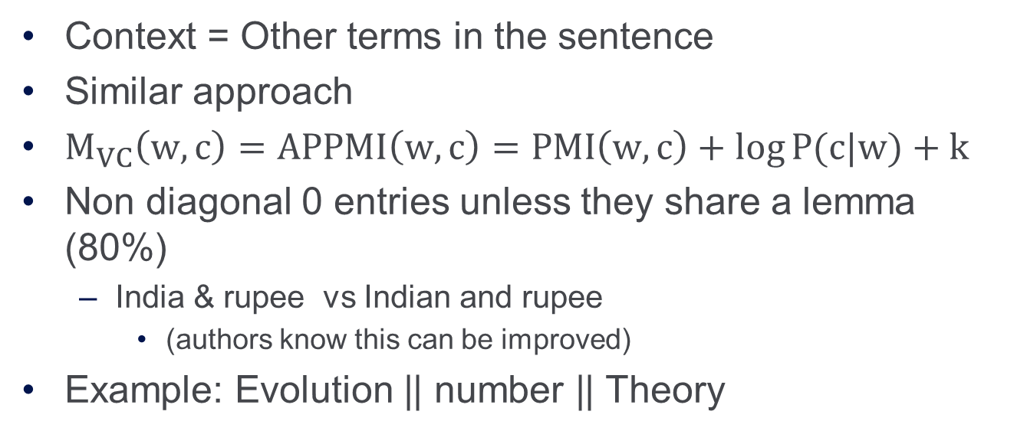
Analogies
Context = Other terms in the sentence
Similar approach
$M_{VC}\left(w,c\right)=APPMI\left(w,c\right)=PMI\left(w,c\right)+\log{P(c|w)}+k$
Non diagonal 0 entries unless they share a lemma (80%)
India & rupee vs Indian and rupee
(authors know this can be improved)
Example: Evolution || number || Theory

Slide 13
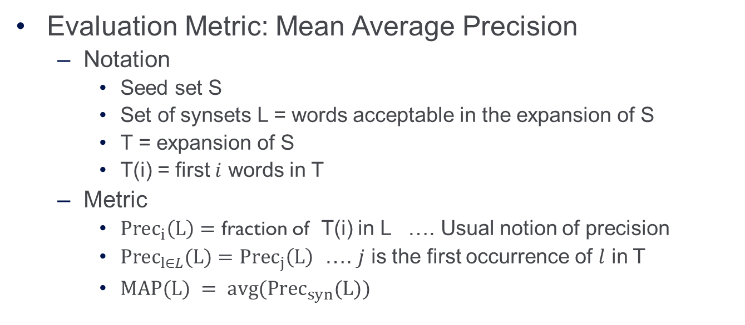
Evaluation Metric
Evaluation Metric: Mean Average Precision
Notation
Seed set S
Set of synsets L = words acceptable in the expansion of S
T = expansion of S
T(i) = first $i$ words in T
Metric
${Prec}_{i}\left(L\right)=$ fraction of T(i) in L …. Usual notion of precision
${Prec}_{l∈L}(L)={Prec}_{j}\left(L\right)$ …. $j$ is the first occurrence of $l$ in T
$MAP(L) = avg({Prec}_{syn}(L))$

Slide 14
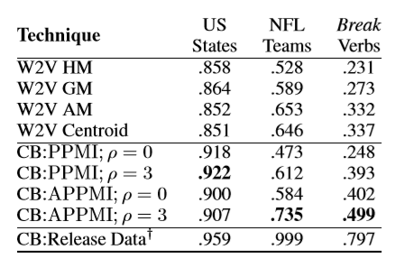
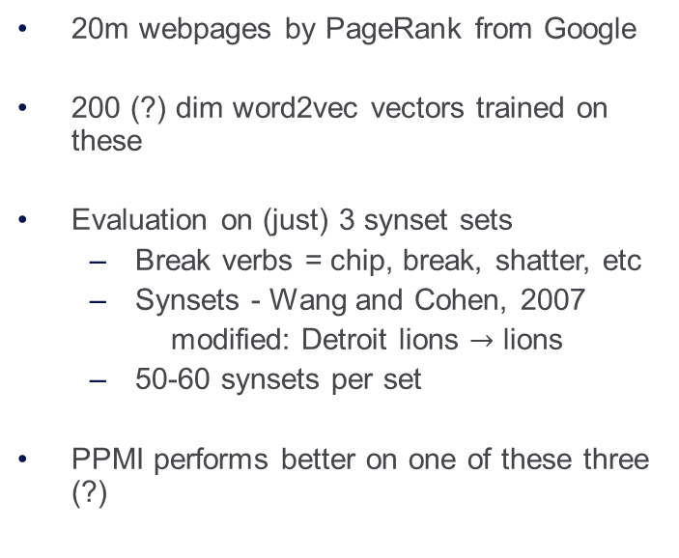
Datasets and Performance
20m webpages by PageRank from Google
200 (?) dim word2vec vectors trained on these
Evaluation on (just) 3 synset sets
Break verbs = chip, break, shatter, etc
Synsets - Wang and Cohen, 2007
modified: Detroit lions $→$ lions
50-60 synsets per set
PPMI performs better on one of these three (?)

Slide 15
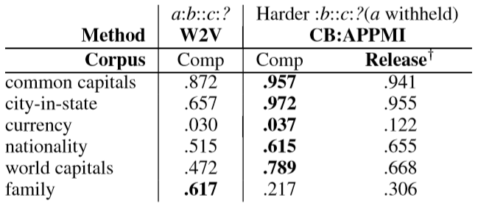
Performance on the Analogy Task
Performance reported on the Analogy Task by Mikolov et al(2013)

Slide 16
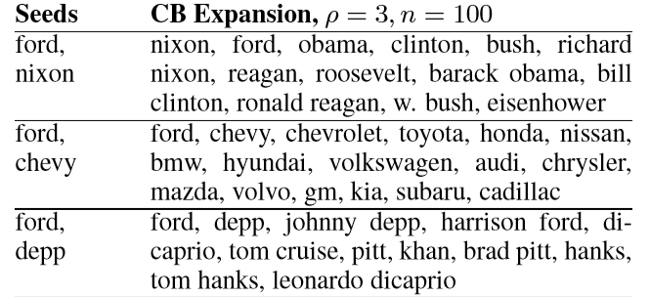
Examples
**give couple of failure cases (not enough)–
Mexico is the expansion of US States (probably from New Mexico)
Sometimes mixed up non football teams with seeds NFL

Slide 17
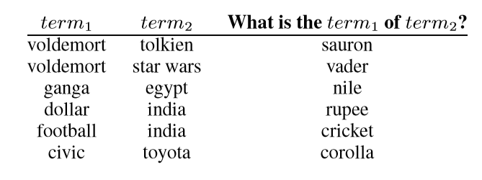
Examples - Analogies
**No failed analogy examples

Slide 18
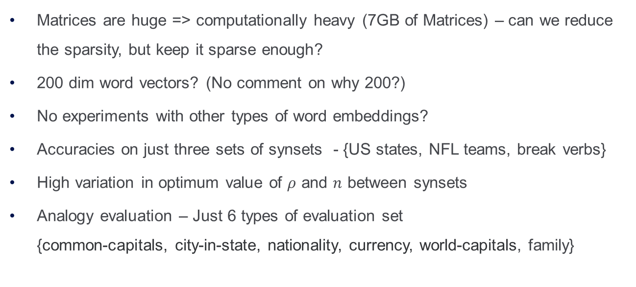
Shortcomings & Criticism
Matrices are huge => computationally heavy (7GB of Matrices) – can we reduce the sparsity, but keep it sparse enough?
200 dim word vectors? (No comment on why 200?)
No experiments with other types of word embeddings?
Accuracies on just three sets of synsets - {US states, NFL teams, break verbs}
High variation in optimum value of $ρ$ and $n$ between synsets
Analogy evaluation – Just 6 types of evaluation set {common-capitals, city-in-state, nationality, currency, world-capitals, family}

Slide 19
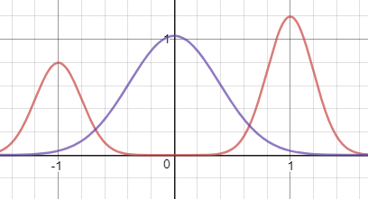
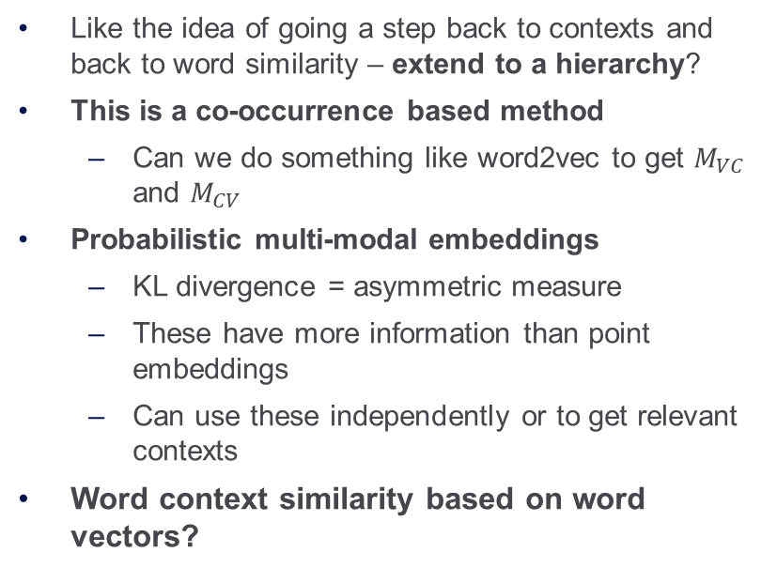
Future Work
Like the idea of going a step back to contexts and back to word similarity – extend to a hierarchy?
This is a co-occurrence based method
Can we do something like word2vec to get $M_{VC}$ and $M_{CV}$
Probabilistic multi-modal embeddings
KL divergence = asymmetric measure
These have more information than point embeddings
Can use these independently or to get relevant contexts
Word context similarity based on word vectors?
Thank You

Slide 20
Future Work
Actual Contexts
Context clusters/abstractions indexes
Word indexes

