Slide 1
INDEPENDENT PRODUCT CASE STUDY · AI SALES
Reimagine CRM around
the buyer’s decision
CRM TODAY
DECISIONOS
Seller process
Buyer decision
Opportunity
→
Stakeholders
Stage
→
Criteria
DecisionOS
Activities
→
Commitments
An AI-native decision layer for complex enterprise sales.
Forecast
→
Decision gaps
INITIAL WEDGE · COMPLEX ENTERPRISE B2B NEW-LOGO SALES
“What did we do?”
“What must become true?”
Qualified opportunity → commercial decision
Traditional CRM models the seller’s process. DecisionOS models the buyer’s decision.
Nitish Ranjan · Independent product concept · Synthetic prototype scenario
Notes:
Start with the thesis. I am not adding an AI copilot to CRM; I am changing the primary object from seller process to buyer decision. DecisionOS builds a live, evidence-backed Decision Twin of each complex opportunity.

Slide 2
MARKET SHIFT
The buyer is more autonomous — and the decision more complex
That makes human seller attention less frequent, but more consequential.
67%
69%
13 + 9
prefer a rep-free
buying experience
prefer validating AI-generated
insight with a salesperson
typical buying decision: 13 internal
stakeholders + 9 external influencers
MORE SELF-SERVICE
MORE COMPLEXITY
Buyer research shifts to digital + AI
Finance · Security · Procurement · IT
Sellers are no longer the primary information source at every step.
Different stakeholders carry different risks, incentives and veto power.
AI makes sales execution cheaper. Human attention becomes more valuable.
Sources: Gartner surveys of ~645 B2B buyers (Aug–Sep 2025; published Mar 9 & May 20, 2026); Forrester, State of Business Buying 2026.
Notes:
Two shifts matter: buyers increasingly research independently, while enterprise buying decisions involve more stakeholders and functions. That makes routine execution easier to automate, but scarce human attention more valuable at high-trust moments.

Slide 3
COMPETITIVE REALITY
Decision intelligence is emerging. What becomes the primary object?
Buyer-side signals, stakeholder gaps and next actions already exist. Our bet is to make decision state the primary object — not another signal feeding an opportunity.
YESTERDAY
TODAY
OUR BET
System of record
System of action
Decision state as primary object
✓
Log contacts
✓
Summarize & research
✓
What must become true?
✓
Update opportunity
✓
Prioritize actions
✓
Evidence + uncertainty
✓
Record activity
✓
Update CRM
✓
Gap → intervention
✓
Build forecast
✓
Run sales agents
✓
Human / AI allocation
Competitive scan
Salesforce
Dynamics
HubSpot
Gong
Salesloft
MEDDPICC
CopilotGTM
We are not claiming buyer-decision thinking is new. The differentiation is a temporal, evidence-backed decision state as the operating object.
Sources: Microsoft Dynamics 365 Sales (2026); CopilotGTM (2026); MEDDPICC; Salesforce, HubSpot, Gong and Salesloft product research.
Notes:
I pressure-tested the novelty. System-of-action capabilities and buyer-side signals already exist, and MEDDPICC/CopilotGTM show that buyer-decision thinking is not new. My specific product bet is a temporal, provenance-aware buyer decision state as the primary operating object, which then drives Decision Gaps, interventions and human/AI allocation.

Slide 4
THE BROKEN ABSTRACTION
CRM stage ≠ buyer progress
A seller can move the opportunity forward while the buying group remains unresolved.
WHAT CRM SEES
WHAT ACTUALLY CHANGED
Acme Corp
“Finance wants to understand whether the implementation effort is justified. They will probably want payback inside 12 months.”
$240K ARR · Proposal · Nov 20
✓
Champion engaged
Sarah · Champion · Oct 2
✓
Technical demo complete
Problem
VALIDATED
✓
Security started
Technical
VALIDATED
Security
IN PROGRESS
✓
Proposal sent
Economics
UNRESOLVED
Procurement
UNKNOWN
Looks healthy
Consensus
INCOMPLETE
The opportunity progressed to proposal. The buyer’s economic decision did not.
Notes:
Acme makes the abstraction failure concrete. The seller has moved to proposal, but Finance has introduced an unvalidated economic criterion. CRM stage is unchanged while the buyer decision materially changed.

Slide 5
SCOPE + ICP
Scope: complex enterprise B2B new-logo sales
Qualified opportunity → commercial decision. Narrow wedge first; CRM replacement is explicitly out of scope.
PRIMARY USER
JOB TO BE DONE
Enterprise Account
Executive
“When I manage multiple complex opportunities, tell me what is actually preventing each buying group from reaching a decision — and where my involvement can materially change the outcome.”
$50K+
60+ days
ACV
sales cycle
SECONDARY USER
PRODUCT BUYER
5+
8–25
Front-line Sales Manager
CRO / VP Sales / RevOps
stakeholders
active deals
Needs intervention visibility, not another dashboard.
Buys better revenue execution and seller capacity.
IN SCOPE
New-logo opportunity · 5+ stakeholders · Finance / Security / IT / Procurement
OUT OF SCOPE
B2C · transactional SMB · AI SDR / lead gen · renewals / support · CRM replacement
ICP thresholds are an initial hypothesis to validate with design partners, not proven market cutoffs.
Notes:
I intentionally narrow the first wedge to complex enterprise B2B AEs: long cycles, high ACV and multiple stakeholders. This is a product-scoping choice, not a requirement in the brief.

Slide 6
NEW PRODUCT PRIMITIVE
The Decision Twin: a live model of what the buyer needs to decide
Persistent structured state — not an ephemeral LLM summary.
VERIFIED
REPORTED
INFERRED
UNKNOWN
PEOPLE
CRITERIA
Who matters?
What must be true?
DECISION
TWIN
STANCES / CONCERNS
PROCESS
What have they expressed?
Which approvals?
COMMITMENTS
EVIDENCE
What was agreed?
How do we know?
Current state
→
Decision gap
→
Intervention
→
Human / AI action
→
Buyer response
→
Updated state
Notes:
The Decision Twin is structured persistent state, not an LLM summary. It tracks people, criteria, process, commitments and evidence, and keeps Verified, Reported, Inferred and Unknown separate.

Slide 7
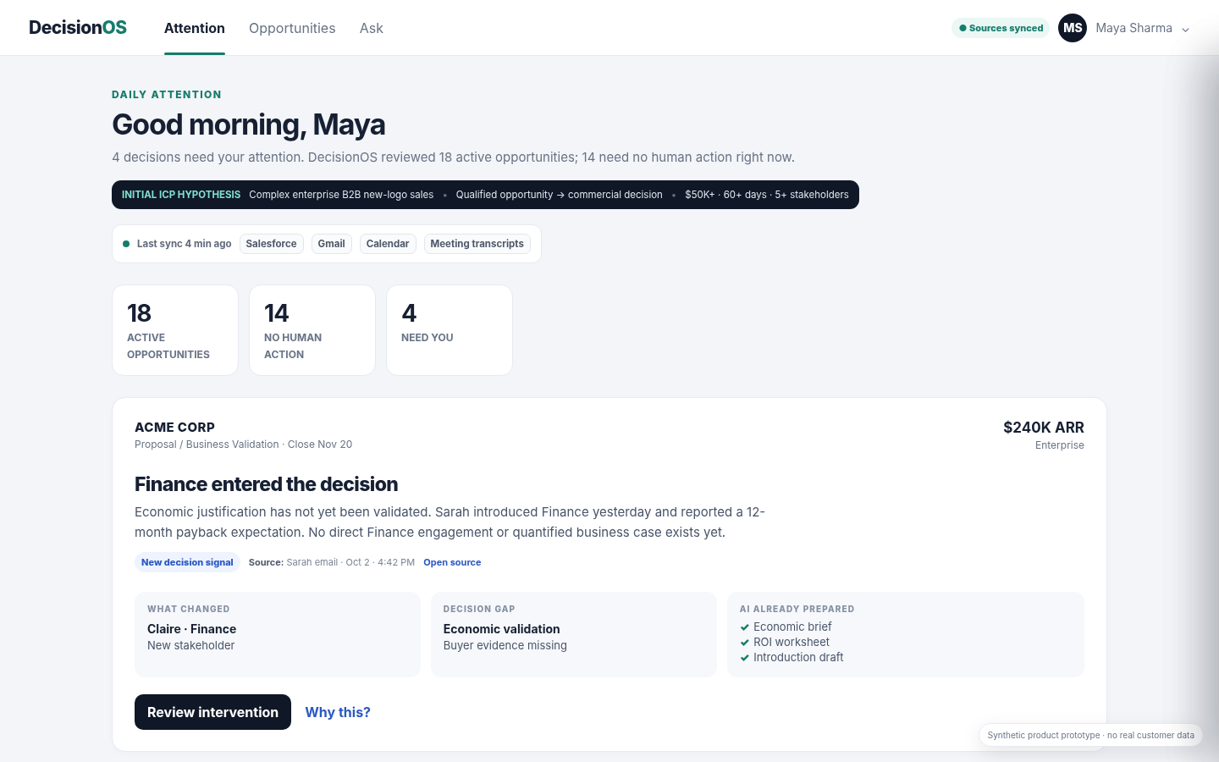
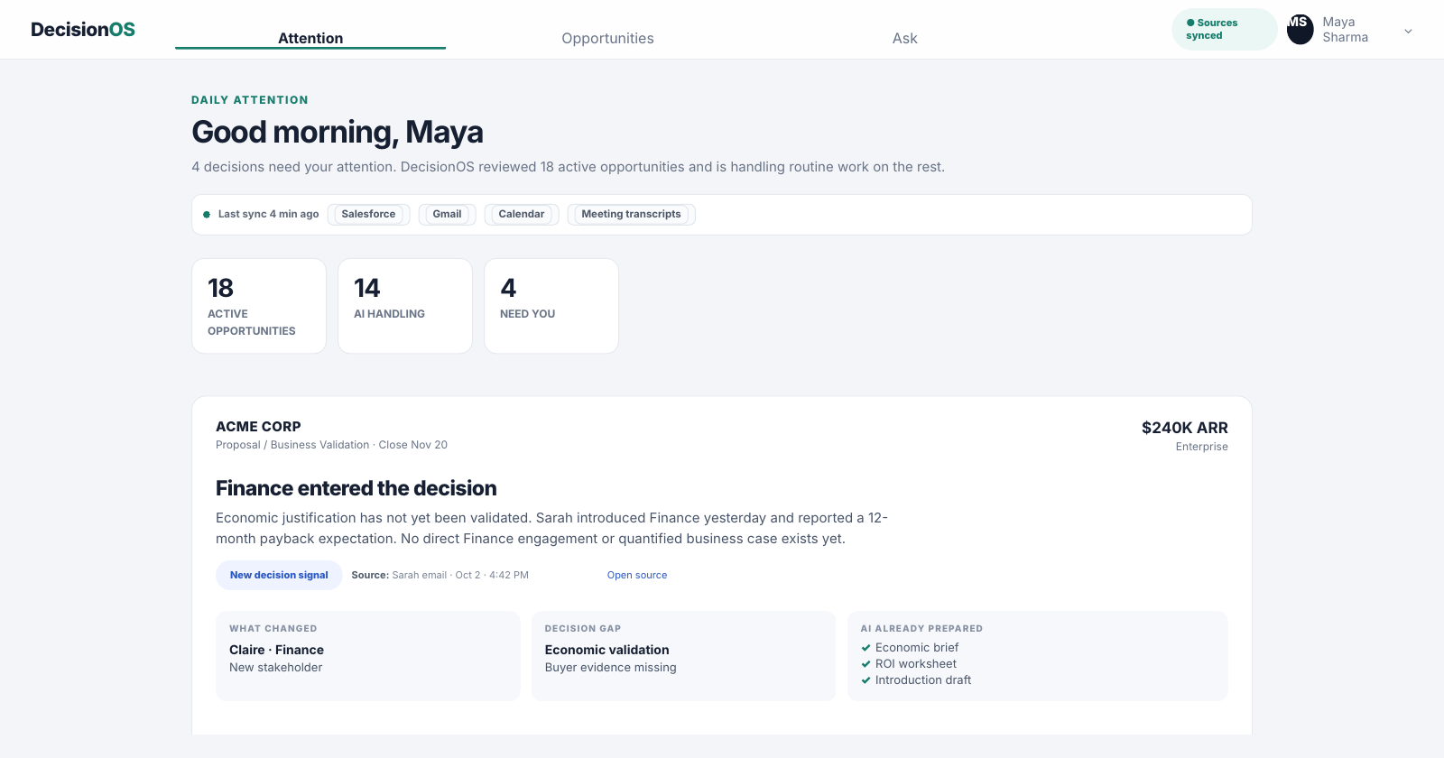
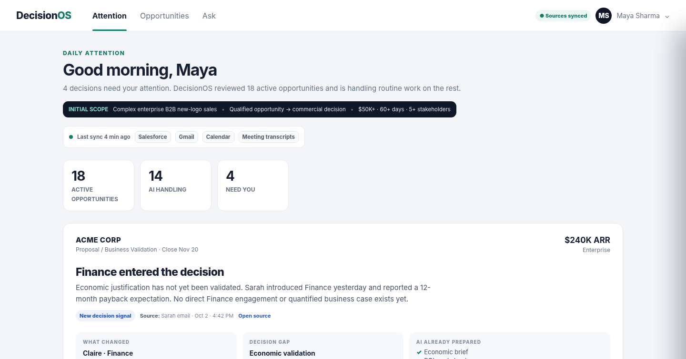
PROTOTYPE
Don’t give sellers more tasks. Give them fewer, higher-leverage decisions
Homepage = exception queue for moments where human judgment matters.
WHAT THE UX PROVES
18 deals → 4 human moments
14 need no human action now; AI monitors and prepares instead of creating more alerts.
Two decision-gap types
Acme = Finance validation. Northstar = stalled Security approval.
AI works before asking
Brief, ROI worksheet and intro draft are already prepared.
Chat is secondary
The seller should not need to know what question to ask.
Prototype: fictional Acme (Finance) + Northstar (Security) flows. No performance claims or real customer data.
Notes:
The homepage is an exception queue. DecisionOS reviews many opportunities, suppresses routine work, and brings the seller only the few situations where human judgment is likely to matter.

Slide 8
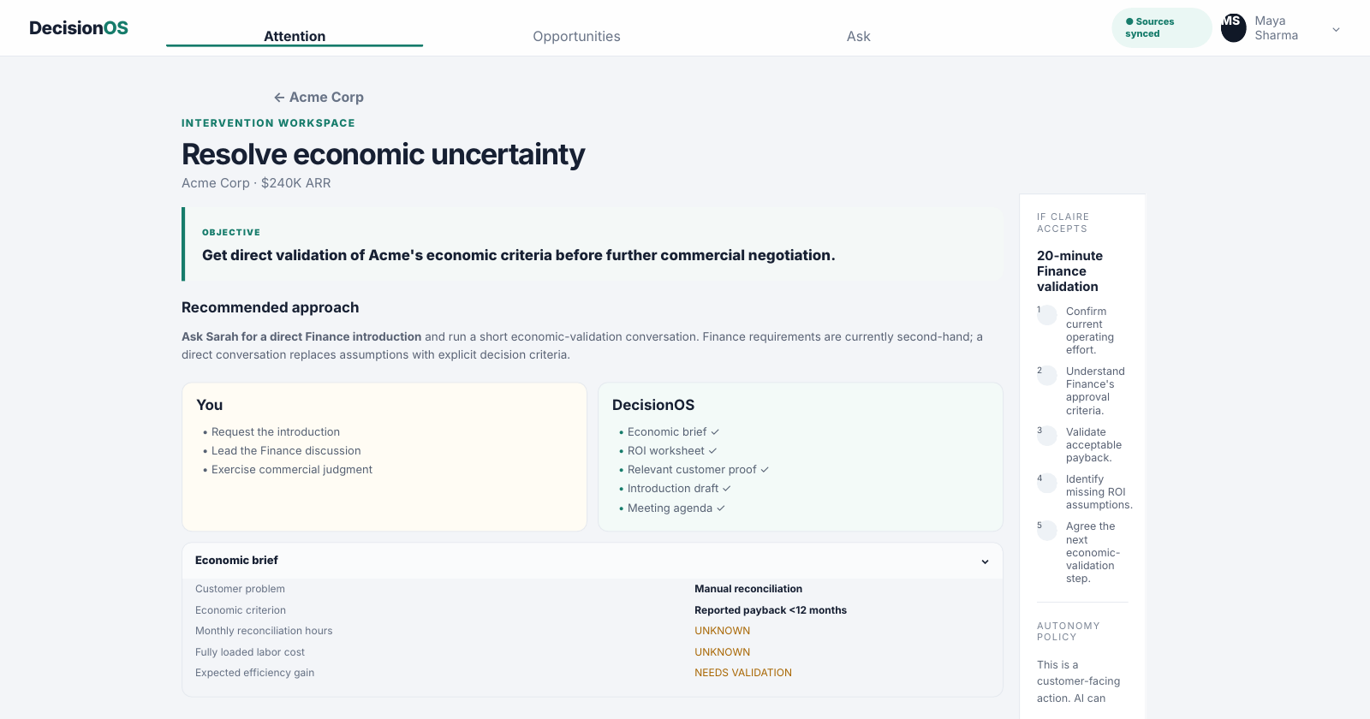
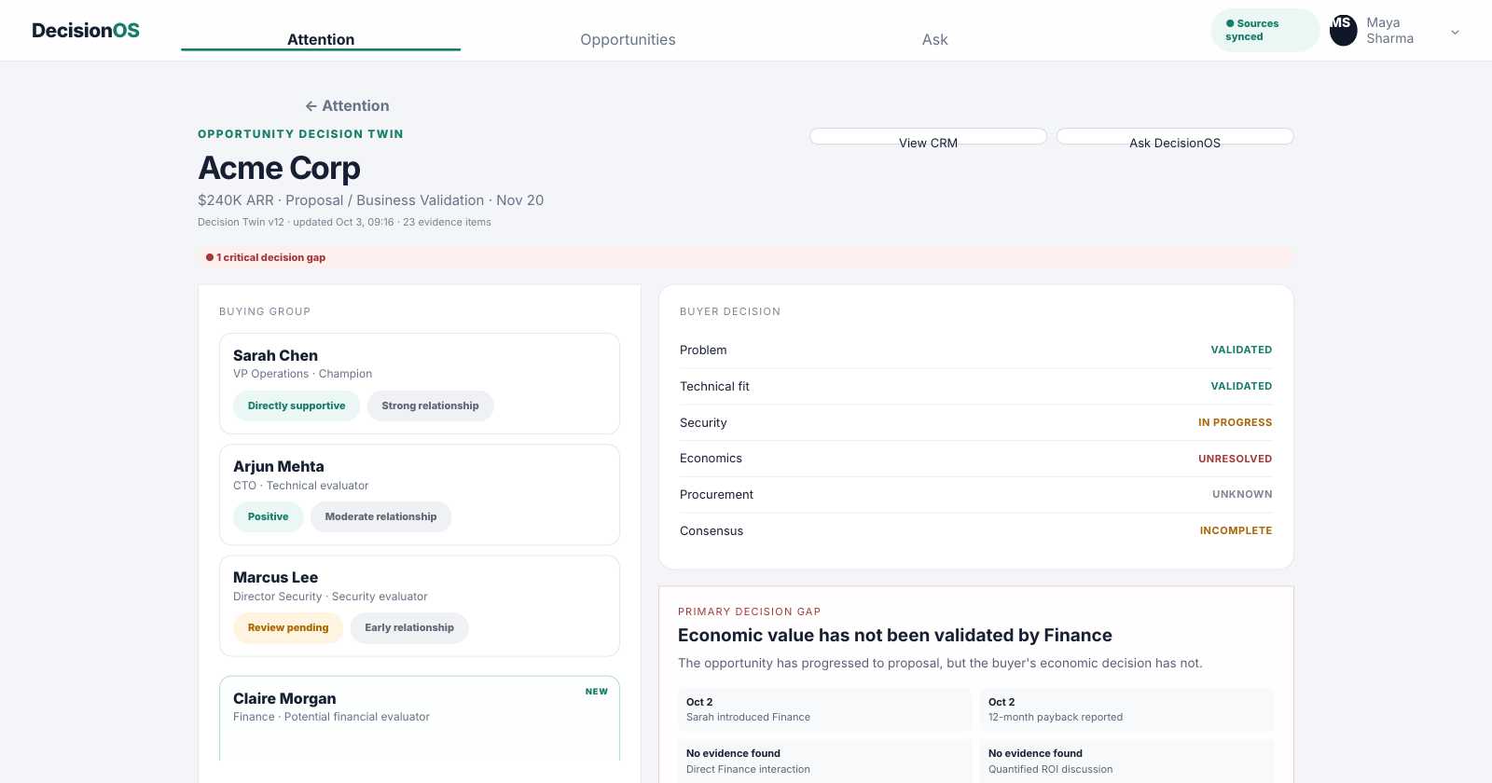
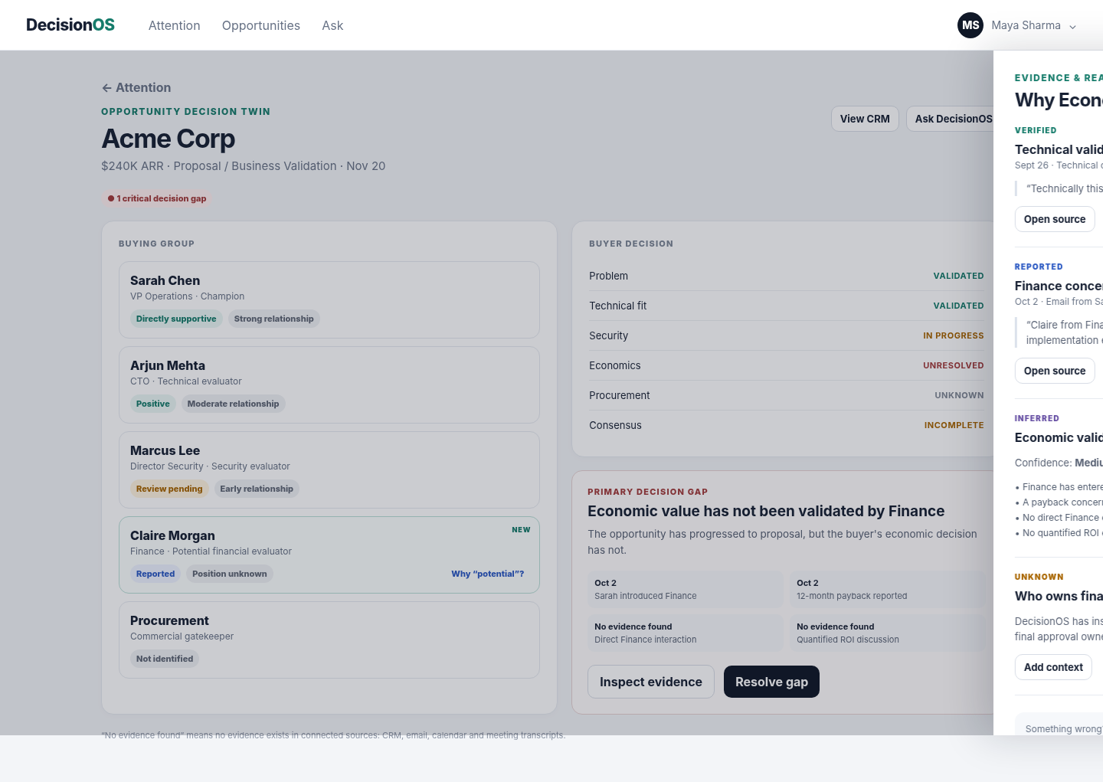
CORE WORKFLOW
Evidence → intervention → buyer state change
The product tracks whether the decision moved — not whether the seller completed a task.
1 · UNDERSTAND
2 · VERIFY
3 · ACT
Decision Twin identifies
Economic validation gap
Facts, reports, inferences
and unknowns stay distinct
AI prepares; seller owns
relationship + judgment
Second full prototype path: Northstar Bank · missed Security commitment → blocker discovery → explicit approval criterion.
Notes:
The workflow is evidence to decision state to gap to intervention. AI prepares the mechanical work; the seller owns the relationship. After the Finance conversation we update the buyer criterion, not a fabricated deal-health score.

Slide 9
COLD-START MVP
Valuable before it learns
No proprietary historical outcome data is required for version one.
1
EVIDENCE
CRM · email · calendar · meeting transcripts
BUILD NOW
NOT YET
✓
CRM overlay
—
Predictive win score
2
DECISION ONTOLOGY
Stakeholders · criteria · approvals · commitments
✓
Decision Twin
—
Autonomous negotiation
✓
Gap detection
—
Full CRM replacement
3
EXPLICIT RULES
Explainable gap logic for common enterprise decisions
✓
Evidence + confidence
—
AI SDR
✓
Intervention recs
—
Self-learning optimization
4
LLM REASONING
Interpret ambiguity · propose interventions · abstain when unknown
✓
AI preparation
—
Causal impact claims
✓
Human approval
First reconstruct reality. Then learn what changes outcomes.
Notes:
A new company has no proprietary outcome dataset. V1 therefore uses connected evidence, a decision ontology, explicit rules and LLM reasoning. First reconstruct reality; then learn what changes outcomes.

Slide 10
ENGINEERING
Probabilistic intelligence, deterministic control
Use AI where interpretation adds value; use software where correctness matters.
INPUTS
Salesforce / HubSpot · Email · Calendar · Transcripts
GUARDRAILS
↓
EVIDENCE LAYER
Canonical events · raw-source pointers · tenant permissions
Provenance
↓
Every factual claim points to source evidence.
AI EXTRACTION
Stakeholders · criteria · commitments · concerns
Abstention
↓
Unknown beats a plausible hallucination.
DECISION TWIN
Structured state + temporal history + provenance
Risk-tiered autonomy
↓
Internal/reversible work can automate; external action requires approval initially.
GAP ENGINE
Rules first · LLM-assisted interpretation where needed
Untrusted content
↓
Emails and transcripts are data — never instructions.
INTERVENTION PLANNER
Candidate actions grounded in evidence + playbook
Auditability
↓
Observe → infer → recommend → act → outcome.
POLICY + ACTION
Permissions · risk tier · human approval · audit
Engineering principle
Deterministic where correctness matters · Probabilistic where interpretation helps · Human-controlled where consequences are high
Notes:
Most of the system is deterministic software. AI is used for semantic interpretation and planning; permissions, state transitions, policies and audit remain deterministic. Customer-facing actions require approval in the MVP.

Slide 11
DELIVERY PLAN
Validate trust before autonomy — and behavior before revenue claims
Start in shadow mode; earn the right to automate.
1
2
3
4
5
OBSERVE
UNDERSTAND
RECOMMEND
ASSIST
CONTROLLED AUTONOMY
Connect sources
Build Decision Twin
Gap detection
Evidence UI
Attention Queue
Interventions
Briefs · drafts
CRM updates
Low-risk actions only
after thresholds
EVALUATE THE AI
EVALUATE THE PRODUCT
TEAM
• Extraction precision / recall
• Decision Twin correction rate
• 1 Product Manager
• Evidence-grounding rate
• Gap usefulness / dismissal
• 1 AI/ML Engineer
• Correct abstention / conflicts
• Recommendation accept / modify
• 1 Backend/Platform Engineer
• Tool + policy compliance
• Gap-resolution time
• 1 Full-stack Engineer
• 1 Product Designer + design partner
Synthetic scenarios test system behavior. Real design-partner pilots test business value.
Notes:
Ship in stages: shadow-mode observation first, then gap detection, recommendations, assisted execution and only later controlled autonomy. Early metrics test truthfulness and usefulness before making revenue claims.

Slide 12
BUSINESS + LONG-TERM ADVANTAGE
Start as an intelligence layer. Become the system that learns how customers decide.
Sell measurable revenue execution — not model tokens.
MVP WEDGE
LEARNING LOOP
DEFENSIBILITY
Decision intelligence
over existing CRM
✓
Decision ontology
Decision State
↓
✓
Decision histories
Product buyer: CRO / VP Sales / RevOps
Intervention
↓
✓
Human corrections
Model: enterprise platform fee + seller seats
Buyer Response
✓
Intervention → outcome data
↓
No forced Salesforce migration.
Updated State
↓
The moat is not the LLM.
Commercial Outcome
CRM learned to record what sellers did. AI CRM learned to help sellers act. The next CRM should understand how customers decide.
DecisionOS · Automate work. Escalate judgment.
Notes:
Start as an intelligence layer over existing CRM. The long-term asset is not the LLM; it is the Decision State → Intervention → Buyer Response → Outcome dataset and the organisation-specific decision ontology.

Slide 13
APPENDIX A
Competitive pressure test: pieces already exist
The claim is not “nobody tracks buyers.” The bet is how the product is organized, governed and learns over time.
PRODUCT
WHAT EXISTS
PRIMARY OPERATING MODEL
Salesforce
Prospecting, engagement, meeting prep, pipeline updates, quoting
Opportunity + CRM context
Dynamics 365
System of action, autonomous agents, Next Best Action
Cross-agent action prioritization
HubSpot
Self-updating CRM, Growth Context, agents
Unified context + outcomes
Gong
Revenue graph, custom agents, governance, conversation intelligence
Revenue context + execution
CopilotGTM
Buyer progress, stakeholder gaps, qualification gaps, risks, next actions
Deal execution / buyer progress
MEDDPICC
Economic buyer, decision criteria/process, champion, paper process
Qualification methodology
DecisionOS
Temporal Decision Twin → evidence → gap → intervention → human/AI action → outcome
Buyer decision state + learning loop
Sources: Salesforce, Microsoft, HubSpot, Gong, CopilotGTM and MEDDPICC product/methodology pages reviewed Oct 2026.
Notes:
Competitive appendix: pieces exist across incumbent CRM, deal-execution products and established sales methodologies. DecisionOS differentiates by making temporal buyer decision state the operating object and explicitly closing the intervention-to-outcome loop.

Slide 14
APPENDIX B
Decision Twin schema
Structured, temporal and provenance-aware.
Opportunity
CRM metadata; seller-owned record
Evidence
Canonical source pointer + excerpt
Stakeholder
Person, role, influence, relationship
Inference
Model interpretation + confidence
Expressed stance / concern
Source-linked support, concern or uncertainty
Decision gap
Current state vs required state
Decision criterion
Condition the buyer needs satisfied
Intervention
Proposed change to resolve a gap
Approval requirement
Security, Finance, Legal, Procurement…
Outcome
Buyer response / state transition
Commitment
Who promised what, by when
Temporal rule:
Never overwrite the old decision state. Store the transition so “what changed?” remains answerable.
Notes:
Schema detail for technical follow-up. Preserve history and provenance so the system can always answer what changed, why it believes that, and which evidence supports it.

Slide 15
APPENDIX C
Risk-tiered autonomy
Autonomy is a policy decision, not a model personality.
0
OBSERVE
Read, extract, summarize
Automatic
1
INTERNAL + REVERSIBLE
Refresh Decision Twin, prepare briefs
Automatic
2
ENTERPRISE WRITES
CRM notes, tasks, reminders
Permissioned
3
CUSTOMER-FACING
Email, meeting scheduling
Human approval in MVP
4
HIGH CONSEQUENCE
Pricing, contract, negotiation, legal
Human-owned
Example:
AI can draft the Finance introduction. Maya must approve the customer-facing send. Pricing commitments remain human-owned.
Notes:
Autonomy is risk-tiered. Observe and internal reversible work can automate; customer-facing work requires approval initially; pricing, legal and contractual commitments remain human-owned.

Slide 16
APPENDIX D
Evaluation framework
“LLM accuracy” is not one metric. Test every layer and the full workflow.
1
Extraction
Stakeholders, criteria, commitments
Precision / recall
2
Grounding
Claim ↔ supporting evidence
Unsupported claim rate
3
Decision state
Known / unknown / conflict / resolved
Human-labeled correctness
4
Gap detection
Important missing condition
False positive / false negative
5
Recommendation
Logical, feasible, safe
Expert rubric + accept/modify/dismiss
6
Action
Correct tool + params + permissions
Tool/action compliance
7
End to end
Signal → state → gap → action → outcome
Golden scenario pass rate
No real dataset yet?
Create a golden synthetic scenario set to test behavior — then move to shadow-mode evaluation on permissioned real deals.
Notes:
Evaluate each layer separately: extraction, grounding, state resolution, gap detection, recommendations, tool actions and end-to-end workflow. With no real dataset, start with golden synthetic scenarios, then shadow-mode real deals.

Slide 17
APPENDIX E
Illustrative design-partner pilot
A ~12-week pilot can test the core product risk if integration scope stays deliberately narrow.
W1–2
Discovery + ontology
Design partner interviews; golden eval set; choose one CRM + one mail provider
W3–4
Evidence layer
Auth, sync, event model, source provenance, permissions
W5–6
Decision Twin
Extraction, entity resolution, temporal state, correction UX
W7–8
Gap engine
Explicit rules; conflict handling; confidence + unknown states
W9–10
Intervention
Attention Queue; planner; brief/draft generation; approval policy
W11–12
Pilot hardening
Offline evals; prompt-injection tests; shadow pilot; instrumentation
Pilot scope assumption:
One CRM + one email provider + existing meeting transcripts. Production hardening and broader integrations follow only if the core hypotheses pass.
Notes:
This is an illustrative design-partner pilot, not a production-GA promise. Roughly twelve weeks is plausible only with one CRM, one email provider and existing transcripts; broader integrations and hardening follow if the core hypotheses pass.

Slide 18
APPENDIX F
Sources, assumptions & integrity notes
Current-market research supports the problem framing; prototype data and product claims are explicitly synthetic.
Gartner · May 20, 2026
69% validate AI insights with reps; 67% rep-free; 70% digital self-service.
gartner.com/en/newsroom/press-releases/2026-05-20-…
Forrester · Feb 23, 2026
73% of purchases span 3+ departments; avg. 13 internal + 9 external influencers.
forrester.com/blogs/three-realities-about-b2b-buying-networks
Microsoft Dynamics 365 · 2026 Wave 1
“CRM from a system of record into a system of action”; agents + prioritized actions.
learn.microsoft.com/en-us/dynamics365/release-plan/2026wave1/sales/…
Salesforce · Feb/Mar 2026
87% of sales orgs use AI; Agentforce Sales covers prospecting → quoting.
salesforce.com/news/stories/state-of-sales-report-announcement-2026
HubSpot · Sep 16, 2026
Self-updating Smart CRM + Growth Context + Breeze Assistant.
hubspot.com/company-news/fall-26-spotlight
Gong · Jun 24, 2026
Revenue Harness: governed custom agents with context, permissions and oversight.
gong.io/press/gong-launches-mission-big-dipper-revenue-harness
CopilotGTM + MEDDPICC · current
CopilotGTM tracks buyer progress/stakeholder gaps; MEDDPICC formalizes economic buyer, decision criteria/process and champion.
copilotgtm.com · meddicc.com
Integrity note: Acme Corp, Maya, all deal values, prototype interactions and future product performance are fictional. No win-rate lift, prediction accuracy or proprietary data claim is made.
Notes:
These are the external sources and integrity assumptions. The Acme scenario and all prototype data are fictional; we make no claim about win-rate lift, prediction accuracy or proprietary historical data.

