Slide 1
COTIVITI
INTERN ASSESSMENT
Clinical Natural Language
Technology for Health Care
Grounding NLP, Computer Vision & Multimodal AI in Radiology
POC
Chest X-Ray Report
Generation System
DenseNet-121 + Transformer
RAG Clinical Agent
FastAPI · Gradio · Docker
Nitish Kumar
San Jose State University
Topic 1 · Report + Proof of Concept

Slide 2
THE OPPORTUNITY
80% of Health Data Is Unstructured
The details that matter (diagnoses, procedures, and the proof behind every claim) sit in free-text notes, scanned faxes, and images. Computers cannot search, code, or audit them directly.
Text
Physician notes, discharge summaries, pathology reports
Scanned
Faxed orders and referrals digitized with OCR
Images
X-ray, CT and MRI read by computer vision
Codes
The clean ICD / CPT codes payment integrity needs
Clinical NLP turns all four into structured data. That is the foundation for accurate coding, payment integrity, and quality measurement.
Cotiviti Intern Assessment · Nitish Kumar · San Jose State University
2

Slide 3
TRENDS
Past → Present → Future
PAST 2000-2017
Rules and Word Lists
PRESENT 2018-2023
Learning from Big Data
FUTURE 2024 on
Generative and Multimodal
cTAKES, MetaMap map text to UMLS / SNOMED / ICD
Hand-written rules and medical word lists
Accurate, but fragile and costly to update
BioBERT, ClinicalBERT, GatorTron models
Image models near expert level: DenseNet, ViT
Good at finding terms and hiding patient IDs
Clinical LLMs (Med-PaLM 2) and LMMs
One model reads an X-ray and drafts the report
RAG keeps answers grounded, cuts made-up facts
Cotiviti Intern Assessment · Nitish Kumar · San Jose State University
3

Slide 4
ANALYSIS
Opportunities & Threats
OPPORTUNITIES
Automated coding: find miscoding and missing documentation at scale
Report drafting from images: faster radiology and pathology turnaround
Traceable AI: RAG shows the exact source behind every answer
More reviewer time: automation handles routine cases so experts focus on the hard ones
THREATS AND RISKS
Made-up facts: models can state false things that sound convincing
Privacy: patient data needs HIPAA-grade handling and strict controls
Bias and drift: uneven results, and accuracy drops as coding rules change
Regulation: FDA and payer oversight of clinical AI keeps changing
Cotiviti Intern Assessment · Nitish Kumar · San Jose State University
4

Slide 5
STRATEGY
Recommended Actions for Cotiviti
01
Grounded Clinical-NLP Layer
Combine medical language models (ClinicalBERT / GatorTron) with a trusted RAG library of coding policies and guidelines, so every AI code links back to an official source.
02
Multimodal Document Understanding
Use OCR, NLP, and computer vision together to check images and notes against submitted claims, catching gaps that text-only review misses.
03
People in the Loop
Track model versions, watch for drift, and send low-confidence cases to a person, so automation supports expert reviewers and stays compliant.
Cotiviti Intern Assessment · Nitish Kumar · San Jose State University
5

Slide 6
PROOF OF CONCEPT
Chest X-Ray Report Generation System
A full working demo: from a raw X-ray to a written report and a grounded clinical Q&A agent.
X-Ray Input
JPEG · PNG · DICOM
DenseNet-121
Vision encoder → 256-d
Transformer
Decoder → report text
RAG Agent
ClinicalBERT + ChromaDB
Clinical Q&A
ReAct reasoning trace
What It Shows
Computer vision plus NLP writes the report
RAG keeps the AI's answers grounded and traceable
DICOM windowing (lung / mediastinum / bone)
Production-Style Stack
FastAPI + Celery + Redis async inference
Prometheus + OpenTelemetry observability
Docker + GitHub Actions · Gradio 4-tab UI
Cotiviti Intern Assessment · Nitish Kumar · San Jose State University
6

Slide 7
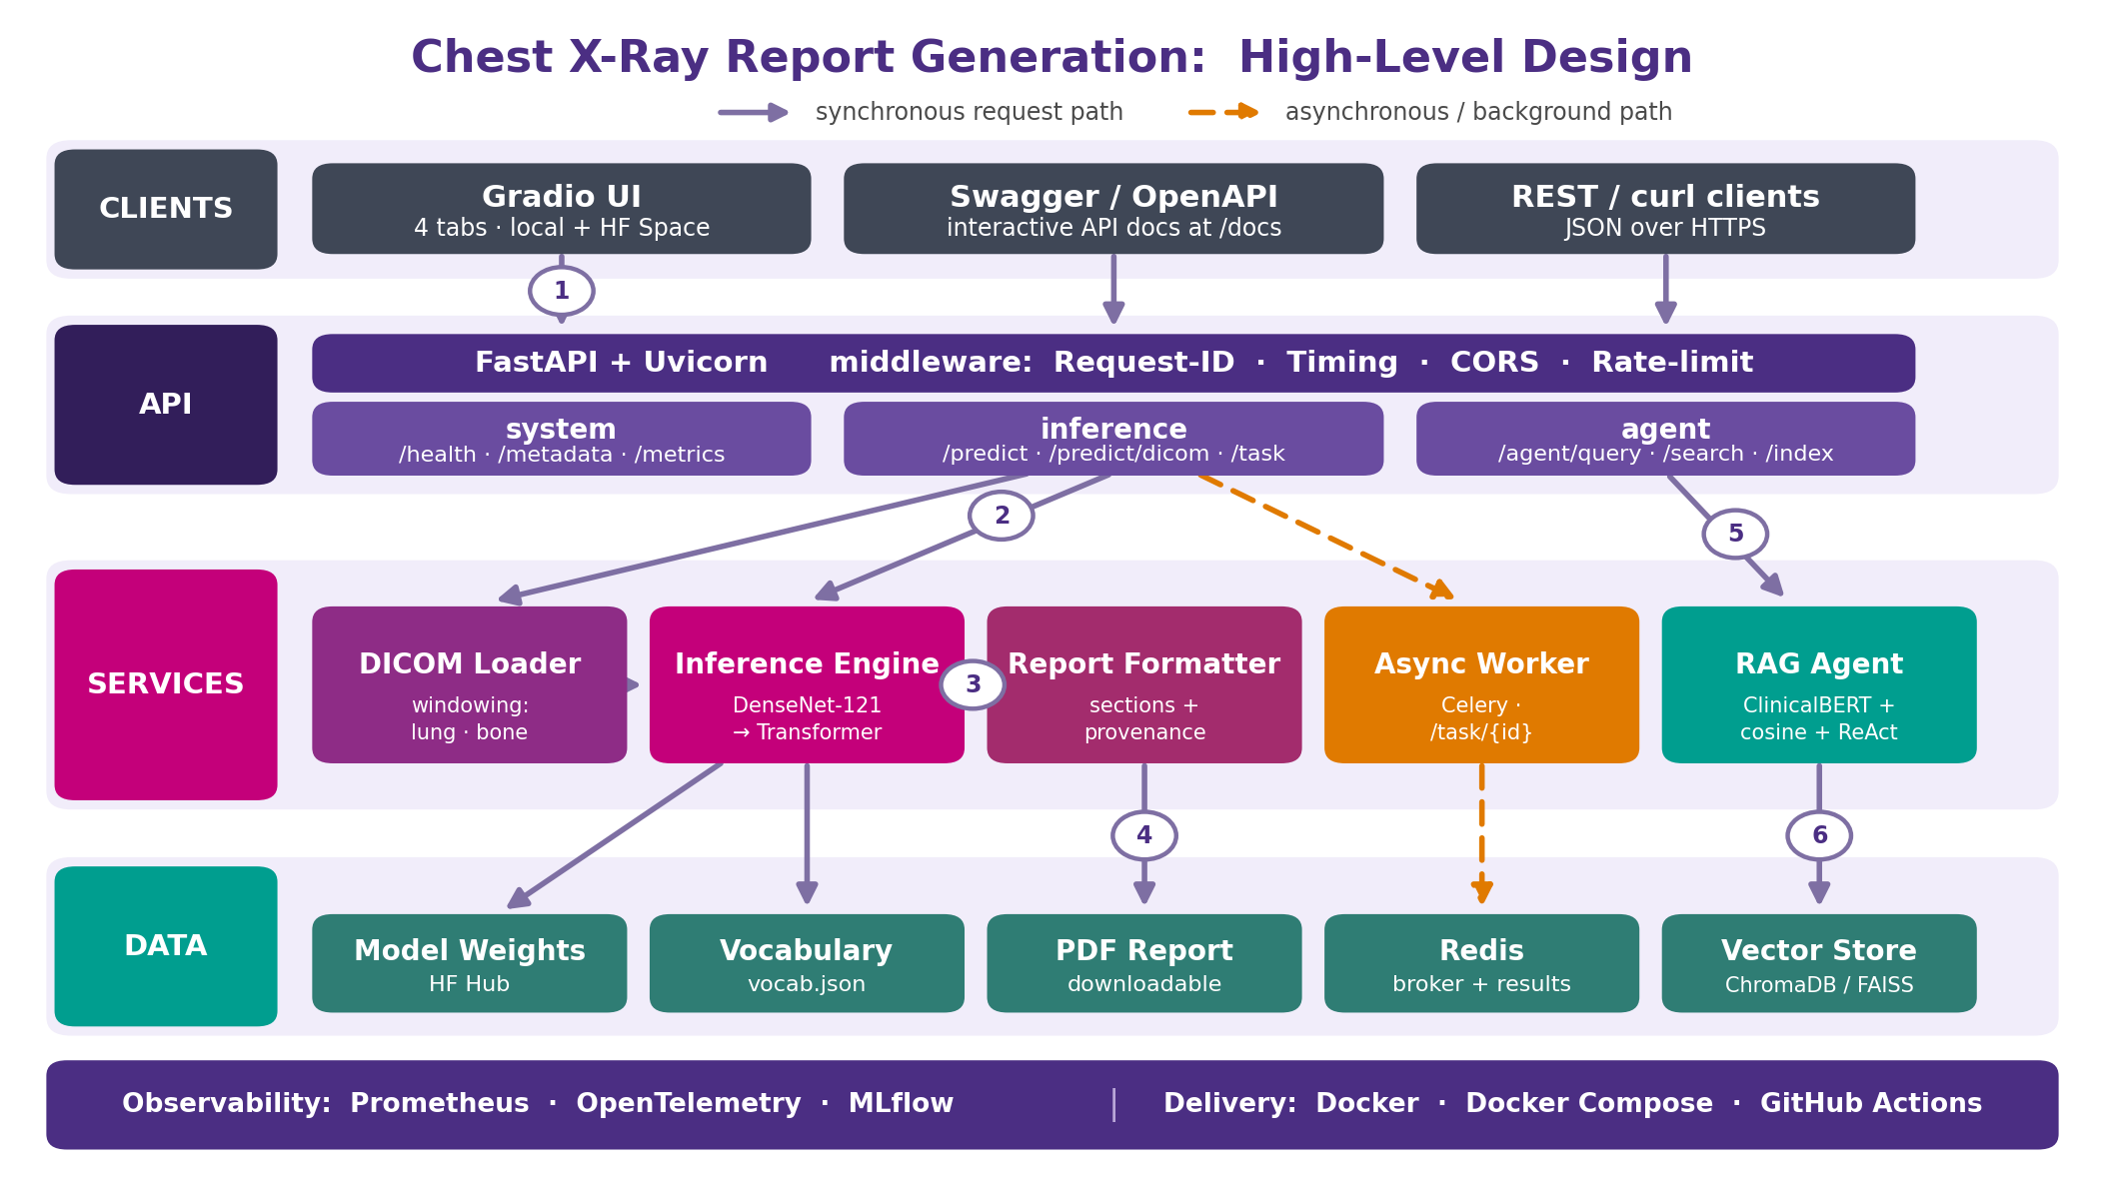
HOW IT WORKS
System Architecture (High-Level Design)
Four layers: clients, then FastAPI, then the services (DICOM, model, formatter, async, RAG), then data. Steps 1 to 4 are the report path. Steps 5 and 6 are the agent path.
Cotiviti Intern Assessment · Nitish Kumar · San Jose State University
7

Slide 8
THE MODEL
DenseNet-121 Encoder and Transformer Decoder
The image becomes numbers. The numbers become words.
X-Ray
224 x 224 x 3
DenseNet-121
1024 features
Projection
256 dimensions
Transformer
3 layers · 8 heads
Report Text
1,606-word vocab
Why DenseNet-121
Every layer feeds all later layers, so features get reused
Fewer parameters than a plain deep CNN of the same depth
Pretrained on ImageNet, so it converges fast on few X-rays
CheXNet showed this exact backbone matches radiologists
Honest Numbers
10.4M parameters, trained for 9 epochs
Greedy decoding, one word at a time, until <end>
It writes one short line, so the app adds the sections
This proves the pipeline, not diagnostic accuracy
Cotiviti Intern Assessment · Nitish Kumar · San Jose State University
8

Slide 9
RAG PIPELINE
Grounding Answers in Retrieved Cases
Retrieval happens first. The answer is built from what was retrieved.
Question
free text
ClinicalBERT
768-d embedding
Vector Store
ChromaDB / FAISS
Cosine Top-k
closest cases
Grounded Answer
+ ReAct trace
Why This Matters
The model cannot invent a case that is not in the store
Every answer quotes the reports it was built from
The ReAct trace shows each step, so a reviewer can check it
This is the audit trail that regulated healthcare needs
Where It Is Stored
ChromaDB is the primary store, with cosine distance
FAISS is the local fallback when ChromaDB is not running
The public demo keeps the index in memory to fit free CPU
New reports can be added live from the Knowledge Base tab
Cotiviti Intern Assessment · Nitish Kumar · San Jose State University
9

Slide 10
LIVE DEMO
What You'll See in the Screenshare
Report Generation
Upload an X-ray and get a generated radiology report
Clinical Agent
Ask a clinical question, see the step-by-step reasoning and a grounded answer
Knowledge Base
Add reports, search by meaning, and manage the vector store
About
How the system works, with the educational research disclaimer
Cotiviti Intern Assessment · Nitish Kumar · San Jose State University
10

Slide 11
Key Takeaways
Clinical NLP unlocks the 80% of health data trapped in text and images.
Grounded, multimodal AI with people in the loop is the safe path for payment integrity.
The POC proves the full pipeline works, from model to deployable service.
Thank You
Nitish Kumar · San Jose State University · nitish.kumar@sjsu.edu

