Slide 1
Systematic Analysis of Engineering Change Request Data
Applying data mining & analytics to derive fact-based insights from ECR databases (Arnarsson, 2020)
Engineering | Data-heavy
Industrial context: large truck development projects (Volvo Group Trucks Technology).
Dataset example used for analysis: ~4,000 ECRs from a large, recently concluded project.
Methods demonstrated: Markov chain DSM (process sequence analysis), NLP + document clustering (knowledge reuse).
Source thesis: Ívar Örn Arnarsson (Chalmers University of Technology), 2020
1

Slide 2
Why analyse ECR data?
Change data is abundant—insight is scarce
Reality
Complex projects span years, with hundreds of engineers and thousands of parts.
Pain
ECRs are documented, but few companies analyse them comprehensively due to complexity.
Opportunity
Systematically retrieving and reusing ECR knowledge can improve process and product decisions.
Framing based on thesis abstract & introduction
2

Slide 3
Research focus
Three components needed for effective ECR analytics
1) Explore & collect ECR data
Identify available data sources and variables captured in ECRs.
2) Capture information needs
Interviews: what do product developers want to know from ECR data?
3) Apply analytical methods
Design & implement Markov-chain DSM + NLP search/clustering pipelines.
Structure mirrors thesis abstract: data → needs → methods
3

Slide 4
ECR data used
Example dataset and the variables inside an ECR record
Industrial case: Volvo Group Trucks Technology.
Example dataset size: ~4,000 ECRs (single large project).
ECRs span the lifecycle: concept → development → after-market.
Records include structured fields + rich free-text.
Field | Example content
Title | Short issue/change label
Part name / number | Component identifiers
Problem description | Observed issue / symptom
Root cause | Hypothesised cause
Solution | Proposed fix / action
Test results | Verification outcomes
Dataset and ECR fields described in thesis introduction
4

Slide 5
Method 1: Markov chain DSM
Modelling ECR process sequences across projects
Model ECR states as a discrete process evolving over time (Markov property).
Estimate transition probabilities between ECR states and visualise in a Design Structure Matrix (DSM).
Applied to ECR data from four product-development projects for comparison.
Patterns identified across projects: most common sequence, prerequisite deviation, process iteration, and deviations from the common sequence.
Under investigation
Testing
Decision
Implemented
DSM visualises transition pathways and highlights iteration patterns for process improvement discussions with domain experts.
Markov chain DSM described in thesis (Paper C summary)
5

Slide 6
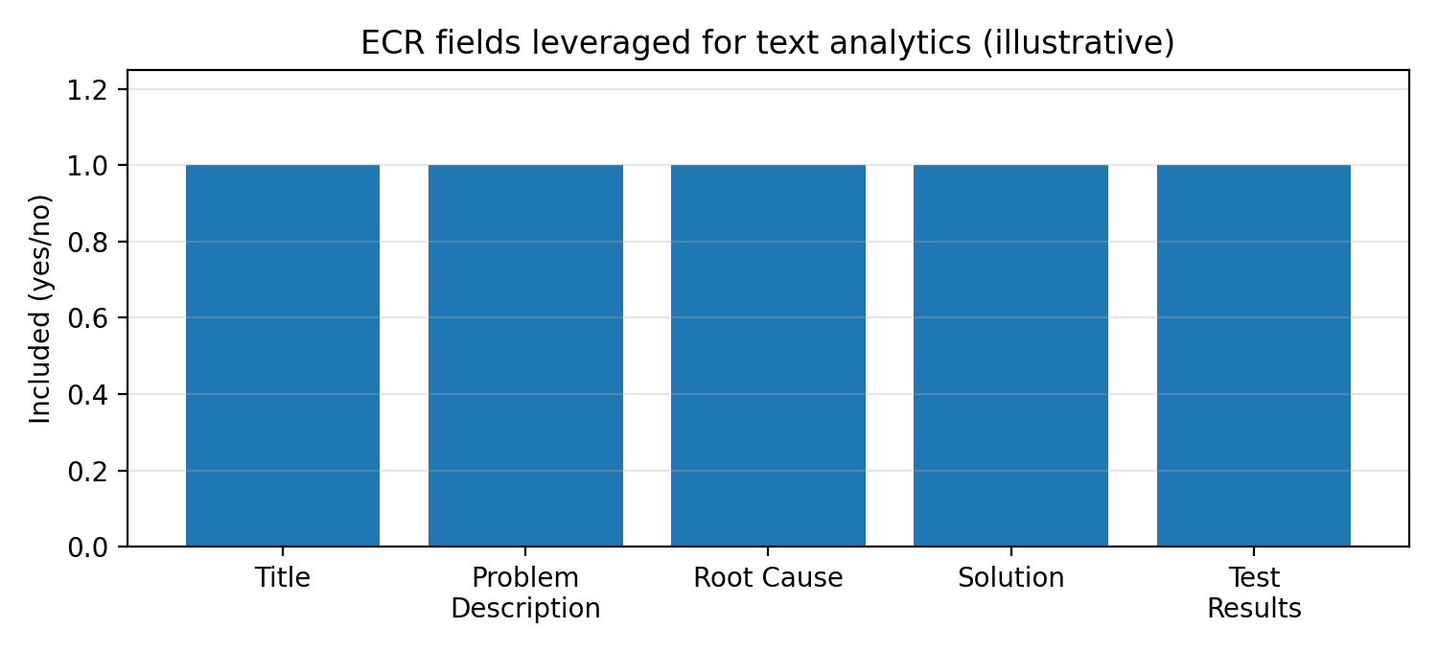
Method 2: NLP search + document clustering
Finding related engineering documents faster
Preprocess text (stopwords, lemmatise, clean, concatenate)
Index in Elasticsearch
Train Doc2Vec
Cluster similar documents
Review shortlist (manual validation)
Goal: support better pre-studies by surfacing a short list of relevant historical documents.
Manual evaluation by a company expert confirmed relevance for returned document sets (case-tested).
Pipeline elements described in thesis (preprocessing → Elasticsearch → Doc2Vec)
6

Slide 7
Key outputs (what the data reveals)
Examples of insight types supported by the thesis
Process insight (DSM)
• Benchmark the most common sequence
• Detect prerequisite deviations
• Surface iteration loops
• Compare patterns across 4 projects
Knowledge reuse (NLP)
• Retrieve related documents from ECR text
• Cluster similar issues/failure modes
• Build shortlists for faster investigation
• Support decision-making for redesigns
Synthesised from thesis abstract + discussion of methods
7

Slide 8
Conclusion
A data-led path from experience-based to proactive process improvement
Core claim: ECR data can be mined systematically to reveal patterns for process improvements and to cluster similar information.
Contribution: applying established data mining algorithms to a novel industrial ECR domain using real industrial data.
Practical outcome: better pre-studies and more robust decisions for new designs / re-designs of products and processes.
Preview Sample | Data-Heavy Defence Deck
Deck is a sample reconstruction based on the thesis narrative (not an official defence deck).
8

