Slide 1
Health economic evaluation for Hepatitis C in Vietnam
Public health viva sample — quick polish (alignment • typography • spacing)
Thesis-inspired sample (Open University, 2024)
Public health problem: chronic HCV causes substantial morbidity and mortality.
Policy decision: how to allocate resources for testing and Direct-Acting Antivirals (DAAs).
Approach: decision-analytic modelling to compare strategies and estimate cost-effectiveness.
Viva PPT – Quick Polish sample (Public Health | Minimal)
1

Slide 2
Background
Why HCV elimination planning needs economics
Public health context
HCV is chronic and often undiagnosed until advanced disease.
DAA therapy can achieve high cure rates; access depends on cost and delivery.
What this deck shows
A minimal, committee-friendly flow:
Problem → Aim → Model → Inputs → Results → Implications
Decision need
Which testing + treatment pathway gives best value?
How sensitive are results to drug price and uptake?
Cleaned layout: consistent cards, spacing and reading order
2

Slide 3
Aim & objectives
What the study set out to answer
Aim
Evaluate the cost-effectiveness of hepatitis C testing and DAA treatment strategies in Vietnam.
Objectives
Compare candidate strategies (testing + treatment).
Estimate costs and health outcomes (e.g., QALYs).
Assess uncertainty (scenario + sensitivity analyses).
Outputs
ICERs and cost-effectiveness plane
Sensitivity analysis (key drivers)
Policy-relevant implications
Quick polish: clear hierarchy and minimal wording
3

Slide 4
Study design
Decision-analytic model comparing strategies (schematic)
Population
Testing
Treatment (DAA)
Outcomes
Perspective & horizon (example)
Health system / payer perspective
Lifetime horizon; discounting applied
Comparators (example)
Status quo vs scaled testing
Targeted vs broader access models
Quick polish: simple visual flow + minimal supporting text
4

Slide 5
Key inputs
How the model is parameterised (clean table)
Parameter group | Examples | Source type
Epidemiology | Prevalence, diagnosis rate, progression risks | Literature / local estimates
Costs | Testing, clinic visits, DAA regimen costs | Price lists / program data
Effectiveness | SVR (cure) rate, adverse events | Trials / real-world data
Utilities | Health-state utilities (QALYs) | Published studies
Program delivery | Uptake, adherence, linkage to care | Program scenarios
Table redesigned for quick scan: consistent spacing, short phrases, stable column widths.
Quick polish: table redesign + alignment consistency
5

Slide 6
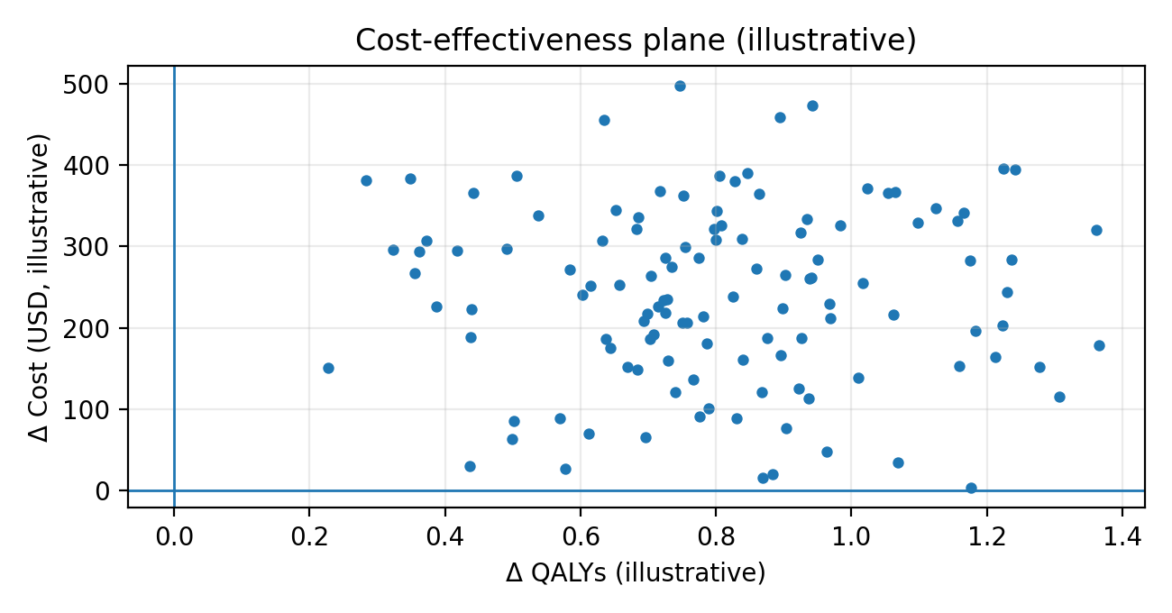
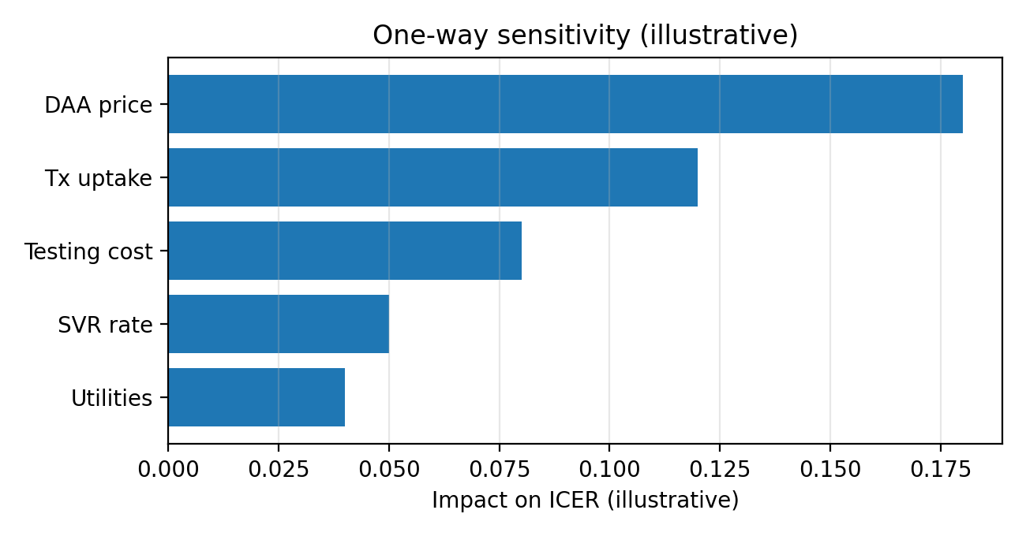
Key results
Value-for-money patterns and uncertainty (illustrative visuals)
Cost-effectiveness plane (illustrative)
Distribution of incremental costs and QALYs across simulations.
Sensitivity (illustrative)
Key drivers influencing results most strongly.
Charts are illustrative to demonstrate viva polishing (not thesis figures)
6

Slide 7
Conclusion
What a committee should take away quickly
Headline finding (template)
DAA access strategies can be cost-effective under plausible pricing and uptake assumptions.
Uncertainty is driven by drug price, testing costs and linkage-to-care.
Quick polish demonstrated
Alignment: consistent margins, grid and card widths
Typography: clear hierarchy
Spacing: readable density for viva delivery
Policy implications
Bundle: testing + treatment + linkage improvements.
Use sensitivity results to set price/uptake targets for programs.
Thesis-inspired sample based on Open University HCV economics thesis (2024)
7

