Slide 1
REACTANCE IN AN A.C. CIRCUIT
Combined effect of R,L and C

Slide 2
REACTANCE IN SERIES
Application of Ohm’s law for D.C. Circuits
Application of Ohm’s law for A.C. Circuits
Peak Voltage R.M.S. Voltage
Peak Current
R.M.S. Current

Slide 3
Resistive Circuits
I and V are in phase
Capacitive and Inductive Circuits
I and V are 90° out of phase

Slide 4
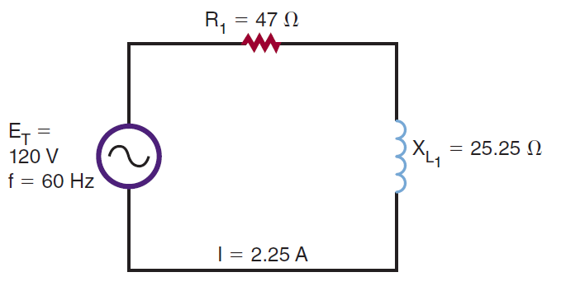
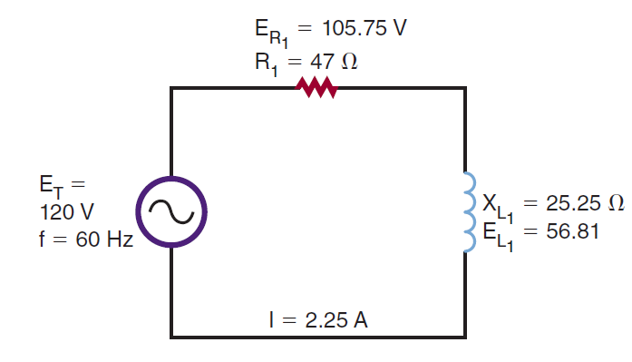
COMBINATION OF REACTIVE AND RESISTIVE COMPONENTS
Find Voltage at each component using Ohm’s Law

Slide 5
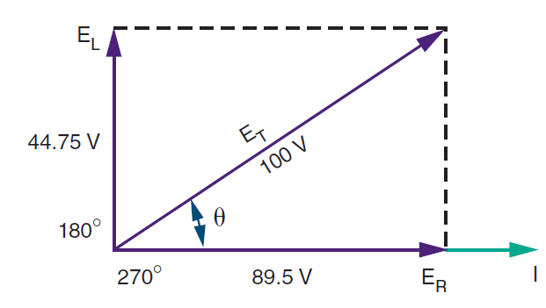
Length of arrow indicates the magnitude

Slide 6
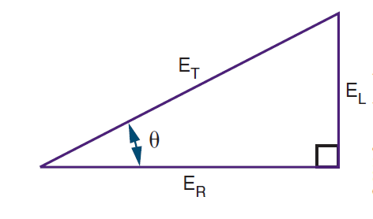

The angle of the Vector ET(θ) indicates the phase between the source voltage and current
From Pythagoras theorem,
ET=√ ER2 + EL2

Slide 7
TIPS TO REMEMBER:
When Circuit is purely resistive, phase angle is 0 because V and I are in phase.
As XL increases, phase angle becomes greater
At 45°, R and XL are equal in value
When a circuit contains pure inductive reactance with no resistance, phase angle increases to 90°
I is same in a series circuit

Slide 8
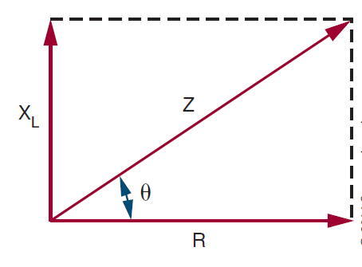
Voltage drop is directly proportional to R or X of that component
So, we can have X and R vectors proportional to voltage vectors
The combined effect of R and X is called as IMPEDANCE(Z)

Slide 9
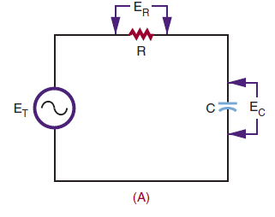
SERIES RC CIRCUIT
Draw Voltage Vectors and Resistance vectors

Slide 10
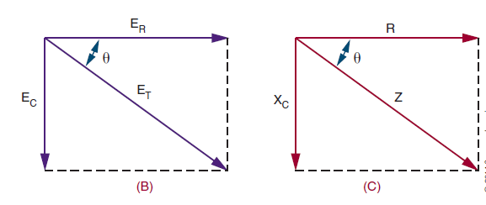

Slide 11
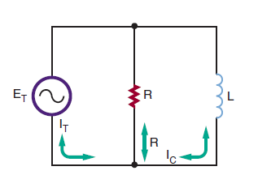
REACTANCE IN PARALLEL CIRCUIT
Voltage in Parallel components is same

Slide 12
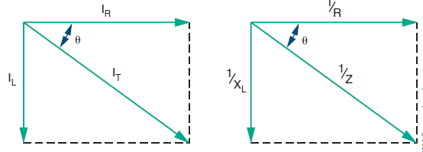


Slide 13
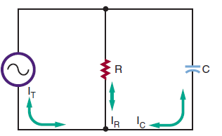
REACTANCE IN PARALLEL CIRCUIT

Slide 14
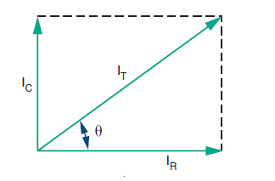
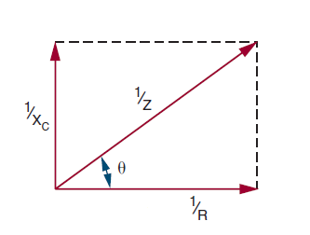


Slide 15
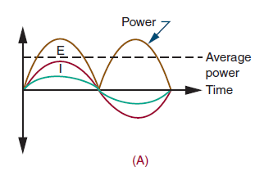
POWER
Power Dissipation in a Resistive Circuit has a non-zero value

Slide 16
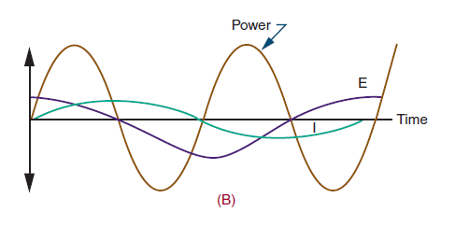
Power Dissipation in a Reactive Circuit
In a reactive circuit there is no average or net power loss

Slide 17
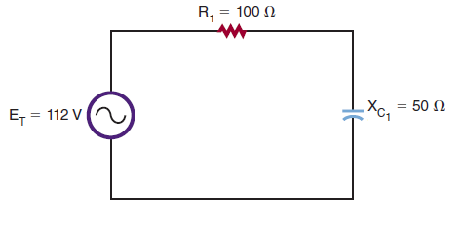
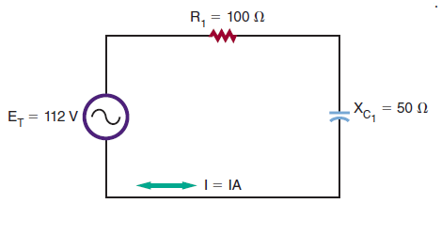
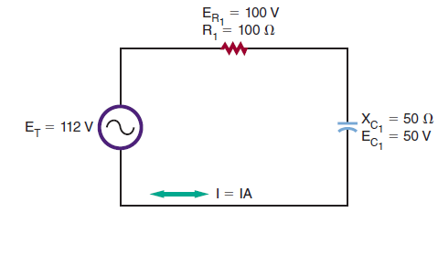
Calculate Current
Calculate voltage at each component
Calculate power at each component by VI

Slide 18
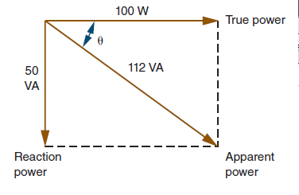
Power Factor= True Power/Apparent Power

Slide 19
Conclusions regarding Power:
For pure resistive circuits
Power factor=1
For pure inductive circuit
Power factor=0
For heavy loads its important consideration that cables must be capable of handling the apparent power

Slide 20
INTRODUCTION TO RESONANCE
Occurs in many fields and also in ELECTRONICS
Device produces broadening or damping effect at resonance
RADIO and TV RECEIVERS—TUNE at a particular frequency because of resonance.
Tuning Circuit-C parallel L

Slide 21
OVERVIEW FROM PRACTICAL CLASS
Parallel tuned ckt—Zmax
Condition for Resonance
R doesn’t effect Fr
Resonant Circuits not used in audio bands of frequencies

