Slide 1
Chapter 1
Fundamentals of Electricity

Slide 2
Objectives
After completing this chapter, you will be able to:
Define atom, matter, element, and molecule
List the parts of an atom
Define the valence shell of an atom
Identify the unit for measuring current
Draw the symbol used to represent current flow in a circuit

Slide 3
Objectives
Describe the difference between conductors, insulators, and semiconductors
Define difference of potential, electromotive force, and voltage
Draw the symbol used to represent voltage
Identify the unit used to measure voltage
Define resistance

Slide 4
Objectives
Identify characteristics of resistance in a circuit
Identify the unit for measuring resistance
Draw the symbol used to represent resistance in a circuit

Slide 5
Matter, Elements, and Compounds
Matter
Anything that occupies space
Can be an element or compound
Element
Basic building block of nature
Compound
Chemical combination of two or more elements

Slide 6
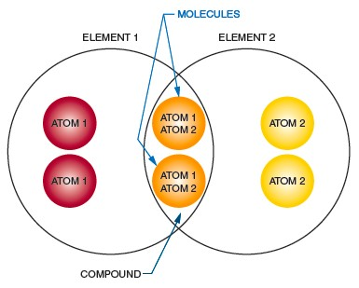
Figure 1-1. The chemical combination of two or more elements is called a compound. A molecule is the chemical combination of two or more atoms. Examples are water (H₂O) and salt (NaCl).

Slide 7
Matter, Elements, and Compounds
(cont’d.)
Atom
– Smallest particle of an element
Molecule
Chemical combination of two or more atoms
Smallest part of a compound
Mixture
Physical combination of elements and compounds

Slide 8
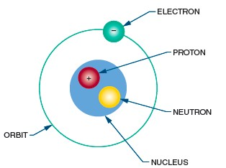
A Closer Look at Atoms
Figure 1-2. Parts of an atom.

Slide 9
A Closer Look at Atoms
(cont’d.)
Atomic number
Distinguishes one element from another
Number of protons in the nucleus
Atomic weight
Mass of the atom
Sum of protons and neutrons

Slide 10
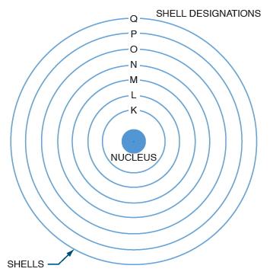
Figure 1-3. The electrons are held in shells around the nucleus.
.

Slide 11
A Closer Look at Atoms
(cont’d.)
Valence shell
Outer shell of an atom
Conductors
Contain a large number of free electrons
Insulators
Prevent the flow of electricity
Absorb valence electrons from other atoms

Slide 12
A Closer Look at Atoms
(cont’d.)
Semiconductors
Can function as conductors or insulators
Ionization
Process of gaining or losing electrons

Slide 13
Current
Current (I)
Flow of electrons from negatively charged atoms to positively charged atoms
Measured in amperes (A)
Coulomb (C)
Charge of 6.24 x 10¹⁸ electrons

Slide 14
Voltage
Potential
Ability of source to perform electrical work
Difference of potential
Referred to as electromotive force (emf) or voltage
Voltage (E)
Force that moves electrons in a circuit
Measured in volts (V)

Slide 15
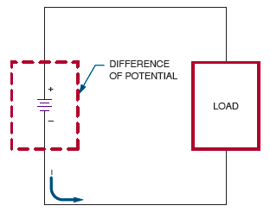
Voltage (cont’d.)
Figure 1-8. Electrons flow in a circuit because of the difference of potential.

Slide 16
Resistance
Resistance (R)
Opposition to current
Measured in ohms (Ω)
Conductors
Low resistance; possess many free electrons
Insulators
High resistance; have few free electrons

Slide 17
Summary
Matter can be an element or a compound
The atom consists of protons, neutrons,
and electrons
Key electronic concepts in this chapter:
– Ionization, current, voltage, resistance,
conductors, insulators

Slide 18
Summary
The flow of electrons is called current
Current can encounter opposition, called
resistance

