Slide 1
Chapter 2
Current

Slide 2
Objectives
After completing this chapter, you will be able to:
  State the two laws of electrostatic charges
  Define coulomb
  Identify the unit used to measure current flow
  Define the relationship of amperes, coulombs, and time through a formula
  Describe how current flows in a circuit

Slide 3
Objectives (cont’d.)
  Describe how electrons travel in a conductor
  Define and use scientific notation
  Identify commonly used prefixes for powers of ten

Slide 4
Electrical Charge
First law of electrostatic charges
  Like charges repel
Second law of electrostatic charges
  Unlike charges attract
Coulomb (C)
  Unit for measuring electrical charge (Q)
  1 C = 6.24 x 10¹⁸ electrons

Slide 5
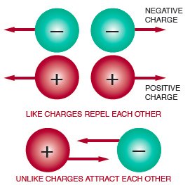
Electrical Charge (cont’d.)
Figure 2-1. Basic laws of electrostatic charges.

Slide 6
Current Flow
Electric current
  Drift of electrons from the negative area to the positive
Ampere (A)
  Unit of measurement for current flow
I = Q/t, where:
  I = current measured in amperes
  Q = quantity of electrical charge in coulombs
  t = time in seconds

Slide 7
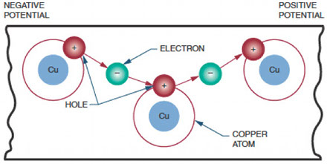
Current Flow (cont’d.)
Figure 2-2. As electrons move from one atom to another,
they create the appearance of a positive charge, called a hole.

Slide 8
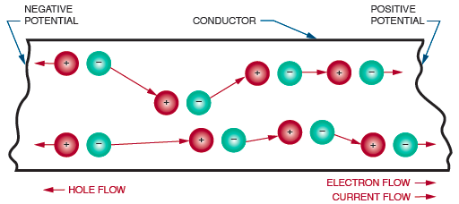
Current Flow (cont’d.)
Figure 2-3. Electron movement occurs in the opposite direction
to hole movement.

Slide 9
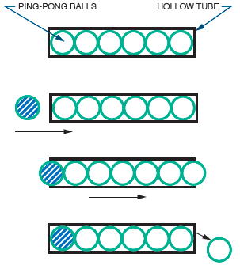
Figure 2-4. Electrons in a conductor react like
Ping-Pong balls in a hollow tube.

Slide 10
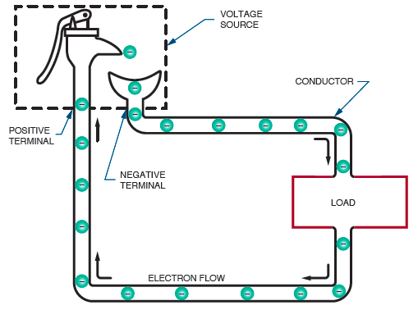
Figure 2-3. Electron movement occurs in the opposite direction
to hole movement.
Figure 2-5. A voltage source can be considered a pump that supplies
electrons to the load and recycles the excess electrons.

Slide 11
Scientific Notation
Scientific notation
  Means to express large and small numbers in shorthand
  Uses single-digit numbers plus powers of ten
Positive exponent
  3 x 10³ = 3.0 x 10³ = 3000
Negative exponent
  3 x 10⁻⁶ = 3.0 x 10⁻⁶ = 0.000003

Slide 12
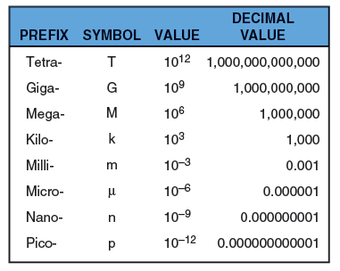
Scientific Notation (cont’d.)
Figure 2-6. Prefixes commonly used in electronics.

Slide 13
Summary
Two laws of electrostatic charges: like charges repel, unlike charges attract
Electrons break free from atoms to produce current flow
I = Q/t
Hole movement occurs in the opposite direction to electron movement

Slide 14
Summary (cont’d.)
Current flow in a circuit is from negative to positive
Electrons travel slowly, but individual electrons move at the speed of light
Key concepts in this chapter:
  Coulumb, ampere, scientific notation

