Slide 1
OPTOELECTRONICS

Slide 2
Device interact with electromagnetic spectrum
Three types of devices
Light Detection devices
Light conversion devices
Light emitting devices

Slide 3
Semiconductor material and doping techniques determine relevant light wavelength for a device

Slide 4
Basics Principles of Light
Light travels in form of radio waves
Light measured in wavelength
Speed= 1.86 * 10^5 miles per second
=3 * 10^8 m/sec
Frequency range of light=300 to 3 * 10^8 GHz
Visible range= 4*10^5 to 7.5*10^5 GHz
IR below 4*10^5 GHz
UV above 7.5*10^5 GHz
Light waves at upper end of frequency range have more energy than light waves at the lower end

Slide 5
LIGHT SENSITIVE DEVICES
Photoconductive Cell (Photo Cell)
Made of light sensitive material- CdS or CdSe on an insulating substrate of Glass or ceramic
R varies from several 100 Ω to several 100 mΩ
Can withstand high operating voltages 200 to 300 Volts, with low power consumption of upto 300 mW.
Disadvantage:
--Slow response to light change

Slide 6
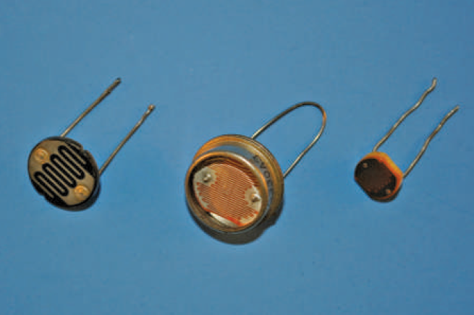

Slide 7
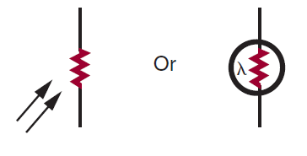
λ represents light sensitive device
Symbol for Photocell

Slide 8
Usage of Photocells
Light meters
Instrusion detectors
Automatic door openers
Equipments to test light intensity

Slide 9
Photovoltaic Cell (Solar cell)
Converts Light energy into electrical energy
Solar Cells -> in converting solar to electrical
Majorly from silicon

Slide 10
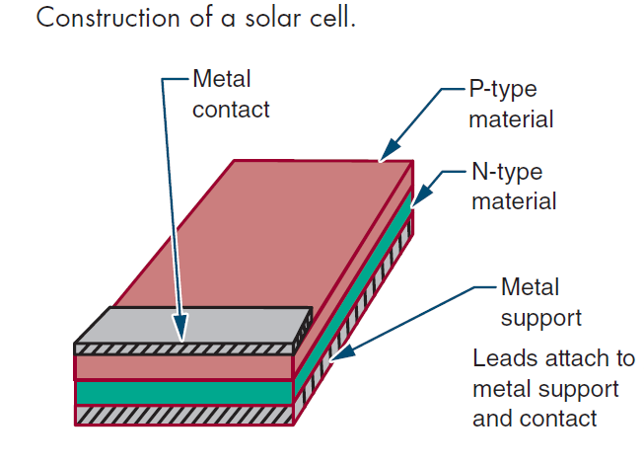
Construction of Solar Cell
Designed with large surface area
Metal support and metal contact act as electrical contacts

Slide 11
Solar Cell is a highly inefficient device
Top efficiency of 15% to 20%
Solar Cells have low voltage output= 0.45 Volt at 50 mA
Must be connected in series and parallel n/w to obtain Desired V and I output.

Slide 12
Applications of Solar cells
Light meters for photographic equipment
Motion picture projector soundtrack decoders
Battery chargers on satellite

Slide 13
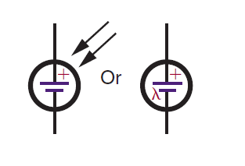
Schematic Symbol for a solar cell

Slide 14
PHOTODIODE
Construction similar to a solar Cell and primarily from Silicon
Used same way as a solar cell, (Light variable resistor)

Slide 15
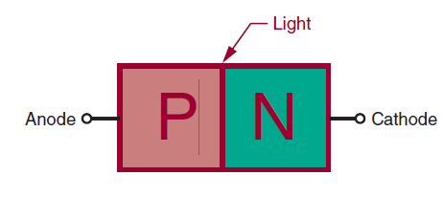
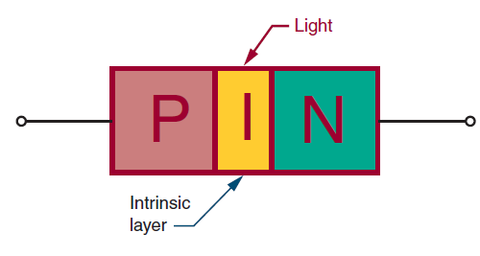
Constructed in two ways

Slide 16
Operation of PN Junction Diode
Same principle as a photovoltaic cell, except that it is used to control current flow and not generate it
R.B. across photodiode forming wide depletion region

Slide 17
PIN Photodiode
Intrinsic layer effectively extends the depletion region
Responds to lower light frequencies(less energy)
PIN photodiode more efficient over a wider range

Slide 18
Advantages of photodiode
Fast response to light changes, fastest of any photosensitive device
Disadvantages of photodiode
Low output compared to other photosensitive devices

Slide 19
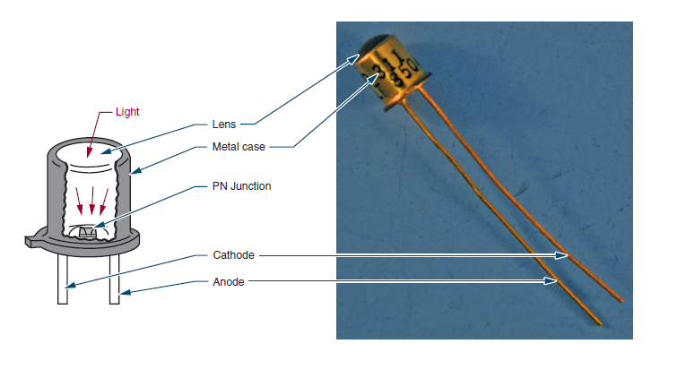
Photodiode Package

Slide 20

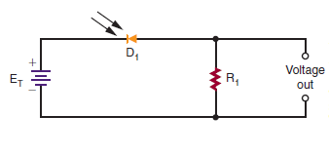
Schematic symbol of Photodiode
Voltage Divider using a photodiode

Slide 21
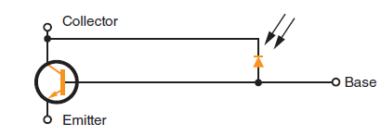
Phototransistor
Constructed like other transistors with 2 P-N junctions
Resembles standard NPN transistor
Packaged and used like a photodiode but has 3 leads
Equivalent circuit of Phototransistor

Slide 22
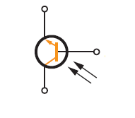
Phototransistor Schematic Symbol

Slide 23
Applications of Phototransistors
Photo tachometer
Photographic exposures controls
Flame detectors
Object counters
Mechanical positioners

Slide 24
Light Emitting Devices
Convert electrical energy to light energy
Unlimited life span
Frequency of emitted light determined by
Type of semiconductor material
Regular diode do not emit light
Light visible because LED packaged in semitransparent material

Slide 25
GaAs- infrared region
GaAsP-visible red light
By changing phosphide content different frequencies produced
LEDs avalaible in colors- Infrared, red, orange, yellow, green, blue, ultraviolet, pink, purple and white.

Slide 26
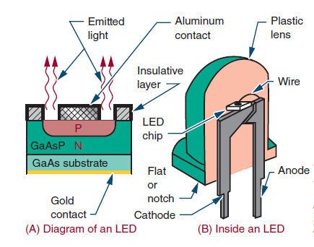
LED Construction

Slide 27
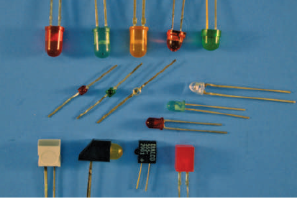
Common LED Packages

Slide 28
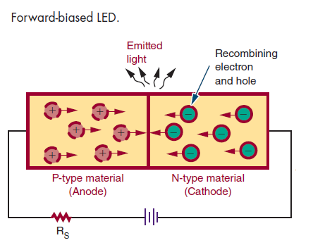
F.B. must exceed 1.2 V
Series resistor

Slide 29
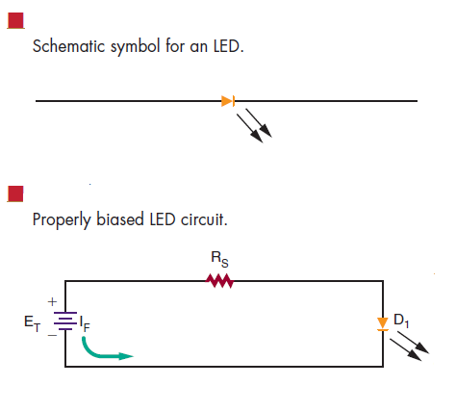

Slide 30
SEVEN SEGMENT DISPLAY
For digital readouts

Slide 31
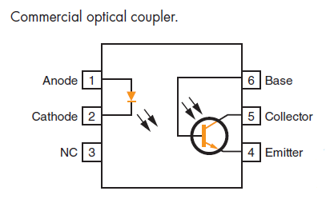
Optical Coupler allows one circuit to pass a signal to another circuit while providing a high degree of electrical insulation

