Slide 1
Printed Circuit Board Fabrication

Slide 2
BREADBOARDING
Solderless connections
Easy to modify the connections
Virtual Breadboards by:
NI’s multisim
New Wave Concept’s Circuit Wizard 2
Cadence’s OrCAD pspice
Spectrum Software’s Micro-Cap 7

Slide 3
Base material :
Epoxy fiberglass
Ceramic and Teflon
Older Days:
Phenolic base
Base Thickness:
0.062’

Slide 4
Copper layer:
0.003 inches thick
Etchant:
Ferric Chloride
Ammonium persulfate
Ammonium Chloride

Slide 5
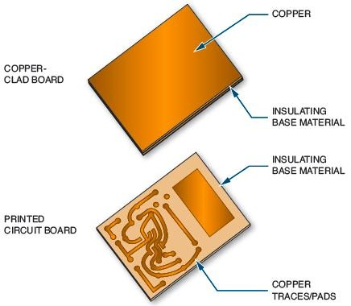
Fundamentals
Figure 38-1. Copper-clad board which is made into a printed circuit board.

Slide 6
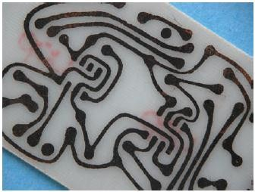
Fundamentals (cont’d.)
Figure 38-4. Example of an etched printed circuit board.

Slide 7
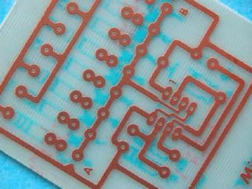
Fundamentals (cont’d.)
Figure 38-5. Printed circuit board that has been etched and resist removed.

Slide 8
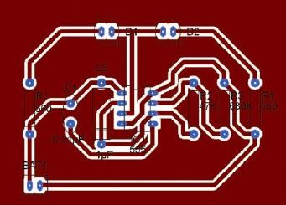
Fundamentals (cont’d.)
Figure 38-6. X-ray view of a printed circuit board layout from the component side.

Slide 9
Through Hole PCBs
SMT
Two Additional layers
Component layout layer
Solder side
Additional layers after it is etched:
Nonconductive (component layout layer) as MAP(with text and graphic symbols)
Solder mask layer (wave soldering-components to solder pads and corrosion protection to PCB)

Slide 10
Ground plane to improve performance
High Density PCBs- pin count increases- two layers
Vias- connection from one layer to another
High speed and high precision more than two layers-4 layers- 2 middle for ??
Single and Double sided PCBs

Slide 11
Problem of Multilayer PCB
Reliability of connections
Difficult to detect defective layer

Slide 12
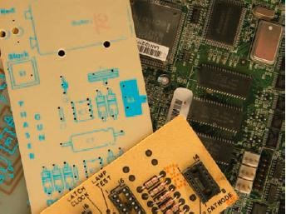
Fundamentals (cont’d.)
Figure 38-7. Examples of the component layer on printed circuit boards.

Slide 13
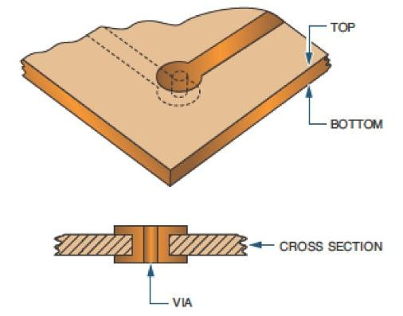
Fundamentals (cont’d.)
Figure 38-10. Vias connect the top to the bottom trace of a printed circuit board.

Slide 14
SOLDER AND SOLDERING IRON
What is soldering
Alloy melting point below 800° F or 427 ° C
Tin and lead in different ratios
Electrical soldering
Surface mounted devices
Graph
Any movement lead to fractured solder
Dull, grainy and mechanically weak and less reliable

Slide 15
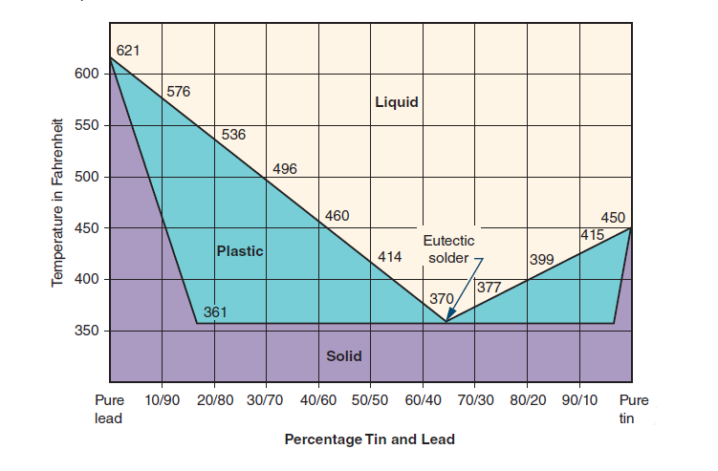
Solder Alloy Vs Temperature

Slide 16
Rosin Flux
Soldering Iron- Tool for installing, removing and replacing components on a PCB.
Selection Criteria: Soldering Iron tip
Cause damage to components or PCB
low-wattage pencil soldering iron with appropriate tip
Solder Guns are inappropriate for PCB
Soldering iron specified by wattage
25 to 40 Watts

Slide 17
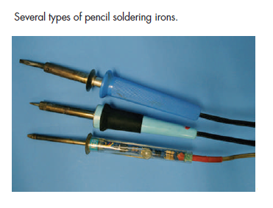

Slide 18
Temperature controlled soldering station
Cordless soldering iron
Iron Clad tips- only occassional cleaning and tinning
Steel wool to clean the tip
Damp sponge to remove any oxidation before soldering

Slide 19
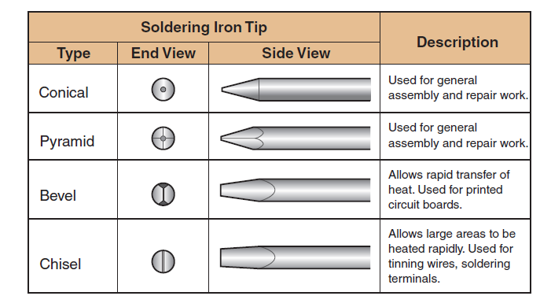

Slide 20
