Slide 1
INTRODUCTION:

The cathode-ray oscilloscope (CRO) is a
multipurpose display instrument used for the observation,
measurement , and analysis of waveforms by plotting amplitude along
y-axis and time along x-axis.
CRO is generally an x-y plotter; on a single screen it can display different signals applied to different channels. It can measure amplitude, frequencies and phase shift of various signals. Many physical quantities like temperature, pressure

and strain can be converted into electrical signals by the use of transducers, and the signals can be displayed on the CRO.
A moving luminous spot over the screen displays the signal. CROs are used to study waveforms, and other time-varying phenomena from very low to very high frequencies.
The central unit of the oscilloscope is the cathode- ray tube (CRT), and the remaining part of the CRO consists of the circuitry required to operate the cathode-ray tube.


Slide 2
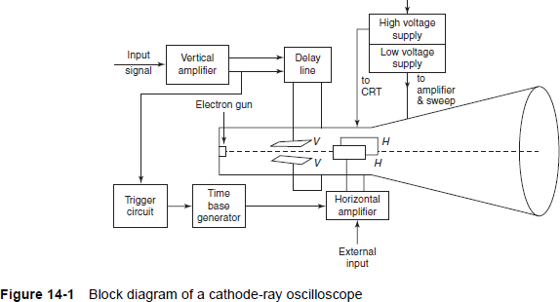
Block diagram of a cathode-ray oscilloscope:

Slide 3
COMPONENTS OF THE CATHODE-RAY OSCILLOSCOPE:
The CRO consists of the following:
(i) CRT
(ii) Vertical amplifier
(iii) Delay line
(iv) Horizontal amplifier
(v) Time-base generator
(vi) Triggering circuit
(vii) Power supply

Slide 4
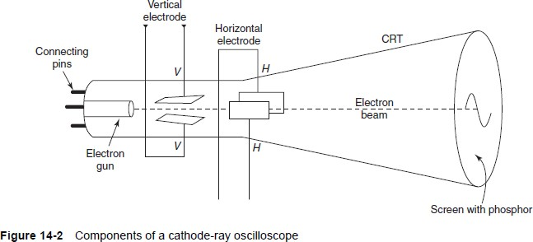
CATHODE-RAY TUBE:
The electron gun or electron emitter, the deflecting system and the fluorescent screen are the three major components of a general purpose CRT. A detailed diagram of the cathode-ray oscilloscope is given in Fig. 14-2.

Slide 5
Electron Gun:

In the electron gun of the CRT, electrons are emitted, converted into a
sharp beam and focused upon the fluorescent screen.
The electron beam consists of an indirectly heated cathode, a control grid, an accelerating electrode and a focusing anode.
The electrodes are connected to the base pins.The cathode emitting the electrons is surrounded by a control grid with a fine hole at its centre.
The accelerated electron beam passes through the fine hole.
The negative voltage at the control grid controls the flow of electrons in the electron beam, and consequently, the brightness of the spot on the CRO screen is controlled.





