Slide 1
Resistance
-Factors affecting it

Slide 2
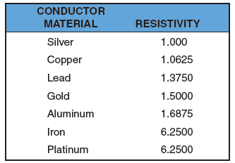
Resistance
Figure 4-1. Resistivity of several conductors
of the same length and cross-section area.

Slide 3
Conductance
Conductance (G)
  Ability of a material to pass electrons
  Unit of conductance is Mho

Slide 4
Resistors
Resistors
  Possess a specific value of resistance to current flow
  Either fixed or variable
  Resistor’s tolerance
    10% tolerance is satisfactory
    Higher tolerance-less expensive

Slide 5
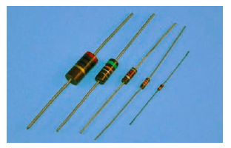
Resistors (cont’d.)
Figure 4-6. Carbon composition resistors were the
most widely used resistors in electronic circuits.

Slide 6
Wire Wound Resistors
Construction
High Current Circuits
Precision is necessary
Resistance range

Slide 7
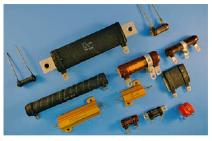
Resistors (cont’d.)
Figure 4-7. Wirewound resistors are available in many different styles.

Slide 8
Thin Film resistors
Popular
Small Size composition
Accuracy
Resistance range- 10 ohm to 1.5 M ohm

Slide 9
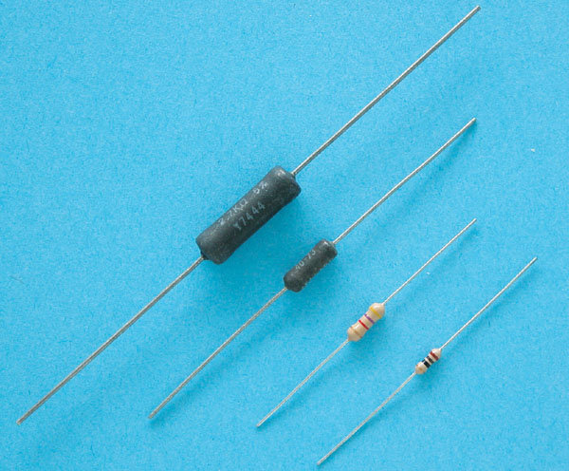
Resistors (cont’d.)
Figure 4-8. The film resistor offers the size of the carbon resistor
with the accuracy of the wirewound resistor.

Slide 10
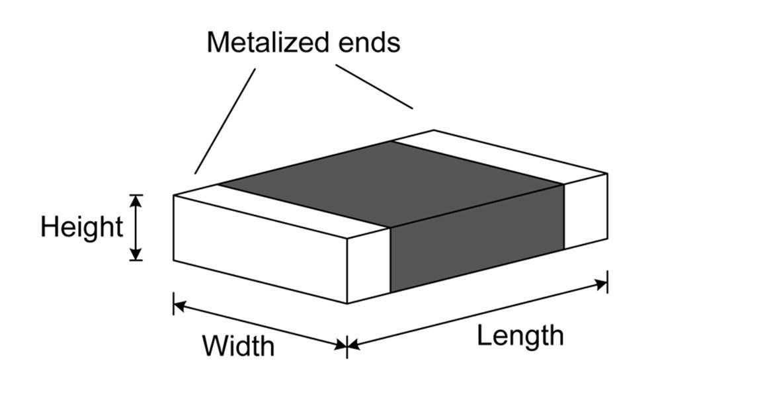
SURFACE MOUNT RESISTORS

Slide 11
SURFACE MOUNT RESISTORS
Ideal for small ckt
Metal tips and no leads
Lightweight
Use of automation assembly processing
Thin film or thick film

Slide 12
Resistors (cont’d.)
Potentiometer (or pot)
  A variable resistor used to control voltage
Rheostat
  A variable resistor used to control current

Slide 13
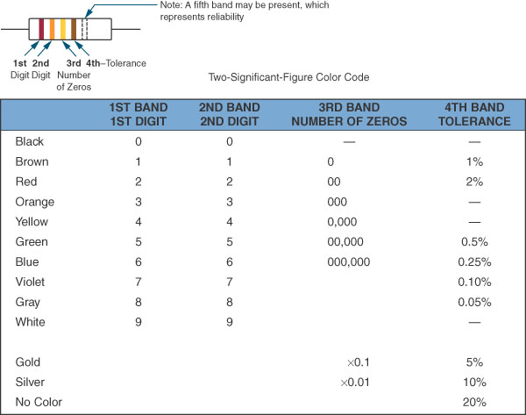
Figure 4-12. The Electronic Industries Association (EIA) color code.

Slide 14
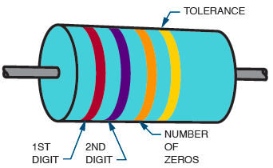
Resistor Identification (cont’d.)
Figure 4-13. Meaning of the colored bands on a carbon composition resistor.

Slide 15
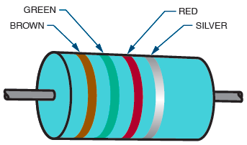
Resistor Identification (cont’d.)
Figure 4-14. This resistor has a resistance value of ????.

Slide 16
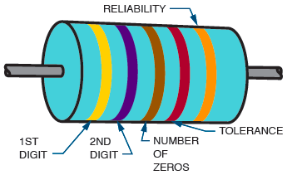
Resistor Identification (cont’d.)
Figure 4-15. The fifth band on a resistor indicates the resistor’s reliability.

Slide 17
QUESTION
Decode the following resistors:
1st Band 2nd Band 3rd Band 4th Band
a. Brown Black red Silver
b. Blue Green Orange Gold
c. Orange White Yellow (None)
d. red red red Silver
e. Yellow Violet Brown Gold

Slide 18
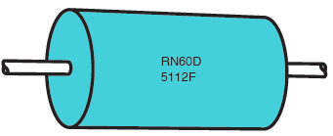
Resistor Identification (cont’d.)
Figure 4-16. Resistors may also be identified by a letter-and-number system.
4R7

Slide 19
Surface Mount Resistors
RC0402J103T
3D9

Slide 20
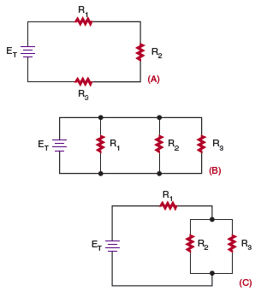
Figure 4-18. Three types of resistive circuits: (A) series circuit,
(B) parallel circuit, (C) series-parallel circuit.

Slide 21
Connecting Resistors in Series
Series circuit
  Provides one path for current to flow
  Total resistance formula:
    R_{T} = R₁ + R₂ + R₃ … + R_{n}

Slide 22
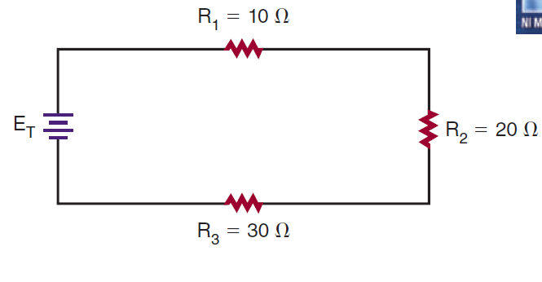
What is the total resistance of the circuit shown in Figure

Slide 23
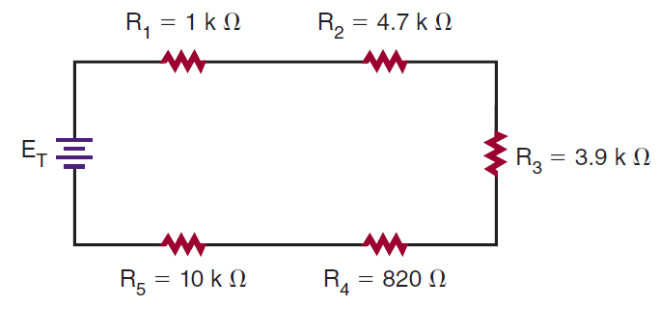
What is the total resistance of the circuit shown in Figure

Slide 24
Connecting Resistors in Parallel
Parallel circuit
  Provides two or more paths for current to flow
  Total resistance formula:
    1/R_{T} = 1/R₁ + 1/R₂ + 1/R₃ … + 1/R_{n}
  Total resistance is always less than smallest resistor

Slide 25
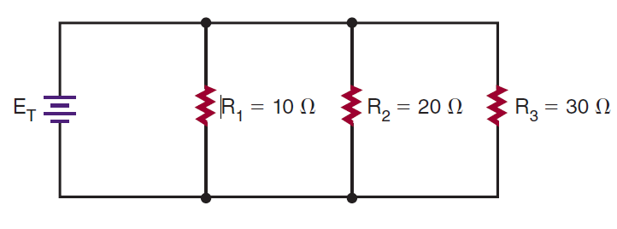
What is the total resistance of the circuit shown in Figure

Slide 26
Connecting Resistors in
Series and Parallel
Series-parallel circuit
  Combination of a series and a parallel circuit
  To calculate total resistance, use the series and parallel formulas

Slide 27
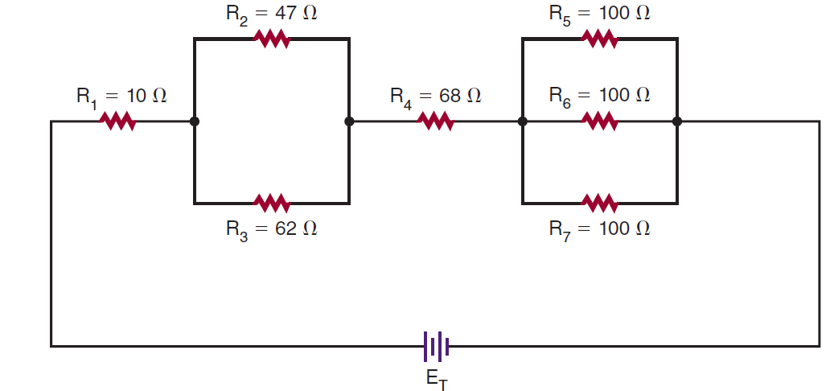
What is the total resistance of the circuit

