Slide 1
Ohm’s Law

Slide 2
Electric Circuits
Electric circuit
  Path that current follows
    Series circuit, parallel circuit, or series-parallel circuit
  Consists of a voltage source, load, and a conductor

Slide 3
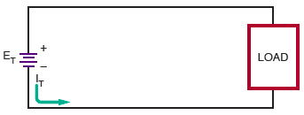
Electric Circuits (cont’d.)
Figure 5-4. Current flow in an electric circuit flows from
the negative side of the voltage source, through the load,
and returns to the voltage source through the positive terminal.

Slide 4
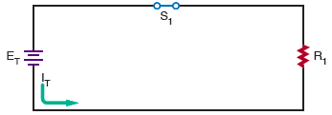
Electric Circuits (cont’d.)
Figure 5-5. A closed circuit supports current flow.

Slide 5
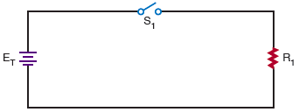
Electric Circuits (cont’d.)
Figure 5-6. An open circuit does not support current flow.

Slide 6
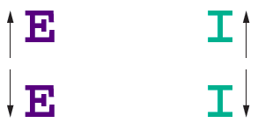
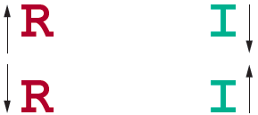
Factors affecting current in an electric circuit :

Slide 7
Ohm’s Law
Ohm’s Law
  Current is directly proportional to voltage and inversely proportional to resistance
  May be expressed as:
  I = E/R
  where: I = current in amperes
  E = voltage in volts
  R = resistance in ohms

Slide 8
Kirchhoff’s Current Law
Kirchhoff’s current law (first law)
  The algebraic sum of all the currents entering and leaving a junction is equal to zero
  Restated: Total current into a junction is equal to the total current out of the junction
  May be expressed as:
  I_{T} = I₁ + I₂ + I₃

Slide 9
Kirchhoff’s Voltage Law
Kirchhoff’s voltage law (second law)
  The algebraic sum of all the voltages around a closed circuit equals zero
  Restated: The sum of all the voltage drops in a closed circuit will equal the voltage source
  May be expressed as:
  E_{T} – E₁ – E₂ – E₃ = 0 or
  E_{T} = E₁ + E₂ + E₃

Slide 10
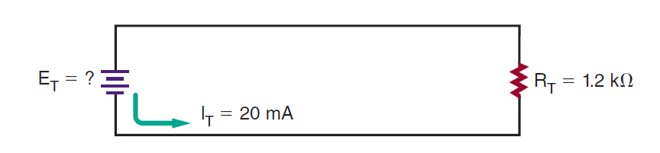
In the circuit shown in Figure, how much voltage is required to produce 20 milliamps of current flow?

Slide 11
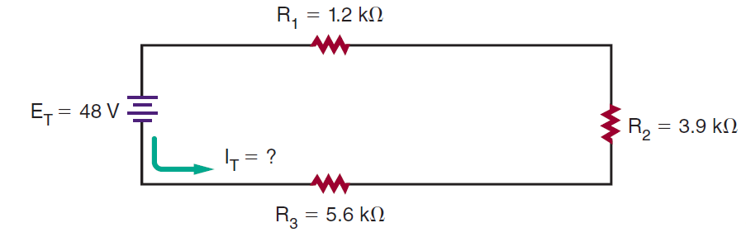
How much voltage is dropped across resistor R2 in the circuit shown in Figure

Slide 12
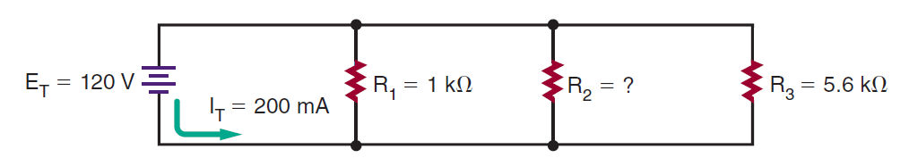
What is the value of R2 in the circuit shown in Figure

Slide 13
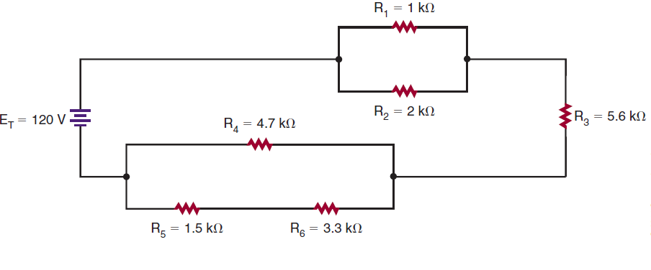
What is the current through R3 in the circuit shown in Figure

